Slide 1

Build Microservice-based Applications with Azure Service Fabric

Slide 2

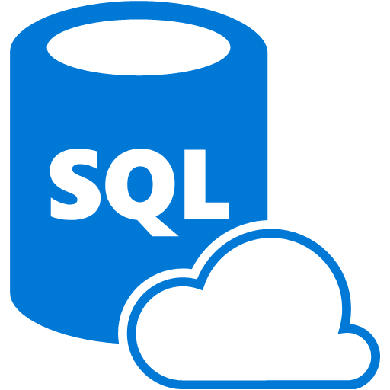
Use Case - Shared Data Context
API #1
Azure SQL Database, Code First Approach
API #5
API #2
API #4
API #3

Slide 3

Issues – Schema change affects all
API #1
API #5
Schema Change
DB
API #2
API #4
API #3

Slide 4
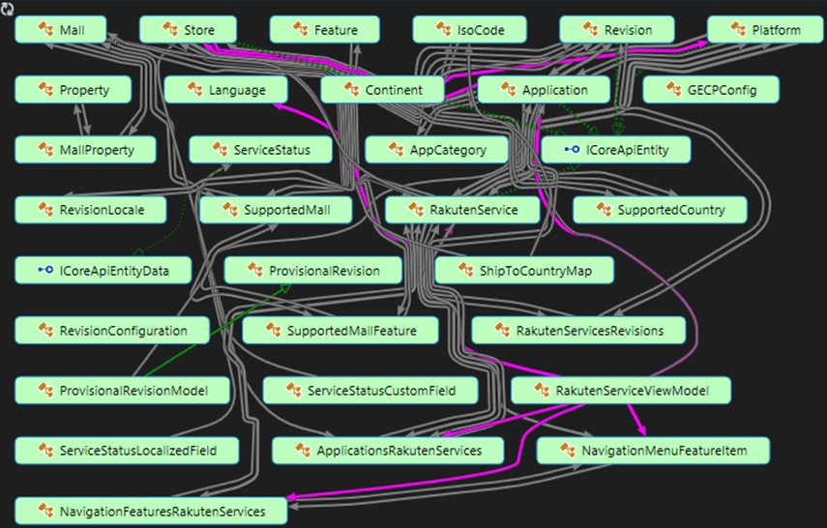
Initial State

Slide 5
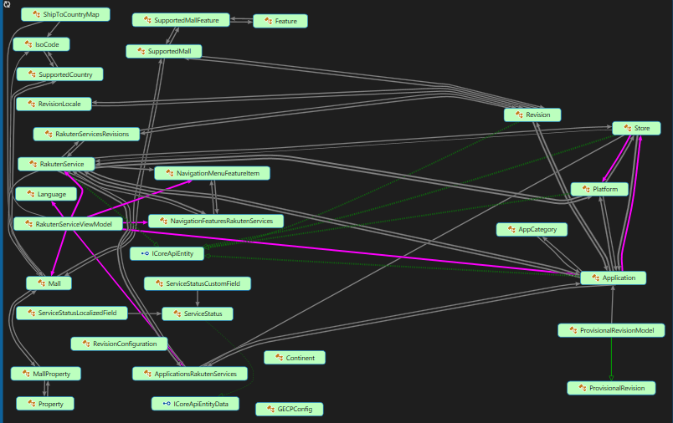
Grouping

Slide 6
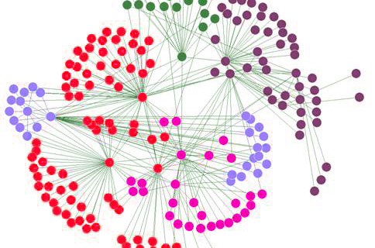
Microservices
Small Autonomous services that work together, modelled around a business domain
Small - 2 weeks to rewrite / few hundred lines of code
Independently scalable and deployable

Slide 7

Microservices Examples
Protocol gateways
User profiles
Shopping carts
Inventory processing
Queues
Caches

Slide 8
API Relations
API #2
6 Callers
API #1
API #3
API #4
API #5
2 Callers
API #6
4 Callers
API #9
API #8
API #7

Slide 9

Why now?
Build and operate a service at scale
Enable greater customer reach
Faster delivery of features and capabilities
Improved resource utilization to reduce costs

Slide 10
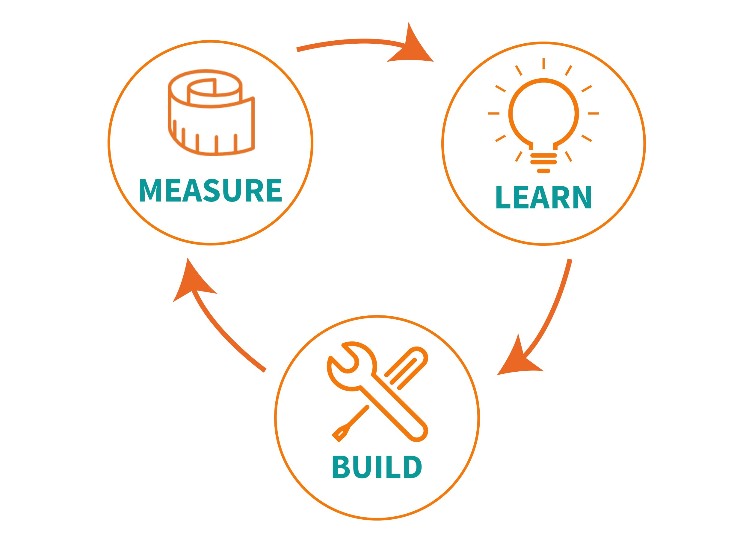
Lean Startup

Slide 11
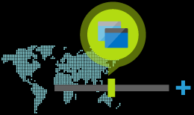
Why Microservices?
Scale specific application parts based on demand
Development teams are more agile in rolling out changes
Provide features to faster and more frequently

Slide 12
SOA vs Microservices
SOA | Microservices
Service Deployed in a Shared Bus | Services Deployed at the Edge
One Team Goal | Team aligned with Business Units
Centralize Mediation | Dumb interfaces
Not prescriptive on the back-end implementation | Prescribes back-end implementation pattern

Slide 13
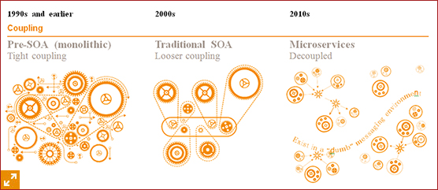
Fine-grained SOA
Independent changes to each
Decoupled federation of services
Agreed-upon standards for communication

Slide 14
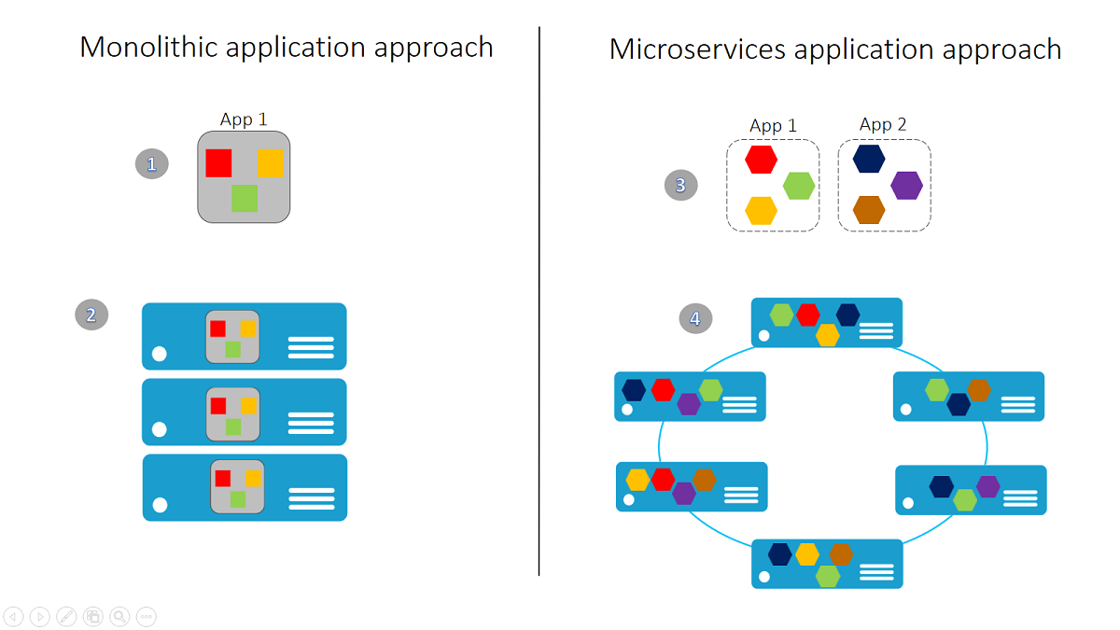

Slide 15
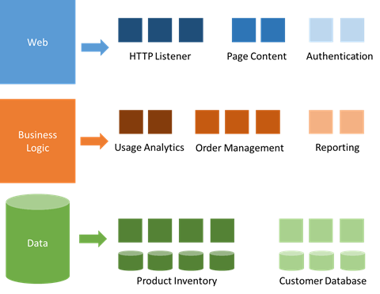
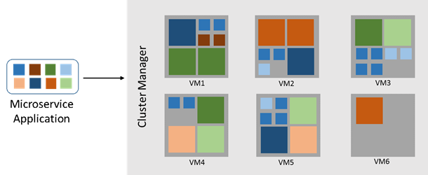
Microservices Model

Slide 16
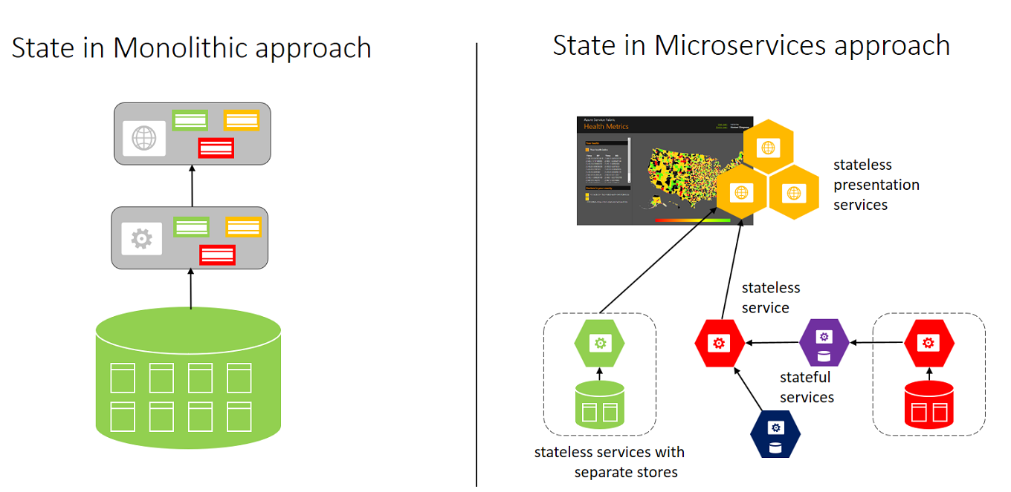

Slide 17

Microservices Characteristics
Encapsulate a customer or business scenario
Developed by a small engineering team
Any programming language / framework
Code (state) independently versioned, deployed, and scaled

Slide 18


Microservices Characteristics
Well-defined interfaces and protocols for communication
Unique names (URLs) for resolving
Remain consistent and available during failures

Slide 19
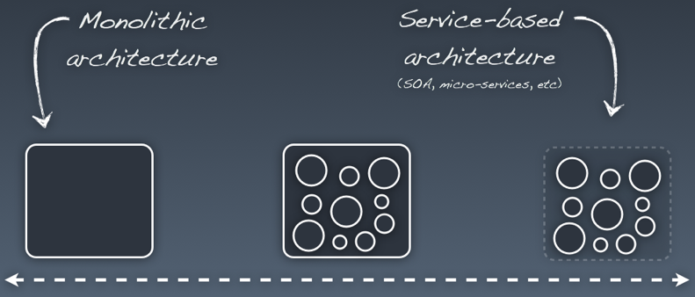
Breaking Process
Begin with a monolith
Break it in stages
Start with parts that need to be more scalability or agility

Slide 20
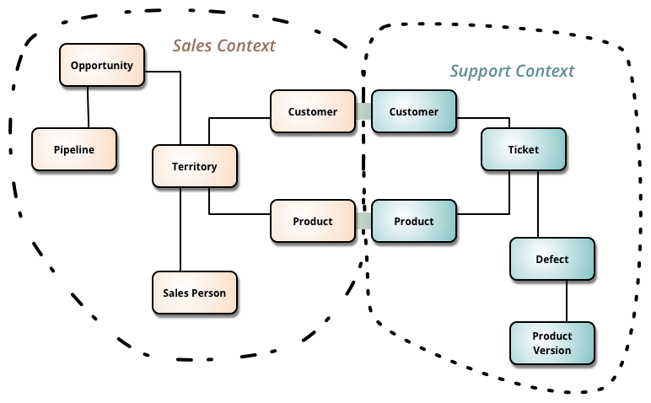
Bounded Context

Slide 21
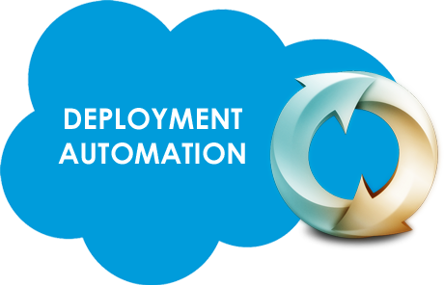
Microservices Principles
Model around business domain
Hide Implementation (database)
Automation
Chunky, not Chatty

Slide 22

Microservices Principles
Dumb pipes, smart endpoints
Deploy independently
Isolate Failure
Highly Observable

Slide 23
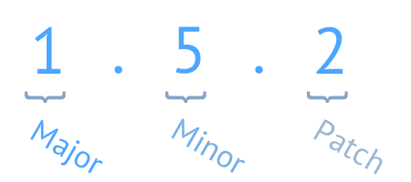
Versioning
Multiple different versions are rolled out
Multiple different versions run side by side
Rolling back to an earlier version
Perform A/B-style testing
Upgrade for a specific customers to test new functionality

Slide 24
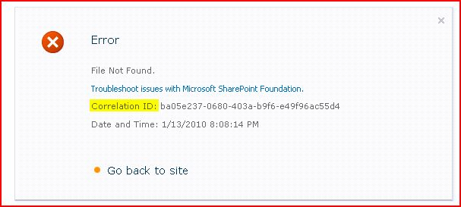
Logging
Correlation context across services
Independent logging
Standard for health and diagnostic events
Different teams agree on a single logging format
Application wide log events view

Slide 25
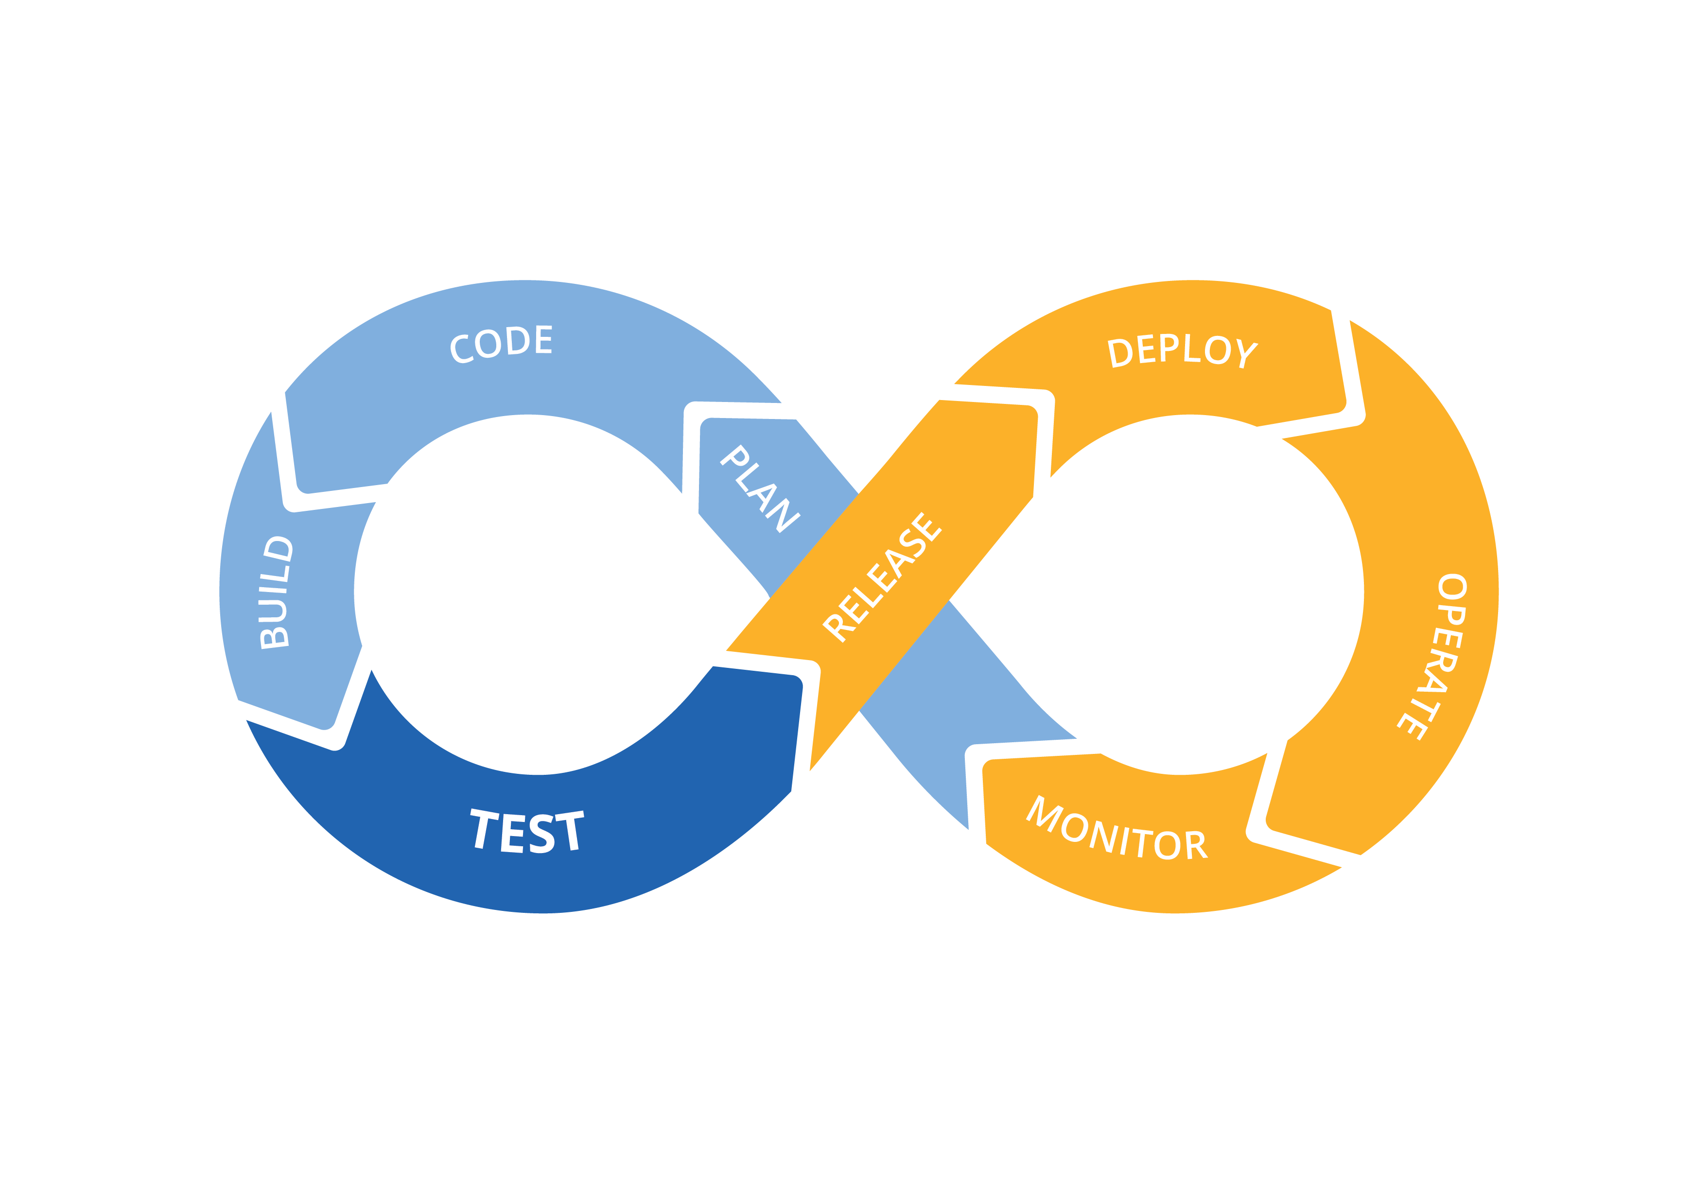
Microservices Challenges
Significant Operations Overhead
DevOps skills required
Implicit Interfaces

Slide 26
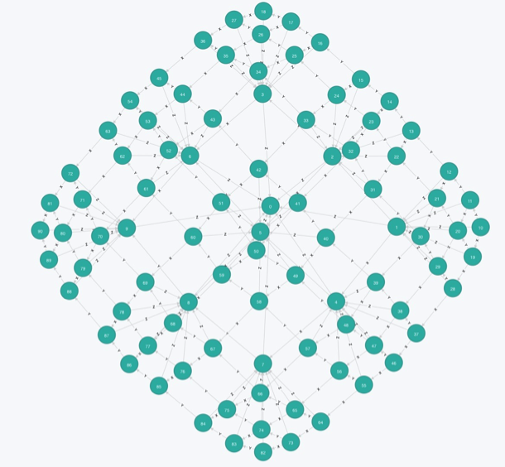
Microservices Challenges
Managing the big number of separate entities
Complex deployments and versioning
More network traffic between the microservices
Network latencies
Hard to “see” the whole system.

Slide 27

Microservices Challenges
Distributed Computing Complexity
Duplication of Effort
Testability Challenges

Slide 28
What do these have in common?
Skype for Business
Hybrid Ops
Azure Document DB
billions transactions/week
Intune
over 1m devices
Azure Core Infrastructure
thousands of machines
Event Hubs
20bn events/day
Bing Cortana
500m evals/sec
Azure SQL Database
millions of databases
Power BI

Slide 29
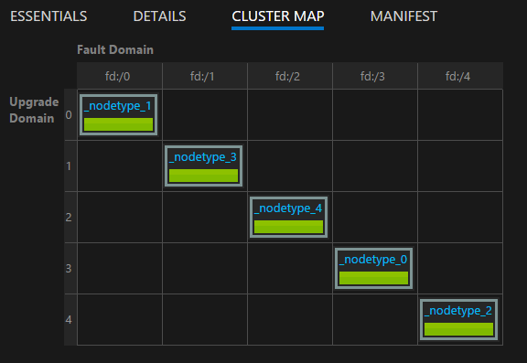
Azure Service Fabric
Distributed systems platform
Simplifies packaging, deployment, and management of microservices
Resolves challenges in developing and managing cloud applications

Slide 30
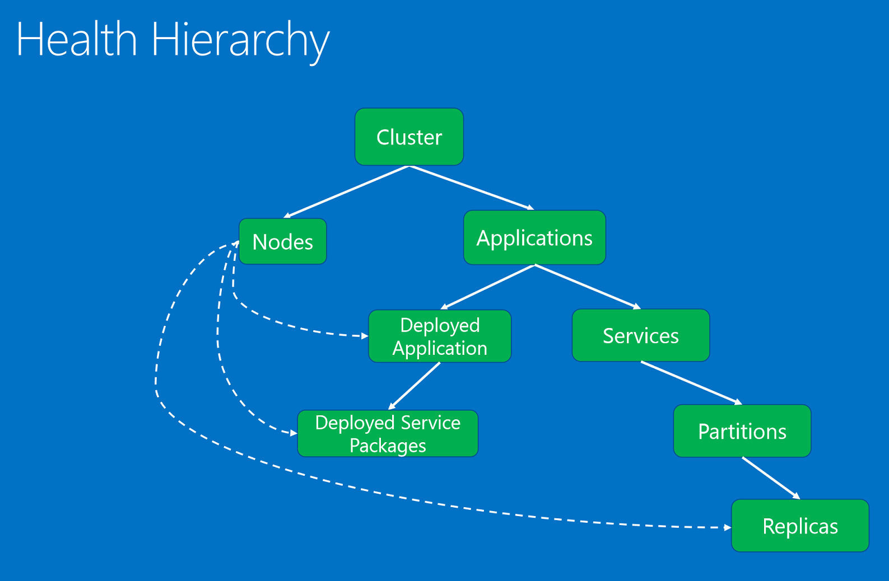
Azure Service Fabric
Management of upgrades, detecting and restarting failed services
Service discovery
State management
Health monitoring

Slide 31

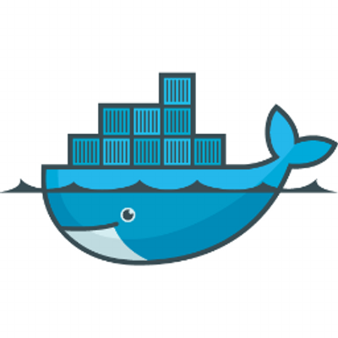
Containers
Hosts microservices inside containers
Containers deployed and activated across the cluster
Docker support coming

Slide 32
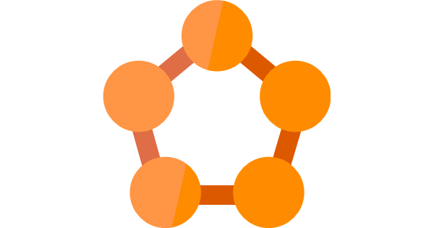
Azure Service Fabric
Generally Available
Preview for Windows Server:
Install on premise
Install on alternative clouds
Preview for Linux

Slide 33

Azure Service Fabric
Azure Stack support coming
Great tooling
Excellent Integration with Visual Studio

Slide 34

Capabilities
Perform near real-time data analysis
In-memory computation
Parallel transactions
Event processing

Slide 35
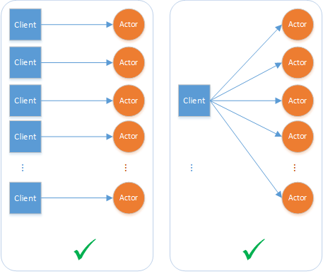
API-s
Reliable Actors
Reliable Services
Make the job more straightforward
Integrate with the platform at a deeper level
Take advantage of built-in high availability.

Slide 36
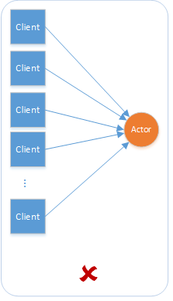
Reliable Actors
Stateless / Stateful objects via the Actor model
Lots of independent units of computation/state
Uses a turn-based threading model
Avoid code that calls out to other actors or services
An actor cannot process other incoming requests until all its outbound requests have completed

Slide 37
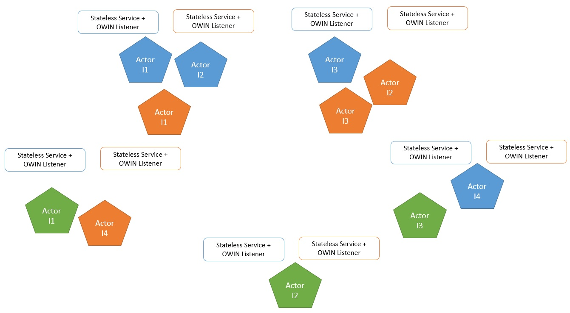
Reliable Actors
Independent objects -actors
Service Fabric takes care:
Deployment
Scaling
Communication across actors

Slide 38
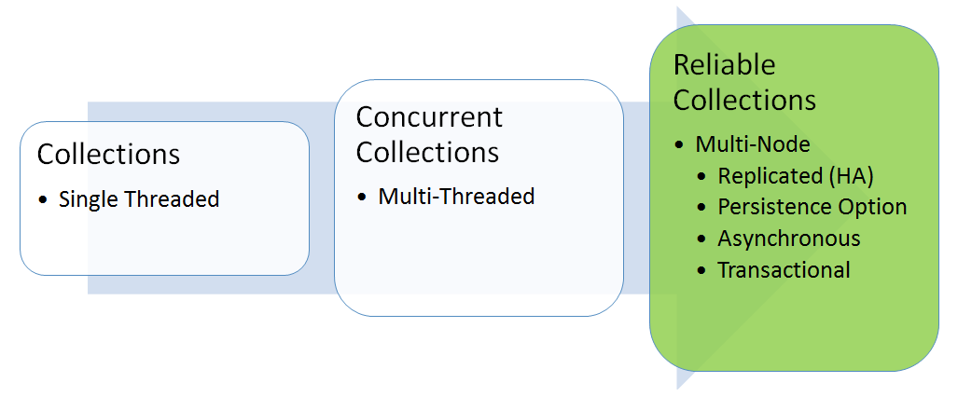
Reliable Services
Reliable Services:
Stateless
Stateful (reliable collections)

Slide 39


Stateless
Examples : protocol gateways, web proxies
Do not maintain a state outside of any given request or response
State maintained in dedicated data storage
Azure Examples: Web Apps, Cloud Services

Slide 40



Stateful
Examples :
user accounts
databases
shopping carts
queues
Maintain a state beyond the request and its response.
Internet-scale applications have both - Stateless & Stateful

Slide 41
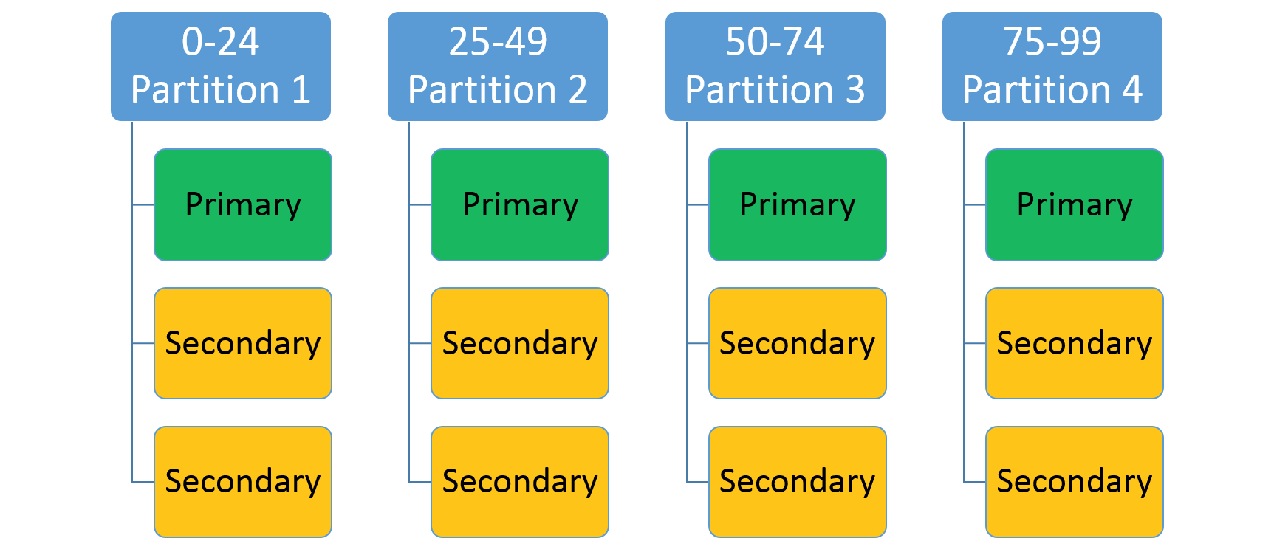
Stateful
Partitions to spread state
Replication of state
Primary replica + Multiple secondary

Slide 42
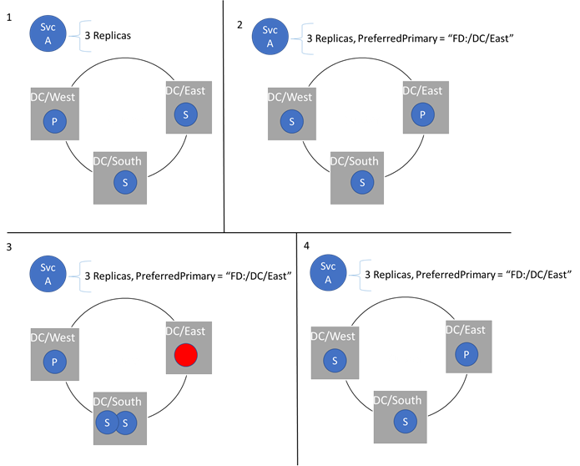
Stateful
Write to the primary replica
Syncs with the secondary
Primary replica fails -> secondary becomes new primary

Slide 43


Why Stateful?
High-throughput, low-latency, failure-tolerant online transaction processing (OLTP)
Examples: Search, IoT, Trading systems, Credit card processing and fraud detection systems, personal record management
Keep code and data close on the same machine

Slide 44

Why Stateful?
Application design simplification
Remove the need for queues and caches
Fewer moving parts to manage in your application as a whole

Slide 45
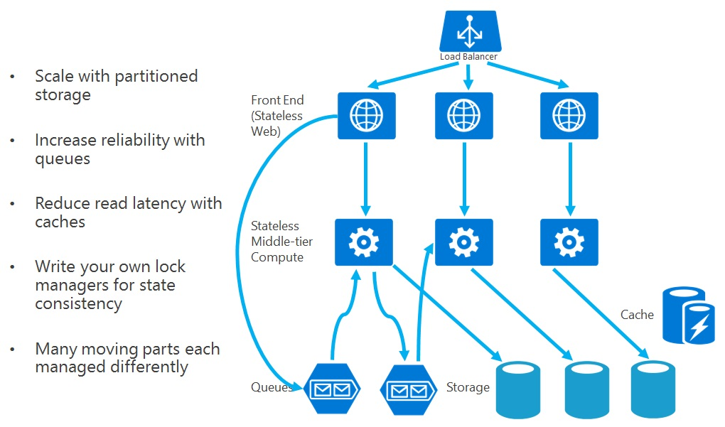
Stateless App

Slide 46
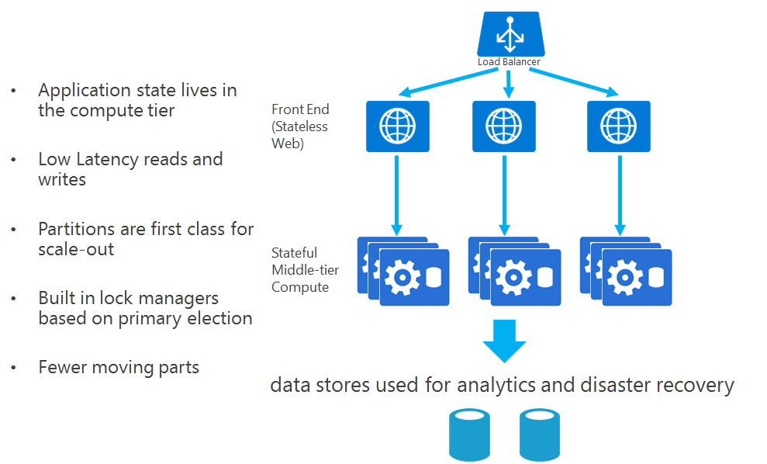
Stateful App

Slide 47
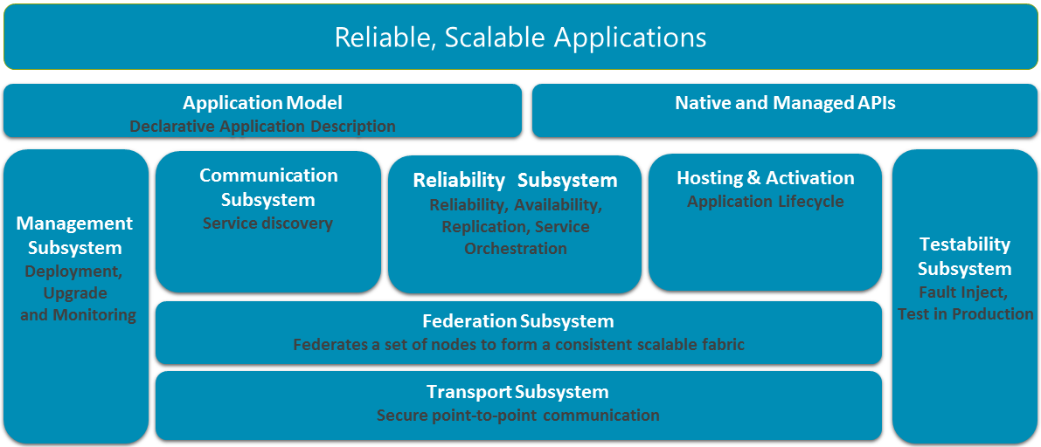
Architecture

Slide 48
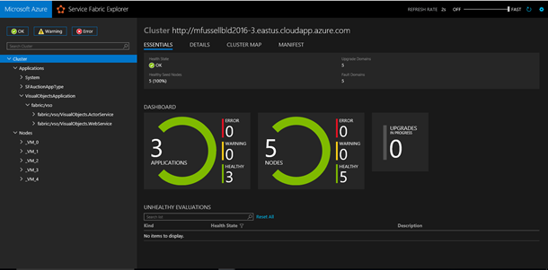
DevOps
Any framework supported
Rolling upgrades
Automatically rolling back in case of error
Never leaves the application in an inconsistent or unknown state
Fully scriptable -> easy to integrate with CI / CD

Slide 49
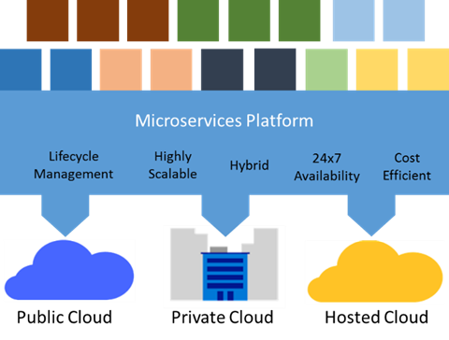
Deploy Everywhere

Slide 50
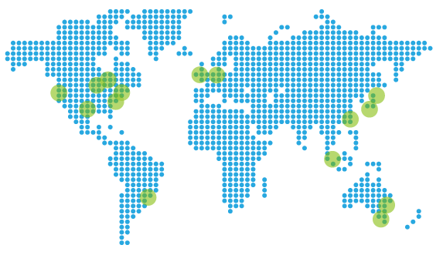
Global Availability
East US
North Central US
South Central US
West US
West Europe
Japan West
Australia East
Australia Southeast

Slide 51

Demo

Slide 52


