Slide 1
Service Fabric and Containers Adam Hems please see me ☺
Boris Scholl
PM Azure Compute
bscholl@microsoft.com

Slide 2
Agenda
Density and Isolation levels
Service Fabric container scenarios
Service Fabric container integration
Guest Container
SF applications in a container
Demo

Slide 3
Density & Isolation levels
More isolated More efficient
PC
VM
Container
Process
Hardware | Not shared | Shared | Shared | Shared
Kernel | Not shared | Not shared | Shared* | Shared
System Resources (ex: File System) | Not shared | Not shared | Not shared | Shared
* Windows Hyper-V containers do not share a kernel
Notes:
Services per
PC:
VMs: Well isolated, but it they are big and takes a long time to boot up
Fast to boot up. Downside with processes is that they are not well isolated from the rest of the environment and can quickly result in noisy neighbor situations, potentially compromising the entire virtual machine if the code was not written well.

Slide 4
Service Fabric container scenarios
Lift and Shift scenarios
Need better isolation than job objects
Container = job objects + namespaces
Mixed environments (Node.js application, Service Fabric applications)
Immutable environments

Slide 5
Service Fabric container integration
Support for Docker, Windows and Hyper-V containers
Running guest containers in Service Fabric
Container does not reference any SF APIs etc.
Uses container guest executable feature
Uses Service Fabric Cluster management and resource scheduling capabilities
Building containerized Service Fabric applications
Container contains SF runtime
Build stateless and stateful SF services
Uses Service Fabric Cluster management and resource scheduling capabilities

Slide 6
Service Fabric Container Integration - Guest Container
Container Images
Datacenter (Azure, Amazon, On-Premises)
<ServiceManifest Name=“ContosoServiceTypePkg" Version="1.0">
<ServiceTypes>
<StatelessServiceType ServiceTypeName=“ContosoServiceType" ... >
</StatelessServiceType>
</ServiceTypes>
<CodePackage Name="CodePkg" Version="1.0">
<EntryPoint>
<ContainerHost> <ImageName>contoso/frontend</ImageName> </ContainerHost>
</EntryPoint>
</CodePackage>
. . .
</ServiceManifest>
FE
VM #1
FE
Side car
image: contoso/frontend
Order Service
Service Fabric
image: contoso/order
VM #5
VM #2
Data
base
Side car
FE
Side car
Side car
image: contoso/config
Service Fabric
Service Fabric
Data
base
VM #4
VM #3
image: contoso/data
Order Service
Side car
Database
Order Service
Side car
Service Fabric
Service Fabric

Slide 7
What happens under the cover?
Execute a Docker run with arguments provided
Docker looks in local registry for “contoso/frontend”
If not local, pulls down from DockerHub
Support for DTR
Host port mapping Expose command.
Full network configuration options will be there when we go into preview

Slide 8
Service Fabric - Guest Container considerations
Same functionality as Guest Executables
Use standard Docker tools
Define container images in the same ServiceManifest to make sure they end up on the same node or use a placement constraints to place on the same
Service Registry/Discovery
Use built in Naming service
Other options (Consul, etcd, etc.)
Monitoring up to you (at this point)

Slide 9
Using the Naming Service
ApplicationManifest.xml
ServiceManifest.xml
….
<Policies>
<ContainerHostPolicies CodePackageRef="NodeService.Code">
<PortBinding ContainerPort="8905" EndpointRef="Endpoint1"/>
</ContainerHostPolicies>
</Policies>
…..
….....
<CodePackage Name="NodeService.Code" Version="1.0">
<EntryPoint>
<ContainerHost>
<ImageName>bmscholl/winnodesf:1</ImageName>
<Commands></Commands>
</ContainerHost>
</EntryPoint>
</CodePackage>
<Resources>
<Endpoints>
<Endpoint Name="Endpoint1" UriScheme="http"/>
</Endpoints>
</Resources>
….....
Dynamic port assignment
Static port assignment by adding port to
endpoint

Slide 10
Service Fabric Container Integration – SF Service
Container Images
Datacenter (Azure, Amazon, On-Premises)
<ServiceManifest Name=“ContosoServiceTypePkg" Version="1.0">
<ServiceTypes>
<StatelessServiceType ServiceTypeName=“ContosoServiceType" ... >
</StatelessServiceType>
</ServiceTypes>
<CodePackage Name="CodePkg" Version="1.0">
<EntryPoint>
<ContainerHost> <ImageName>contoso/frontend</ImageName> </ContainerHost>
</EntryPoint>
</CodePackage>
. . .
</ServiceManifest>
VM #1
FE
FE
Order Service
Service Fabric
image: contoso/frontend
Service Fabric
Service Fabric
Order Service
Service Fabric
VM #5
VM #2
Service Fabric
FE
FE
Order Service
image: contoso/order
Service Fabric
Service Fabric
Service Fabric
Service Fabric
Service Fabric
VM #4
VM #3
FE
FE
Service Fabric
Service Fabric
Service Fabric
Service Fabric

Slide 11
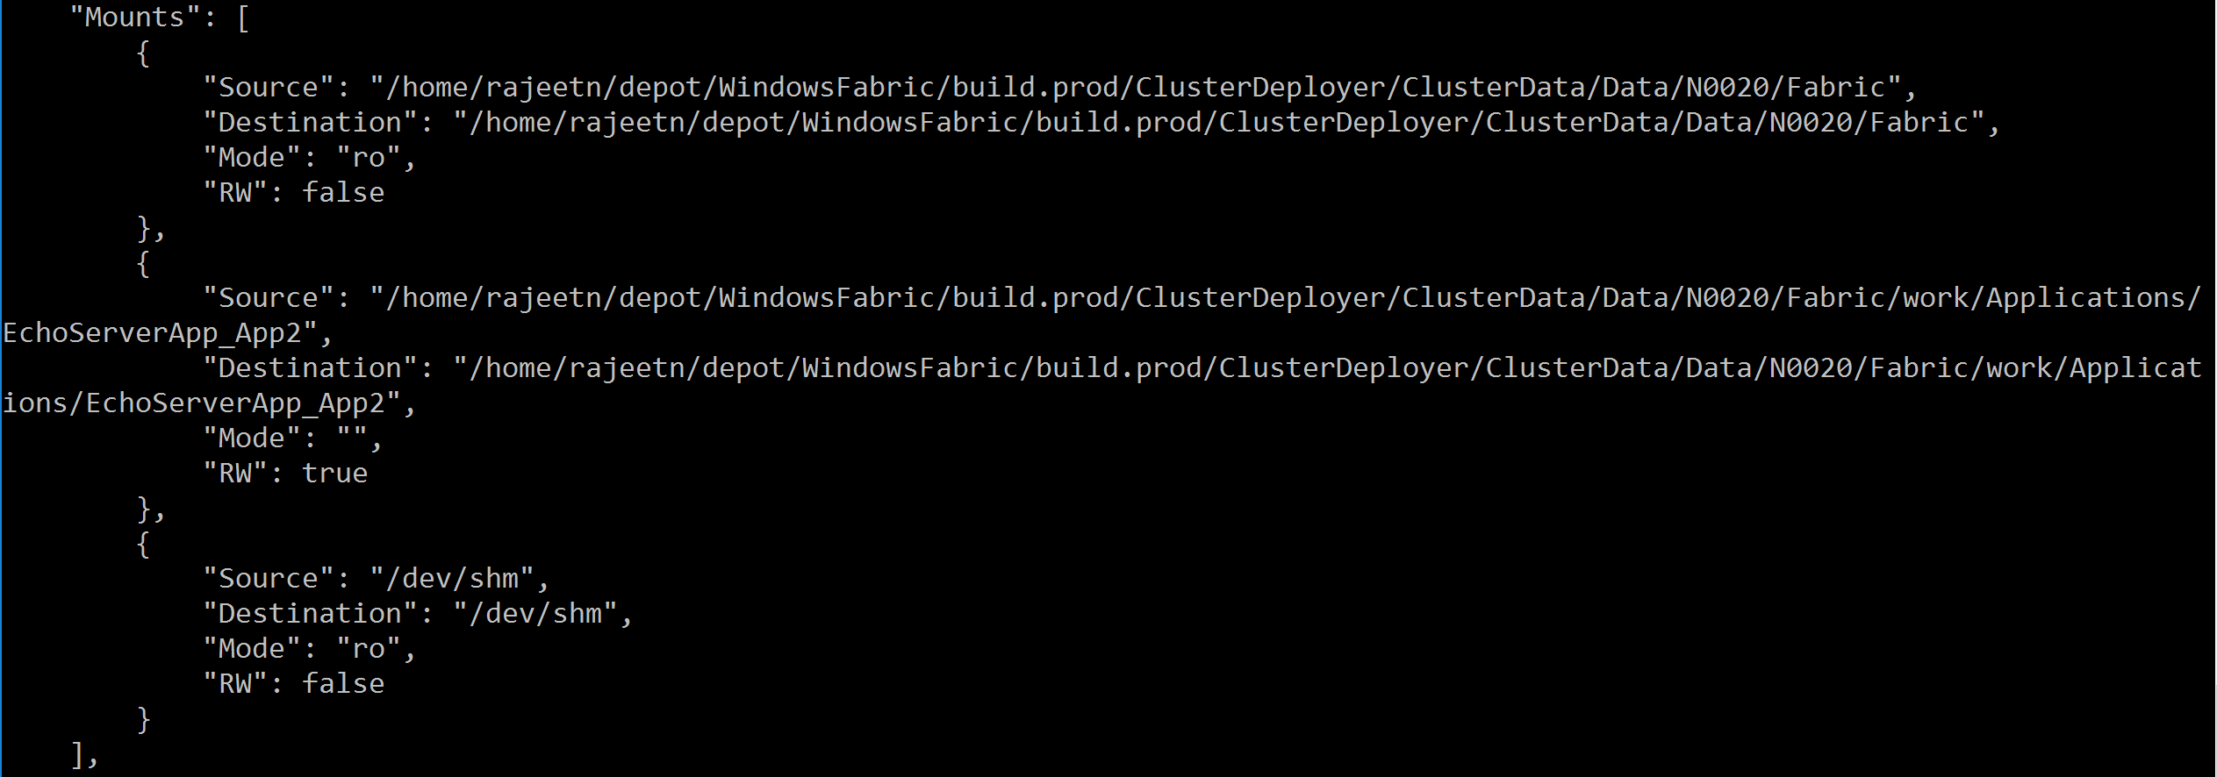
SF services - container volumes
SF Service – docker inspect output
SF echo server container
..\Data\..\work\applications\Echo
..\Data\..\work\applications\Echo
DockerHost: 157.59.37.29
Notes:
For SF services we mount the applications working folder as a volume into the container (for stateful services we also mount the ../work directory on the host)
The directory is mapped when we launch the container.
[
{
"Id": "2fbbb6d3a3727361f5a5de42baa48b8e75e669ea3a7c57bda6418aa6eeac1719",
"Created": "2016-03-18T17:12:23.661456241Z",
"Path": "./sample.sh",
"Args": [],
"State": {
"Running": true,
"Paused": false,
"Restarting": false,
"OOMKilled": false,
"Dead": false,
"Pid": 65185,
"ExitCode": 0,
"Error": "",
"StartedAt": "2016-03-18T17:12:23.840817988Z",
"FinishedAt": "0001-01-01T00:00:00Z"
},
"Image": "176275fdb7584a616d4aa52ef1642a71dd4671f229743fc3e541a78cf7c2ab3c",
"NetworkSettings": {
"Bridge": "",
"EndpointID": "fd508c2363cacb73cae588d5f3e8e59bad629f3def5d9da1a75736b25c5a3be6",
"Gateway": "\u003cnil\u003e",
"GlobalIPv6Address": "",
"GlobalIPv6PrefixLen": 0,
"HairpinMode": false,
"IPAddress": "",
"IPPrefixLen": 0,
"IPv6Gateway": "",
"LinkLocalIPv6Address": "",
"LinkLocalIPv6PrefixLen": 0,
"MacAddress": "",
"NetworkID": "7a10a18a73349adee6d3b9d5ba30ed70a754d8201e956fa33ed9735ba0ad8551",
"PortMapping": null,
"Ports": {},
"SandboxKey": "/var/run/docker/netns/default",
"SecondaryIPAddresses": null,
"SecondaryIPv6Addresses": null
},
"ResolvConfPath": "/var/lib/docker/containers/2fbbb6d3a3727361f5a5de42baa48b8e75e669ea3a7c57bda6418aa6eeac1719/resolv.conf",
"HostnamePath": "/var/lib/docker/containers/2fbbb6d3a3727361f5a5de42baa48b8e75e669ea3a7c57bda6418aa6eeac1719/hostname",
"HostsPath": "/var/lib/docker/containers/2fbbb6d3a3727361f5a5de42baa48b8e75e669ea3a7c57bda6418aa6eeac1719/hosts",
"LogPath": "/var/lib/docker/containers/2fbbb6d3a3727361f5a5de42baa48b8e75e669ea3a7c57bda6418aa6eeac1719/2fbbb6d3a3727361f5a5de42baa48b8e75e669ea3a7c57bda6418aa6eeac1719-json.log",
"Name": "/N0020_2_Basic_Code",
"RestartCount": 0,
"Driver": "aufs",
"ExecDriver": "native-0.2",
"MountLabel": "",
"ProcessLabel": "",
"AppArmorProfile": "",
"ExecIDs": null,
"HostConfig": {
"Binds": [
"/home/rajeetn/depot/WindowsFabric/build.prod/ClusterDeployer/ClusterData/Data/N0020/Fabric:/home/rajeetn/depot/WindowsFabric/build.prod/ClusterDeployer/ClusterData/Data/N0020/Fabric:ro",
"/home/rajeetn/depot/WindowsFabric/build.prod/ClusterDeployer/ClusterData/Data/N0020/Fabric/work/Applications/EchoServerApp_App2:/home/rajeetn/depot/WindowsFabric/build.prod/ClusterDeployer/ClusterData/Data/N0020/Fabric/work/Applications/EchoServerApp_App2",
"/dev/shm:/dev/shm:ro"
],
"ContainerIDFile": "",
"LxcConf": null,
"Memory": 0,
"MemorySwap": 0,
"CpuShares": 0,
"CpuPeriod": 0,
"CpusetCpus": "",
"CpusetMems": "",
"CpuQuota": 0,
"BlkioWeight": 0,
"OomKillDisable": false,
"MemorySwappiness": null,
"Privileged": false,
"PortBindings": null,
"Links": null,
"PublishAllPorts": true,
"Dns": null,
"DnsSearch": null,
"ExtraHosts": null,
"VolumesFrom": null,
"Devices": null,
"NetworkMode": "host",
"IpcMode": "",
"PidMode": "",
"UTSMode": "",
"CapAdd": null,
"CapDrop": null,
"GroupAdd": null,
"RestartPolicy": {
"Name": "",
"MaximumRetryCount": 0
},
"SecurityOpt": null,
"ReadonlyRootfs": false,
"Ulimits": null,
"LogConfig": {
"Type": "json-file",
"Config": {}
},
"CgroupParent": "",
"ConsoleSize": [
0,
0
]
},
"GraphDriver": {
"Name": "aufs",
"Data": null
},
"Mounts": [
{
"Source": "/home/rajeetn/depot/WindowsFabric/build.prod/ClusterDeployer/ClusterData/Data/N0020/Fabric",
"Destination": "/home/rajeetn/depot/WindowsFabric/build.prod/ClusterDeployer/ClusterData/Data/N0020/Fabric",
"Mode": "ro",
"RW": false
},
{
"Source": "/home/rajeetn/depot/WindowsFabric/build.prod/ClusterDeployer/ClusterData/Data/N0020/Fabric/work/Applications/EchoServerApp_App2",
"Destination": "/home/rajeetn/depot/WindowsFabric/build.prod/ClusterDeployer/ClusterData/Data/N0020/Fabric/work/Applications/EchoServerApp_App2",
"Mode": "",
"RW": true
},
{
"Source": "/dev/shm",
"Destination": "/dev/shm",
"Mode": "ro",
"RW": false
}
],
"Config": {
"Hostname": "rajeet-linuxvm",
"Domainname": "",
"User": "",
"AttachStdin": false,
"AttachStdout": false,
"AttachStderr": false,
"ExposedPorts": {
"8057/tcp": {},
"8081/tcp": {}
},
"Tty": false,
"OpenStdin": false,
"StdinOnce": false,
"Env": [
"FabricPackageFileName=/home/rajeetn/depot/WindowsFabric/build.prod/ClusterDeployer/ClusterData/Data/N0020/Fabric/Fabric.Package.current.xml",
"Fabric_ApplicationHostId=4946b696-d9da-214f-a1f3-3c274d97e8f1",
"Fabric_ApplicationHostType=Activated_SingleCodePackage",
"Fabric_ApplicationId=EchoServerApp_App2",
"Fabric_ApplicationName=fabric:/echoserver1",
"Fabric_CodePackageInstanceId=131027947434842400",
"Fabric_CodePackageName=Code",
"Fabric_ContainerHost=true",
"Fabric_NodeId=cf68563e16a44f808e86197a9cf83de5",
"Fabric_RuntimeConnectionAddress=localhost:10587",
"Fabric_ServicePackageInstanceId=131027947434822140",
"Fabric_ServicePackageName=Basic",
"Fabric_ServicePackageVersionInstance=1.0:1.0:131027947337580780",
"PATH=/usr/local/sbin:/usr/local/bin:/usr/sbin:/usr/bin:/sbin:/bin"
],
"Cmd": null,
"Image": "rajeetn/echoserver-1.0",
"Volumes": null,
"WorkingDir": "/EchoServer",
"Entrypoint": [
"./sample.sh"
],
"OnBuild": null,
"Labels": null
}
}
]

Slide 12
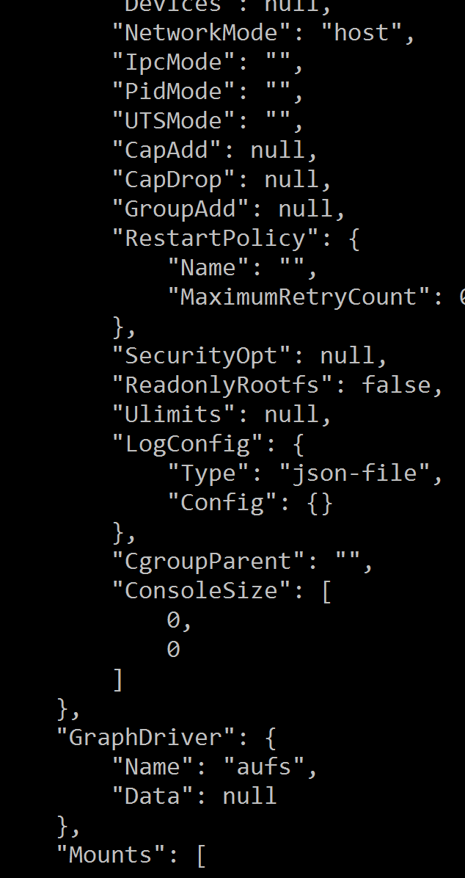
Networking – host mode (state of today)
Docker inspect output:
SF echo server container
Expose: 8081
http://someurl:8081
8081
L0
eth0
157.59.37.29
DockerHost: 157.59.37.29
eth0
Notes:
Currently w only support host networking, later we will support all the networking options available. Because the container shares the networking namespace of the host in host networking, it is directly exposed to the public network; consequently, you need to carry out the coordination via port mapping.
[
{
"Id": "2fbbb6d3a3727361f5a5de42baa48b8e75e669ea3a7c57bda6418aa6eeac1719",
"Created": "2016-03-18T17:12:23.661456241Z",
"Path": "./sample.sh",
"Args": [],
"State": {
"Running": true,
"Paused": false,
"Restarting": false,
"OOMKilled": false,
"Dead": false,
"Pid": 65185,
"ExitCode": 0,
"Error": "",
"StartedAt": "2016-03-18T17:12:23.840817988Z",
"FinishedAt": "0001-01-01T00:00:00Z"
},
"Image": "176275fdb7584a616d4aa52ef1642a71dd4671f229743fc3e541a78cf7c2ab3c",
"NetworkSettings": {
"Bridge": "",
"EndpointID": "fd508c2363cacb73cae588d5f3e8e59bad629f3def5d9da1a75736b25c5a3be6",
"Gateway": "\u003cnil\u003e",
"GlobalIPv6Address": "",
"GlobalIPv6PrefixLen": 0,
"HairpinMode": false,
"IPAddress": "",
"IPPrefixLen": 0,
"IPv6Gateway": "",
"LinkLocalIPv6Address": "",
"LinkLocalIPv6PrefixLen": 0,
"MacAddress": "",
"NetworkID": "7a10a18a73349adee6d3b9d5ba30ed70a754d8201e956fa33ed9735ba0ad8551",
"PortMapping": null,
"Ports": {},
"SandboxKey": "/var/run/docker/netns/default",
"SecondaryIPAddresses": null,
"SecondaryIPv6Addresses": null
},
"ResolvConfPath": "/var/lib/docker/containers/2fbbb6d3a3727361f5a5de42baa48b8e75e669ea3a7c57bda6418aa6eeac1719/resolv.conf",
"HostnamePath": "/var/lib/docker/containers/2fbbb6d3a3727361f5a5de42baa48b8e75e669ea3a7c57bda6418aa6eeac1719/hostname",
"HostsPath": "/var/lib/docker/containers/2fbbb6d3a3727361f5a5de42baa48b8e75e669ea3a7c57bda6418aa6eeac1719/hosts",
"LogPath": "/var/lib/docker/containers/2fbbb6d3a3727361f5a5de42baa48b8e75e669ea3a7c57bda6418aa6eeac1719/2fbbb6d3a3727361f5a5de42baa48b8e75e669ea3a7c57bda6418aa6eeac1719-json.log",
"Name": "/N0020_2_Basic_Code",
"RestartCount": 0,
"Driver": "aufs",
"ExecDriver": "native-0.2",
"MountLabel": "",
"ProcessLabel": "",
"AppArmorProfile": "",
"ExecIDs": null,
"HostConfig": {
"Binds": [
"/home/rajeetn/depot/WindowsFabric/build.prod/ClusterDeployer/ClusterData/Data/N0020/Fabric:/home/rajeetn/depot/WindowsFabric/build.prod/ClusterDeployer/ClusterData/Data/N0020/Fabric:ro",
"/home/rajeetn/depot/WindowsFabric/build.prod/ClusterDeployer/ClusterData/Data/N0020/Fabric/work/Applications/EchoServerApp_App2:/home/rajeetn/depot/WindowsFabric/build.prod/ClusterDeployer/ClusterData/Data/N0020/Fabric/work/Applications/EchoServerApp_App2",
"/dev/shm:/dev/shm:ro"
],
"ContainerIDFile": "",
"LxcConf": null,
"Memory": 0,
"MemorySwap": 0,
"CpuShares": 0,
"CpuPeriod": 0,
"CpusetCpus": "",
"CpusetMems": "",
"CpuQuota": 0,
"BlkioWeight": 0,
"OomKillDisable": false,
"MemorySwappiness": null,
"Privileged": false,
"PortBindings": null,
"Links": null,
"PublishAllPorts": true,
"Dns": null,
"DnsSearch": null,
"ExtraHosts": null,
"VolumesFrom": null,
"Devices": null,
"NetworkMode": "host",
"IpcMode": "",
"PidMode": "",
"UTSMode": "",
"CapAdd": null,
"CapDrop": null,
"GroupAdd": null,
"RestartPolicy": {
"Name": "",
"MaximumRetryCount": 0
},
"SecurityOpt": null,
"ReadonlyRootfs": false,
"Ulimits": null,
"LogConfig": {
"Type": "json-file",
"Config": {}
},
"CgroupParent": "",
"ConsoleSize": [
0,
0
]
},
"GraphDriver": {
"Name": "aufs",
"Data": null
},
"Mounts": [
{
"Source": "/home/rajeetn/depot/WindowsFabric/build.prod/ClusterDeployer/ClusterData/Data/N0020/Fabric",
"Destination": "/home/rajeetn/depot/WindowsFabric/build.prod/ClusterDeployer/ClusterData/Data/N0020/Fabric",
"Mode": "ro",
"RW": false
},
{
"Source": "/home/rajeetn/depot/WindowsFabric/build.prod/ClusterDeployer/ClusterData/Data/N0020/Fabric/work/Applications/EchoServerApp_App2",
"Destination": "/home/rajeetn/depot/WindowsFabric/build.prod/ClusterDeployer/ClusterData/Data/N0020/Fabric/work/Applications/EchoServerApp_App2",
"Mode": "",
"RW": true
},
{
"Source": "/dev/shm",
"Destination": "/dev/shm",
"Mode": "ro",
"RW": false
}
],
"Config": {
"Hostname": "rajeet-linuxvm",
"Domainname": "",
"User": "",
"AttachStdin": false,
"AttachStdout": false,
"AttachStderr": false,
"ExposedPorts": {
"8057/tcp": {},
"8081/tcp": {}
},
"Tty": false,
"OpenStdin": false,
"StdinOnce": false,
"Env": [
"FabricPackageFileName=/home/rajeetn/depot/WindowsFabric/build.prod/ClusterDeployer/ClusterData/Data/N0020/Fabric/Fabric.Package.current.xml",
"Fabric_ApplicationHostId=4946b696-d9da-214f-a1f3-3c274d97e8f1",
"Fabric_ApplicationHostType=Activated_SingleCodePackage",
"Fabric_ApplicationId=EchoServerApp_App2",
"Fabric_ApplicationName=fabric:/echoserver1",
"Fabric_CodePackageInstanceId=131027947434842400",
"Fabric_CodePackageName=Code",
"Fabric_ContainerHost=true",
"Fabric_NodeId=cf68563e16a44f808e86197a9cf83de5",
"Fabric_RuntimeConnectionAddress=localhost:10587",
"Fabric_ServicePackageInstanceId=131027947434822140",
"Fabric_ServicePackageName=Basic",
"Fabric_ServicePackageVersionInstance=1.0:1.0:131027947337580780",
"PATH=/usr/local/sbin:/usr/local/bin:/usr/sbin:/usr/bin:/sbin:/bin"
],
"Cmd": null,
"Image": "rajeetn/echoserver-1.0",
"Volumes": null,
"WorkingDir": "/EchoServer",
"Entrypoint": [
"./sample.sh"
],
"OnBuild": null,
"Labels": null
}
}
]

Slide 13
Service Fabric – SF Container considerations
Same functionality as Service Fabric Services
Use standard Docker tools
Docker commands for building and pushing images to a DTR
Define container images in the same ServiceManifest
Service Registry/Discovery -> Naming Service
Monitoring -> SF health system

Slide 14
Demo

