Slide 1

Building Microservices Applications on Azure Service Fabric
Jeffrey Richter
Slides/demos: http://1drv.ms/1Tfp1EH
Microsoft Azure
Service Fabric
Notes:
Azure Service Fabric is a distributed systems platform used to build scalable, reliable, and easily managed applications (microservices) for the cloud. It is a free Windows component that works with any cloud: Azure, Amazon, on-premises, etc. In this talk, Jeff introduces you to Azure Service Fabric and shows you how it can help you with your own cloud services.

Slide 2
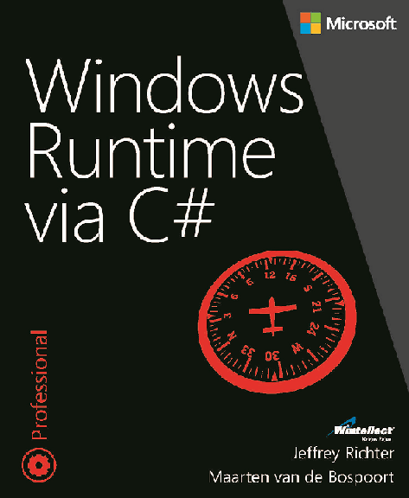

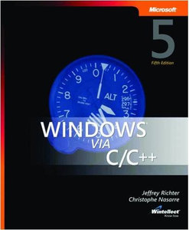



Jeffrey Richter: Microsoft Software Engineer, Wintellect Co-Founder, & Author
JeffreyR@Microsoft.com
www.linkedin.com/in/JeffRichter
@JeffRichter
Notes:
Jeffrey Richter: Software Engineer, Azure Hyper-Scale Compute team
Jeffrey Richter is a Microsoft Software Engineer on the Azure Hyper-Scale compute team. He is also a co-founder of Wintellect, a software consulting and training company. He has authored many videos available on WintellectNOW, has spoken at many industry conferences, and is the author of several best-selling Windows and .NET Framework programming books including Windows Runtime via C#, CLR via C#, 4th Edition, and Windows via C/C++, 5th Edition. Jeffrey has also been a contributing editor to MSDN Magazine where he authored many feature articles and columns.

Slide 3
What is Service Fabric
Next generation of PaaS on Azure
Elastic scale, OS updates, SF updates
Microservices platform for Windows (soon, Linux)
DevOps, rolling upgrades, etc.
Polycloud including on-premises
Programming models
Stateless Win32 apps written in any language (some feature not supported)
Reliable Services: Stateless & stateful (for hot data; gives low-latency reads)
ASP.NET 5
Service Fabric is free of charge
SDK: http://aka.ms/ServiceFabricSDK

Slide 4
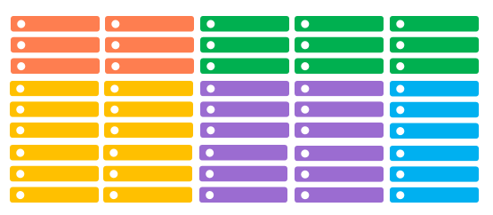
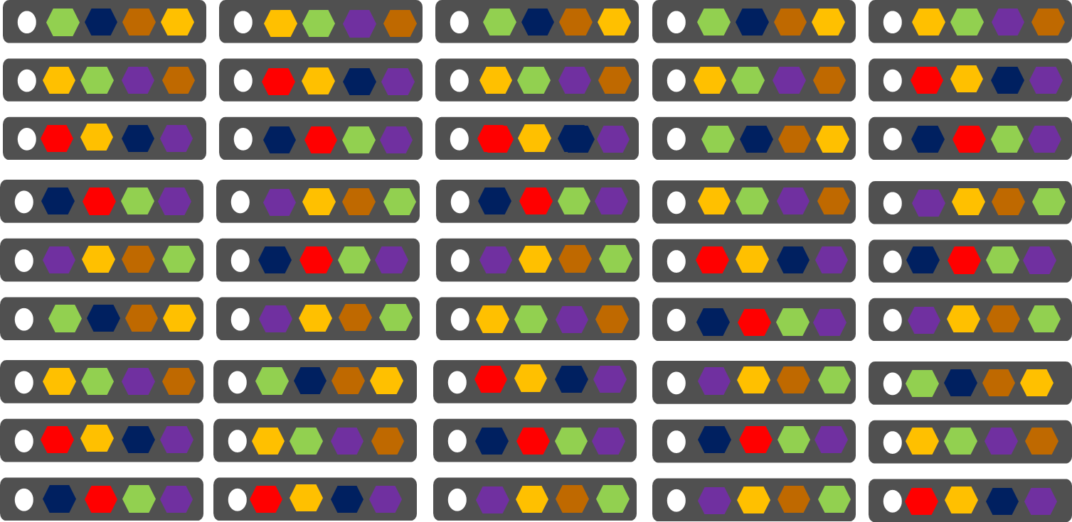
Cloud Services vs Service Fabric
Azure Cloud Services (Web & Worker Roles)
Azure Service Fabric
(Services)
1 service instance per VM
Slow deployment & upgrades
Slow scaling of roles up/down
Emulator for development
Many microservices per PC/VM
Fast deployment & upgrades
Fast scaling of microservices up/down
OneBox cluster for development

Slide 5

Service Fabric Cluster with 5 Nodes
Datacenter (Azure, Amazon, On-Premises)
PC/VM #2
Service Fabric
Your code, etc.
PC/VM #3
Service Fabric
Your code, etc. (Port: 19080)
PC/VM #1
Your code, etc.
Service Fabric
PC/VM #4
Load Balancer
Your code, etc.
Service Fabric
Your code, etc.
PC/VM #5
Web Request (Port: 80/443/?)
Service Fabric
Your code, etc.
*SF supports 1,000s of nodes
Notes:
Box representing cloud
Contains Cluster (can contain 1000s of nodes)
Contains Nodes (@ has name)
Endpoints
HttpGateWay (19007), Cluster (tcp: 19000)?
Your “static” code/data/config
Load Balancer
Animate: start w/DC box
Enter some nodes (names)
Install OS/SF
Establish endpoints to create cluster
You code/data/config
Load Balancer
Client request → LB → to a node
---
<?xml version="1.0" encoding="utf-8"?>
<!--
WARNING WARNING WARNING WARNING WARNING WARNING WARNING WARNING WARNING WARNING WARNING
WARNING WARNING WARNING WARNING WARNING WARNING WARNING WARNING WARNING WARNING WARNING
WARNING WARNING WARNING WARNING WARNING WARNING WARNING WARNING WARNING WARNING WARNING
The settings used within this ClusterManifest are expressly for use only
within a developer single-box environment. Any use of these settings outside
of that environment are highly likely to produce incorrect, and misperforming
systems.
WARNING WARNING WARNING WARNING WARNING WARNING WARNING WARNING WARNING WARNING WARNING
WARNING WARNING WARNING WARNING WARNING WARNING WARNING WARNING WARNING WARNING WARNING
WARNING WARNING WARNING WARNING WARNING WARNING WARNING WARNING WARNING WARNING WARNING
-->
<ClusterManifest
xmlns:xsd="http://www.w3.org/2001/XMLSchema"
xmlns:xsi="http://www.w3.org/2001/XMLSchema-instance"
xmlns="http://schemas.microsoft.com/2011/01/fabric"
Name="ComputerName-Local-Cluster"
Version="1.0">
<NodeTypes>
<NodeType Name="NodeType1">
<Endpoints>
<ClientConnectionEndpoint Port="19000" />
<LeaseDriverEndpoint Port="19001" />
<ClusterConnectionEndpoint Port="19002" />
<HttpGatewayEndpoint Port="19007" Protocol="http" />
<ServiceConnectionEndpoint Port="19006" />
<ApplicationEndpoints StartPort="30001" EndPort="31000" />
</Endpoints>
</NodeType>
<NodeType Name="NodeType2">
<Endpoints>
<ClientConnectionEndpoint Port="19010" />
<LeaseDriverEndpoint Port="19011" />
<ClusterConnectionEndpoint Port="19012" />
<HttpGatewayEndpoint Port="19017" Protocol="http" />
<ServiceConnectionEndpoint Port="19016" />
<ApplicationEndpoints StartPort="31001" EndPort="32000" />
</Endpoints>
</NodeType>
<NodeType Name="NodeType3">
<Endpoints>
<ClientConnectionEndpoint Port="19020" />
<LeaseDriverEndpoint Port="19021" />
<ClusterConnectionEndpoint Port="19022" />
<HttpGatewayEndpoint Port="19027" Protocol="http" />
<ServiceConnectionEndpoint Port="19026" />
<ApplicationEndpoints StartPort="32001" EndPort="33000" />
</Endpoints>
</NodeType>
<NodeType Name="NodeType4">
<Endpoints>
<ClientConnectionEndpoint Port="19030" />
<LeaseDriverEndpoint Port="19031" />
<ClusterConnectionEndpoint Port="19032" />
<HttpGatewayEndpoint Port="19037" Protocol="http" />
<ServiceConnectionEndpoint Port="19036" />
<ApplicationEndpoints StartPort="33001" EndPort="34000" />
</Endpoints>
</NodeType>
<NodeType Name="NodeType5">
<Endpoints>
<ClientConnectionEndpoint Port="19040" />
<LeaseDriverEndpoint Port="19041" />
<ClusterConnectionEndpoint Port="19042" />
<HttpGatewayEndpoint Port="19047" Protocol="http" />
<ServiceConnectionEndpoint Port="19046" />
<ApplicationEndpoints StartPort="34001" EndPort="35000" />
</Endpoints>
</NodeType>
</NodeTypes>
<Infrastructure>
<WindowsServer IsScaleMin="true">
<NodeList>
<Node NodeName="Node.1" IPAddressOrFQDN="localhost" IsSeedNode="true" NodeTypeRef="NodeType1" FaultDomain="fd:/FD01" UpgradeDomain="UD1" />
<Node NodeName="Node.2" IPAddressOrFQDN="localhost" IsSeedNode="true" NodeTypeRef="NodeType2" FaultDomain="fd:/FD02" UpgradeDomain="UD2" />
<Node NodeName="Node.3" IPAddressOrFQDN="localhost" IsSeedNode="true" NodeTypeRef="NodeType3" FaultDomain="fd:/FD03" UpgradeDomain="UD3" />
<Node NodeName="Node.4" IPAddressOrFQDN="localhost" IsSeedNode="false" NodeTypeRef="NodeType4" FaultDomain="fd:/FD04" UpgradeDomain="UD1" />
<Node NodeName="Node.5" IPAddressOrFQDN="localhost" IsSeedNode="false" NodeTypeRef="NodeType5" FaultDomain="fd:/FD05" UpgradeDomain="UD2" />
</NodeList>
</WindowsServer>
</Infrastructure>
<FabricSettings>
<Section Name="Security">
<Parameter Name="ClusterCredentialType" Value="None" />
<Parameter Name="ServerAuthCredentialType" Value="None" />
</Section>
<Section Name="FailoverManager">
<!-- expected cluster size allows the placement to start when the cluster is started. This value should be less than total number of nodes
as without it the FailoverManager will not start the placement of the user services. This value should be 80% to 90% of the cluster size.
-->
<Parameter Name="ExpectedClusterSize" Value="4" />
<!-- The default target and min replica set sizes are 7 and 5. The below configuration is not required for cluster that have 7 or more nodes. -->
<Parameter Name="TargetReplicaSetSize" Value="5" />
<Parameter Name="MinReplicaSetSize" Value="3" />
<Parameter Name="ReconfigurationTimeLimit" Value="20" />
<Parameter Name="BuildReplicaTimeLimit" Value="20" />
<Parameter Name="CreateInstanceTimeLimit" Value="20" />
<Parameter Name="PlacementTimeLimit" Value="20" />
</Section>
<Section Name="ReconfigurationAgent">
<Parameter Name="ServiceApiHealthDuration" Value="20" />
<Parameter Name="ServiceReconfigurationApiHealthDuration" Value="20" />
<Parameter Name="LocalHealthReportingTimerInterval" Value="5" />
<Parameter Name="IsDeactivationInfoEnabled" Value="true" />
</Section>
<Section Name="ClusterManager">
<!-- The default target and min replica set sizes are 7 and 5. The below configuration is not required for cluster that have 7 or more nodes. -->
<Parameter Name="TargetReplicaSetSize" Value="5" />
<Parameter Name="MinReplicaSetSize" Value="3" />
<Parameter Name="UpgradeStatusPollInterval" Value="5" />
<Parameter Name="UpgradeHealthCheckInterval" Value="5" />
<Parameter Name="FabricUpgradeHealthCheckInterval" Value="5" />
</Section>
<Section Name="NamingService">
<!-- The default target and min replica set sizes are 7 and 5. The below configuration is not required for cluster that have 7 or more nodes. -->
<Parameter Name="TargetReplicaSetSize" Value="5" />
<Parameter Name="MinReplicaSetSize" Value="3" />
</Section>
<Section Name="Management">
<Parameter Name="ImageStoreConnectionString" Value="file:C:\SfDevCluster\Data\ImageStore" />
<Parameter Name="ImageCachingEnabled" Value="false" />
</Section>
<Section Name="Hosting">
<Parameter Name="EndpointProviderEnabled" Value="true" />
<Parameter Name="RunAsPolicyEnabled" Value="true" />
<Parameter Name="DeactivationScanInterval" Value="60" />
<Parameter Name="DeactivationGraceInterval" Value="10" />
<Parameter Name="EnableProcessDebugging" Value="true" />
<Parameter Name="ServiceTypeRegistrationTimeout" Value="20" />
<Parameter Name="CacheCleanupScanInterval" Value="300" />
</Section>
<Section Name="HttpGateway">
<Parameter Name="IsEnabled" Value="true" />
</Section>
<Section Name="PlacementAndLoadBalancing">
<!-- balance the load on the cluster every 5 minutes. -->
<Parameter Name="MinLoadBalancingInterval" Value="300" />
</Section>
<Section Name="Federation">
<Parameter Name="NodeIdGeneratorVersion" Value="V3" />
</Section>
<Section Name="Trace/Etw">
<Parameter Name="Level" Value="4" />
</Section>
<!-- Configure the DCA to cleanup the log folder only. The collection of the logs, performance counters and crashdumps is not performed on the local machine. -->
<Section Name="Diagnostics">
<Parameter Name="ProducerInstances" Value="ServiceFabricEtlFile, ServiceFabricPerfCtrFolder" />
<Parameter Name="MaxDiskQuotaInMB" Value="10240" />
</Section>
<Section Name="ServiceFabricEtlFile">
<Parameter Name="ProducerType" Value="EtlFileProducer" />
<Parameter Name="IsEnabled" Value="true" />
<Parameter Name="EtlReadIntervalInMinutes" Value=" 5" />
<Parameter Name="DataDeletionAgeInDays" Value="3" />
</Section>
<Section Name="ServiceFabricPerfCtrFolder">
<Parameter Name="ProducerType" Value="FolderProducer" />
<Parameter Name="IsEnabled" Value="true" />
<Parameter Name="FolderType" Value="WindowsFabricPerformanceCounters" />
<Parameter Name="DataDeletionAgeInDays" Value="3" />
</Section>
<Section Name="TransactionalReplicator">
<Parameter Name="MaxStreamSizeInMB" Value="64" />
</Section>
</FabricSettings>
</ClusterManifest>

Slide 6
Deploying Service Fabric
Azure
Portal
ARM template
PowerShell to Azure portal
AzureStack
On-Premises other public clouds
Execute MSI for Service Fabric on each VM
Add VM info (IP, ports) into JSON template
OneBox (local development cluster)
SDK

Slide 7
Service Fabric’s Infrastructure Services
Cluster Manager (ports 19080 [REST] & 19000 [TCP]) Performs cluster REST & PowerShell/FabricClient operations
Failover Manager Rebalances resources as nodes come/go
Naming Maps service instances to endpoints
Image store (not on OneBox) Contains your Application packages
Upgrade Service (Azure only) Coordinates upgrading SF itself with Azure’s SFRP
C
Node #2
F
C
N
I
Node #1
N
C
I
F
Node #3
C
F
U
I
Node #5
N
F
U
Node #4
U
N
I
U
Notes:
All services are on all nodes except for image/upgrade services

Slide 8
Service Fabric Explorer

Slide 9
Node Processes
PC/VM
OneBox [testing]
FabricHost.exe [Auto-starts at boot]
Fabric.exe [Inter-node communication]
Fabric.exe [Inter-node communication]
Node
Node
FabricGateway.exe [Cluster communication]
FabricGateway.exe [Cluster communication]
Your App’s Services Ex: ASP.NET or other .exe [Exposes public endpoint(s)]
Your App’s Services Ex: ASP.NET or other .exe [Exposes public endpoint(s)]
Notes:
FileStoreService.exe is on all nodes too

Slide 10
Application Packaging & Deployment

Slide 11
Defining Application Types & Service Types
An application is a collection of services
In Service Fabric terms, we call these application types & service types
So, an application type is a collection of service types
Package the application types & services
A package is a directory with an XML manifest file
Cluster
eStore App Type
“Contoso” eStore App
“Fabrikam” eStore App
Gallery Svc Type
“G” Gallery Svc
“G” Gallery Svc
Payment Svc Type
“P” Payment Svc
“P” Payment Svc

Slide 12
App Pkg Dir & its Manifest XML File
C:\eStoreAppTypePkg
│ ApplicationManifest.xml
│
├───GalleryServicePkg │ │ ServiceManifest.xml
│ │
│ └───CodePkg
│ Gallery.exe
│ GalleryLib.dll
│ Setup.bat
│
└───PaymentServicePkg
│ ServiceManifest.xml
│
└───CodePkg
Payment.exe
<ApplicationManifest ApplicationTypeName="eStoreAppType" ApplicationTypeVersion="1.0" ...>
<ServiceManifestImport> <ServiceManifestRef ServiceManifestName="GalleryServicePkg" ServiceManifestVersion="1.0" ... /> <ServiceManifestRef ServiceManifestName="PaymentServicePkg" ServiceManifestVersion="1.0" ... /> ... </ServiceManifestImport> </ApplicationManifest>
Notes:
<?xml version="1.0" encoding="utf-8"?>
<ApplicationManifest xmlns:xsd="http://www.w3.org/2001/XMLSchema" xmlns:xsi="http://www.w3.org/2001/XMLSchema-instance" ApplicationTypeName="DemoAppType" ApplicationTypeVersion="1.0" xmlns="http://schemas.microsoft.com/2011/01/fabric">
<ServiceManifestImport>
<ServiceManifestRef ServiceManifestName="WebServer" ServiceManifestVersion="1.0" />
</ServiceManifestImport>
<DefaultServices>
<Service Name="WebServerService">
<StatelessService ServiceTypeName="WebServer" InstanceCount="1">
<SingletonPartition />
</StatelessService>
</Service>
</DefaultServices>
</ApplicationManifest>

Slide 13
Service Pkg Dir & its Manifest XML File
C:\eStoreAppTypePkg
│ ApplicationManifest.xml
│
├───GalleryServicePkg │ │ ServiceManifest.xml
│ │
│ └───CodePkg
│ Gallery.exe
│ GalleryLib.dll
│
└───PaymentServicePkg
│ ServiceManifest.xml
│
└───CodePkg
Payment.exe
<ServiceManifest Name="GalleryServicePkg" Version="1.0">
<ServiceTypes>
<StatelessServiceType ServiceTypeName="GalleryServiceType" ... >
</StatelessServiceType>
</ServiceTypes>
<CodePackage Name="CodePkg" Version="1.0">
<EntryPoint> <ExeHost> <Program>Gallery.exe</Program> </ExeHost> </EntryPoint>
</CodePackage>
<Resources> <Endpoints>
<Endpoint Name="GalleryEndpoint" Type="Input" Protocol="http" Port="8080" />
</Endpoints> </Resources>
</ServiceManifest>
Notes:
<?xml version="1.0" encoding="utf-8"?>
<ServiceManifest xmlns:xsd="http://www.w3.org/2001/XMLSchema" xmlns:xsi="http://www.w3.org/2001/XMLSchema-instance" Name="WebServer" Version="1.0" xmlns="http://schemas.microsoft.com/2011/01/fabric">
<ServiceTypes>
<StatelessServiceType ServiceTypeName="WebServer" UseImplicitHost="true">
<Extensions>
<Extension Name="__GeneratedServiceType__">
<GeneratedNames xmlns="http://schemas.microsoft.com/2015/03/fabact-no-schema">
<DefaultService Name="WebServerService" />
<ServiceEndpoint Name="WebServerTypeEndpoint" />
</GeneratedNames>
</Extension>
</Extensions>
</StatelessServiceType>
</ServiceTypes>
<CodePackage Name="C" Version="1.0">
<EntryPoint>
<ExeHost>
<Program>simplewebserver.exe</Program>
<WorkingFolder>CodePackage</WorkingFolder>
</ExeHost>
</EntryPoint>
</CodePackage>
<Resources>
<Endpoints>
<Endpoint Name="WebServerTypeEndpoint" Protocol="http" Port="8080" Type="Input" />
</Endpoints>
</Resources>
</ServiceManifest>

Slide 14
Runtime Relationships
Cluster Management, Billing (VMs), Geolocation, Multitenancy
1+ Named Applications
Isolation, Multitenancy, Unit of versioning/config
1+ Named Services Code package(s), Multitenancy (w/o isolation)
Stateless: 1 Partition No value
Stateful: 1+ Partitions Addressability, Scale
1+ Instances Scale, Availability
1+ Replicas Availability
You can dynamically start/remove named apps/services and instances; not partitions.
The # instances is set per named service; all partitions have the same # of instances
Notes:
A named service has 1 process/code package/node
Multiple partition instances per process; never 2 instance of same partition in 1 process
When SF assigns partition instances to a node:
Node gets code package(s)
1 process/code package
1 object per partition instance assigned to node

Slide 15
Creating Apps, Services, Partitions, & Instances
Registered & provisioned
App type=“A” with Service type=“S”
Create 1 named app
Creates 2 named services
Node #2
f:/A1/S1, P₁, I₂
Node #1
f:/A1/S1, P₁, I₁
App Type | App Version | App Name
“A” | 1.0 | fabric:/A1
Node #3
f:/A1/S1, P₁, I₃
Node #5
f:/A1/S2, P₁, I₁
f:/A1/S2, P₂, I₂
App Name | Service Type | Service Name | # Partitions | # Instances
fabric:/A1 | “S” | fabric:/A1/S1 | 1 | 3
fabric:/A1 | “S” | fabric:/A1/S2 | 2 | 2
Node #4
f:/A1/S2, P₁, I₂
f:/A1/S2, P₂, I₁
NOTE: When using SF programming models, instances from same named app/service are in the same process
Notes:
PartitionID=Guid, InstanceID=Int64

Slide 16
Deploy Application Type & Create App Instance
Notes:
What Win32 console app does
Use tool to create “package”
Use PowerShell commands to
Copy package to cluster & replicated
Maybe say: No dependency on outside storage
Register application type
Create new application & deploy to 2 nodes
Start service
DEMO: Show/explain app & service instance URI naming
DEMO: show how to delete service, app, app package

Slide 17
The Cluster Resource Manager
Notes:
https://channel9.msdn.com/Events/Ignite/2015/BRK3485
https://azure.microsoft.com/en-us/documentation/articles/service-fabric-resource-balancer-cluster-description/
https://azure.microsoft.com/en-us/documentation/articles/service-fabric-resource-balancer-service-description/

Slide 18
DEMO: Cluster Resource Manager
12 Node Cluster 6 in America, 6 in Europe; 2 FE & 4 BE in each Datacenter
1
2
3
4
4 Instances, FE=true
3 Instances, C=America, FE=false D=50GB
3 Instances, C=America, FE=false, D=50GB
D=100GB
#1
Continent: America
FrontEnd: true
Disk: 100GB
#2
Continent: America
FrontEnd: true
Disk: 100GB
#7
Continent: Europe
FrontEnd: true
Disk: 100GB
#8
Continent: Europe
FrontEnd: true
Disk: 100GB
1
2
1
#3
Continent: America
FrontEnd: false
Disk: 100GB
#4
Continent: America
FrontEnd: false
Disk: 100GB
#9
Continent: Europe
FrontEnd: false
Disk: 100GB
#10
Continent: Europe
FrontEnd: false
Disk: 100GB
3
2
3
#5
Continent: America
FrontEnd: false
Disk: 100GB
#6
Continent: America
FrontEnd: false
Disk: 100GB
#11
Continent: Europe
FrontEnd: false
Disk: 100GB
#12
Continent: Europe
FrontEnd: false
Disk: 100GB
3

Slide 19
Q & A

