Slide 1
Logs in analytics
Matt Risley
University of Cincinnati, OBAIS

Slide 2
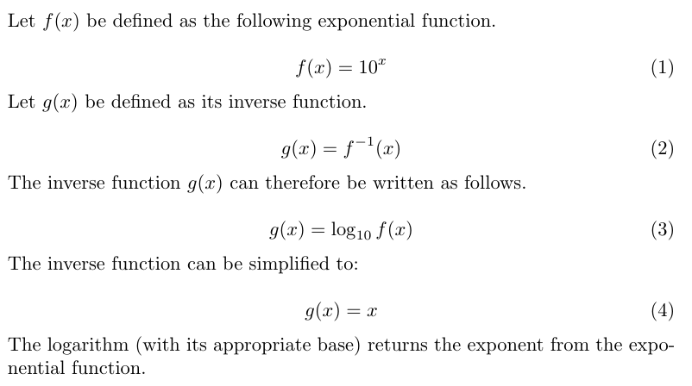
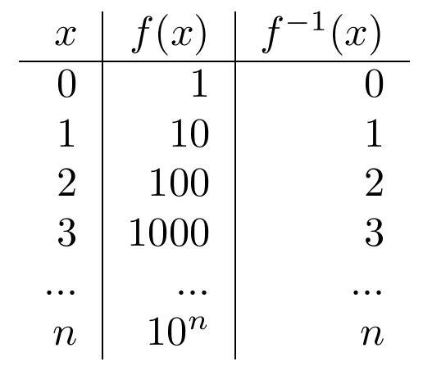
What is a log transformation?
The logarithm is the inverse of the exponential function.

Slide 3
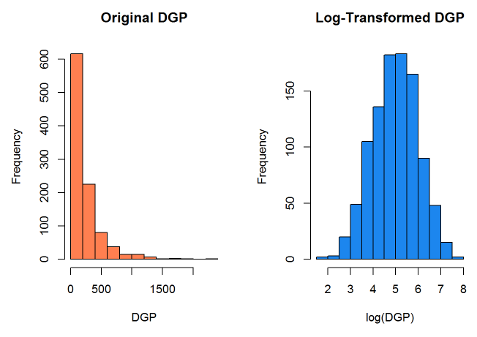
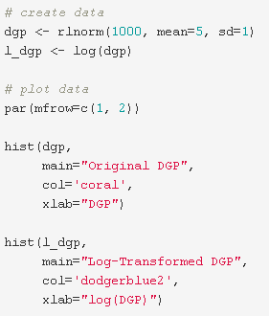

Why is it used in analytics?
Most modeling techniques and statistical testing rely on the normal distribution.
A normal distribution often does not describe observed data.
The logarithmic transformation normalizes some skewed data.
http://people.duke.edu/~rnau/411log.htm

Slide 4

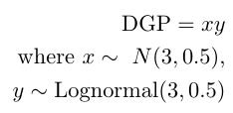
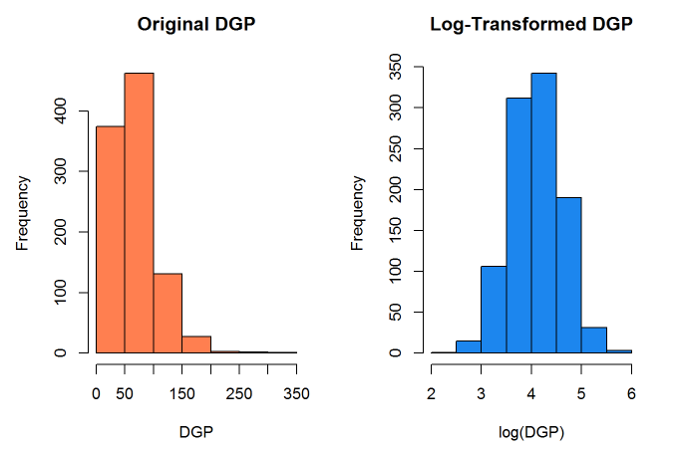
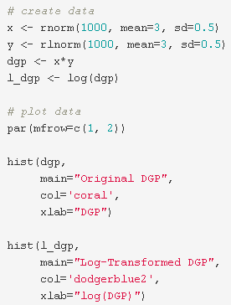
Why is it used in analytics?
Transforms multiplicative relationships into additive ones.
Most economic and financial data include impacts from multipliers.
i.e., the multiplier effect

Slide 5
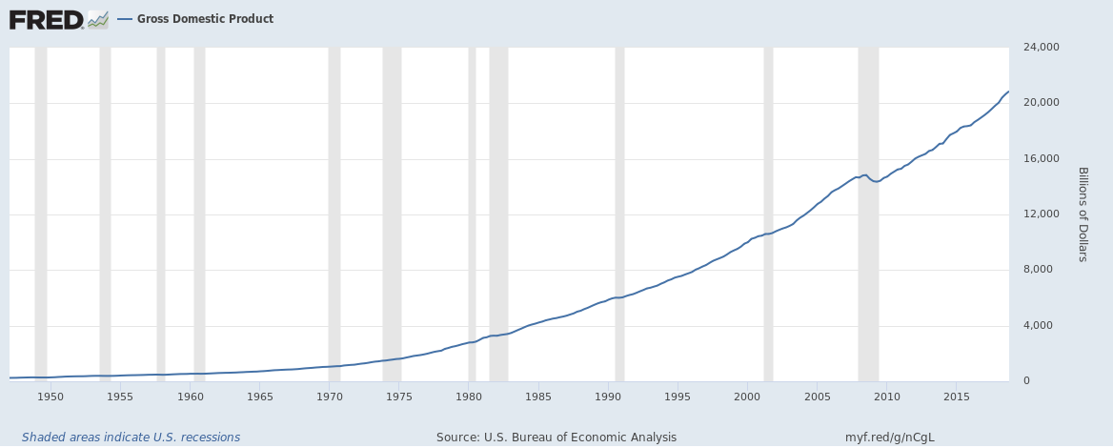
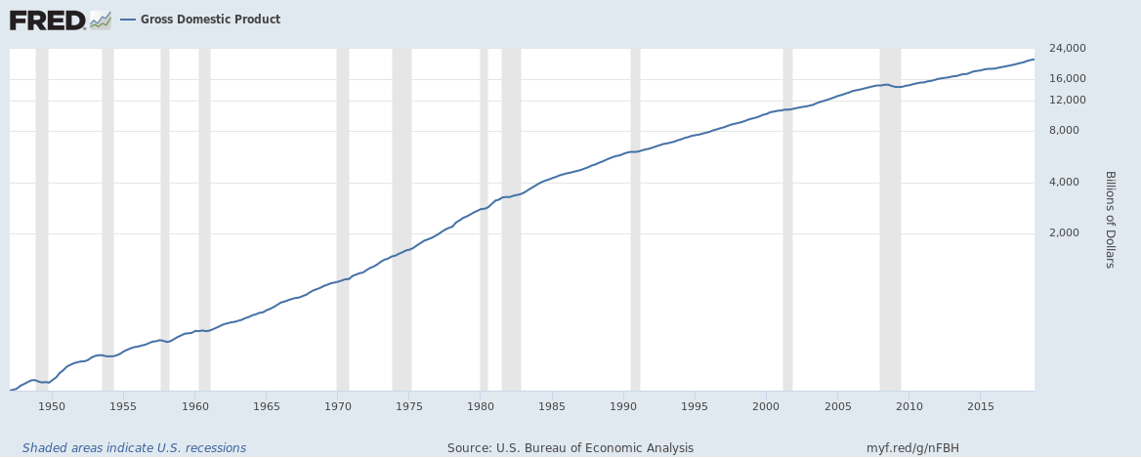
Why is it used in analytics?
Transforms exponential growth trends into linear trends.
Exponential growth = compounding growth.
Most financial and economic series have compounding as part of their data generating processes.
inflation, interest, expansion cycles
Albert Einstein supposedly once said that compounding [interest] is the most powerful force in the universe.

Slide 6
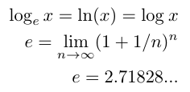
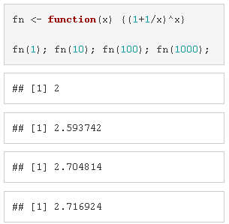
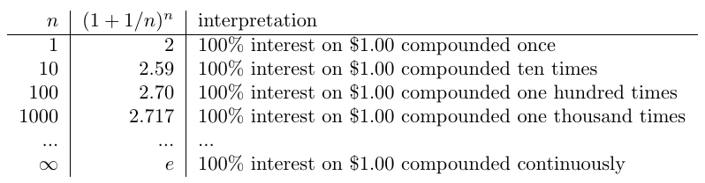
Why is it used in analytics?
Data with these properties fit linear models well under the log transformation.
Why is the natural logarithm the default?
natural logarithm uses e (Euler’s number) as the base.

Slide 7
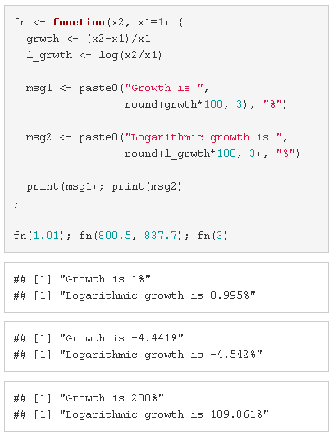
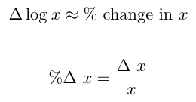
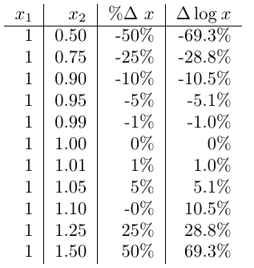
Why is the natural logarithm the default?
Consistent estimator of growth, but not unbiased.
Bias is a function of % change (Appendix 1)
Aids in interpretation.

Slide 8
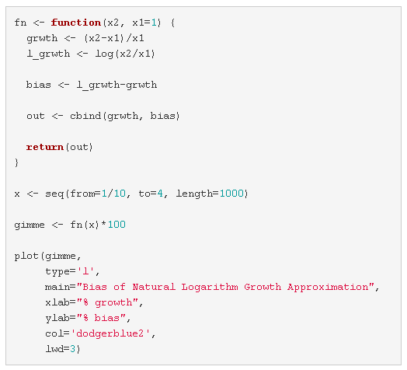
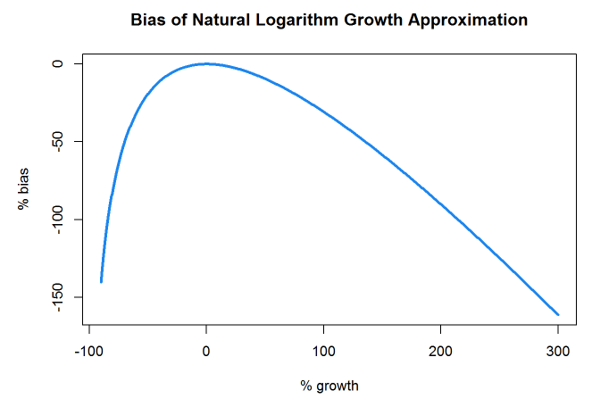
Appendix 1
As an estimator of growth, the natural logarithm has bias that is a function of the growth.

