Slide 1
CoronaPU
Kareem Elsawah
Emad Mostafa
Ahmed Emad
Ahmed Salah
Mohamed Sameh
Marawan Osama
Youssef Omara
Ali Ganzouri

Slide 2
General Structure
ROM
RAM
ALU
Assembler
Data Path
Assembly Code
VGA Simulator
Control Unit
Compiler
Video RAM
GPU
VGA Output
Bemo Code

Slide 3
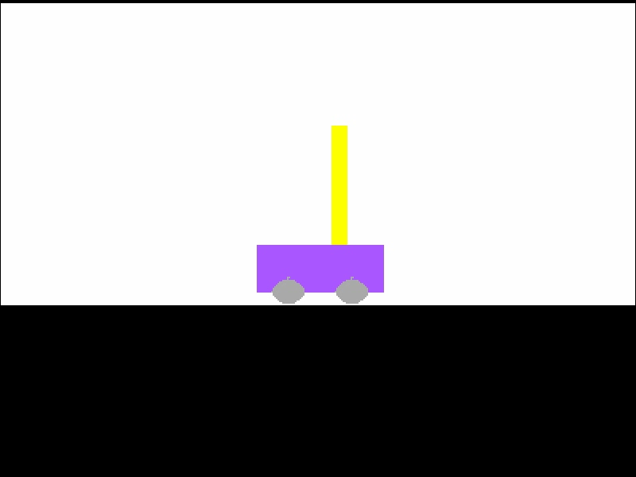
Programs created
3D Graphics
Cartpole balancing, control using Reinforcement Learning

Slide 4
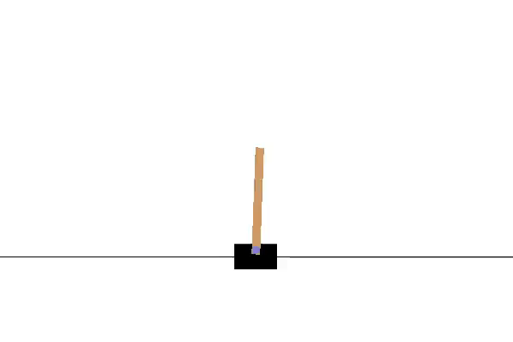
Cartpole balancing
Balance a pole on a cart for at least 200 frames
Controls:
Left Right

Slide 5
Our Cartpole balancing results

Slide 6
3D Rotating Cube
Everything was done on our computer including the following:
Rotations
Projections from 3D down to 2D
Rendering of the project cube
Outputting the render result as VGA output

Slide 7
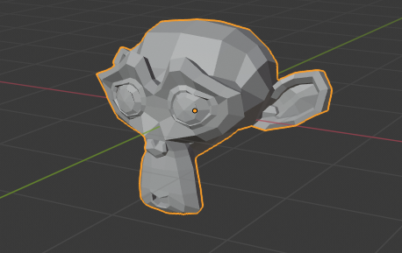
3D Graphics
Can render any .obj 3d file as a wireframe model and rotate it

Slide 8
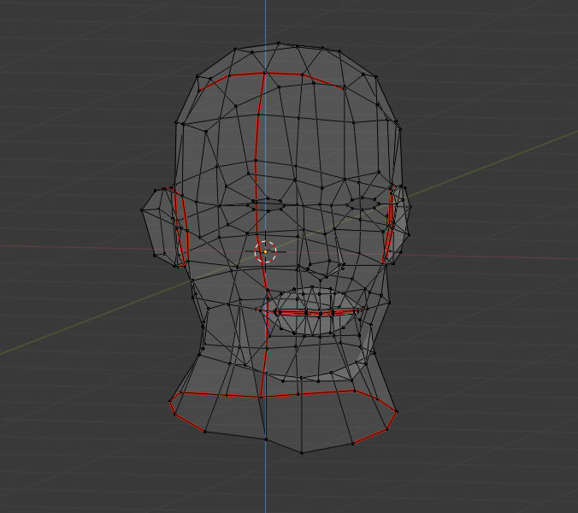
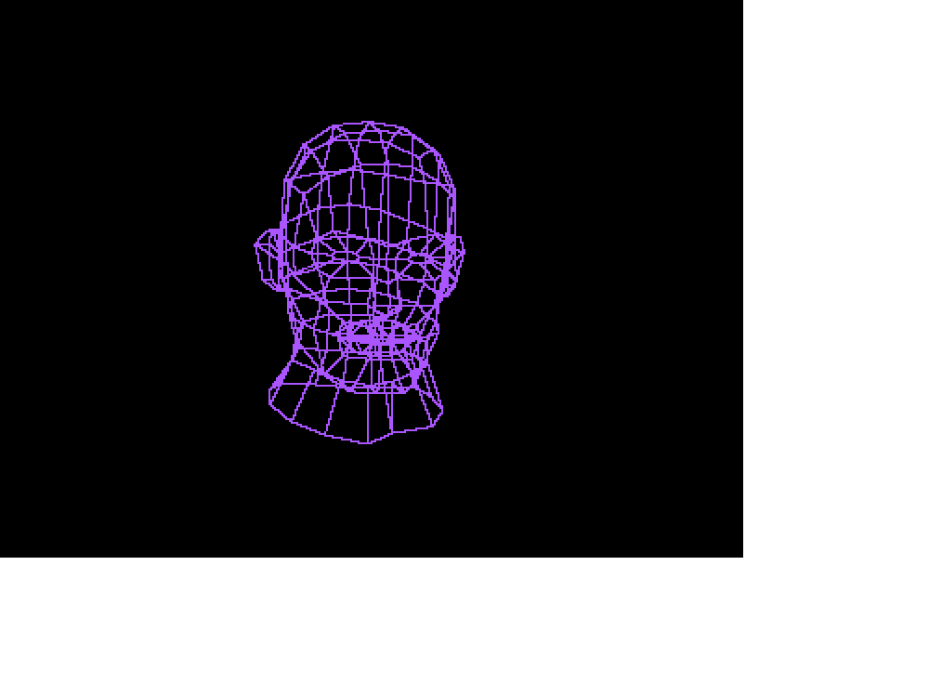
More Renders

Slide 9
Quick Demos
Demo 1: How to compile and run Bemo
Demo 2: VGA Screen

