Slide 1


The A Team:
David Evans
Adam Driscoll
Josh Bennett
Joe Phaneuf
Henry Chen
GROUNDSBOT
The golf course mowing robot
Sponsor:
Notes:
Joe

Slide 2
Test Objectives
Demonstrate user interface
Demonstrate mowing coverage %
Demonstrate coverage rate
Demonstrate handling on slopes
Demonstrate ability to avoid static obstacles
Demonstrate ability to avoid dynamic obstacles
Notes:
Joe

Slide 3
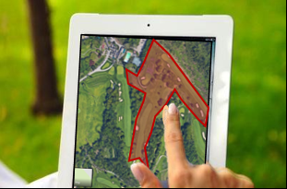
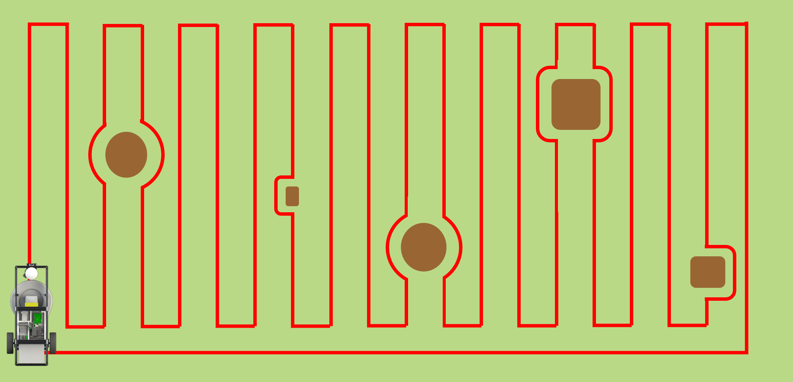
SVE Test 1
Objective: Demonstrate User Interface and Static Obstacle Detection
Notes:
Joe

Slide 4
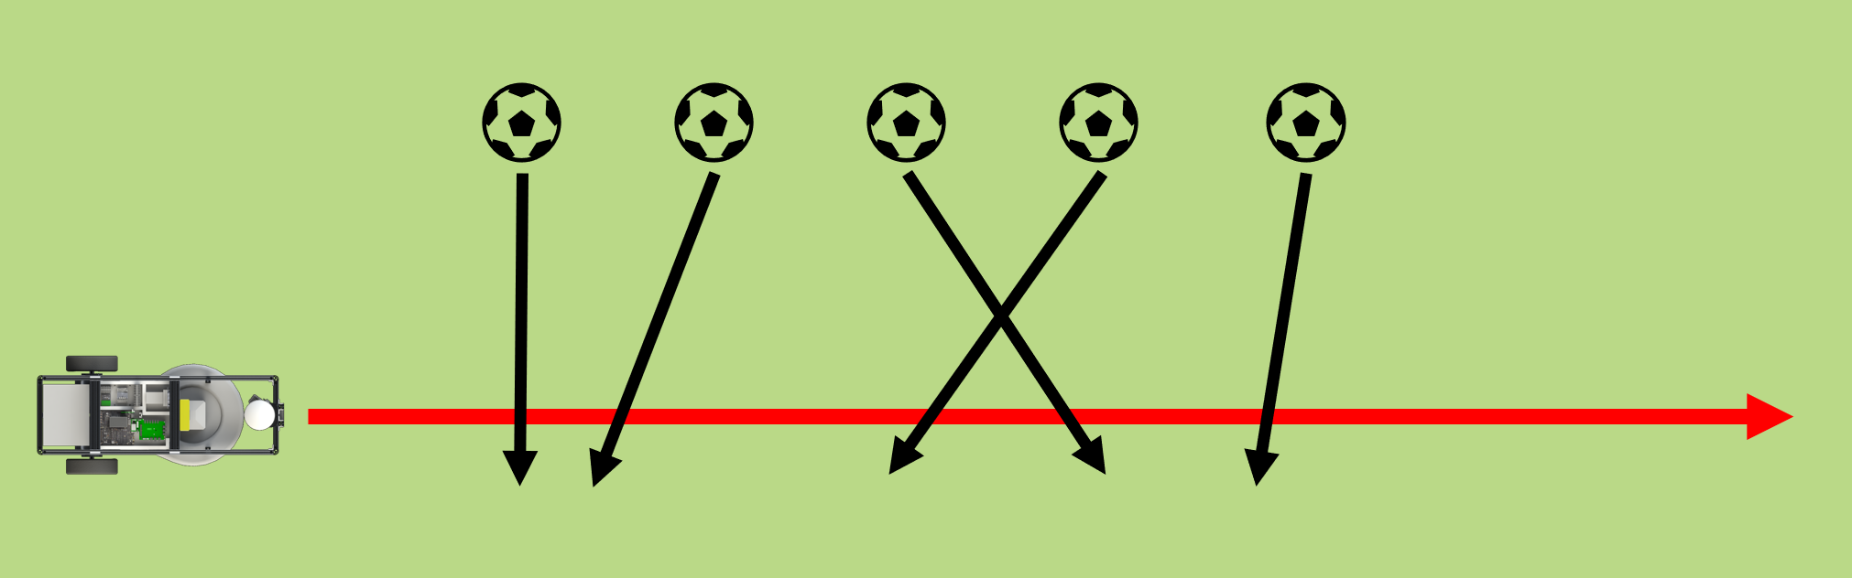
SVE Test 2
Objective: Demonstrate GroundsBot’s dynamic obstacle detection
Notes:
Adam
Key point. GroundsBot should reroute around STATIC obstacles, but will just stop if a dynamic obstacle is detected

Slide 5
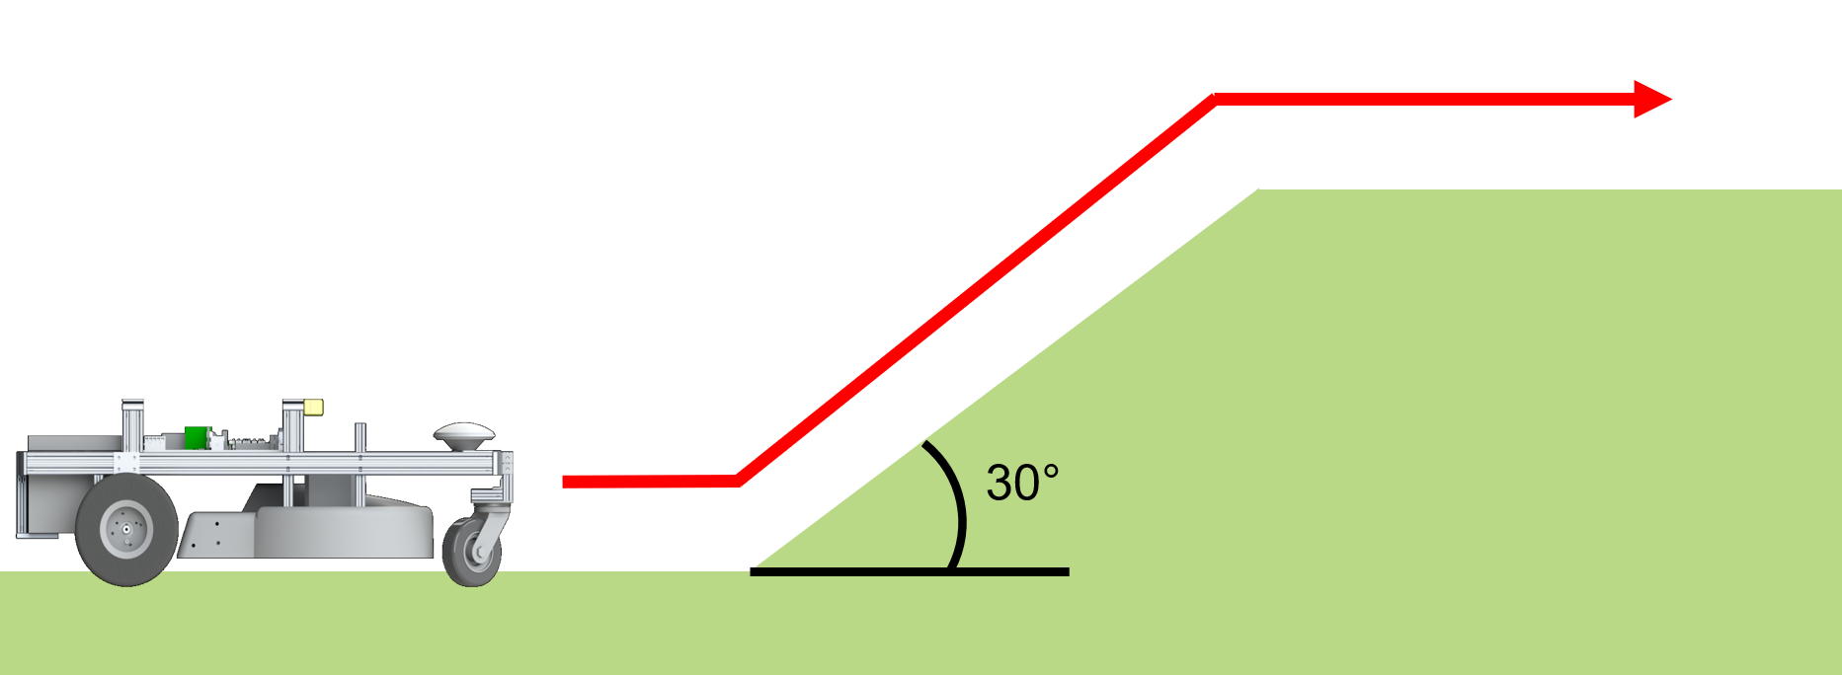
SVE Test 3
Objective: Demonstrate that GroundsBot can operate on sloped regions
Notes:
Josh

Slide 6
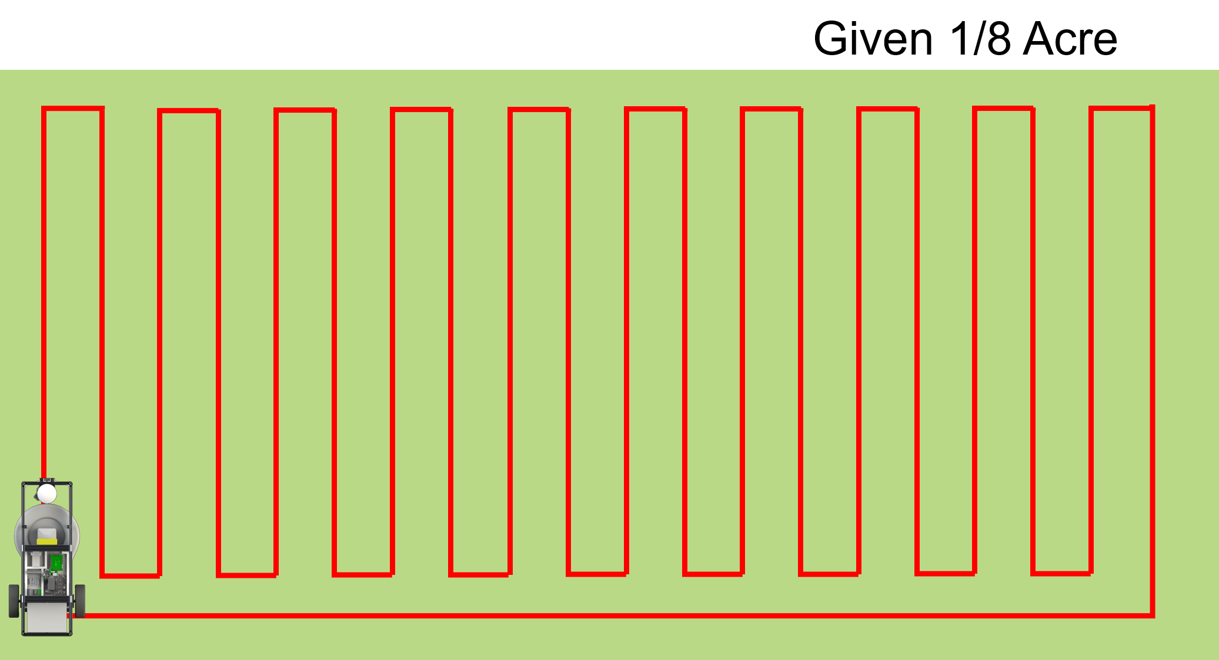
SVE Test 4
Objective: Validate GroundsBot’s mowing coverage and coverage rate
Notes:
Offline
Henry

Slide 7
Questions for the audience?
Coverage rate and coverage percentage split from test 1?
How do we measure coverage?
Split dynamic and static obstacle testing make sense?
Does hill test show GroundsBot can handle hills?

Slide 8
U/I Subsystem
GroundsBot
Software
Architecture
(with logging infrastructure)
Navigation Subsystem
Boundary Input
Polygon Boundary
Display Mowing Plan
Mowing Plan
Global
Planner
Localize Position
Display Mowing Status
Log Map
Perception Subsystem
Pose Estimate
GPS Waypoints
Detect Static Obstacles
Local
Planner
Stereo Camera
Generate
Map
Point Cloud
Local Costmap
Detect Dynamic Obstacles
Velocity Commands
Platform
Notes:
David

Slide 9
Questions for the audience?
Does this logically make sense?
Does anyone have any experience generating costmaps?
Global planner, local planner relationship? Right now the global planner does not update over time, it only provides a set of GPS waypoints at the beginning. Does this make sense?

Slide 10
Requirements:
M.P.1, First time user inputs map within 15 minutes
M.P.2, System returns proposed route/coverage map within 5 minutes
M.P.3, Cover 1/4 acre per hour on flat, unobstructed terrain
M.P.4, Cut 95% of the grass on flat, unobstructed terrain
M.P.5, Navigate 30 degree sloped grass
M.P.6 , Detect 80% of static objects greater than 3 inches in height and 2 inches in width
M.P.7 , Detect 80% of dynamic objects greater than 6 inches in height and 6 inches in width travelling less than 4 mph
M.P.8 , Mow to within 1 foot of detected obstacles
M.P.9 , Return home to within 5 feet of starting position

Slide 11
SVE Test 1: Procedure
1. Obstacle Officer places new obstacles until test site contains a total of 5 obstacles 2. Obstacle Officer places Yellow cone as home position marker 3. GroundsBot Technician holds GroundsBot safety tether and follows GroundsBot for duration of test 4. GroundsBot Technician powers on GroundsBot. 5. Technical Sales Rep opens UI on laptop and establishes a connection with GroundsBot 6. Technical Sales Rep briefs New User on app functionality 7. New User uses UI on laptop to define boundaries of area to be mowed through the UI 8. New User uses UI on laptop to submit the mowing area to GroundsBot 9. GroundsBot develops a coverage plan 10. GroundsBot mows the area 11. GroundsBot returns to its starting position 12. New user receives coverage report on laptop UI 13. Obstacle Officer measures and records distances from mowed grass to obstacles 14. Obstacle Officer measures and records distance from GroundsBot to home position

Slide 12
SVE Test 1: Validation Criteria
Verification Criteria
M.P.1, First time user inputs map within 15 minutes
M.P.2, System returns proposed route/coverage map within 5 minutes
M.P.6 , Detect 80% of static objects greater than 3 inches in height and 2 inches in width
M.P.8 , Mow to within 1 foot of detected obstacles
M.P.9 , Return home to within 5 feet of starting position
D.P.1 , Mow to within 3 inches of a detected obstacles
D.P.2 , Visually report mowing coverage and obstacles encountered
M.N.2 , Be clearly visible , GroundsBot should indicate its presence and status to everyone nearby

Slide 13
SVE Test 2
Objective: Validate GroundsBot’s dynamic obstacle detection
Procedure
Power on GroundsBot
Open UI and establish connection with GroundsBot
Team member creates a straight line path for GroundsBot to follow using the UI
Team member enables GroundsBot and GroundsBot starts moving along path
Rest of team lines up along path GroundsBot is following
As GroundsBot approaches team member uses calibrated GrudsMeter® to roll a soccer ball in front of GroundsBot as per requirements
When soccer ball enters line of sight Groundsbot will stop
When soccer ball leaves line of sight Groundsbot will continue along its original path
Repeat steps 6-8 four more times.

Slide 14
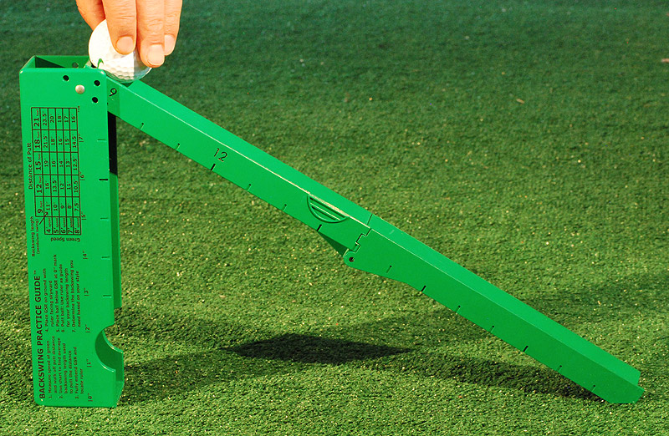
SVE Test 2
Verification Criteria
M.P.7 - Detect 80% of dynamic objects greater tha6 inches in height and 6 inches in width travelling less than 4 mph
GroundsBot detects a moving obstacle
GroundsBot stops moving until the obstacle has left line of sight. Groundsbot will come to a full stop for ⅘ dynamic obstacles.
Once obstacle has left line of sight, GroundsBot continues moving along original path

Slide 15
SVE Test 3
Procedure
Surveyor measures test site and marks region containing 30 degree slope with cones
Cinematographer begins recording
Operator navigates GroundsBot straight up 30 degree slope
Cinematographer ends recording

Slide 16
SVE Test 3
Verification Criteria
M.P.5, Navigate 30 degree sloped grass

Slide 17
SVE Test 4
Procedure
Cinematographer 1 initializes static camera position and begins recording
Cinematographer 2 begins recording and follows GroundsBot
Operator navigates GroundsBot to home position using RC transmitter
Operator launches mission and Time Cop starts stopwatch
GroundsBot completes mission and returns home and Time Cop stops stopwatch
Surveyor bounds and measures failed coverage with stakes and tape measure
Cinematographers 1 and 2 end recording

Slide 18
SVE Test 4
Verification Criteria
M.P.3: Cover 1/8 acre per 30 minutes on flat, unobstructed terrain
M.P.4: Cut 95% of the grass on flat, unobstructed terrain
M.N.3: Do not tear up grass

Slide 19
U/I Subsystem
GroundsBot
Software
Architecture
Navigation Subsystem
Boundary Input
Polygon Boundary
Display Mowing Plan
Mowing Plan
Global
Planner
Localize Position
Perception Subsystem
Detect Static Obstacles
GPS Waypoints
Pose Estimate
Stereo Camera
Generate
Map
Local
Planner
Point Cloud
Local Costmap
Detect Dynamic Obstacles
Velocity Commands
Platform

