Slide 1



Autonomous Volcanic Terrain Exploration
Using a Markov Decision Process (MDP)
CSE440.01
GROUP 05
MEMBERS
Shakil Ahmed -2221452042
Fahim Foysal - 2233594642
Shefa Tabassum- 2232993042
Tanvir Ahmed-2231047642

Slide 2
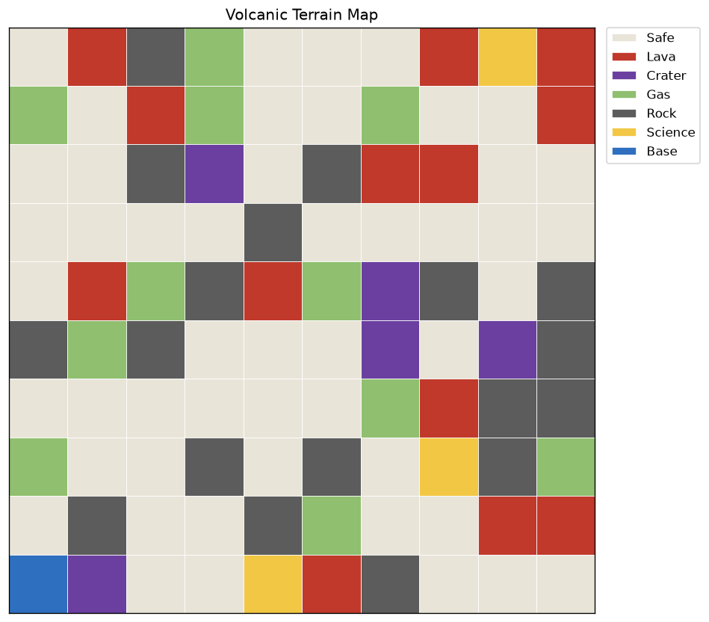
The Problem
Volcanic terrain is too dangerous for humans to explore directly
The rover must collect science samples and survive the mission
Lava is fatal; craters and gas are costly; rock blocks movement
Movement is unreliable; the rover can slip sideways or stall
The terrain itself changes while the mission is running

Slide 3
What Is an MDP?
A Markov Decision Process models decision-making under uncertainty
An agent picks actions to maximize long-term reward, not just the next step
The next state depends only on the current state and action taken
Here: states = grid cells, actions = moves, rewards = safety + science
Agent observes the STATE
↓
Policy chooses an ACTION
↓
Environment returns REWARD + next STATE
↓
Repeat until the mission ends

Slide 4
The MDP Formulation
States: every walkable grid cell (rock excluded)
Actions: up / down / left / right / stay / scan
Transitions: 75% intended, 10% drift each side, 5% stall
Rewards: science +20, base +5, safe −1, gas −15, crater −40, lava −100
Solved exactly with value iteration
V(s) = max_a Σ P(s'|s,a) [R(s,a,s') + γV(s')]
The Bellman backup, repeated until convergence

Slide 5
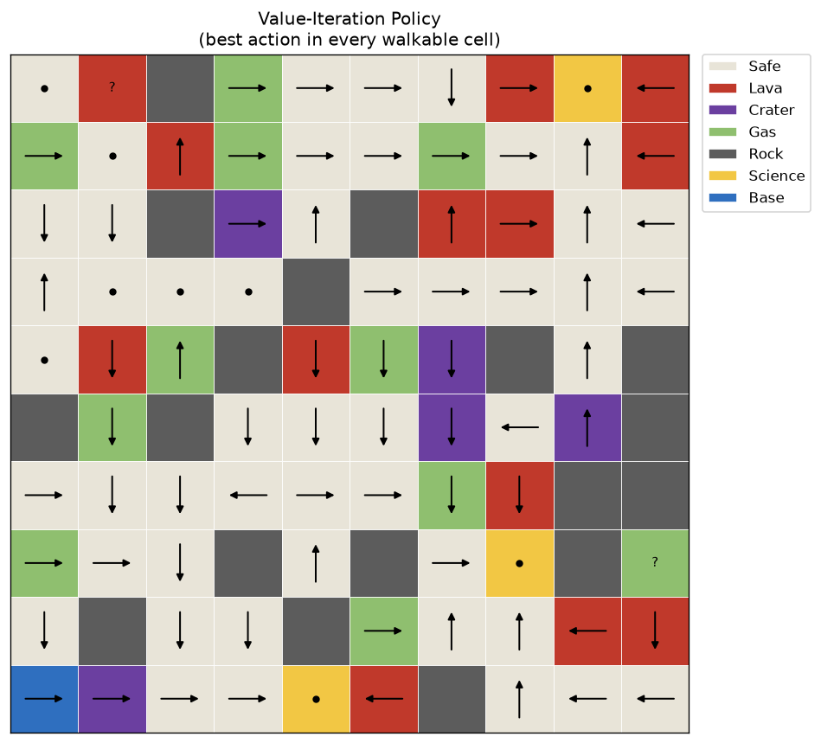
The Computed Policy
One optimal action per cell: a complete plan, not one path
The flow bends around lava and craters, converging on science and base
Robust by construction, even if a slip lands on a cell that already has a plan

Slide 6
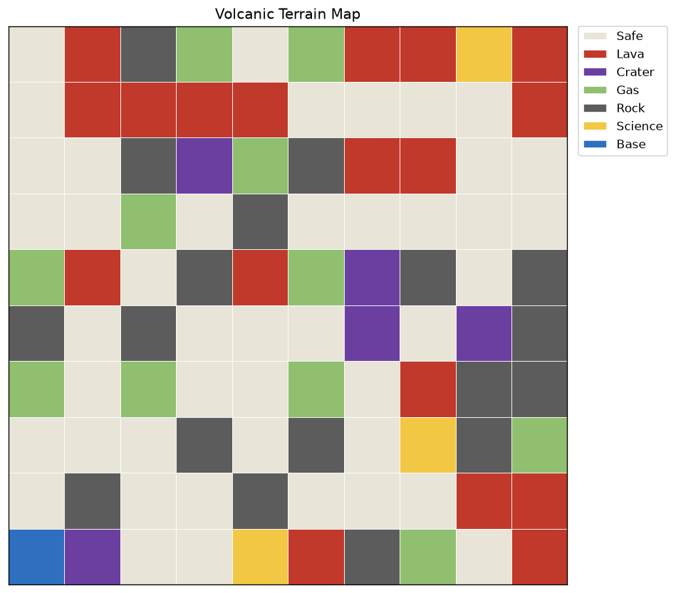
Adaptive Behavior: Re-Planning & Hazards
Collect-once rule: a sample is gathered once, then the cell resets to safe ground
The agent instantly re-runs value iteration after every collection
Gas drifts (15% per step) and lava spreads (8% per step) into safe neighbors
Any terrain change triggers a fresh re-plan; a lava flow reaching the rover ends the mission

Slide 7
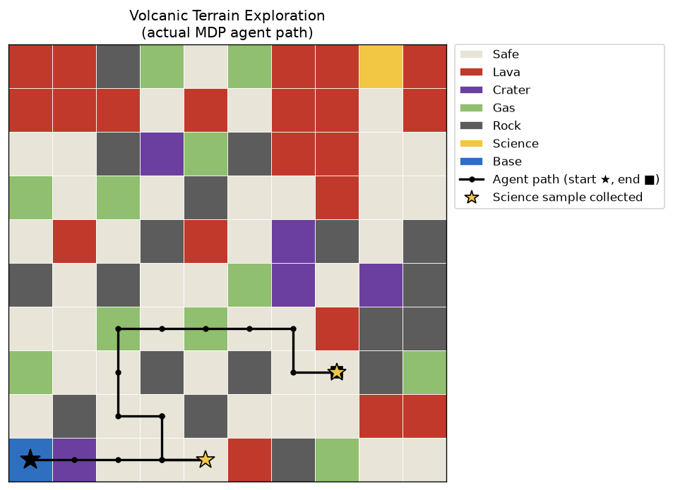
A Completed Mission
Seed 42, dynamic hazards ON
24
Steps Taken
2
Science Samples Collected
71
Hazard Events Survived

Slide 8
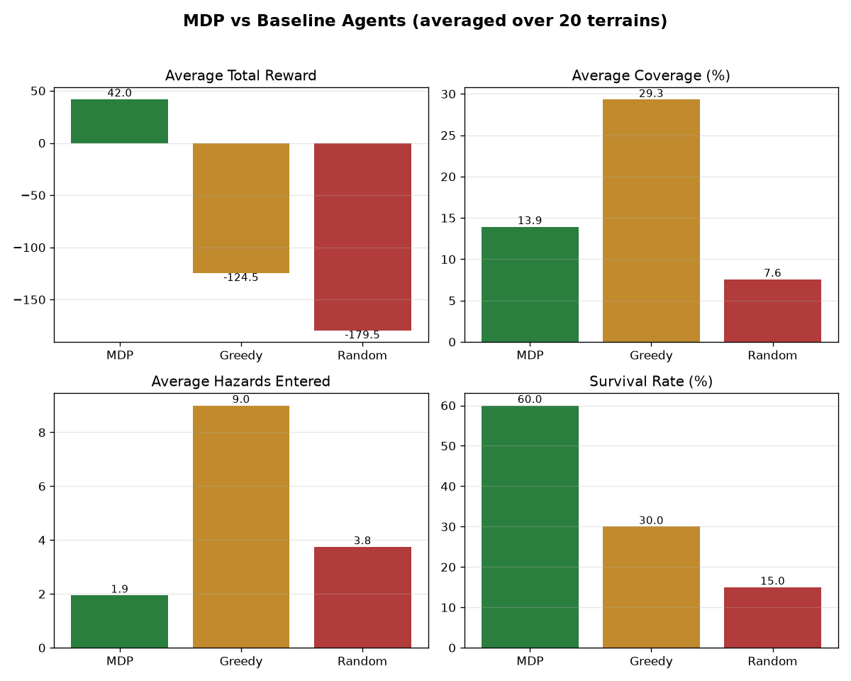
Planning Beats Heuristics
20 random terrains, three agents: MDP, Greedy, Random
Only the MDP agent earns a positive reward: +42 vs −124 vs −180
MDP survives 60% of missions, double the greedy baseline
Roughly 5× fewer hazard entries than either baseline

Slide 9
Conclusions & Future Work
Decision-theoretic planning decisively beats simple heuristics
Safety and science behavior emerge from the reward model alone
Future: risk-sensitive objectives, energy budgets, multi-rover teams
Everything is seeded and reproducible: python main.py
“The reward model is the specification.”

Slide 10
Thank You!

