Slide 1
Autonomous Volcanic Terrain Exploration
Using a Markov Decision Process (MDP)
Project Update 1
We are Group 5:
Shakil Ahmed · Fahim Foysal · Shefa Tabassum · Tanvir Ahmed
CSE 440 (Artificial Intelligence) · Section 1 · Instructor: Dr. Mohammad Shifat-E-Rabbi
Group 5 | Shakil Ahmed · Fahim Foysal · Shefa Tabassum · Tanvir Ahmed

Slide 2
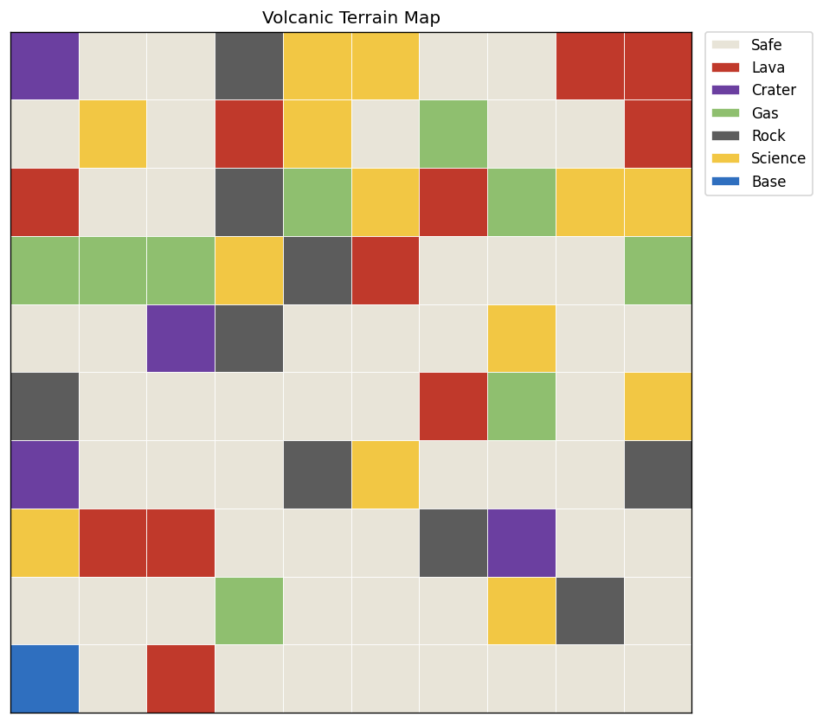
Problem & goal
• An autonomous rover exploring hazardous volcanic terrain
• Grid world: safe ground, lava, craters, gas, rock, science points, base
• Movement is stochastic: the rover can slip or stall
• Goal: collect science, avoid hazards, and survive, planned with an MDP
Group 5 | Shakil Ahmed · Fahim Foysal · Shefa Tabassum · Tanvir Ahmed

Slide 3
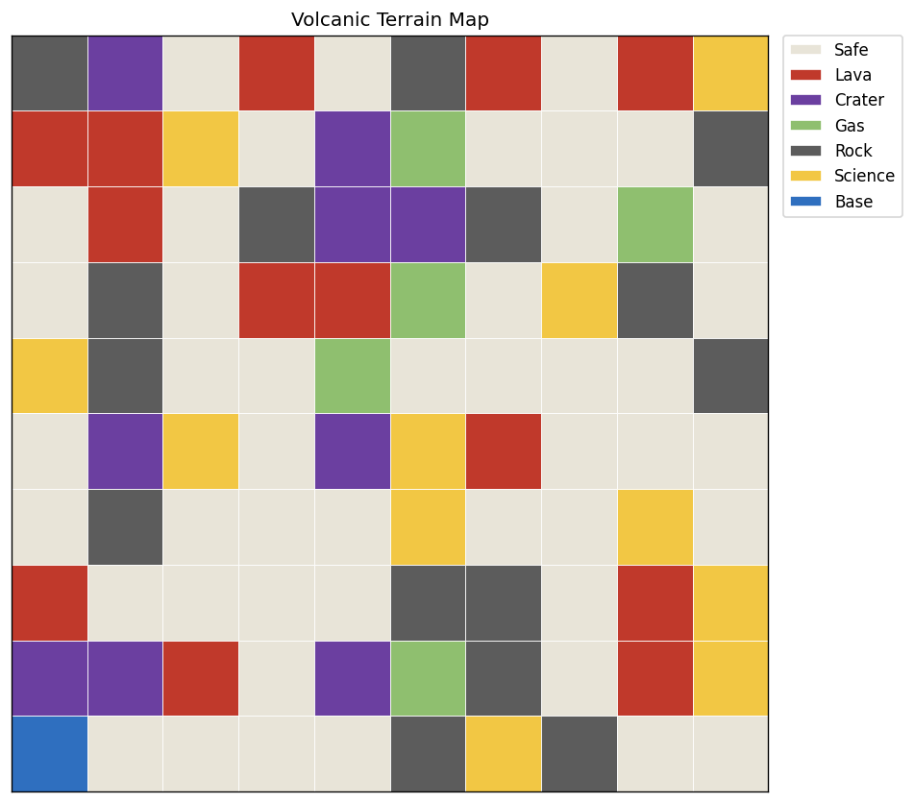
Done: terrain generator & MDP core (Member 1)
• Seeded procedural terrain with configurable cell probabilities
• Hazard density capped so maps stay traversable; CSV save/load
• MDP formulation: states, 6 actions, slip transitions, reward model
• Value iteration + optimal policy extraction, γ = 0.9
Group 5 | Shakil Ahmed · Fahim Foysal · Shefa Tabassum · Tanvir Ahmed

Slide 4
Done: agent, simulation & visualization (Members 2 & 3)
• MDPExplorerAgent: starts at base, follows the policy, samples real outcomes
• Tracks reward, hazards, science, survival; mission summary
• Simulation loop with step budget and coverage target
• Matplotlib terrain rendering with legend, one color per cell type
Group 5 | Shakil Ahmed · Fahim Foysal · Shefa Tabassum · Tanvir Ahmed

Slide 5
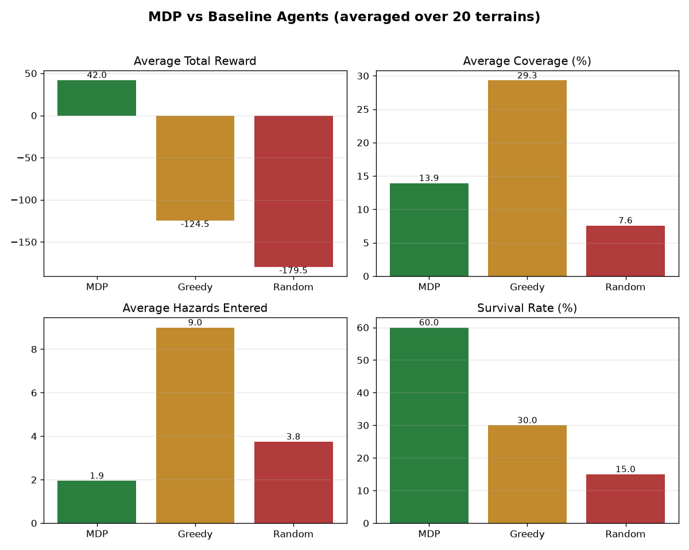
Done: baseline experiments (Member 4)
• Three agents compared on identical terrains: MDP vs Greedy vs Random
• Shared metrics: reward, coverage, hazards, science, survival
• CSV results + performance plot generated automatically
Group 5 | Shakil Ahmed · Fahim Foysal · Shefa Tabassum · Tanvir Ahmed

Slide 6
Plan to the final submission
• Dynamic hazards: drifting gas and spreading lava, with re-planning
• Fix the science-camping behavior (collect-once rule in the core agent)
• Mission map with the real agent path instead of a sample path
• Full pipeline in main.py; final report, slides, one-minute demo video
Group 5 | Shakil Ahmed · Fahim Foysal · Shefa Tabassum · Tanvir Ahmed

