Slide 1
AGRICULTURAL ADVISORY SYSTEM FOR BANGLADESH
KrishokChat
THE SITUATION
A farmer finds dark spots spreading on his brinjal leaves a week before harvest. He needs to know what it is, what to spray, how much, and whether it is safe.
His options today are a dealer who profits from the sale, a Facebook group where strangers guess, or a general chatbot that never learned Bangladeshi crops or official guidance.
For a smallholder, a confidently wrong answer is a lost crop or an unsafe chemical sprayed on food and water.
A Bengali-first crop advisory that answers from Bangladeshi government sources, verifies every chemical dose before it reaches a farmer, and runs on the phone already in his pocket.
Working prototype
Tested baseline
Offline capable
About 16 million farm households make these decisions with no expert in reach.
Application track supporting presentation

Slide 2
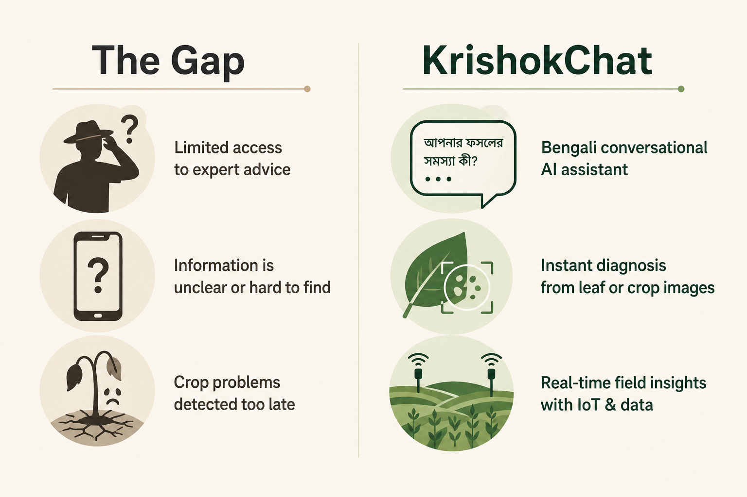
THE GAP, AND WHAT IS NEW
Not a chat wrapper, an advisory that can be checked
WHAT MAKES IT ORIGINAL
Answers are composed, not improvised
Common high risk questions such as a registered dose resolve from a structured, source cited knowledge base. The same question returns the same cited answer every time.
Dialect and intent are handled first
Farmers write in dialect and Banglish. The system reads intent, turns it into a structured request, and answers what was actually asked.
The language model has bounded authority
It phrases and disambiguates. It is not trusted to invent a dose, and it is bypassed entirely when a cited table can answer.
Advice arrives in Bengali or Banglish, by text, voice, or a photo of the leaf.
KrishokChat Innovation Fair Bangladesh
2 / 5

Slide 3
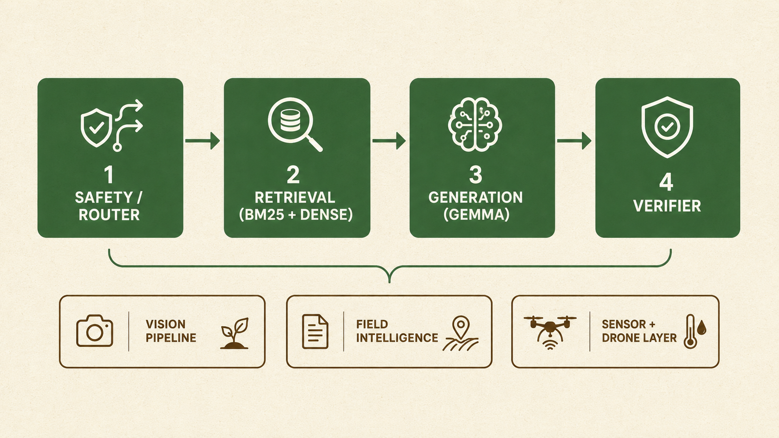
TECHNICAL CAPABILITY AND MATURITY
The system runs today, end to end
WHAT ALREADY WORKS
Photo to grounded guidance
A crop photo is recognised, routed to a crop specific disease model, then matched to treatment guidance from government manuals in one screen.
Retrieval over curated sources
BM25 over 2,135 source traced knowledge nodes, with hybrid dense retrieval available, so every answer traces to a real passage.
Served locally, not rented
A quantised Gemma model runs through llama.cpp, so the core assistant does not depend on a paid frontier API to function.
Beyond the chat surface
Soil and irrigation image analysis, sensor based insect prediction, and a drone field view feed the same assistant.
410 / 0
50 / 50
2,135
20,112
6
automated tests passing and failing
fixed scenarios reproduced exactly
source traced knowledge nodes
safety records across 12 risk categories
Bengali dialects on a 110 word map
KrishokChat Innovation Fair Bangladesh
3 / 5

Slide 4
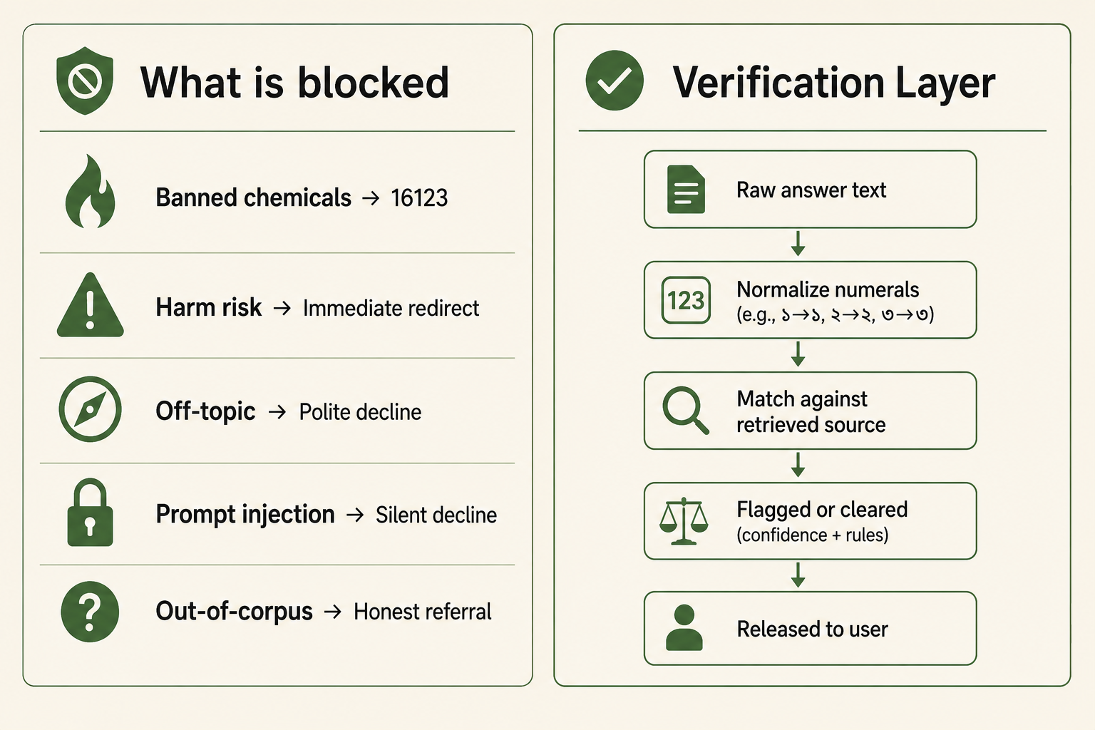
ETHICS AND SAFETY
Refusing well is a feature, not a limitation
WHY IT IS SAFE TO DEPLOY
Safety runs before retrieval
Unsafe and banned chemical requests are caught against a Bangladesh specific registry before any answer is formed.
Every dose is checked against its source
Numeric claims are normalised across Bengali and English numerals, then verified against the retrieved passage before release.
Honest refusal with a real destination
Outside coverage, the system says so and redirects to the national Krishi Call Center on 16123 rather than guessing.
Auditable by design
Every request, classification, and verification result is written to a local audit record, so safety behaviour is measured rather than assumed.
Safer chemical use protects the farmer applying it, the family eating the crop, and the water downstream.
KrishokChat Innovation Fair Bangladesh
4 / 5

Slide 5
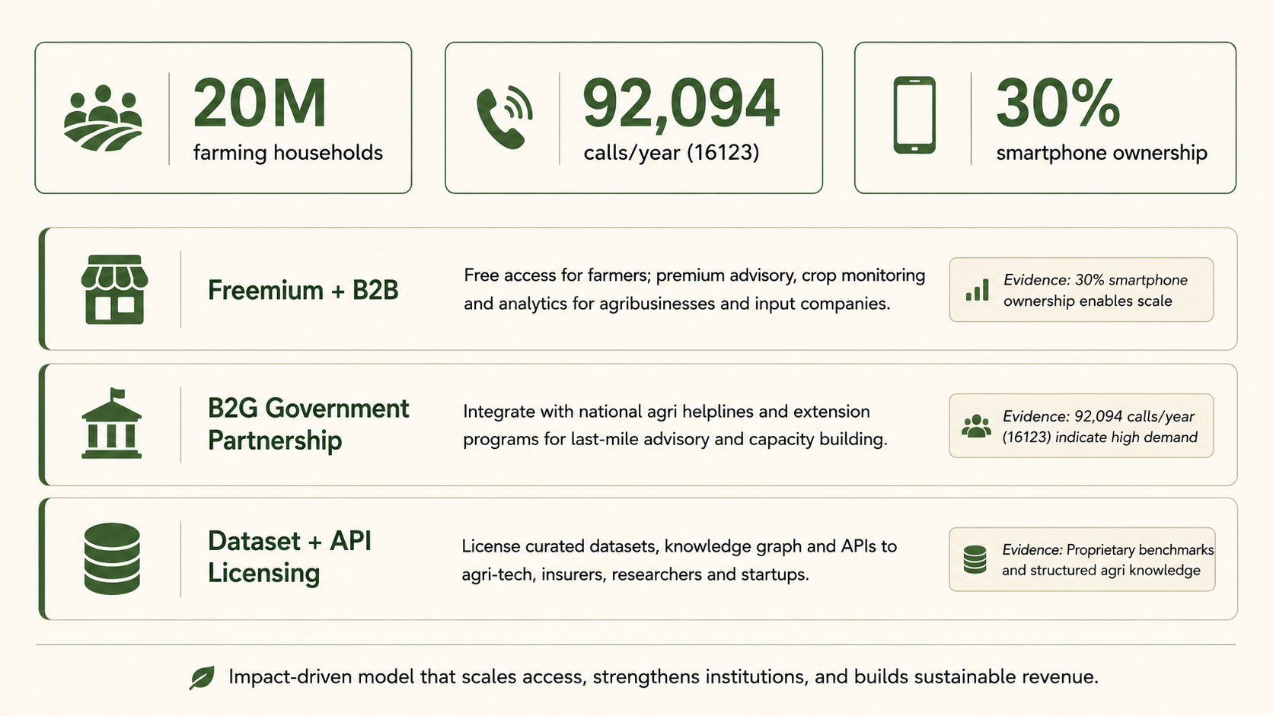
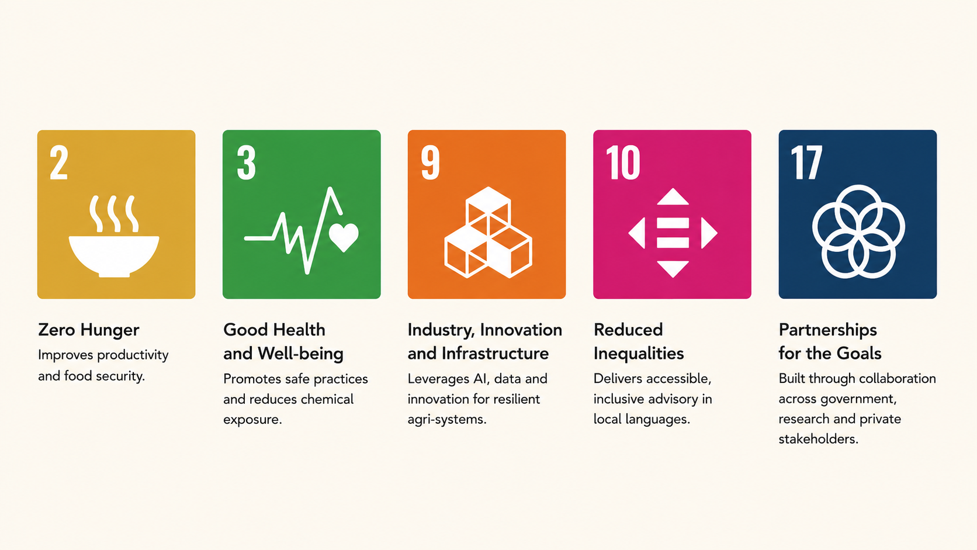
MARKET, INCLUSION AND DEVELOPMENT GOALS
A route to scale that does not price out the farmer
DEMAND, INCLUSION AND LEADERSHIP
Demand is already visible
The national helpline absorbs about 92,094 calls a year, which is farmers actively seeking advice they cannot otherwise reach.
Inclusion is built into the interface
Voice and Banglish input serve farmers with limited literacy, women managing homestead plots, and young farmers entering the sector, all without a paywall.
Led with research and discipline
Three research papers document the dataset, the safety critical advisory design, and the provenance traceable retrieval architecture, with the engineering held to a fixed regression baseline.
KrishokChat Innovation Fair Bangladesh
5 / 5

