Slide 1
AGRICULTURAL ADVISORY SYSTEM FOR BANGLADESH
KrishokChat
THE SITUATION
A farmer finds dark spots spreading on his brinjal leaves a week before harvest. He needs to know what it is, what to spray, how much, and whether it is safe.
His options today are a dealer who profits from the sale, a Facebook group where strangers guess, or a general chatbot that never learned Bangladeshi crops or official guidance.
For a smallholder, a confidently wrong answer is a lost harvest or an unsafe chemical sprayed on food and water.
A Bengali-first crop advisory that answers from Bangladeshi government sources, verifies every chemical dose before a farmer sees it, and runs on the phone already in his pocket.
Working system, tested baseline
Grounded in official sources
Built for low connectivity
About 16 million farm households make these decisions with no expert in reach.
Research foundation: arxiv.org/abs/2606.29243 and arxiv.org/abs/2608.14886

Slide 2
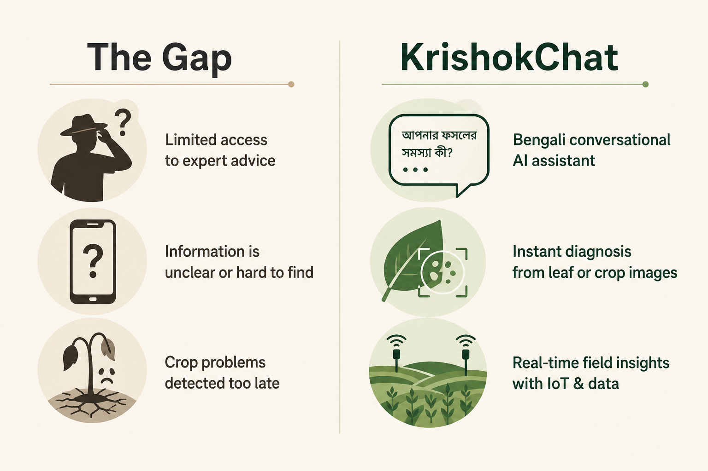
THE PROBLEM
Farmers do not lack questions, they lack a trustworthy answer
WHAT WE BUILT IT AROUND
KrishokChat began from field conversations and the questions farmers actually ask: what disease is this, what treatment fits, how much to apply, whether a chemical is even allowed in Bangladesh, and why a crop is failing to grow.
Asked the way farmers speak
Bengali or Banglish, by text, voice, or a photo of the leaf, with dialect handled rather than corrected.
Answered from named sources
Guidance is tied to Bangladeshi institutional documents, so the farmer is reading official practice rather than a model's general memory.
Refused honestly when it should be
Outside its coverage the system says so and points to the national Krishi Call Center on 16123.
Where advice breaks down today, and what replaces it.
KrishokChat Innovation Fair Bangladesh
2 / 9

Slide 3
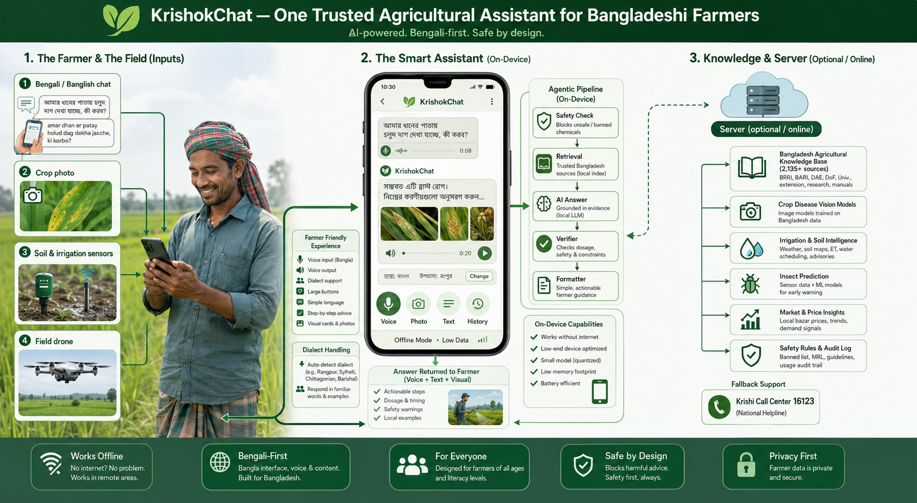
THE SYSTEM AT A GLANCE
One assistant, many inputs, the server optional
A farmer's chat, a crop photo, soil and irrigation sensors, and a field drone all feed the same on-device assistant.
Four steps, every time
1 Safety
banned and unsafe requests stop here
2 Retrieval
BM25 over curated official sources
3 Answer
composed from retrieved evidence
4 Verifier
each dose checked against its source
The heavy language model is one step of four. Knowledge, safety rules, and vision models stay separate from it, which is what makes an on-device path realistic.
KrishokChat Innovation Fair Bangladesh
3 / 9

Slide 4
ORIGINALITY AND RESEARCH FOUNDATION
The contribution is the architecture, not the model choice
WHAT IS GENUINELY NEW
PUBLISHED FOUNDATION
Answers are composed, not improvised
High risk questions such as a registered dose resolve from a structured, source cited knowledge base. The same question returns the same cited answer every time, which a generative model cannot promise.
The benchmark and safety critical advisory dataset behind the assistant: arxiv.org/abs/2606.29243
The provenance traceable retrieval architecture the answers are grounded in: arxiv.org/abs/2608.14886
A third paper covers the system and its evaluation, with further work in progress.
The language model has bounded authority
It phrases and disambiguates. It is never trusted to invent a dose, and it is bypassed entirely when a cited table can already answer.
Provenance is structural
Citations are attached by construction rather than requested from the model, so a fabricated reference is not a failure mode that can occur.
WHY THIS IS NOT AN API WRAPPER
A quantised Gemma model is served locally through llama.cpp, the retrieval index and dose references are built offline into versioned artifacts, and the safety registry is domain specific to Bangladesh. Nothing critical to a farmer's answer depends on a rented frontier API.
Dialect and intent are first class
A farmer's vague, dialect heavy question is classified into intent and converted into a structured request before anything is retrieved.
KrishokChat Innovation Fair Bangladesh
4 / 9

Slide 5
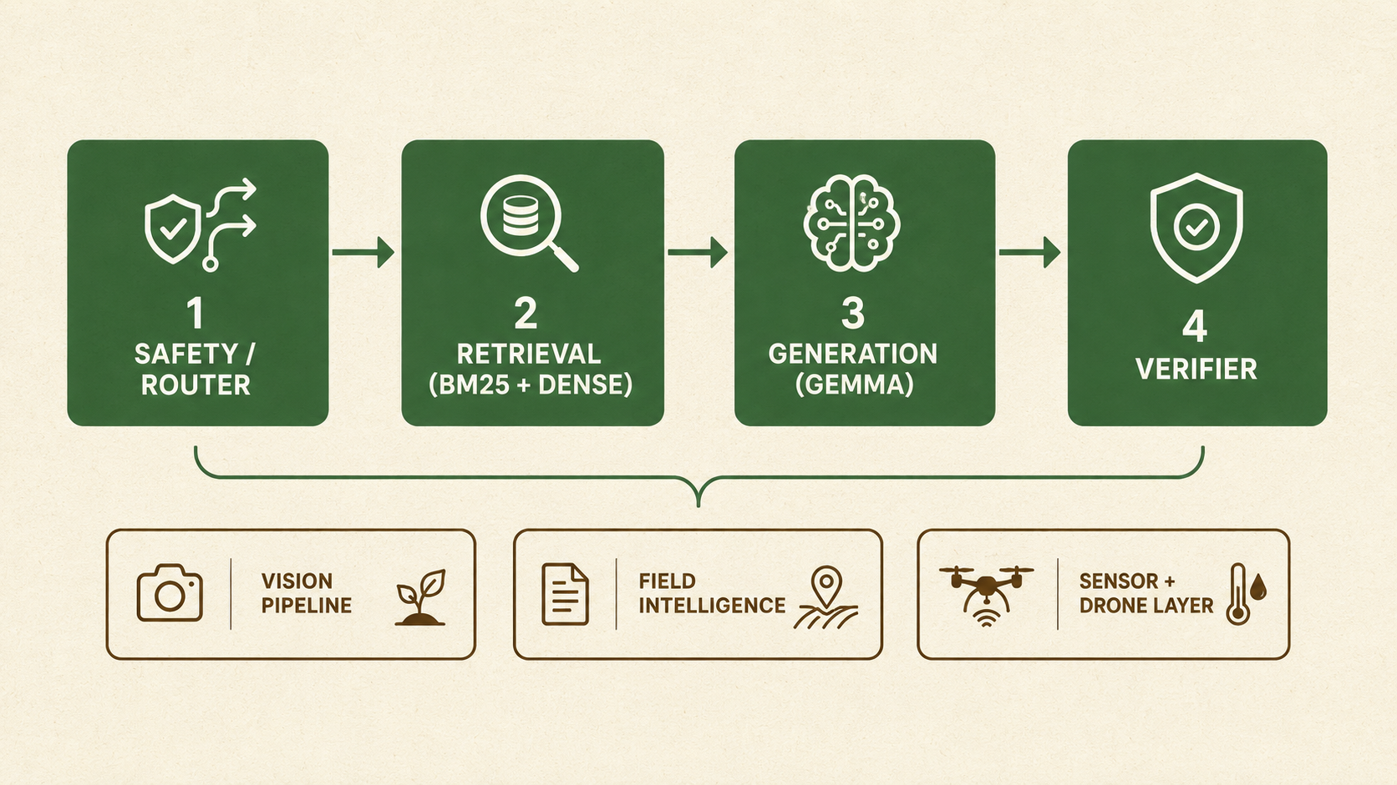
TECHNICAL CAPABILITY AND MATURITY
A working prototype, running end to end today
WHAT ALREADY WORKS
Photo to grounded guidance
The crop is recognised first, then routed to a crop specific disease model, then matched to treatment guidance from government manuals in one screen.
Retrieval over curated knowledge
BM25 over 2,135 source traced nodes, with hybrid dense retrieval available, so each answer traces to a real passage.
More than a chat surface
Soil and irrigation image analysis, sensor based insect prediction, and a drone field view all report into the same assistant.
Engineered to stay correct
A fixed regression baseline and a replay set guard every change, which is what separates a maintainable pilot from a fragile demo.
The core pipeline, with vision, field intelligence, and the sensor and drone layer feeding the same advisory surface.
410 / 0
50 / 50
2,135
20,112
6
automated tests passing and failing
fixed scenarios reproduced exactly
source traced knowledge nodes
safety records, 12 risk categories
Bengali dialects, 110 word map
KrishokChat Innovation Fair Bangladesh
5 / 9

Slide 6
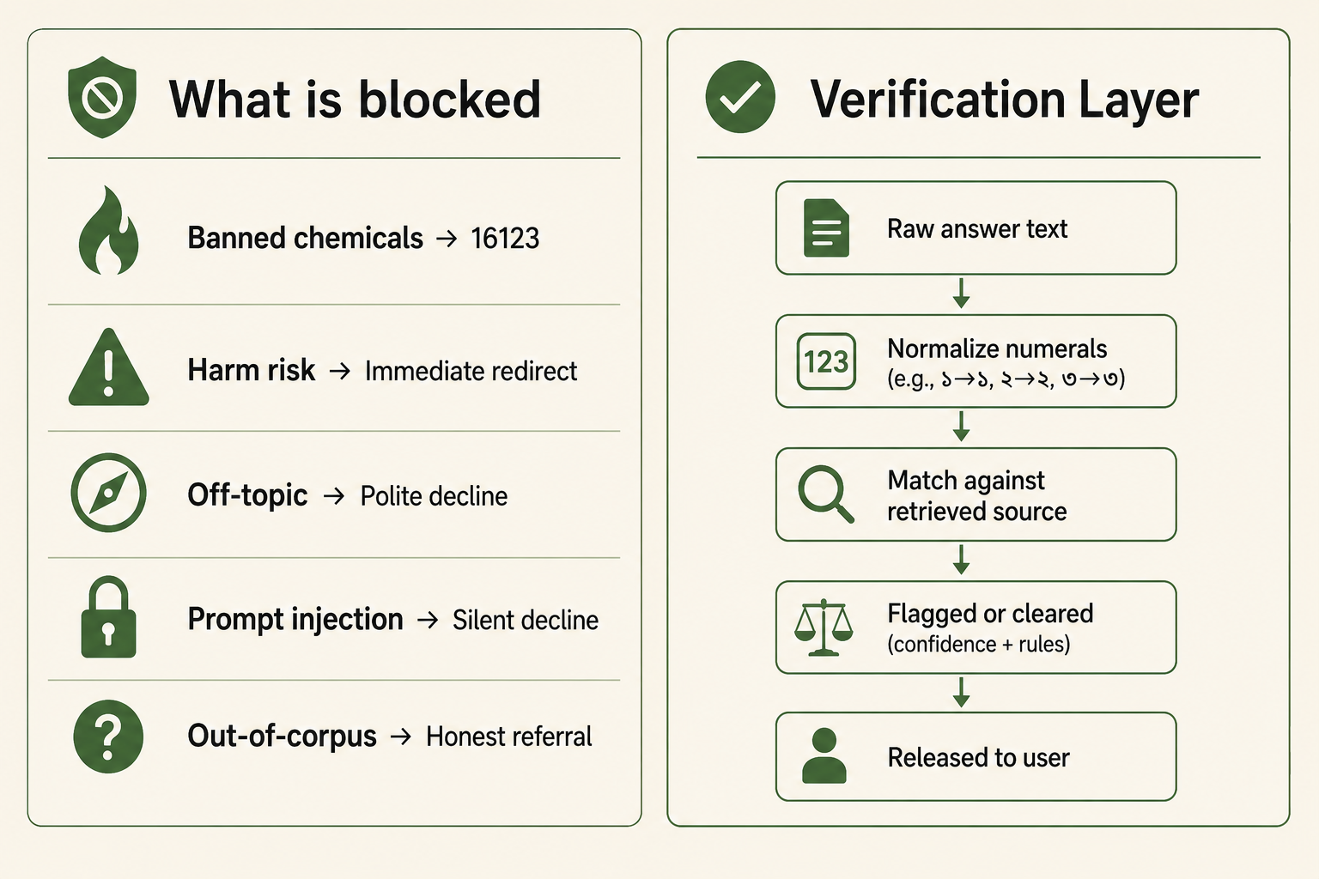
ETHICS AND SAFETY
Refusing well is a feature, not a limitation
WHY IT IS SAFE TO DEPLOY
Safety runs before retrieval
Restricted and banned agrochemical requests are caught against a Bangladesh specific registry before any answer is formed.
Every dose is checked against its source
Numeric claims are normalised across Bengali and English numerals, then matched to the retrieved passage before the farmer sees them.
A calm response to crisis framing
Anything reading as poisoning or self harm risk receives a supportive redirect to 16123 and in person medical help, never a normal answer.
Auditable rather than asserted
Every request, classification, and verification result is written to a local audit record, kept on the device and never sent to a third party.
What is blocked before retrieval, and how a numeric claim is verified before release.
Safer chemical use protects the farmer applying it, the family eating the crop, and the water downstream.
KrishokChat Innovation Fair Bangladesh
6 / 9

Slide 7
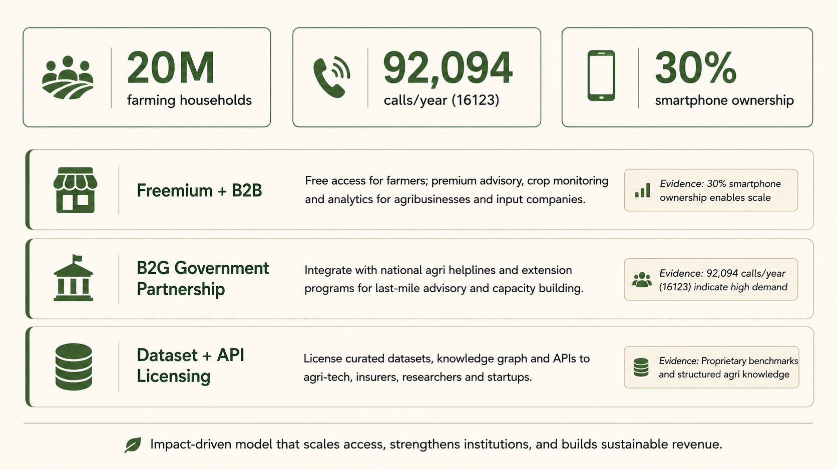
MARKET DEMAND AND COMMERCIALIZATION
A route to revenue that does not price out the farmer
WHY ADOPTION IS FEASIBLE
The demand is already measurable
The national helpline absorbs roughly 92,094 calls a year. Those are farmers actively seeking advice they cannot otherwise reach.
Unit economics allow a free tier
Because common questions resolve from cited tables instead of a paid model call, serving cost per farmer stays low enough for the core advisory to remain free.
Institutions are the paying side
Dealers, cooperatives, input companies, insurers, and extension programs need multi farmer dashboards, branded advisory channels, and licensed data, and each of those is a product rather than a promise.
The audit trail is commercially useful
Any partner who must demonstrate responsible advice can point to a verifiable record, which a general chatbot cannot provide.
Demand indicators and the three revenue paths, each tied to evidence rather than projection.
KrishokChat Innovation Fair Bangladesh
7 / 9

Slide 8
SOCIAL INCLUSION AND LEADERSHIP
Reaching the farmers usually left out
SOCIAL INCLUSION
INNOVATIVE LEADERSHIP
Literacy is not a barrier to entry
The work is led as research and as engineering at once. Three papers document the dataset, the safety critical advisory design, and the provenance traceable retrieval architecture, while the system itself is held to a fixed regression baseline with a documented roadmap executed one reviewed change at a time.
Field conversations with farmers set the requirements, and the refusal behaviour was designed with the national helpline as the escalation path rather than as a competitor.
Voice input and Banglish handling mean a farmer who cannot type formal Bengali still receives the same quality of guidance as anyone else.
Women managing homestead plots
Advice arrives privately on a household phone, without needing a trip to a dealer or a male intermediary to ask on her behalf.
Young and first generation farmers
WHERE WE ARE
Free access and plain language lower the cost of learning good practice, which is exactly where new entrants are most exposed to bad advice.
A working, tested system today, with the fully offline path, wider crop coverage, and weather driven alerting landing before the fair. Not a demonstration looking for a problem, but a working answer to one that farmers face every season.
Low connectivity is designed for
Keeping knowledge and safety rules separate from the heavy model is what lets the critical answers work where the network does not.
KrishokChat Innovation Fair Bangladesh
8 / 9

Slide 9
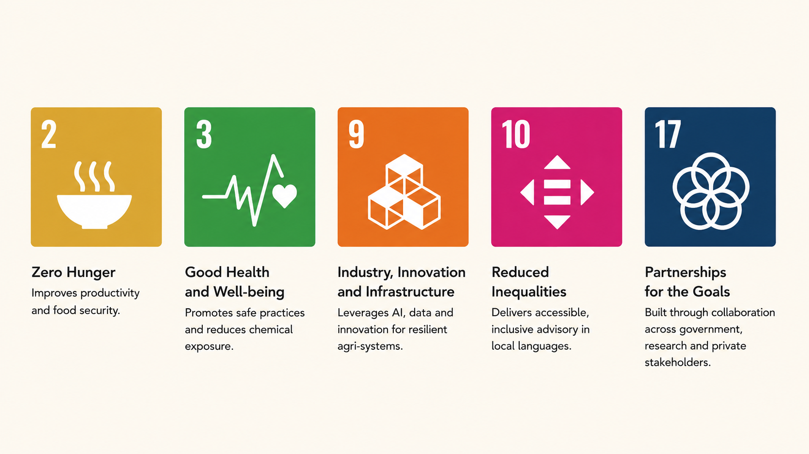
SUSTAINABLE DEVELOPMENT CONTRIBUTION
Five goals the system moves in practice, not in principle
HOW EACH ONE IS ACTUALLY MOVED
Goal 2 and Goal 3
Goal 9 and Goal 10
Goal 17
› Yield protected by catching disease early instead of after a field is lost.
› Chemical exposure reduced by blocking banned actives and verifying every dose before it reaches the farmer.
› Resilient agri infrastructure built on curated national knowledge and a locally served model rather than rented capacity.
› Advisory delivered in Bengali, Banglish, and voice, so access does not depend on literacy or income.
› Designed to escalate into the national Krishi Call Center on 16123 rather than compete with it.
› Dataset, benchmarks, and architecture published openly so government, research, and industry can build on the same base.
Each claim above maps to a mechanism already in the system rather than an intention, which is the difference between contributing to these goals and citing them.
KrishokChat Innovation Fair Bangladesh
9 / 9

