Slide 1
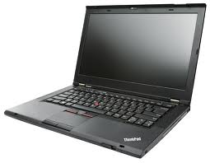
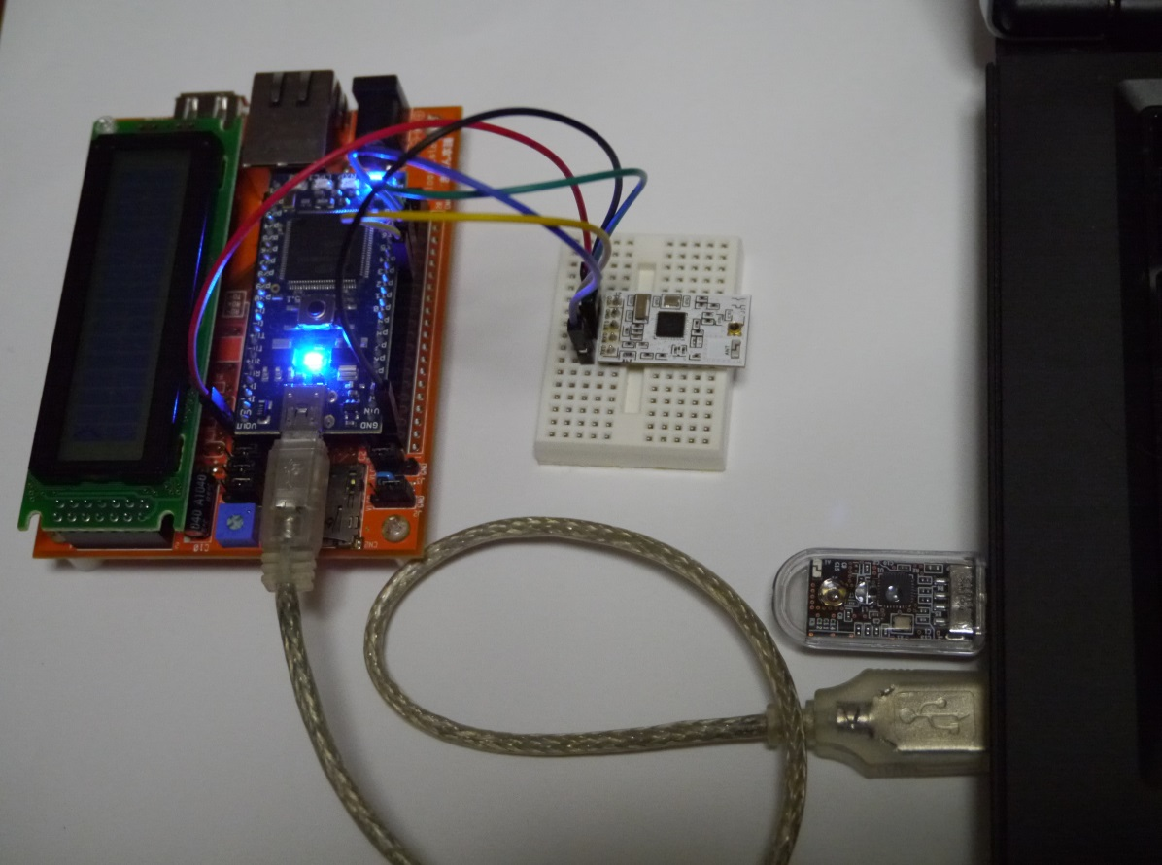
USB
mbed
on ☆ board Orange
キー入力
USB
RecvCB.exe
p14
p13
p15
GND
VOUT
TXD
RXD
RTS
GND
VDD
BC-ANT-USB
受信
BC-ANT-SERIAL2
送信

Slide 2
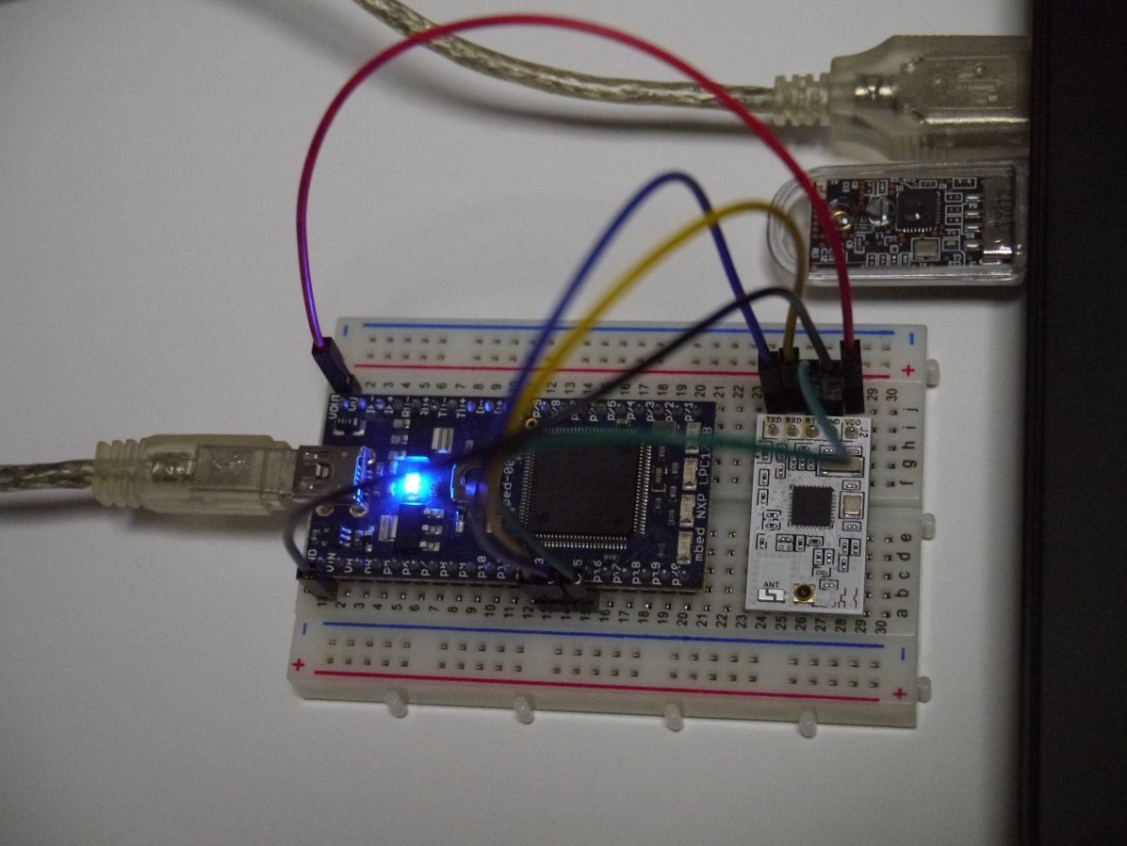
USB
mbed (LPC1768)
受信データ
USB
SendCB.exe
p14
p13
p15
GND
VOUT
TXD
RXD
RTS
GND
VDD
BC-ANT-USB
送信
BC-ANT-SERIAL2
受信

