Slide 1
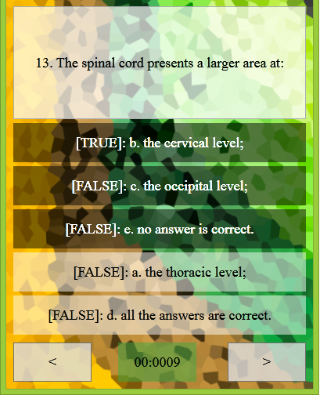
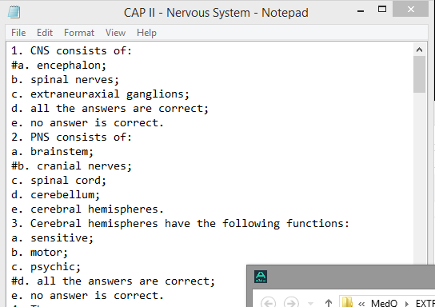

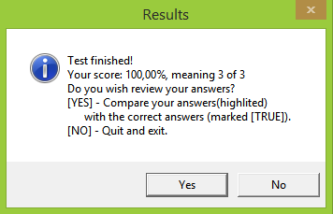



Project A288 by Marcu Tudor
INFOMATRIX 2015
www.github.com/MRTSoft/A288
Easily create a new quiz by loading it form a .txt file
Multiple correct answers with user feedback support
Powered by:
Optional timer, random question selection and answers shuffling

