Slide 1

IE7275 : Data Mining In Engineering
Prof. Aparna Alavilli
Bank Marketing Campaign Prediction
Parth Dhameliya
Mrudula Tanniru

Slide 2
Content
Executive Summary
Background
Scope & Objectives
Project Development Timeline
Development Strategy
Development Details
Results
Next Step
Socialization & Distribution

Slide 3
Executive summary
The project aims to develop a classification model to predict whether customer will subscribe the term deposit.
Here we are using dataset from UCI repository that is Bank Marketing
The data is related with direct marketing campaigns (phone calls) of a Portuguese banking institution.
The model will help banks and other financial institutions to identify potential customers who are most likely to subscribe to their products.

Slide 4
Background
The bank marketing industry refers to the process of promoting and selling financial products and services offered by banks to potential customer.
This project is important because the success of bank’s marketing campaigns can have a significant impact on its revenue and profitability.
By identifying the factors that influence a customer’s decision to subscribe to a term deposit, the bank can target potential customers more effectively and increase the success rate of their marketing campaigns.

Slide 5
Scope & Objective
The project delivers to build a predictive model which can predict whether a customer will subscribe to the new term deposit product on available information.
The model takes information such as demographic data like age, job, education level, and marital status. It also includes information about the customer's financial situation, such as their account balance, credit history, and whether they have a loan with the bank.
Additionally, it includes data on the campaign itself, such as the number of contacts made with each customer, the outcome of the campaign (whether the customer subscribed to the deposit product or not), and the time and date of the contact.

Slide 6
Scope & Objective
To perform exploratory data analysis to identify patterns which can help organization to optimize their marketing campaigns.
There are some limitations such as it cannot predict future market trends or customer behavior.
It cannot provide universal solution or all marketing campaigns.

Slide 7
Project Development Timeline
Project Proposal
19th March
Cleaning Dataset
22th March
Exploratory Data Analysis
24th March
Data Partitioning
26th March
Model Building & Selection
28th March

Slide 8
Development Strategy
As per the aim of the project, we have to predict which customer will subscribe the term deposit.
In this project we have the input features and the targets, targets are ‘yes’ or ‘no’. So, we went for classification models like Logistic Regression, KNN Classifier and Decision Tree Classifier.
The above machine learning models are focused on classification approach.
For validation and data partitioning K-Fold cross validation was used to create an accurate model with minimal overfitting.

Slide 9
Development Details
Data Source : UCI Bank Marketing Dataset
About Dataset : 20 input features and 1 Target “yes” or “no”.
Size : 41188

Slide 10
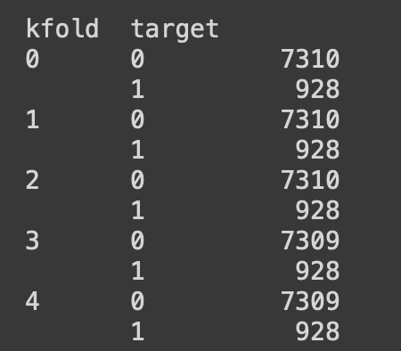
Development Details
For validation and data partitioning K-Fold cross validation was used to create an accurate model with minimal overfitting.
Stratified K-Folds were used which provides equal no. of classes in every fold which can avoid imbalance classes in every fold.

Slide 11
Development Details
Model Training was performed in each fold to train on whole dataset and validation on the same dataset.

Slide 12
Results
Model Selection was based on the avg score CV Score of train and validation which can provide details on overfitting/underfitting.
Below Table showcase the accuracy metric of 5 FOLDS.
FOLDS | LR-TRN | LR-VALID | KNN-TRN | KNN-VALID | DT-TRN | DT-VALID
1 | 0.908134 | 0.909323 | 0.924401 | 0.902768 | 1.0 | 0.885895
2 | 0.909135 | 0.909565 | 0.924127 | 0.902646 | 1.0 | 0.897184
3 | 0.909165 | 0.909565 | 0.925524 | 0.902768 | 1.0 | 0.888444
4 | 0.909866 | 0.904698 | 0.923037 | 0.905184 | 1.0 | 0.891587
5 | 0.908167 | 0.910283 | 0.923007 | 0.906762 | 1.0 | 0.895107

Slide 13
Results
Below Table showcase the AUC-ROC-SCORE metric of 5 FOLDS.
FOLDS | LR-TRN | LR-VALID | KNN-TRN | KNN-VALID | DT-TRN | DT-VALID
1 | 0.676938 | 0.677488 | 0.763601 | 0.708134 | 1.0 | 0.719323
2 | 0.683265 | 0.685152 | 0.767093 | 0.712769 | 1.0 | 0.747793
3 | 0.685164 | 0.683740 | 0.773054 | 0.709074 | 1.0 | 0.728757
4 | 0.686733 | 0.668772 | 0.762950 | 0.707147 | 1.0 | 0.734294
5 | 0.676838 | 0.689794 | 0.763168 | 0.724500 | 1.0 | 0.750389

Slide 14
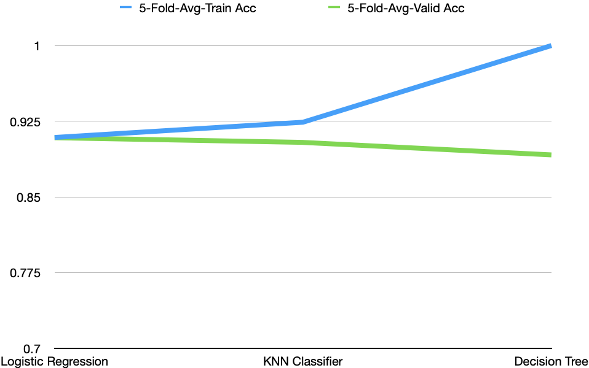
Results

Slide 15
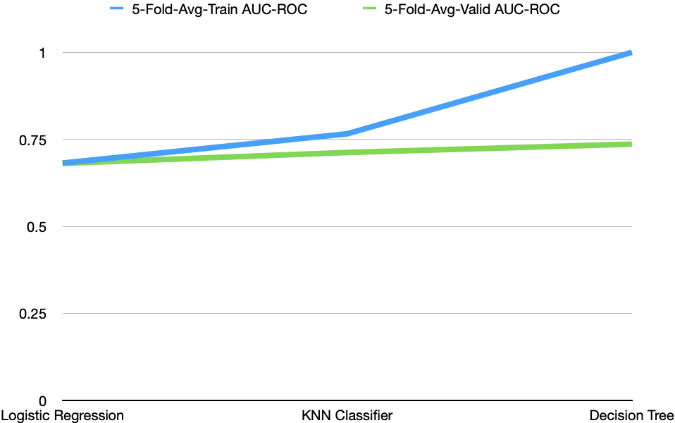
Results

Slide 16
Next Steps
To create more optimized model by using hyperparameter search techniques.
To create graphical user interface for deploying on cloud.
To implement more advance models like neural networks.

Slide 17
Socialization & Distribution
To publish on Github open source community where people can use it for their use purpose.
Providing access to a model or API that allows users to query the data in real-time, either through a web interface or a programmatic API.

Slide 18
Thank you

