Slide 1

Abstract: The data is related to a direct marketing campaign (phone calls) of a Portuguese banking institution. Source: [Moro et al., 2014] S. Moro, P. Cortez and P. Rita. A Data-Driven Approach to Predict the Success of Bank Telemarketing. Decision Support Systems, Elsevier, 62:22-31, June 2014
Bank Marketing Data Analysis: Tap into the Hidden Demographics
Analysis by Marie Vrablic
Data:
UCI Machine Learning Repository:
https://archive.ics.uci.edu/ml/datasets/Bank+Marketing#

Slide 2
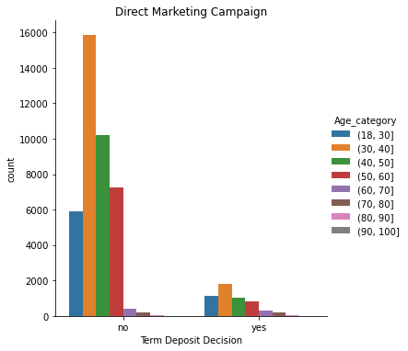

Out of 45,211 clients called, only 5289 (11.7%) signed up for a term deposit. Of the clients who said "no", 26,095 (57.7%) fell into the age groups of 31-40 and 41-50. Tapping into less marketed demographics can increase term deposit participation.
Data Source:
UCI Machine Learning Repository: https://archive.ics.uci.edu/ml/datasets/Bank+Marketing#

Slide 3
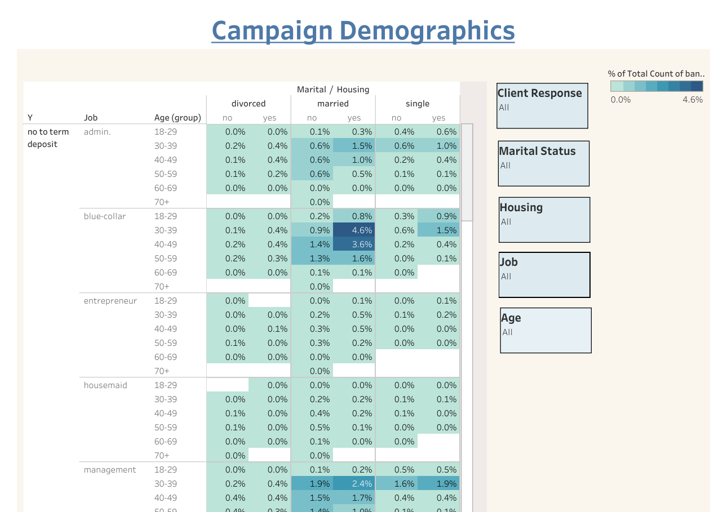
https://public.tableau.com/shared/KR9PYRY2Y?:display_count=n&:origin=viz_share_link
Identifying trends in the data on the macro level, most of our clients lie within the married category of the blue-collar, management, and technical workforce. This leaves a high level of untapped clients in other areas, specifically, students who could benefit from a term deposit to help pay off college loans and/or save for a down payment on a house. In addition, the retired category could benefit from saving for funeral expenses and/or inheritance.
Data Source:
UCI Machine Learning Repository: https://archive.ics.uci.edu/ml/datasets/Bank+Marketing#

Slide 4
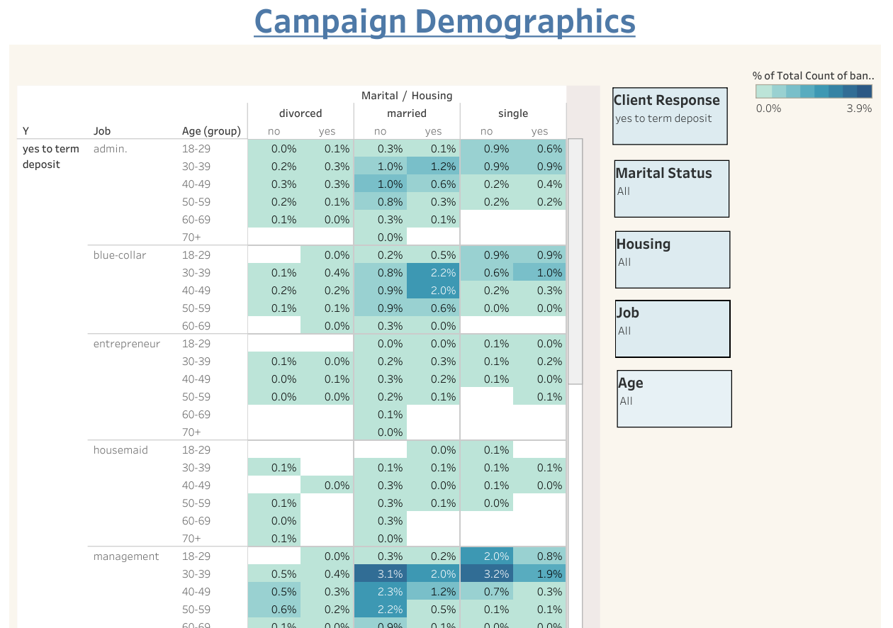
Drilling down to clients who said “yes”, shows most of the clients are from management, but 56.4% do not own a home. Linking a term deposit to a down payment on a home may be a way to increase participation. Drilling down further shows married clients who do not own a home. This data also shows us our retired and older clients are signing up. We should capitalize on this by including more older adults in other workforce areas in our campaign.
https://public.tableau.com/shared/KR9PYRY2Y?:display_count=n&:origin=viz_share_link
Data Source:
UCI Machine Learning Repository: https://archive.ics.uci.edu/ml/datasets/Bank+Marketing#
Notes:
Leverage EBIT slide, then flow into Revenue, COGS and Operational Expenses

Slide 5
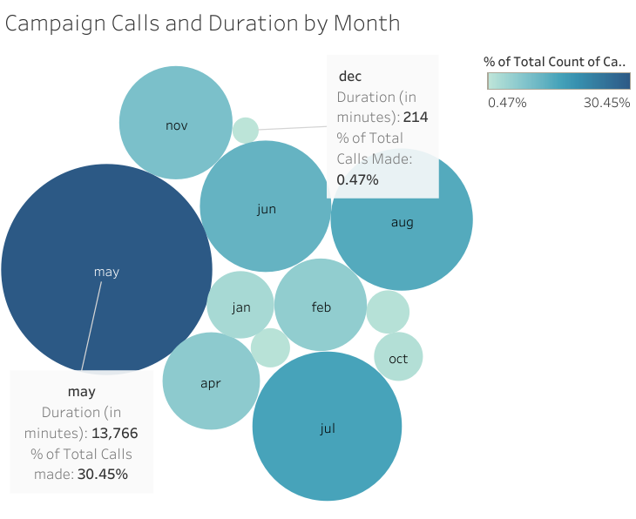
In addition to expanding our term deposits to other demographics, campaign calls need to be more spread out throughout the campaign, with ~70% of calls being made in the summer months between May and August.
Data Source:
UCI Machine Learning Repository: https://archive.ics.uci.edu/ml/datasets/Bank+Marketing#

Slide 6
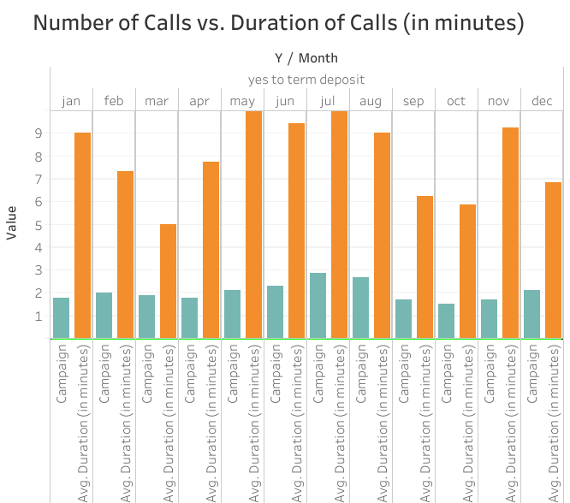
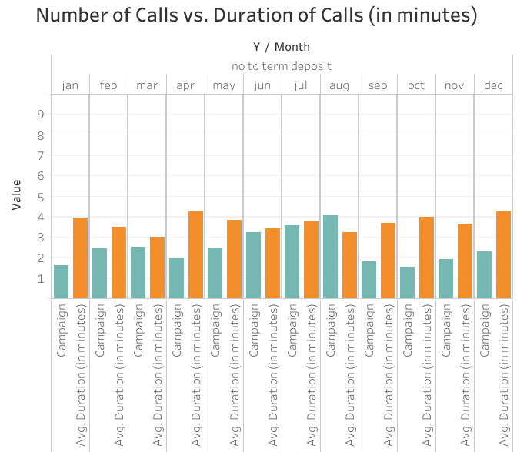

When clients signed up for a term deposit, the average number of calls were 2.1 with an average duration of 8.95 minutes, compared to 2.8 calls when the client said “no” and an average duration of 3.68 minutes.
Customer representatives should work on building relationships with customers to keep clients on the phone longer to convert sales.
Data Source:
UCI Machine Learning Repository: https://archive.ics.uci.edu/ml/datasets/Bank+Marketing#

Slide 7
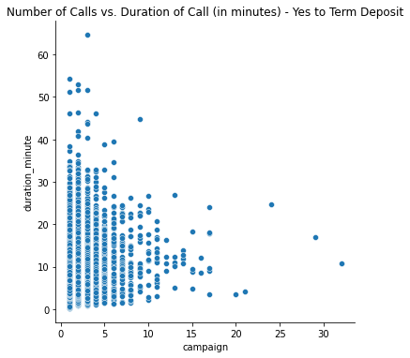
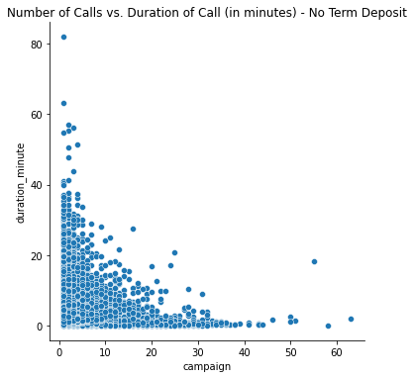


Customer representatives should not call clients more than 3-4 times in one campaign, to avoid negative attitudes towards the business.
Average number of campaign calls is ~5.
Average number of campaign calls is ~10+.
Data Source:
UCI Machine Learning Repository: https://archive.ics.uci.edu/ml/datasets/Bank+Marketing#

Slide 8
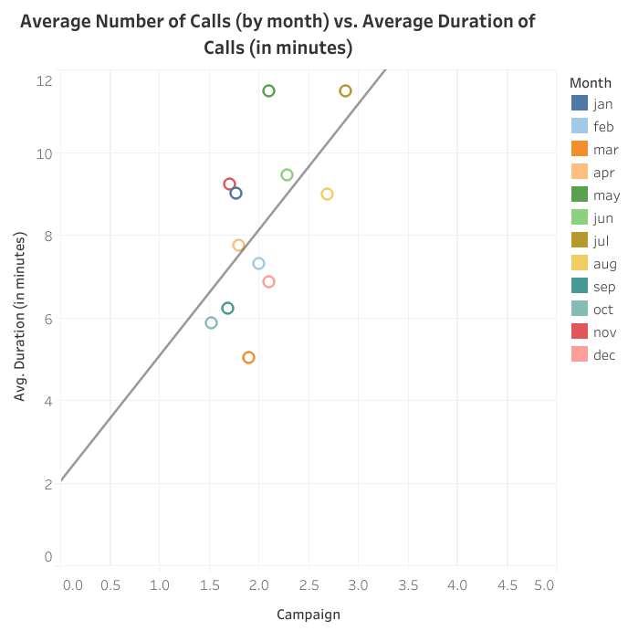
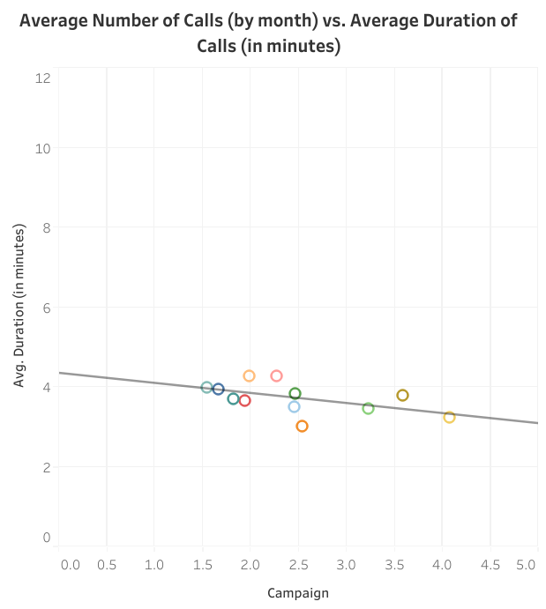
Customer representatives should keep the number of calls to 3 or less while building the relationship with the client and keeping them on the phone for ~5+ minutes.
Clients who said “yes” to a term deposit.
Clients who said “no” to a term deposit.
Data Source:
UCI Machine Learning Repository: https://archive.ics.uci.edu/ml/datasets/Bank+Marketing#

Slide 9
Improve the process…
Focus on students and retirees/older adults
Call on other work force areas besides tech and management
Spread calls over entire length of campaign
Limit number of calls to 3 or 4 over length of campaign
Keep customers on phone more than 5 minutes
Are we being inclusive?

