Slide 1


Group No. 10 VP & RPTP SCIENCE COLLEGE
FORAM R. GAJJAR (ROLL NO.09)
          &
MIHIR J. GOSAI (ROLL NO.20)

Slide 2


PROJECT DEFINITION
CRUMBLE is a social news aggregation and discussion website.
Users can create posts as per his wish in any community and can also participate in discussions.
Communities are groups that organize content based of different categories and get latest updates leading to a uniform discussion on it.
Only Registered members can submit their content through text posts and also can like or dislike other posts created by different members.

Slide 3
PURPOSE
Crumble is website comprising user-generated content and discussion.
The posts on site is divided into categories called communities.
User can like /dislike or comment any post and continue further conversation.
Discussions are organized on user-created areas of interest.

Slide 4
SCOPE
Registration of account is free. Account verification process is completed via email. After verification user can browse communities and even create new community.
User can participate in any community of his/her interests. The discussions are organized on the basis of community. User can participate in any discussion and put forward his/her opinion by commenting on particular post. The discussions mainly includes current topics of the community. This all is based fully on user-created areas of interests.

Slide 5
FEATURES
In this system one more facility is provided that It does not ask about any of your personal information except your Email ID.
It provided better security and stops unauthorized access to important and sensitive. It offers better services in terms of speed, accuracy and Security..

Slide 6
PRODUCT FUNCTION
Registration is validated through email verification.
Authenticated users can make posts on website.
CONSTRAINTS
Guest users are not allowed to make posts or comment or participate in any discussion. To make a post the user must be logged in his/her account.

Slide 7
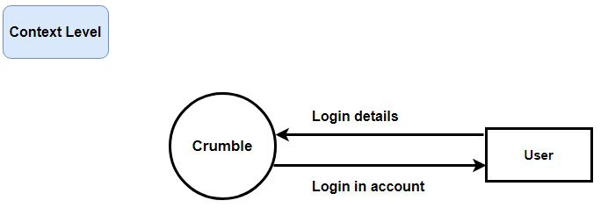
DATA-FLOW DIAGRAMS (DFD)

Slide 8
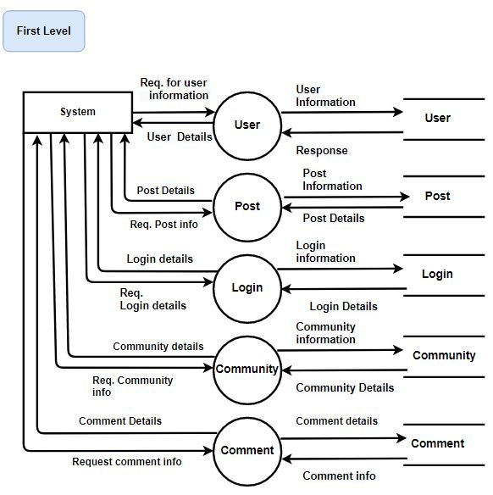

Slide 9
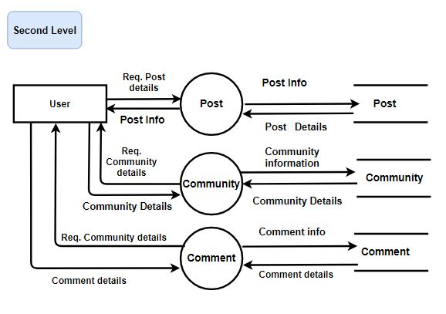

Slide 10
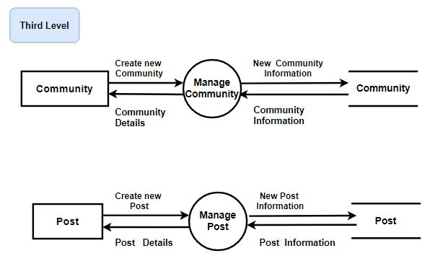

Slide 11
TOOLS & TECHNOLOGIES USED
For Front-End :- Angular, HTML, CSS, JavaScript.
For Back-End :- Spring Boot, Spring Security, Spring Data JPA, MySQL

Slide 12
LOGICAL-DATABASE REQUIREMENTS
This website contains database necessary for it to function according to requirements.
It includes database such as User, user-community, user-post, community, community-posts, post, comments, vote, token , refresh-token.

Slide 13
FRONT-END
User can view posts created by other members on the website.
User can log in in to his account through user name and password.
User can browse different communities .

Slide 14
BACK-END
User Table
User_Community Table
User_Posts Table
Community Table
Community_Posts Table
Post Table
Comments Table
Vote Table
Token Table
Refresh_token Table

Slide 15
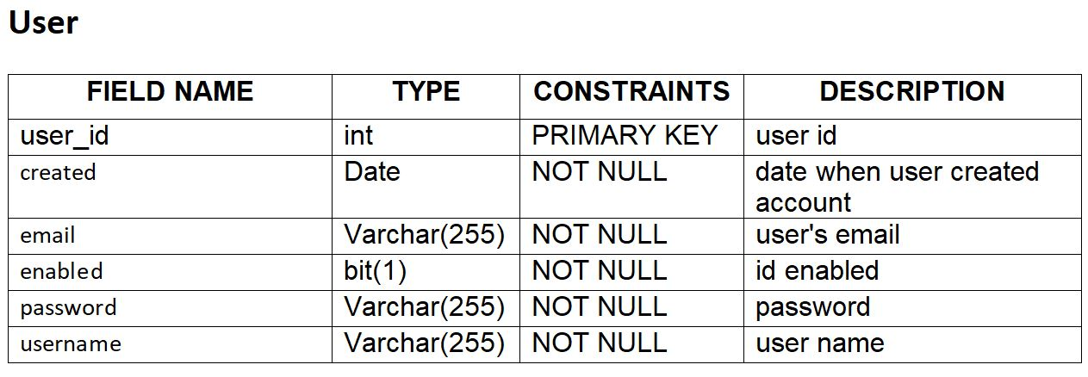
BACK END

Slide 16
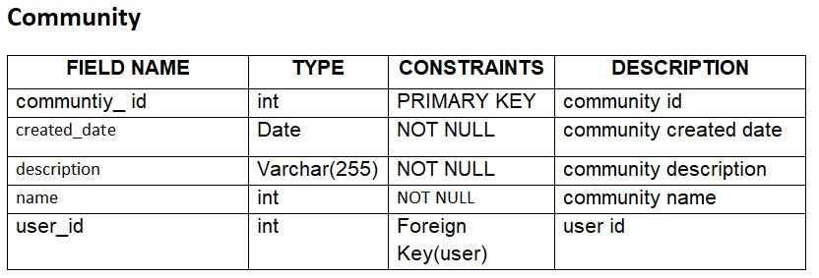
BACK END

Slide 17
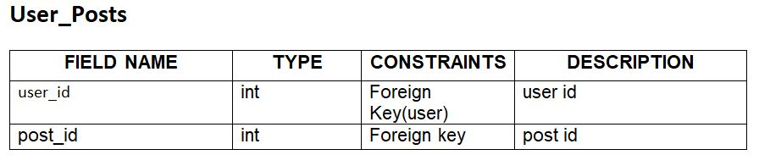
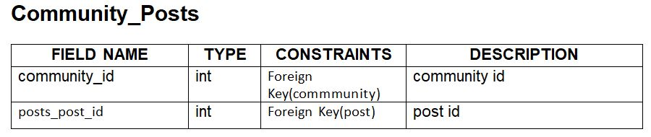
BACK END

Slide 18
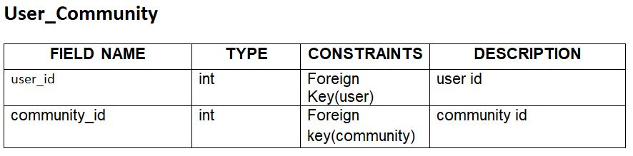
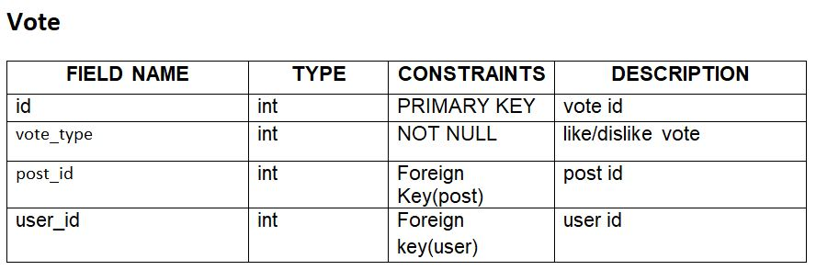
BACK END

Slide 19
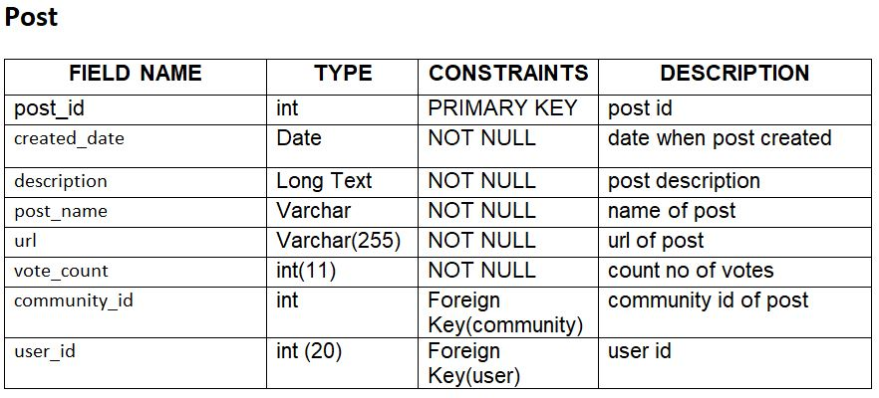
BACK END

Slide 20
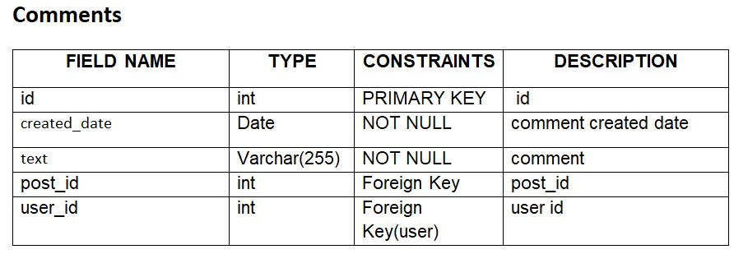
BACK END

Slide 21
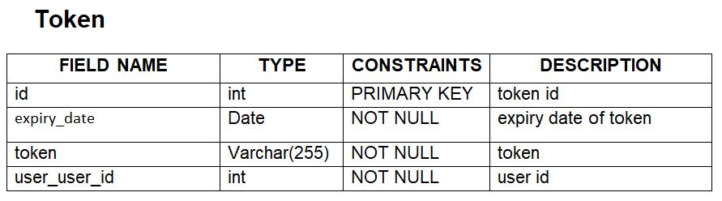
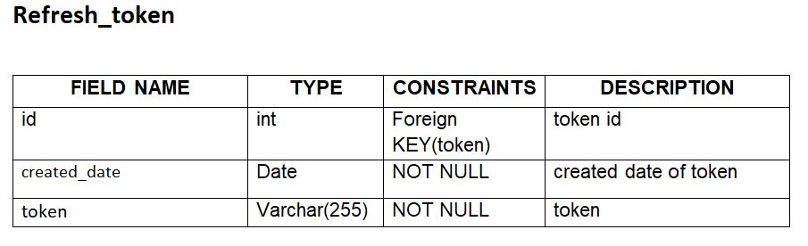
BACK END

Slide 22
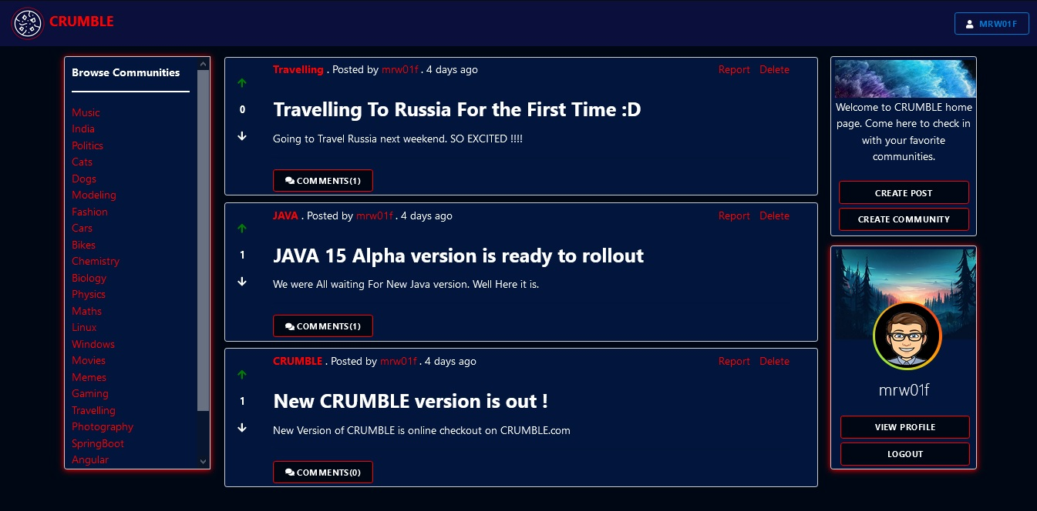
SCREEN LAYOUT
Home Page

Slide 23
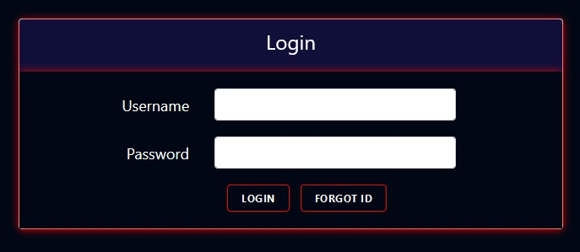
LOGIN

Slide 24
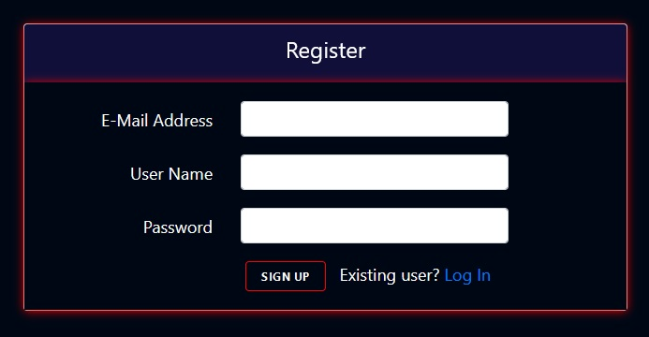
SIGN UP

Slide 25
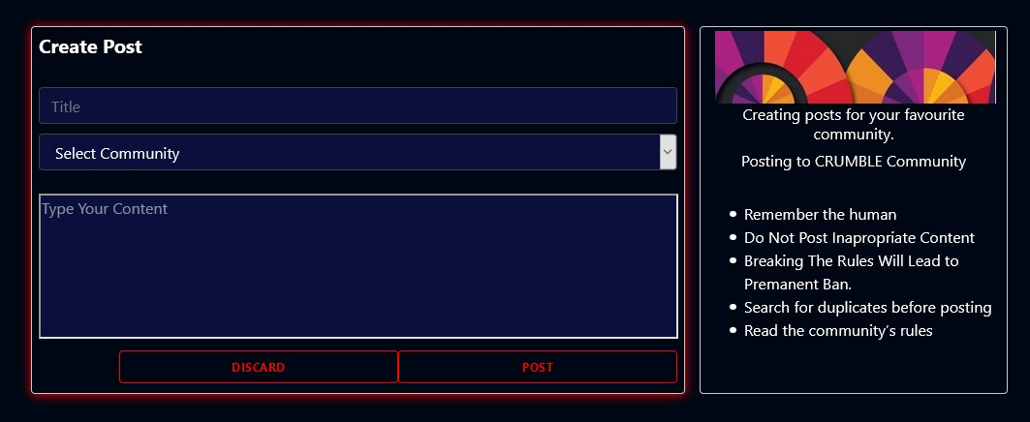
CREATE POST

Slide 26
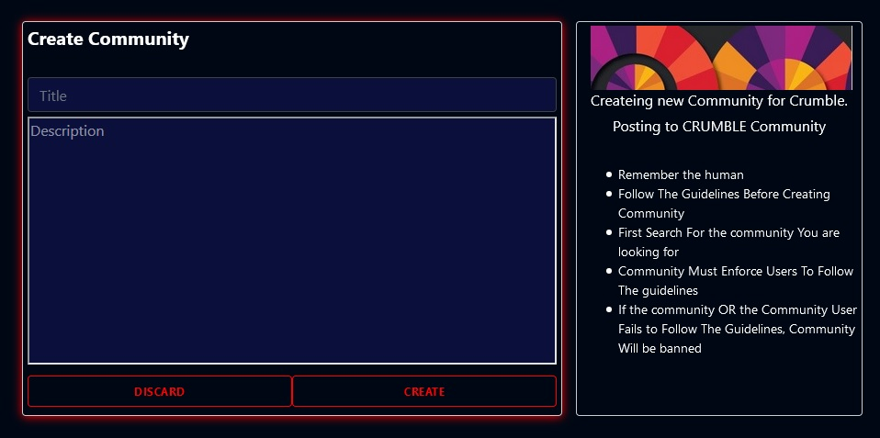
CREATE COMMUNITY

Slide 27
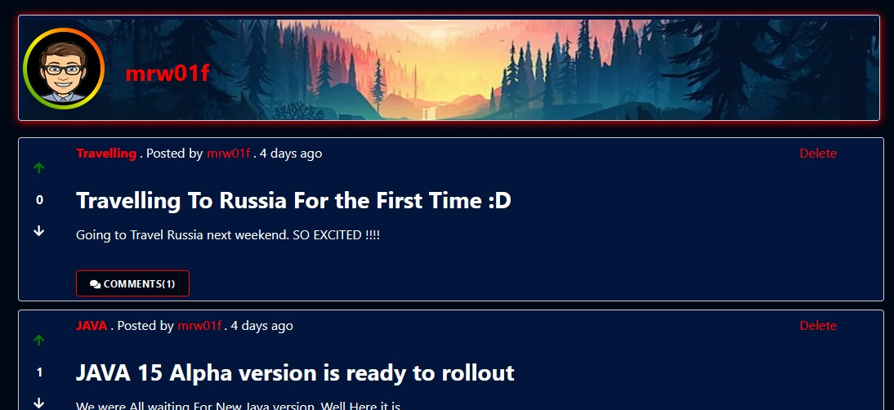
USER-PROFILE

Slide 28
CONCLUSION
Crumble is a web application which provides a platform to communicate your ideas, interests and opinion to other people. People with common interests get a ground to share their opinion and ideas for a specific topic. Users can participate in various discussions and put forward their thoughts and suggestions. Users are updated with the latest news regarding a particular community which keeps them posted with current news. It is a platform to reach a wide range of people with different ideas and opinion.

Slide 29
THANK YOU

