Slide 1

SENTINEL
Network security for places with no security team
Catches scans, brute force, malware beacons and DNS tunnels. Explains them in plain English. Alerts you on Slack, Discord or Telegram.
Runs on one gateway Mac
Local-first
Observe only
Notes:
Open with the one-line promise: network security for places with no security team. Sentinel runs on the gateway Mac, spots scans, password guessing, malware check-ins and DNS tunnelling, explains them in plain English and alerts you on Slack, Discord or Telegram.

Slide 2



Small networks, no one watching
No security team
Enterprise tools don't fit
Traffic is just noise
An IT generalist at best. Nobody reads logs or reviews traffic.
IDS and SIEM products need analysts, tuning and a budget.
A port scan or a malware check-in looks like ordinary packets.
The result: attackers can scan, guess passwords and phone home for days without anyone noticing.
Notes:
The problem: a college lab, a small office or a home lab has an IT generalist at best, not a security team. Enterprise tools assume analysts, tuning and budget. And raw network traffic is just noise until someone tells a story from it.

Slide 3

Sentinel watches the gateway for you
Your devices
Gateway Mac + Sentinel
You, in plain English
laptops, phones, printers, lab PCs
captures and analyses traffic
live dashboard + Slack / Discord / Telegram
Passive
Local-first
Plain English
observes only, never blocks
only alert summaries you choose leave the network
“192.168.2.30 tried 400 ports in 10 seconds”
Notes:
One Mac sits where all traffic crosses (for example the Internet-Sharing gateway). Sentinel observes passively. It never blocks anything. When something looks wrong you get a plain-English alert, in the terminal and on chat.

Slide 4



Built for networks without a SOC
Small teams & offices
College labs & classrooms
Home labs & power users
10 to 100 devices, one person who 'does IT'. Wants to know when something is wrong, without a dashboard farm.
Shared machines, curious students, exam weeks. Wants scans and brute force flagged the moment they start.
A gateway Mac, a pile of IoT gadgets. Wants a quiet watchdog that speaks plainly.
Not for:
enterprise-scale monitoring, or active blocking (it observes and advises, it is not an IPS).
Notes:
Who it is for: small teams and offices, college labs and classrooms, and home labs or IT generalists. Who it is not for: enterprises needing scale and active blocking. Sentinel is a prioritisation assistant, not an IPS.

Slide 5
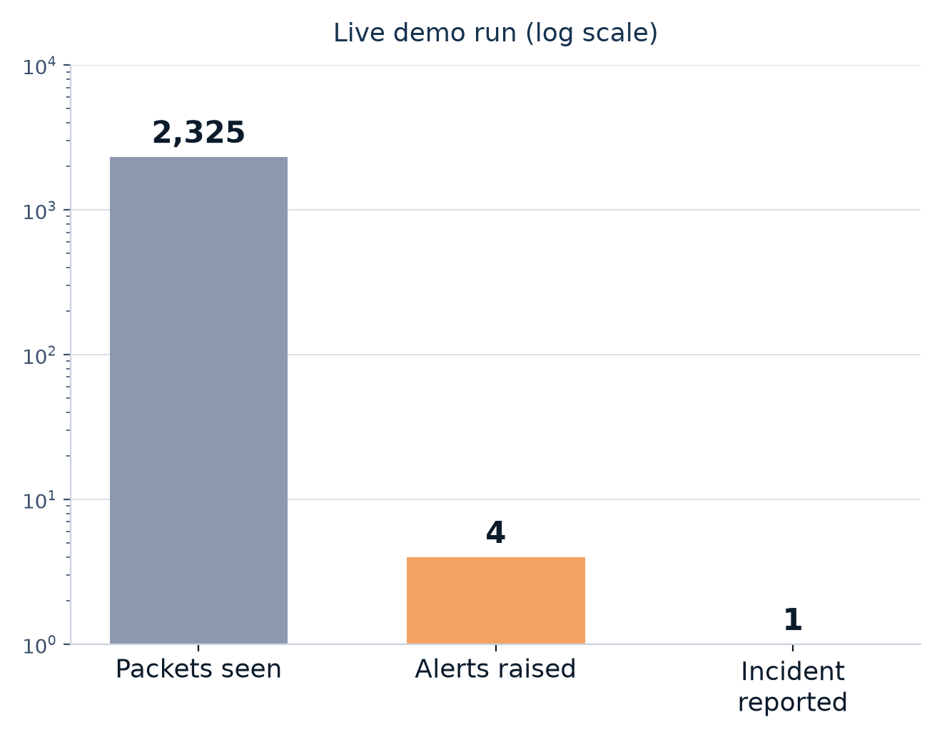
Thousands of packets, one story
What the admin sees
T1046
Port scan
T1110
Repeated logins
T1071.001
Malware check-ins
T1071.004
DNS tunnelling
One device, one growing incident, four red alerts
Notes:
From the live four-attack demo on localhost: about 2,300 packets were seen, four alerts were raised, and the admin sees one incident whose chain tells the story: scan, then password guessing, then malware check-ins, then DNS tunnelling.

Slide 6
From packets to a plain-English alert
Capture
Parse
Windows
Detect
Correlate
Explain
Alert
tcpdump or a pcap file
flows, DNS names
10 s · 5 min · 1 h
rules, timing, ML
incident + ATT&CK
LLM or template
CLI · chat
Deterministic
ML detectors (roadmap)
LLM wording only
Delivery
Key rule: detection is never decided by an LLM. Rules and statistics decide; the model only writes the words.
Notes:
Walk left to right. Capture and parse are deterministic. Three time windows (10 seconds, 5 minutes, 1 hour) turn packets into per-device features. Detectors raise alerts, correlation turns alerts into one incident tagged with MITRE ATT&CK, an LLM or a template writes the explanation, and the alert goes to the terminal and chat.

Slide 7






A cascade of detectors, one job each
Static rules
Port scans, brute force, DNS entropy / length / TXT signals
BUILT
Periodicity analysis
Beaconing: how regular are the connection intervals (jitter)?
BUILT
Isolation Forest
Per-device 'unusual for this device' baseline
ROADMAP
n-gram model
Random-looking domain names (DGA, tunnel payloads)
ROADMAP
Autoencoder
Second opinion: traffic the model cannot reconstruct
ROADMAP
LLM – Gemma 4 E2B (default target)
Writes the alert in plain English; never decides
BUILT · PLUGGABLE
Agreement between detectors raises confidence; one detector alone lowers it.
Notes:
Be precise about status. Built and running today: static rules, periodicity analysis for beaconing, and the pluggable LLM that writes the alert text (Gemma 4 E2B is the intended default model, served by Ollama or llama.cpp). The Isolation Forest per-device baseline, the n-gram domain-name model and the autoencoder are designed and specified but are the roadmap, not shipped yet.

Slide 8



Four attack patterns caught today
Port scan
T1046
Brute force
T1110
20+ ports or hosts, 60%+ of attempts fail
8+ connections to a login service, mostly accepted
Demo: 400 ports, 99.75% failed
Demo: 21 logins to port 2222
Beaconing
T1071.001
DNS tunnel
T1071.004
10+ accepted connections, jitter under 15%
10+ lookups with 2 of 4 signals: entropy, length, subdomains, TXT
Demo: 13 check-ins, 1.0003 s apart
Demo: 14 TXT lookups, names 67 chars
Notes:
Each card shows what the detector looks for in a single 10-second window and what we measured in the live localhost demo. Port scan: hundreds of ports, almost all closed. Brute force: many accepted connections to a login service. Beaconing: connections at near-perfectly regular intervals. DNS tunnelling: long random names to one domain.

Slide 9
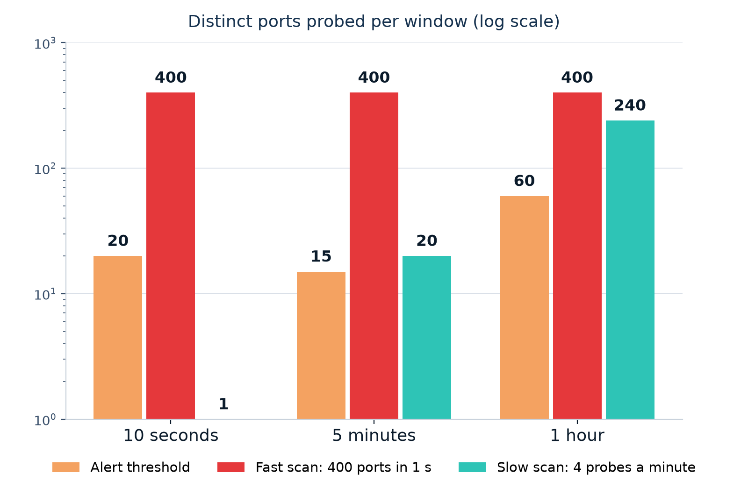
Three clocks catch fast and slow attackers
Why it matters
A slow scan stays under the 10 s threshold: about 1 port.
The 5 min and 1 h windows see 20 and 240 ports and fire.
Fast attacks are caught within seconds; slow ones still get caught.
Notes:
Sentinel looks at every device over 10 seconds, 5 minutes and 1 hour at the same time. A fast scan (400 ports in a second) trips all of them. A patient scanner sending four probes a minute never trips the 10-second window: it only touches about one port there. But over five minutes it has touched about twenty ports, and over an hour about two hundred and forty, so the longer windows catch it. This is verified by an automated test that fails if only the 10-second window is enabled.

Slide 10
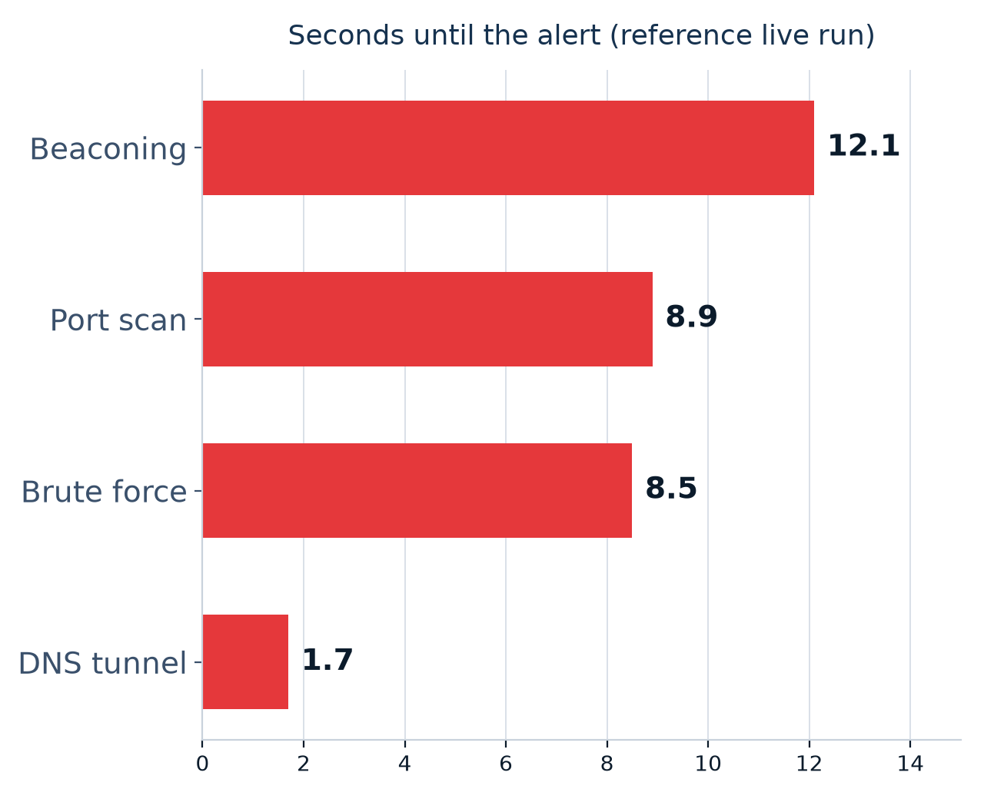
Tested live: attacks caught, noise silent
4 / 4
0
attacks detected live
alerts on normal web traffic
48 / 48
0
grid-phase checks passed
false alarms, 12 benign networks
Localhost run, 10-second window only, notifications off. Alert time varies with the 10 s grid.
Notes:
These are measured. In a live localhost run with only the 10-second window enabled and notifications off, all four attacks were detected and the control (ordinary web traffic) raised nothing. Alert time depends on where the 10-second evaluation grid falls, so individual runs ranged from about 1 to 12 seconds. The tiles on the right come from the automated test suite: a 12-seed soak of random benign networks produced no alerts, and short attack bursts were caught at all 12 phases of the grid.

Slide 11
Criticals stay pinned on top
SENTINEL | watch lo0 | 01:12 | events 4183 | CRIT 4 | q quit c clear
1
Pinned
PINNED: CRITICAL ALERTS (4) every one stays; newest on top
Every critical alert stacks, newest on top, and stays until you clear it.
CRITICAL 1.00
23:52:00 Unusual DNS requests that may hide data
CRITICAL 1.00
23:51:40 Device contacts one server at fixed intervals
CRITICAL 1.00
23:51:10 Repeated login attempts against a service
Counter
2
CRITICAL 1.00
23:51:00 Device is probing many network ports
CRIT goes up by one for each critical alert.
RECENT TRAFFIC (sliding window)
23:52:01.220 127.0.0.1:55012 -> 127.0.0.1:53 udp dns? x7k2...
23:52:01.331 127.0.0.1:55013 -> 127.0.0.1:53 udp dns? q9m4...
23:52:01.442 127.0.0.1:55014 -> 127.0.0.1:53 udp dns? b3zt...
3
Sliding window
23:52:01.553 127.0.0.1:55015 -> 127.0.0.1:53 udp dns? h8w1...
23:52:01.664 127.0.0.1:55016 -> 127.0.0.1:53 udp dns? n5r6...
Recent traffic fills the rest of the screen and adapts to the terminal size.
23:52:01.775 127.0.0.1:55017 -> 127.0.0.1:53 udp dns? c2v0...
23:52:01.886 127.0.0.1:55018 -> 127.0.0.1:53 udp dns? p4d8...
Notes:
This is the live dashboard, started with watch -d. Every CRITICAL alert gets its own pinned line the moment it is reported and stays there, newest on top, so it can never scroll away in the traffic. The CRIT counter in the header counts each one. The grey traffic below is a sliding window that fills the rest of the terminal and adapts when you resize it. q quits, c clears the pins.

Slide 12



From incident to Slack, safely
Incident
Sanitizer
Gemma 4 E2B
Faithfulness check
Slack
Discord
from the rules
only validated numbers and addresses pass
local LLM via Ollama or llama.cpp
numbers, IPs, techniques must match evidence
Telegram
Model off, slow or wrong?
CRITICAL
Device is probing many network ports
Built-in template text, same facts
192.168.2.30 tried 400 different ports on 192.168.2.20 within 10 seconds, and 100% of the attempts failed.
Retries, circuit breaker, rate limits and disabled @mentions on every channel.
Suggested: if you do not recognise this activity, disconnect the device.
T1046 Network Service Discovery · Confidence 100%
Notes:
How an alert is made. The incident goes through a sanitizer, so hostile text from the network such as DNS names never reaches the model or chat. A local LLM, Gemma 4 E2B as the default target served through Ollama or llama.cpp, writes the explanation as structured JSON. A faithfulness check rejects any number, IP address or technique that is not in the evidence, and then Sentinel falls back to built-in template text. The result goes to Slack, Discord and Telegram, with retries, a circuit breaker and rate limits. Mentions are disabled.

Slide 13





Safe by design
Observe only
Hostile-text proof
No payloads
Never blocks or changes the network.
Network strings never reach the LLM, chat or terminal unescaped.
Stores alerts and summaries, not packet contents.
Secrets stay private
Local-first
Claims are checked
Webhook URLs and tokens in a chmod 600 file, never printed.
The LLM runs on your machine; only alerts you choose leave.
Model text is rejected if it invents a number, IP or technique.
Notes:
This is a security product, so it treats the network as hostile. It only observes. DNS names and host names can be crafted by an attacker, so they never reach the LLM, chat or the screen unescaped. No payloads are stored. Secrets live in a private file. Every sentence the model writes is checked against the evidence.

Slide 14
How to run it
1
Install
make bootstrap
Optional add-ons
Chat alerts: fill secrets.env, add -n
LLM text: enable [llm], run sentinel llm test
Offline demo: sentinel replay demo.pcap -d
Narrated attacks: demo_attacks.py
2
Check
uv run sentinel doctor
3
Monitor
uv run sentinel watch --iface lo0 -d
4
Attack (2nd console)
uv run python tools/demo_attacks.py
5
Review
uv run sentinel incidents
Notes:
Five commands. Install, check, start the monitor in one console, launch the attacks in a second console, and review the incidents. To get chat alerts, fill secrets.env and add -n. To get LLM-written text, enable the [llm] section and run sentinel llm test. Everything runs on localhost for the demo. For repeated rehearsals of the same attack use --config demo-10s.toml, which shortens the alert cooldown.

Slide 15
How it's meant to be used
Install
Watch
Get alerted
Triage
Tune
on the gateway Mac
dashboard or background
Slack, Discord, Telegram
ack, dismiss, resolve
allow-lists for known-good
repeat
Replay a capture
Watch live
Full-screen dashboard
Send alerts
sentinel replay file.pcap
sentinel watch --iface en0
add -d
add -n
Notes:
The daily loop. Install it on the gateway once. Leave the dashboard or the background monitor running. When an alert arrives on chat, look at the incident, then acknowledge, dismiss or resolve it. If a legitimate device keeps alerting, add it to the allow-lists so the next alert means something.

Slide 16
Where it stands today
Verified
Built, awaiting a real-world run
Next
Live capture on localhost
4 attack patterns + a silent control
Pinned live dashboard
327 automated tests, all passing
Slack, Discord, Telegram delivery
Gemma 4 E2B via Ollama / llama.cpp
Gateway capture with other devices
Isolation Forest baselines
n-gram domain model
Autoencoder second opinion
ARP spoofing, rogue DHCP, canary
Web interface
Notes:
Be upfront. Verified: the detectors, the CLI and the dashboard work on real loopback traffic, backed by a large automated test suite. Built but not yet exercised for real: delivery to real Slack, Discord and Telegram accounts, a real Gemma 4 E2B model server, and capture on a gateway with other devices. Next: the ML detectors (Isolation Forest, n-gram, autoencoder), ARP spoofing, rogue DHCP, canary tripwires and a web interface.

Slide 17

Demo time
Watch four attacks turn into four red alerts, live.
uv run sentinel watch --iface lo0 -d
uv run python tools/demo_attacks.py
Notes:
Close with the demo: start the dashboard in one console, run the narrated attack script in the other, and let the pinned red alerts do the talking.

