Slide 1
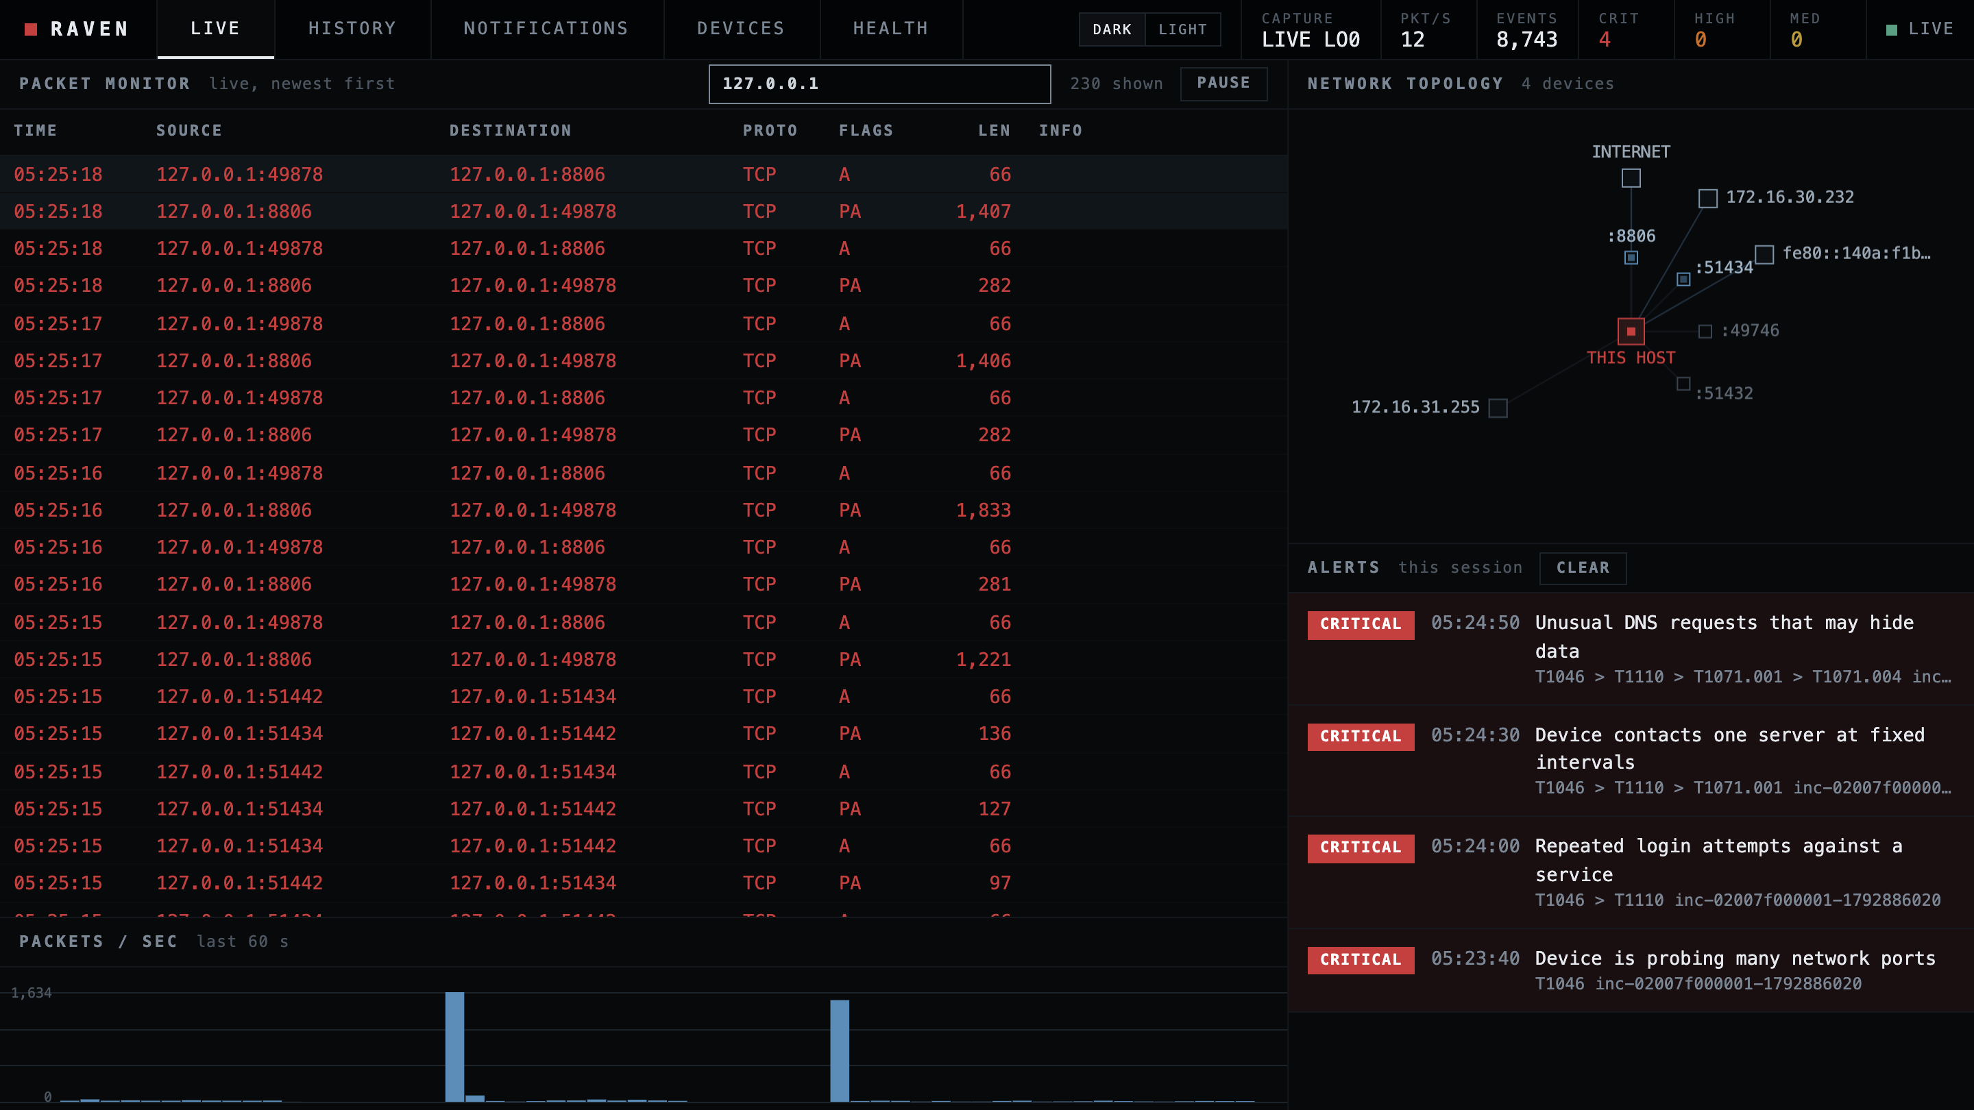
NETWORK ANOMALY DETECTOR
Raven
Network security for places with no security team.
5
462
4 / 4
detectors, rules and
statistical
automated tests
live attacks caught
on loopback
REAL SCREENSHOT: LIVE TEST ON LOOPBACK
Runs on one Mac. No cloud. No account.
Notes:
One-line promise: network security for places with no security team. Raven runs on the gateway Mac, spots port scans, password guessing, malware check-ins, DNS tunnelling and unusual traffic, explains each in plain English, keeps a permanent history, and can alert Slack, Discord or Telegram. The screenshot on the right is the real console during a live test on this Mac.

Slide 2



Small networks are attacked like big ones. Nobody is watching.
01 / THE PROBLEM
No security staff
Tools built for a SOC
Attacks hide in the noise
The admin is also the help desk. Nobody reads logs, and alerts nobody understands get ignored.
Enterprise products assume analysts, a SIEM and a budget. Small teams cannot run or afford them.
A port scan, password guessing, a malware check-in: each is ordinary traffic until something counts it.
Raven: one Mac on the gateway watches the traffic, spots the pattern, and tells the admin in plain English what to look at.
Notes:
The gap: schools, labs and small offices have the same exposure as a company but no analyst. Commercial tools assume a security operations team. The attacks themselves are quiet: a scan or a password-guessing run looks like background noise unless something is counting.

Slide 3






From packets to a plain-English alert in six steps
02 / HOW IT WORKS
1
2
3
4
5
6
Capture
Count
Detect
Correlate
Explain
Deliver
tcpdump live,
or any .pcap
per device over
10 s, 5 min, 1 h
5 detectors:
rules + 2 models
one incident per
device, ATT&CK chain
plain English:
templates or local LLM
console, history,
Slack/Discord/Telegram
Sanitiser gate: DNS names and hostnames come from the network, so they are treated as hostile. They are cleaned before any LLM, notification or screen sees them, and the console only ever shows them as plain text.
LLMs never decide: detection is rules and statistics. A local model, if you turn one on, only rewrites the wording, and its output is fact-checked against the evidence.
Notes:
Walk left to right. Capture reads packets with tcpdump or from a pcap file. Features count what each device did over 10 seconds, 5 minutes and 1 hour. Detectors are readable rules plus two statistical models. Correlation joins alerts on the same device into an incident with an attack chain. Explain writes the words, from templates or an optional local LLM. Deliver puts it on the console, in the permanent history and, if enabled, on Slack, Discord or Telegram. The key safety point is the bar underneath: network text is sanitised before any LLM, alert or screen sees it.

Slide 4
Five detectors, each tied to an ATT&CK technique
03 / WHAT IT DETECTS
Port scan
T1046
Brute force
T1110
Beaconing
T1071.001
One device probing many ports or hosts, fast or slow.
Many connections to SSH, RDP, SMB or FTP that mostly complete.
One server contacted at suspiciously regular intervals.
400 ports in about 1 s, 99.75% failed
21 logins to port 2222, all completed
13 check-ins every 1.0003 s, jitter 0.2%
DNS tunnelling
T1071.004
Unusual behaviour
statistical
WHY THE STATISTICAL ONE IS CAPPED
It only knows "unusual", not "attack". Its alerts are capped at MEDIUM, carry no ATT&CK technique, and are hidden while a named attack is already active on that device.
Long, random-looking lookups under one domain. An n-gram model scores how random the names look.
An Isolation Forest learns your network's normal, then flags volume far beyond it.
14 TXT lookups, 67 characters, 4.5 bits/char
bulk upload: bytes_out 263x the baseline
Notes:
Each card shows what the detector looks for and the real evidence recorded in the live loopback test (numbers from demo.md and docs/ABLATION.md). The first four are rules with thresholds you can read and tune. The fifth, unusual behaviour, is statistical and says only 'unusual', never a named attack.

Slide 5
A local console that shows what is happening, now
04 / THE LIVE CONSOLE
1
Packet monitor
1
2
Every packet event, newest first, with a filter box. A flagged device shows red for a minute.
2
Network topology
This host in the middle, devices around it, service ports as small boxes. A scan lights up the ports.
3
3
Alert stack
Every CRITICAL stays on screen with its headline and ATT&CK chain.
4
Packets per second
4
The last 60 seconds, so a burst stands out.
Listens on 127.0.0.1 only. Token needed once. Strict content-security policy.
Notes:
This is a real screenshot, not a mock-up: the console during the live loopback test with all four attacks run. 1: the packet monitor, newest first, filterable; packets from a flagged device turn red for a minute. 2: topology around this host, with service ports as small boxes, so a scan shows up as ports lighting up. 3: the alert stack, every CRITICAL stays visible. 4: packets per second. It listens on 127.0.0.1 only, with a one-time token.

Slide 6
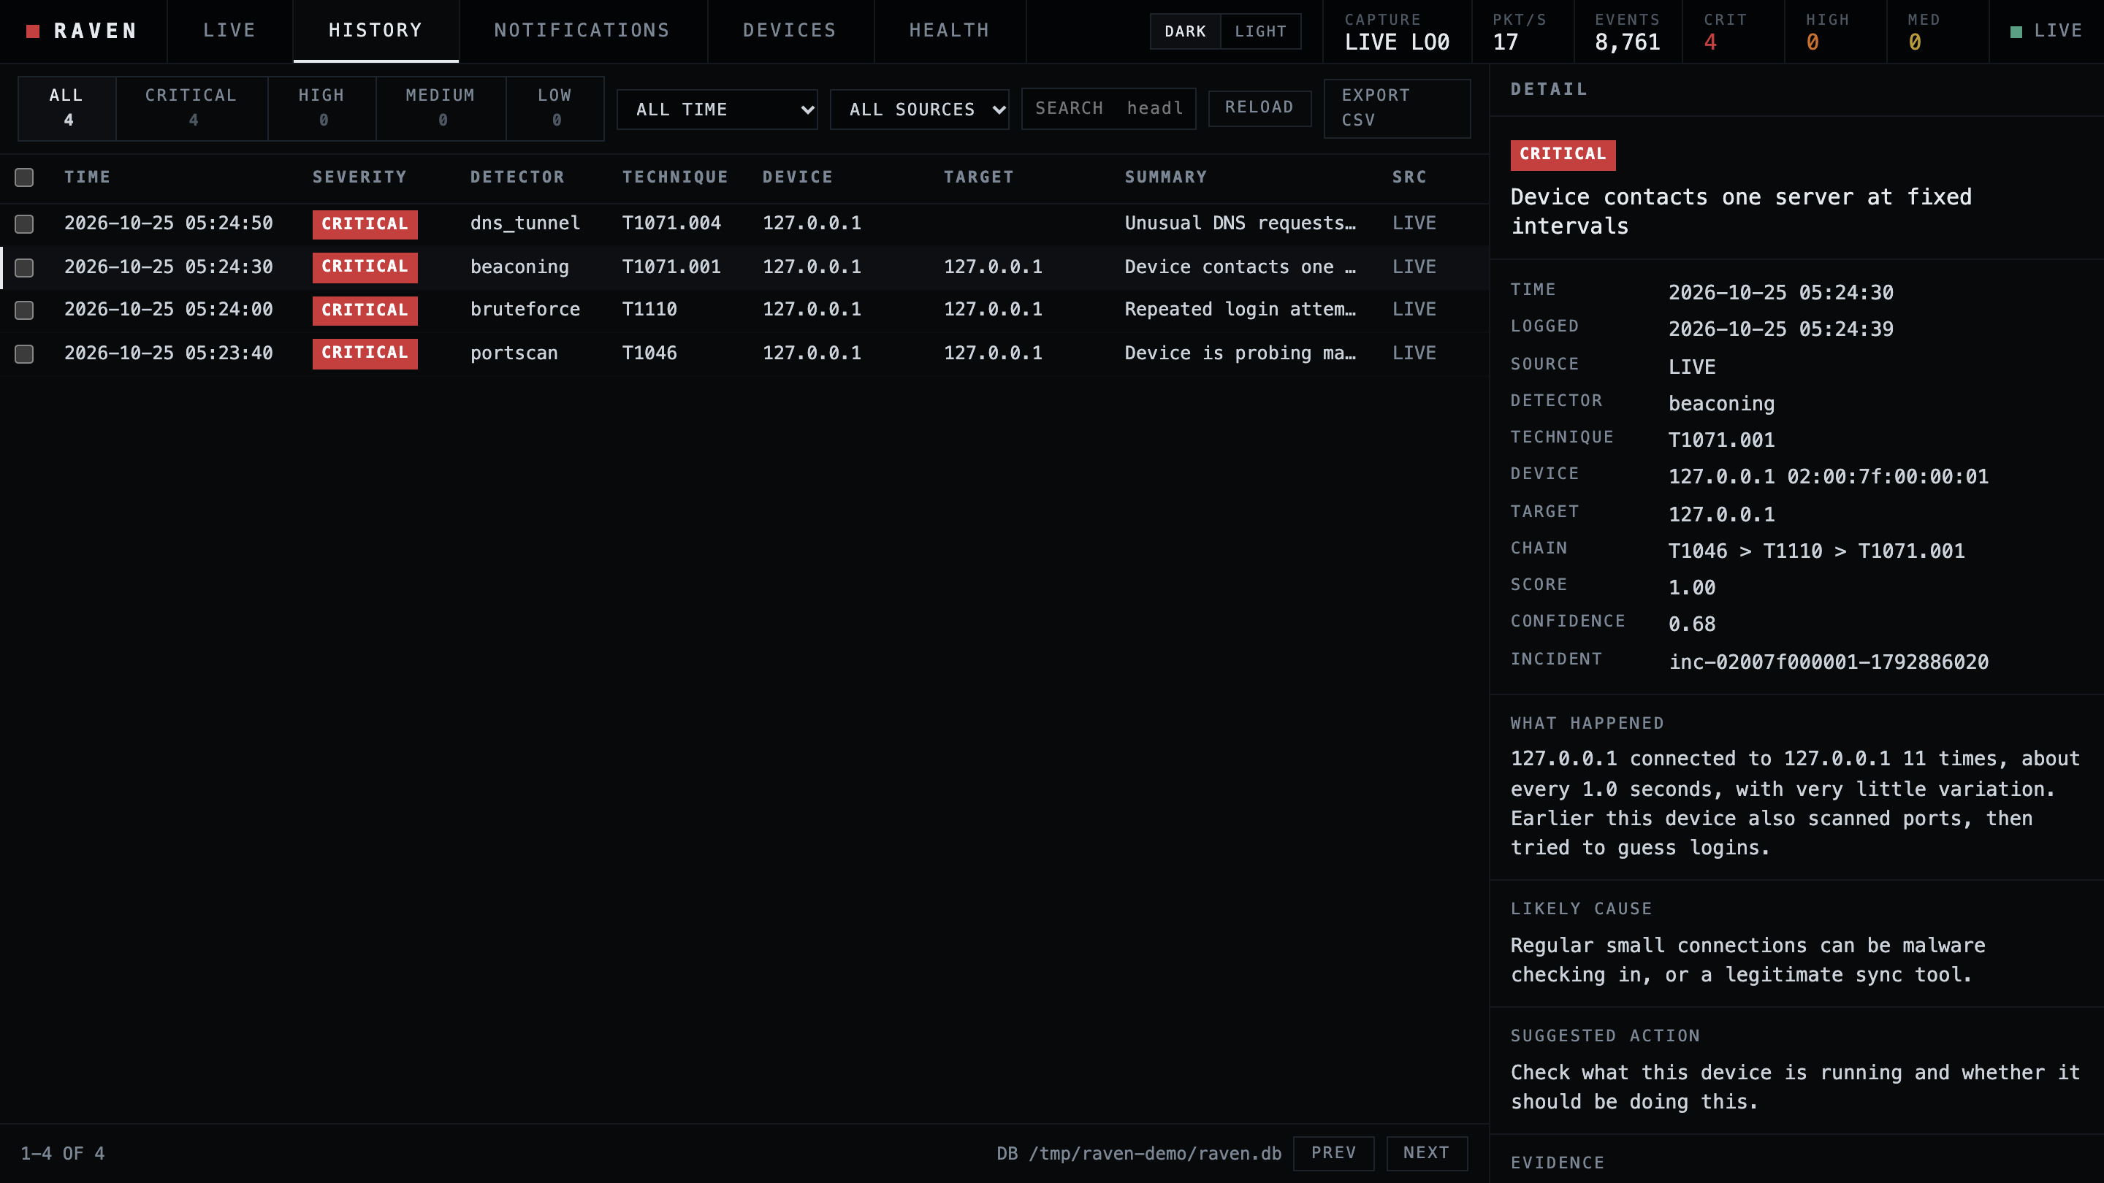
A permanent history you can search, export and clean up
05 / THE HISTORY
Survives restarts
SQLite in ~/.raven. The same history from any folder.
Find anything
Filter by severity, time, source. Search headline, IP, technique or incident.
See why
Plain-English explanation plus the numbers that triggered it.
Take it with you
CSV export, or raven history --json for scripts.
Stay in control
Delete chosen entries; every deletion is audited.
Notes:
Every detection is written to a SQLite database in the user's folder, so it survives restarts. The History tab filters by severity, time and source, searches headline, address, technique or incident id, opens the full explanation and the numbers behind it, exports CSV, and deletes chosen entries (two clicks to confirm, each deletion recorded in an audit log). The same data is available in the terminal with 'raven history'.

Slide 7
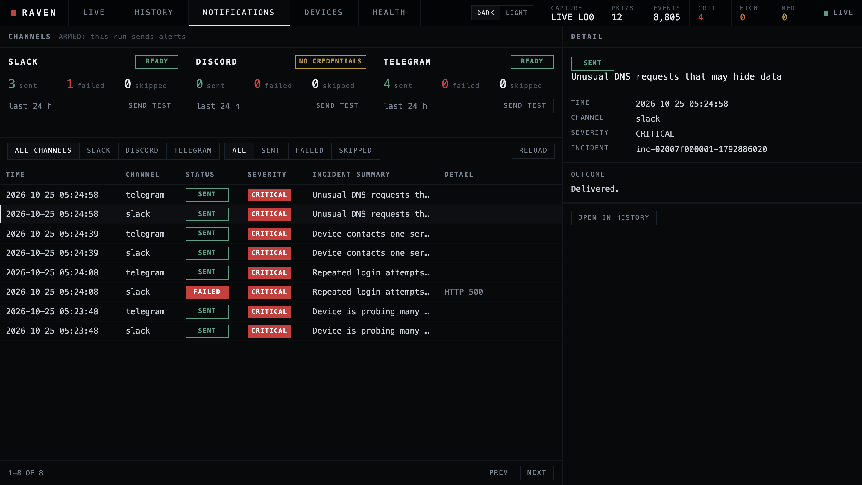
Know what was sent, and what failed
06 / NOTIFICATIONS
Channel status
Ready, no credentials or not in config, with 24 h counts.
Armed or not
A banner says whether this run will actually send alerts.
A log of every send
Headline, severity and, for failures, the reason.
Prove delivery
SEND TEST sends one marked message, after a second click.
Nothing sensitive
Reasons never contain URLs or tokens.
Notes:
The Notifications tab shows the three channels with their state: ready, no credentials, or not listed in the config, and sent, failed and skipped counts for the last 24 hours. The banner says whether this run is armed: alerts only go out when the run was started with the notify flag and notifications are enabled. Below is the delivery log: every attempt with the headline and severity it carried and, for a failure, a short reason such as HTTP 500, never a URL or a token. The test button sends one clearly marked sample message to the real channel after a second click, so you can prove delivery before an attack happens. In this screenshot the notification transport was a fake that failed one Slack message on purpose to show a failure row, so nothing was sent anywhere.

Slide 8
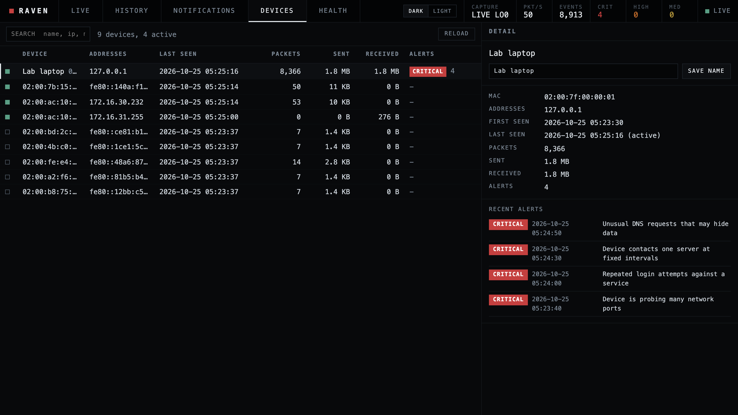
Every device, with its alert record
07 / DEVICES
What the capture has seen
By MAC: addresses, last seen, packets, bytes in and out.
Survives restarts
Stored in the database, not just in memory.
Alerts per device
Worst severity and recent alerts; click to open in History.
Name it
Your label, saved and audited, never from network data.
No noise
Broadcast and multicast addresses are left out.
Notes:
The Devices tab is the inventory of what the capture has seen, by MAC address: addresses, last seen, packets, bytes sent and received, and how many alerts each device has with the worst severity. It is stored in the database, so it survives restarts. Select a device to see its recent alerts and give it a name; names are typed by the admin and never taken from network data. Broadcast and multicast addresses are not devices and are skipped. One limit: a device is a MAC, so machines behind a router show up as the router.

Slide 9
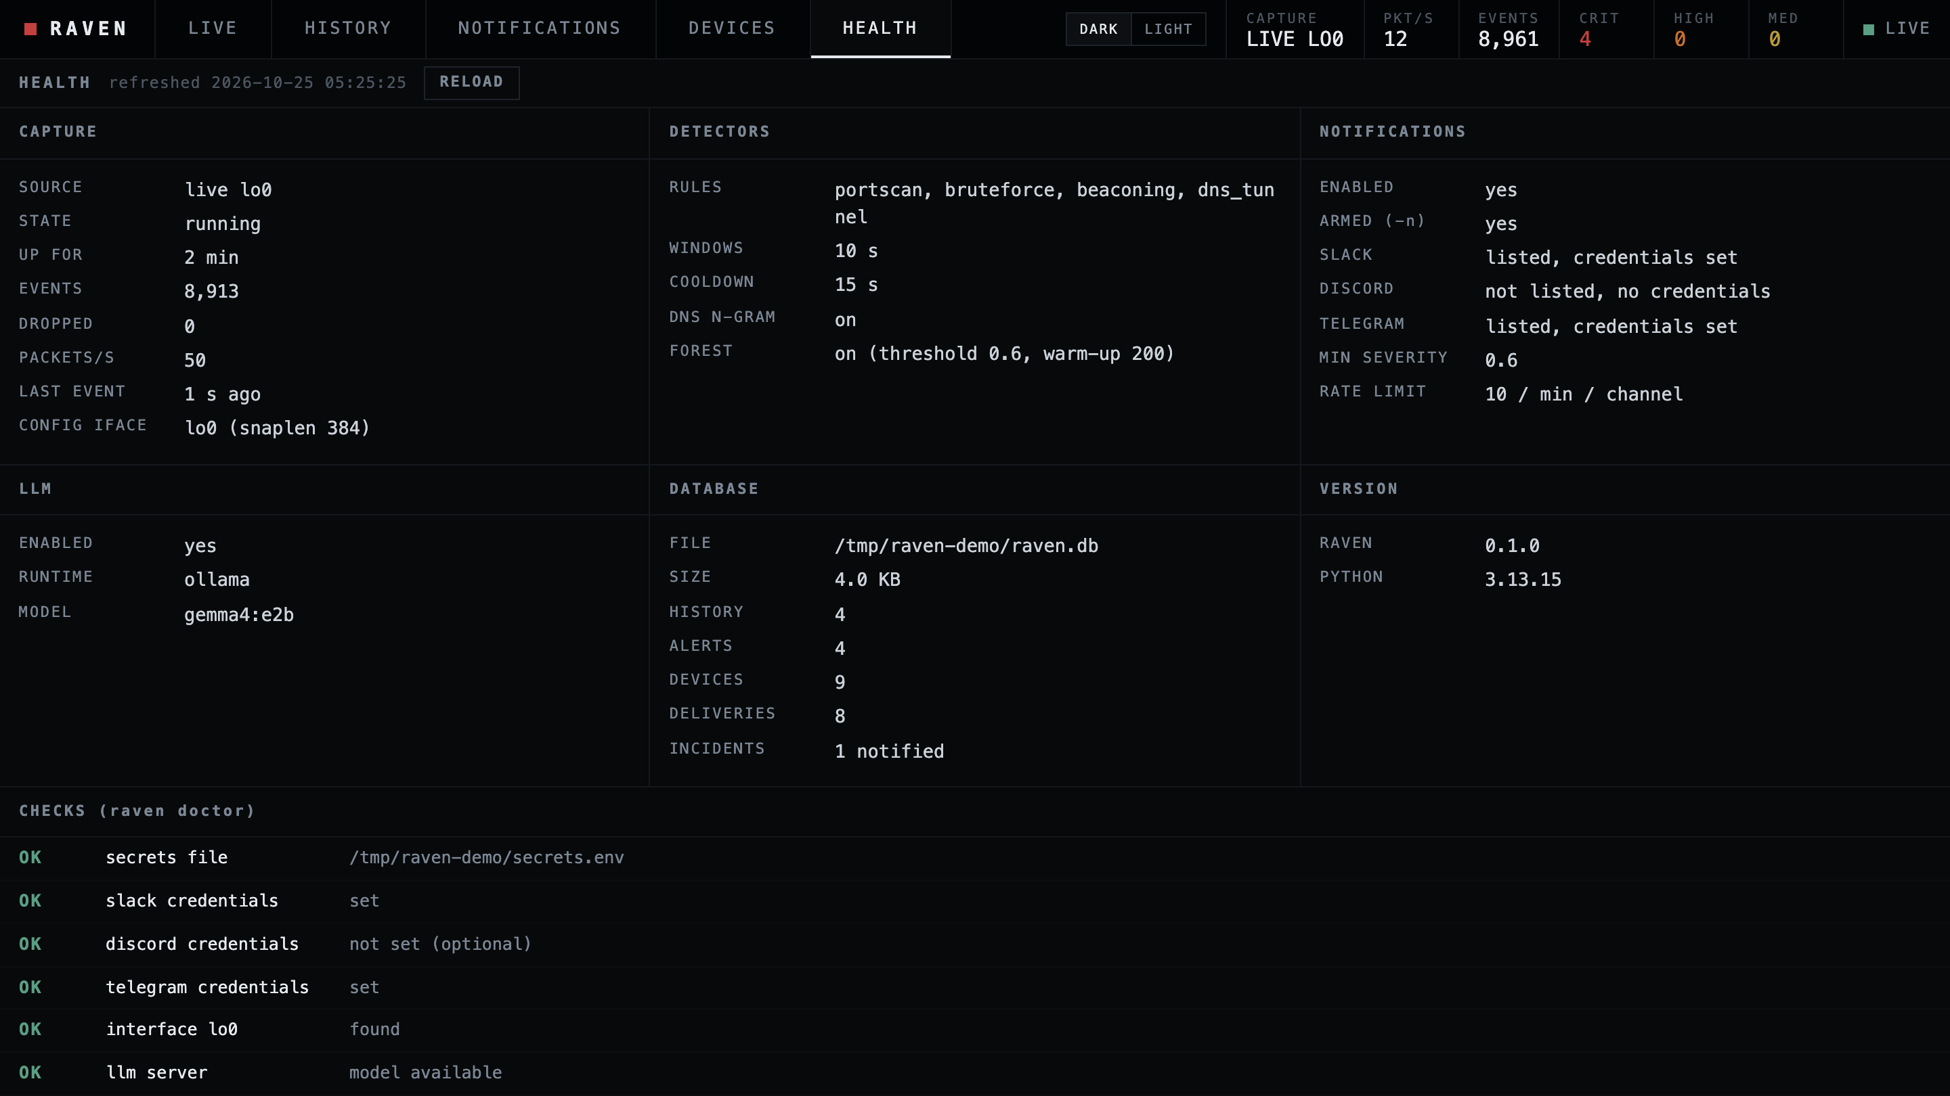
Is it healthy? One page answers
08 / HEALTH
Is capture alive
Source, state, uptime and the age of the last packet.
What is switched on
Rules, windows, thresholds and both statistical models.
Setup at a glance
Alerts armed? Which LLM model? Credentials: set or not.
The database
Size and counts of history, devices and deliveries.
Checks built in
The same checks as raven doctor, refreshed live.
Notes:
The Health tab answers whether the capture is alive and how the run is set up. Capture shows the source, state, uptime and how long ago the last packet arrived, in amber if a live capture has been silent. Detectors lists the rules, windows, cooldown and the two statistical models with their thresholds. Notifications and the LLM show setup, with credentials only as set or not set. Database shows size and counts. Underneath are the same checks as the doctor command, including whether the LLM server has the model, refreshed every few seconds.

Slide 10
Fast attacks and slow ones: three clocks, not one
09 / MULTI-TIMESCALE WINDOWS
SLOWEST PORT SCAN EACH CLOCK STILL CATCHES (default thresholds, probes per minute)
10 s window
120 / min
20 ports in 10 s
fast scan: CRITICAL in the live test
5 min window
3 / min
15 ports in 5 min
slow scan, 1 probe/s: HIGH in the live test
1 hour window
1 / min
60 ports in 1 hour
low-and-slow: one probe a minute
bar length uses a square-root scale
One short window sees only the fast attacker. Three clocks also catch the patient one.
Notes:
A single short window misses a patient attacker who probes slowly. Raven counts over 10 seconds, 5 minutes and 1 hour. The default scan thresholds are 20 distinct ports in 10 seconds, 15 in 5 minutes and 60 in an hour. Expressed as a probing rate, that is the chart: a scan must go faster than 120 probes a minute to trip the short clock, but the 5-minute clock catches 3 a minute and the 1-hour clock catches 1 a minute. In the live loopback test a fast scan was CRITICAL through the 10-second window and a scan of one probe per second was HIGH through the 5-minute window.

Slide 11
Two statistical models catch what the rules miss
10 / STATISTICAL DETECTORS
DNS N-GRAM / HOW RANDOM DOES A NAME LOOK?
ISOLATION FOREST / IS THIS NORMAL?
average bits per character (higher = more random)
40 min
learns
20 s upload
ordinary names
random names
of normal browsing
by 3 devices
what normal looks like
on this network
864 KB per 10 s,
one long connection
bytes out in one 10 s window
2
3
4
5
6
largest ever seen: about 3,300 B
threshold 4.8
this tunnel: 5.69
the upload: 863,784 B = 263x
RULES ALONE: MISSED
WITH N-GRAM: CAUGHT
RULES ALONE: MISSED
WITH FOREST: CAUGHT
Measured on synthetic traffic only. Both are on by default and switchable. Normal traffic raised nothing in the 12-network benign test; the false-alarm rate on a real network is not yet known.
Notes:
Our own rule says a model ships enabled only if an ablation shows it adds something without raising false alarms on normal traffic. docs/ABLATION.md has the details; the data is synthetic. Left: a slow DNS tunnel with short names, 10 queries in 5 minutes, 20-character base32 labels. Only one rule signal fired, entropy 3.88, and two are needed, so the rules alone missed it. The n-gram model scores how pronounceable a name is. Ordinary names land at 2.5 to 3.5 bits per character, random ones at 5.4 and above; this tunnel scored 5.69, the second signal, so it was caught. Right: a 20-second bulk upload after 40 minutes of normal browsing. No rule covers volume. The Isolation Forest learned the network's normal, and bytes out was 263 times anything it had seen. Be upfront about limits: synthetic traffic, a small built-in word list, a 35-minute warm-up, and the real-network false-alarm rate is not yet known.

Slide 12
Tested live: all four attacks caught, the control stayed quiet
11 / MEASURED, NOT CLAIMED
SECONDS FROM ATTACK START TO ALERT (live, loopback, 10 s window)
DNS tunnel
1.7 s
0
Brute force
8.5 s
alerts from the control:
ordinary web browsing
Port scan
8.9 s
4 / 4
Beaconing
12.1 s
beacon runs caught once the
capture was confirmed running
0
5
10
Detectors run on a 10 s grid, so an alert lands within one grid step of the threshold being crossed.
Notes:
These come from the live loopback test in demo.md: Raven captured lo0 on this Mac with only the 10-second window while the four attack scripts ran against 127.0.0.1. Bars show seconds from attack start to alert. The DNS tunnel was fastest, 1.7 s; the beacon needed about 12 s because it needs ten check-ins one second apart. The control, ordinary web browsing, raised nothing. Stability: port scan, brute force, DNS and the control were right in about 15 live runs each; the beacon missed 2 of 21 early attempts because the attack started before tcpdump was capturing, and after the driver waited for tcpdump it was 4 of 4. Real beacons check in every 30 to 300 seconds, so they need minutes, not seconds.

Slide 13





Quiet by design: false alarms are what make people stop reading alerts
12 / FALSE-ALARM CONTROL
Two signals, not one
DNS tunnelling needs two independent signals to agree.
BENIGN TEST SUITE (SYNTHETIC)
0
Shared services are not C2
A destination or domain that 3+ devices use is treated as a shared service.
alerts
Cooldown
Once a detector fires for a device it stays quiet for 5 minutes. No alert storms.
12 seeded networks, 8 devices each, 40 minutes of browsing, shared-service polling, refused connections and hashed CDN names. All with both statistical models on.
Statistical guard
The forest only fires when a value is over 2x anything in its baseline.
Your allow-lists
Real-network false-alarm rate: not yet measured. A one-day check is on the verification list.
trusted_ips, allowed destinations and ignored domains, in one config file.
Notes:
A detector that cries wolf gets ignored, so every rule has a guard. DNS tunnelling needs two independent signals. A domain looked up by three or more devices is a shared service, not one machine's C2. A destination that many hosts contact is not a beacon. After an alert the same detector stays quiet for that device for five minutes. The Isolation Forest only alerts when a count or volume is more than double anything in its baseline; without that guard it raised false alarms on our benign test networks, which is why the guard exists. The result so far: 12 seeded benign networks of eight devices for 40 minutes raised nothing. Again: synthetic data, real-network rate unknown.

Slide 14



Alerts an admin can act on, not raw numbers
13 / EXPLANATIONS
WHAT THE DETECTOR RECORDED
WHAT THE ADMIN READS
detector beaconing
technique T1071.001
dst_port 8080
count 16
mean_interval 1.0003 s
interval_cv 0.0023
mean_bytes ~1 KB
CRITICAL
Device contacts one server at fixed intervals
What happened The device connected to the same server 16 times, about every 1.0 seconds, with very little variation.
Likely cause Regular small connections can be malware checking in, or a legitimate sync tool.
Suggested action Check what this device is running and whether it should be doing this.
Templates first
Optional local LLM
Fact-checked
Always available, always matches the evidence.
Ollama or llama.cpp, on your machine. Tried with Gemma (e2b) through Ollama.
Invented facts are rejected; the template is used instead.
Notes:
Left is what the detector actually recorded: only numbers. Right is what the admin reads, taken from the real History detail in the screenshot: a headline, what happened, the likely cause and a suggested action. The text comes from fixed templates, so it is always available and always matches the evidence. If you run a local model, Ollama or llama.cpp, it rewrites the wording from the same sanitised fields. Its output is checked against the evidence: invented numbers, addresses or techniques cause the template to be used instead. The model can only pick an action from a fixed list.

Slide 15



Alerts where the admin already is
14 / NOTIFICATIONS
WHAT ARRIVES
[CRITICAL] Device is probing many network ports
Device 192.168.2.30 tried 400 different ports on 192.168.2.20 within 10 seconds, and 99% of the attempts failed. Check what this device is running, or disconnect it if you do not recognise this.
Slack
Discord
Telegram
incoming webhook
webhook
bot token + chat id
POLICIES THAT PREVENT ALERT FATIGUE
severity floor
de-duplication
rate limit
retry + back-off
circuit breaker
default 0.6
one per chain step
10 / min / channel
2 retries
3 failures, 5 min off
Opt-in, off by default. Keys stay in a private file. Messages never contain packet data. Delivery is tested against fakes; real-channel delivery is still to be confirmed.
Notes:
Notifications are opt-in and off by default. Slack and Discord use webhooks, Telegram a bot token and chat id; keys live in a private file, never in the config or logs. Policies stop alert fatigue: a severity floor, de-duplication, a per-channel rate limit, retries with back-off and a circuit breaker that pauses a failing channel. Messages carry only a sanitised summary: device, technique, score and advice, never packet data. Be honest about status: delivery is tested against fakes; sending to real Slack, Discord and Telegram is on the verification list.

Slide 16





A security tool has to be safe to run
15 / SECURITY BY DESIGN
Network text is hostile
SECURITY TEST GROUP
DNS names and hostnames pass one sanitiser before any LLM, alert or screen. The console shows them as plain text only.
85
tests that must
never be empty
A locked-down console
127.0.0.1 only, per-run token, strict content-security policy, no inline scripts, and a test that fails if HTML is built from strings.
Observe and alert only
They cover hostile DNS names, hostile history filters, SQL text in searches, spreadsheet-formula export, cross-site delete, rename and test-send requests, and planted symlinks.
Raven never blocks, changes firewall rules or touches the network. A human decides what to do.
Secrets stay private
Webhook URLs and tokens live in a mode 600 file, are never printed or logged, and errors never leak URLs.
Found and fixed: an automated review flagged a symlink risk in the sudo file-ownership code; it is fixed and tested.
Attack scripts stay home
The demo attacks refuse any target except loopback. Own machine only.
Notes:
Five points. One: strings from the network are hostile and go through one sanitiser. Two: the console is local only, with a token, a strict content-security policy and no way for network text to become markup; the test suite fails if code that builds HTML from strings is added. Three: Raven only observes and alerts; it never blocks or changes the network. Four: secrets are in a mode 600 file and never printed. Five: the demo attack scripts refuse any target except loopback. Also mention the delete and history paths are validated and audited, and that automated security review found and we fixed a symlink issue in the sudo file-ownership code.

Slide 17





Who it is for, and where it sits
16 / WHO AND WHERE
Laptops
FOR
Internet
Gateway Mac
Small teams
Schools and colleges
Labs and home offices
Students learning detection
Internet Sharing
bridge100
Phones
runs Raven
Printers, IoT
NOT FOR
Enterprise scale
Automatic blocking
Reading encrypted traffic
Sees all traffic that crosses the gateway.
On a plain laptop on Wi-Fi it sees only that laptop.
HOW IT IS USED
1
Install on the gateway Mac
2
Watch the console, or just wait for alerts
3
Open History to review what happened
Notes:
Raven sees what crosses the interface it captures, so it belongs on the gateway: a Mac sharing its connection, where clients appear on bridge100. On a normal laptop on Wi-Fi it only sees that laptop's own traffic. Be clear about the audience: small teams, schools and labs with no analyst, and people learning detection. It is not an enterprise product, not an intrusion prevention system, and does not read encrypted content.

Slide 18
From clone to first detection in five minutes
17 / RUN IT
1 INSTALL
$ brew install uv
$ git clone https://github.com/MRX-72/Hackt0b3r.git raven && cd raven
$ uv tool install .
$ raven init && raven doctor
2 QUICK START (no network needed)
$ uv run python tools/make_demo_pcap.py demo.pcap
$ raven replay demo.pcap
$ raven ui --replay demo.pcap
$ raven history
3 ATTACK YOURSELF (two terminals)
# terminal 1: the monitor
$ raven --config examples/demo-10s.toml ui --iface lo0
# terminal 2: the attacks, on your own machine only
$ uv run python tools/demo_attacks.py
Notes:
Three blocks. Install uses uv, which fetches Python itself. The quick start needs no network at all: it builds a synthetic capture with one of each attack and replays it. 'Attack yourself' runs the four attacks against your own loopback while the console watches, so you can show the detection live. The demo config uses a 10-second window and keeps demo data out of your real history. Everything is in the README and USER_GUIDE.

Slide 19
TRY IT TODAY
See it catch an attack on your own machine.
$ uv tool install .
$ raven init
$ uv run python \
tools/demo_attacks.py
Five minutes, no network needed, nothing leaves your Mac.
Questions?
README.md · USER_GUIDE.md · docs/ABLATION.md
Notes:
Close on the promise and the call to action: try it in five minutes with no network. Offer to run the live attack demo now. Questions.

