Slide 1
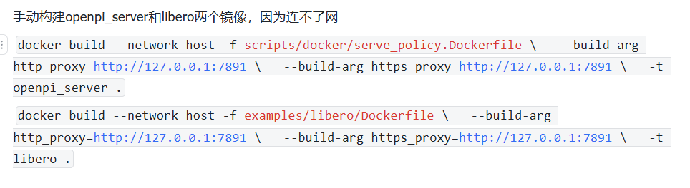
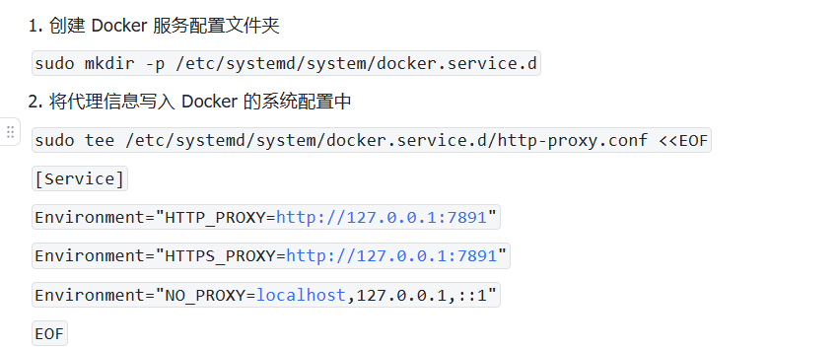
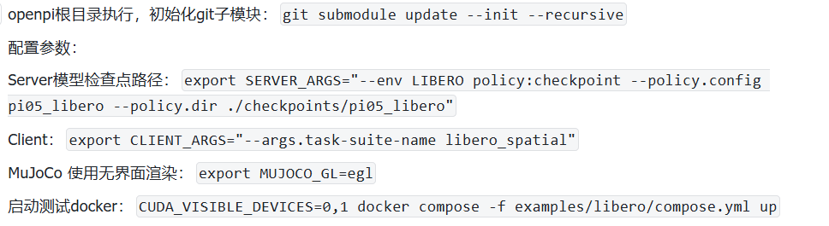
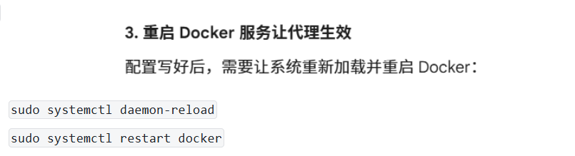
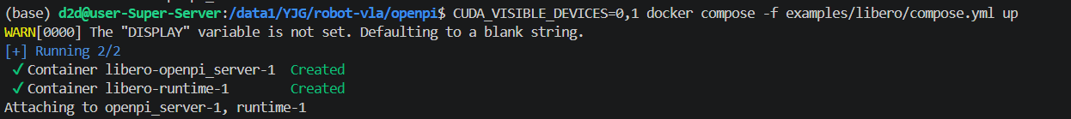
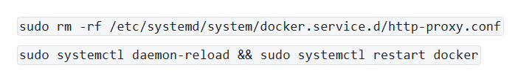
仿真复现openpi0.5VLA
1.安装docker
4090服务器无法连接外网

Slide 2
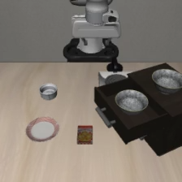
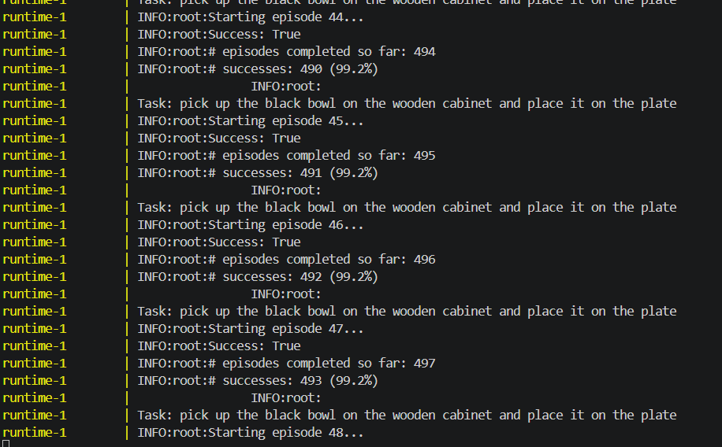
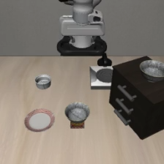
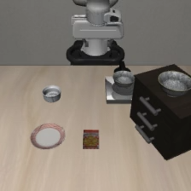

仿真复现openpi0.5VLA
rollout_pick_up_the_black_bowl_in_the_top_drawer_of_the_wooden_cabinet_and_place_it_on_the_plate_success
rollout_pick_up_the_black_bowl_on_the_cookie_box_and_place_it_on_the_plate_success
rollout_pick_up_the_black_bowl_on_the_wooden_cabinet_and_place_it_on_the_plate_failure

Slide 3
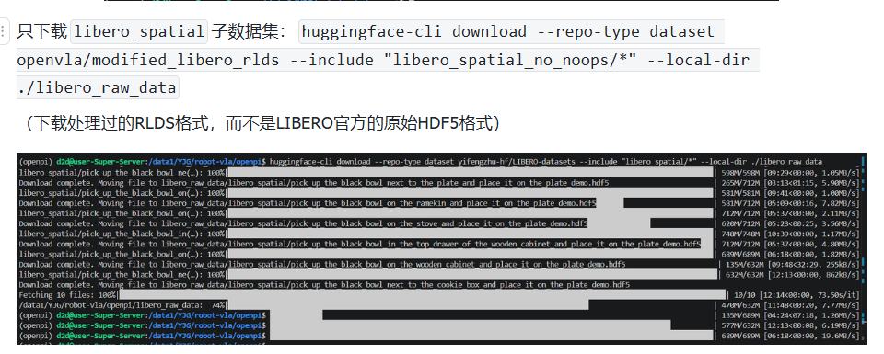
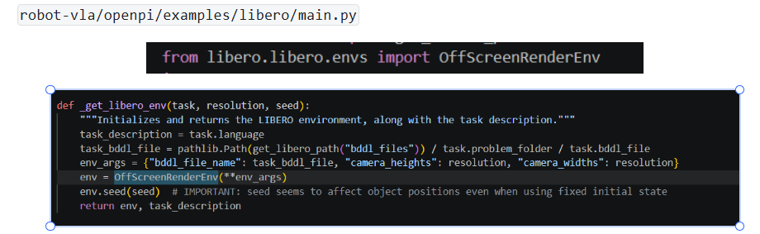
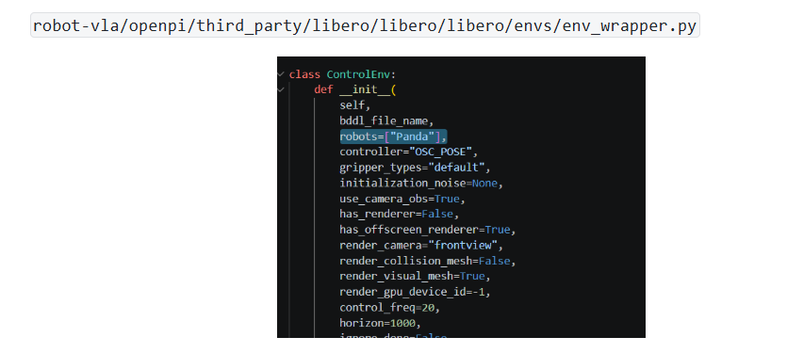
仿真复现openpi0.5VLA
2.迁移方法探索
机械臂移植
默认机械臂是Panda。

