Slide 1
Point-Cloud Segmentation for Walkable Tread Detection on Staircases
A comparative study under sensor noise, for safe stair-climbing robots
Muhammad Nizam Al Anshori ( 1225800010 )
Master Program of Information and Computer Engineering · Politeknik Elektronika Negeri Surabaya
Notes:
Frame this as a research study, not a class project: we benchmark four classical point-cloud segmentation methods for finding walkable stair treads, and we quantify how sensor noise degrades them. Target ~10 minutes.

Slide 2
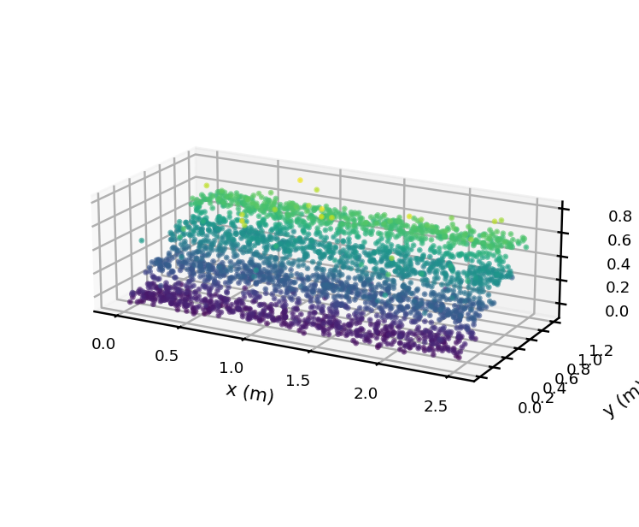
WHY THIS MATTERS
Motivation & Problem
1
Stairs are everywhere Stair-climbing robots constantly meet staircases in human-made environments.
2
Walkable vs. hazardous The robot must tell horizontal treads (safe to step on) from vertical risers and edges.
3
Point clouds are noisy LiDAR and depth cameras output 3D points with sensor noise and outliers.
4
Safety is critical A single mislabeled surface can make the robot slip or fall.
Raw point cloud: 4 steps + outliers (color = height)
Notes:
Precision on the walkable class matters most: a false positive can cause a fall.

Slide 3
WHAT THIS PAPER ADDS
Contributions
1
Controlled synthetic benchmark
A fully labeled 4-step staircase point cloud generated from explicit equations, with adjustable LiDAR noise and outliers.
2
Unified method comparison
Four classical segmentation methods evaluated under identical data, features, and metrics for a fair, reproducible comparison.
3
Noise & safety analysis
A systematic sensor-noise sensitivity study, framed around the walkable-class precision required for safe stair climbing.
Notes:
State the gap: most stair work jumps to a full system; we isolate the segmentation step on a controlled benchmark and quantify noise robustness with safety in mind.

Slide 4
EQUATIONS & PARAMETERS
Synthetic Data Generation
Tread — horizontal (i = 0…3)
x ~ Uniform(0, w)
y ~ Uniform(i·d, (i+1)·d)
z = i·h + εz , εz ~ N(0, 0.02²)
Riser — vertical (i = 1…3)
x ~ Uniform(0, w)
y = i·d + εy , εy ~ N(0, 0.02²)
z ~ Uniform((i−1)·h, i·h)
15,808 points
+ Isotropic LiDAR noise N(0, 0.005²) + 4% random outliers
10,400 tread · 4,800 riser · 608 other
Notes:
Width 2.5 m, tread depth 0.30 m, step height 0.18 m, 4 steps. Ground-truth labels enable quantitative evaluation. Riser i=0 skipped (below floor).

Slide 5
PIPELINE
Methodology: From Points to Surfaces
1
2
3
4
›
›
›
Point cloud
Normal estimation
Geometry analysis
Classify
Raw 3D points (x, y, z) from the sensor.
PCA on k=30 neighbors → nₚ = eigenvector of smallest eigenvalue.
Plane / orientation / cluster / height cues using |nz|.
Tread, Riser, or Other per point.
Orientation key: |nz| → 1 horizontal (tread) |nz| → 0 vertical (riser)
Notes:
The vertical normal component is the shared feature across methods.

Slide 6
GEOMETRIC BASELINES COMPARED
Four Segmentation Methods
1 · RANSAC Plane Fitting
2 · PCA + Normal Analysis
Detects horizontal planes (|nz| > 0.9), then keeps only points whose local normal is also vertical.
Classifies each point directly from |nz|: tread if > 0.85, riser if < 0.35, else edge.
3 · DBSCAN + Slope
4 · Height Histogram
Density clustering rejects outliers; valid points are labeled by their local slope.
Treads cluster at discrete heights; peaks in the z-histogram mark the step levels.
Notes:
Lesson: pure RANSAC and pure DBSCAN have known failure modes on touching surfaces; combining them with normal/slope analysis fixes it.

Slide 7
ACCURACY, PRECISION, RECALL, F1, IOU
Results — Walkable Class
Method | Acc | Prec | Rec | F1 | IoU
RANSAC + Normal | 0.836 | 0.947 | 0.795 | 0.864 | 0.761
PCA + Normal | 0.848 | 0.944 | 0.816 | 0.876 | 0.779
DBSCAN + Slope | 0.843 | 0.957 | 0.798 | 0.870 | 0.770
Height Histogram | 0.854 | 0.935 | 0.836 | 0.883 | 0.790
F1 score by method
Height Histogram leads (best F1/IoU); all methods reach precision > 0.93.
Notes:
Precision–recall trade-off: DBSCAN highest precision, Height Histogram best overall F1/IoU.

Slide 8
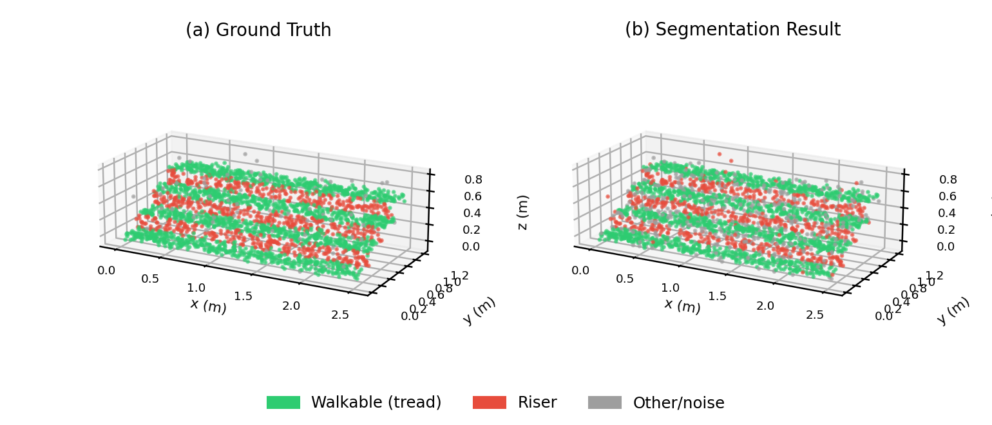
GREEN = WALKABLE · RED = RISER · GRAY = OTHER
Segmentation Result vs Ground Truth
Takeaway: predicted walkable regions closely match ground truth; with precision > 0.93, almost everything marked green is truly a tread.
Notes:
Structure recovered cleanly; main errors are at edges and transition zones.

Slide 9
SENSITIVITY ANALYSIS
Effect of Noise on Accuracy
Monotonic decline
0.970 F1 at no noise
↓
0.329 F1 at sigma 0.08
Reliable up to sigma ≈ 0.02 m; beyond that, normals become unstable.
Notes:
Sharp drop after 0.02 m motivates high-precision sensing or temporal filtering.

Slide 10
IMPLICATIONS
Discussion: Safety for Robots
Precision over recall. A false positive can make the robot slip — target precision > 0.99 via edge filtering and safety margins.
Noise-aware thresholds. Use high-precision sensing or multi-scan temporal filtering; make |nz| thresholds adaptive.
Treat edges specially. The nosing is the most dangerous zone — add a dedicated edge class and a no-step margin.
Fuse, don't trust alone. Adequate as a first perception layer, not a sole safety guarantee — fuse with IMU/camera.
Notes:
Argue that the metric to optimize for a robot is walkable-class precision, not overall accuracy.

Slide 11
CONCLUSION & FUTURE WORK
A reproducible baseline for stair perception
Benchmark + comparison. Controlled labeled staircase cloud; four methods compared under identical conditions.
BEST RESULT
0.883 F1
Best performance. Height histogram and normal analysis reach F1 ≈ 0.88, precision > 0.93.
0.790 IoU
Noise is decisive. Performance falls monotonically with noise — sensor quality and preprocessing are key.
Height histogram, walkable class
Future work. Edge class, noise-adaptive thresholds, region growing, learning-based detectors, real data.
4 methods · 15.8k points
Notes:
Close on the contribution: a reproducible baseline + noise study; deployment needs safety margins and sensor fusion. Thank the audience.

