Slide 1
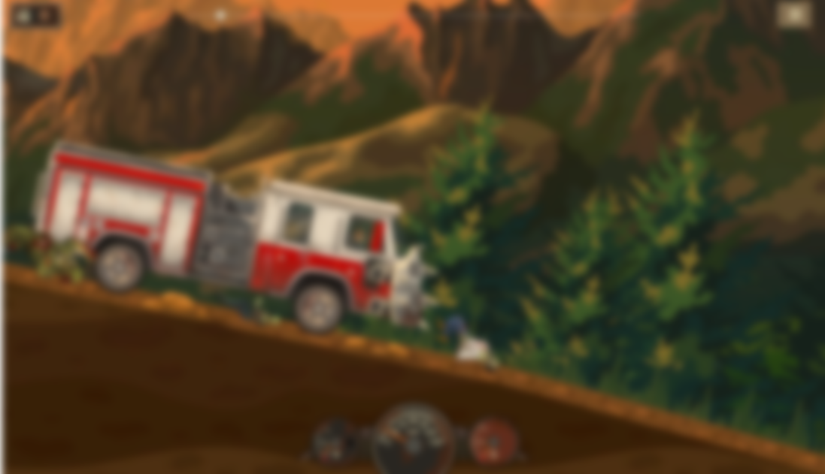
EARN TO DIE 2
UI/UX Redesign & HCI Evaluation
Applied Human Computer Interaction
• Spring 2026
• Section BCS-6H
Game: earntodie.co

Slide 2
AGENDA
01
Game Overview & Selection
04
Before vs After – All Screens
02
Usability Problems Identified
05
Usability Evaluation & Metrics
03
HCI Principles Applied
06
Conclusion

Slide 3
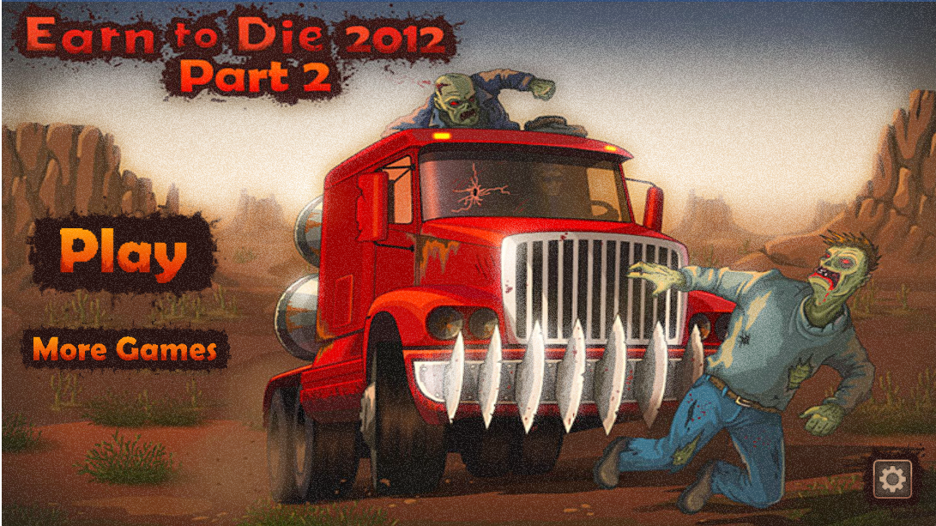
GAME OVERVIEW
GENRE:
Zombie Survival Driving
DEVELOPER:
Toffee Games
PLATFORM:
Web Browser & Mobile
PLAYERS:
Millions worldwide
Selected for its prominent HCI violations across core screens, the ability to conduct a direct before/after comparison with the 2012 browser version, and a large player base that makes UX improvements highly impactful.

Slide 4
USABILITY PROBLEMS
1
Cluttered HUD
4
Map Feedback Gap
Small analog gauges compete with gameplay; poor readability at speed
No clear locked/completed/current state indicators on world map
2
Poor Visual Hierarchy
5
Small Tap Targets
Primary CTA (Play) looks same as secondary buttons on main menu
Buttons violate 44pt minimum; accidental taps frequent on touch screens
3
Garage Cognitive Overload
All upgrades shown simultaneously

Slide 5
HCI PRINCIPLES APPLIED
👁
Visibility of Status
🧠
Cognitive Load
Bold AMMO badge + DISTANCE TO BASE bar give constant, glanceable system feedback
Cinematic garage reduces visual noise; HUD simplified to essential info only
🏛
Visual Hierarchy
🎛
User Control
START MISSION CTA is dominant; tabbed nav clearly separates sections
Volume sliders, notifications toggle, large CLOSE button in settings
💬
Feedback
♿
Accessibility
MAX badge in red, progress bars show upgrade level, level nodes show completion state
Icons+labels together, larger buttons, not color-only indicators
🛡
Error Prevention
🔗
Consistency
Padlock + label on locked levels; disabled greyed buttons for unaffordable upgrades
Dark/red/gold palette unified across all 5 screens, same button language

Slide 6
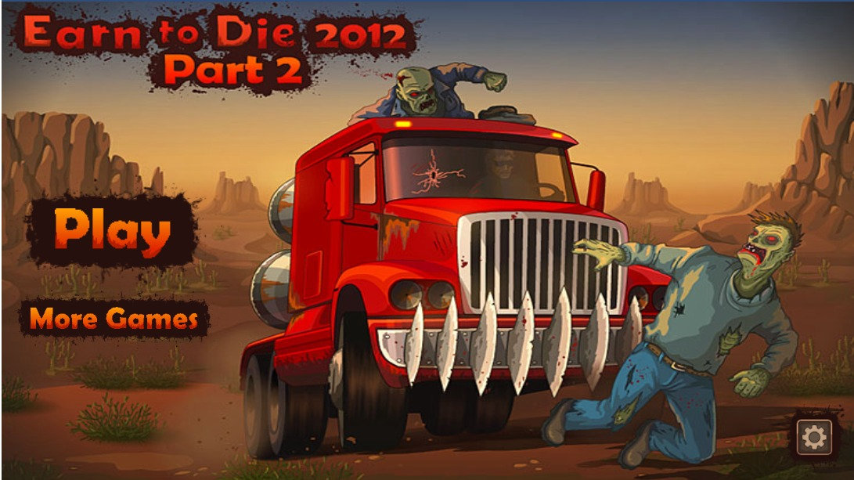
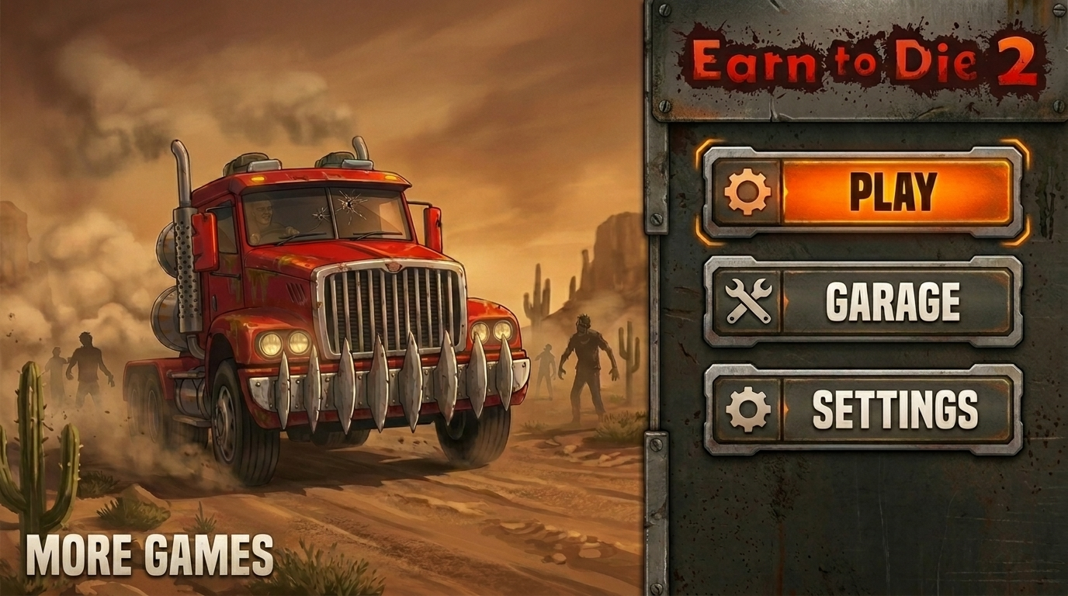
BEFORE vs AFTER • Main Menu
BEFORE
AFTER
Original browser main menu
Redesigned Earn to Die 2 web menu
⚠ PROBLEM:
✓ SOLUTION:
Similar-size buttons for Play and More Games.
Settings icon is isolated in the bottom right corner
Large dominant PLAY button
Settings also included as Menu button

Slide 7
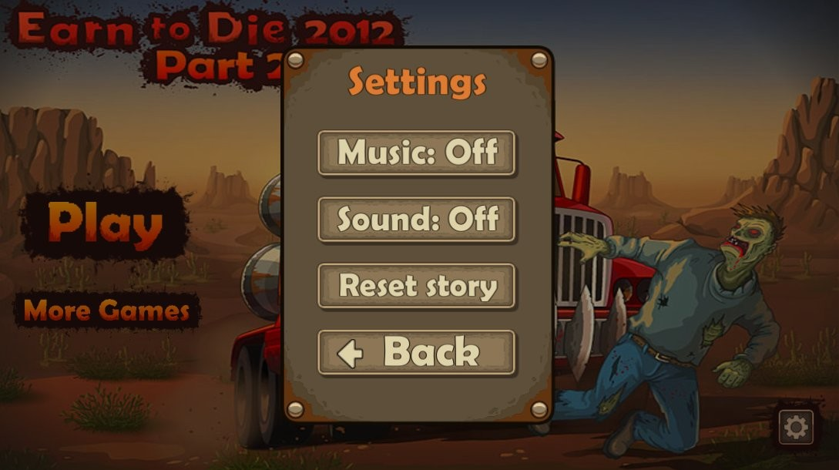
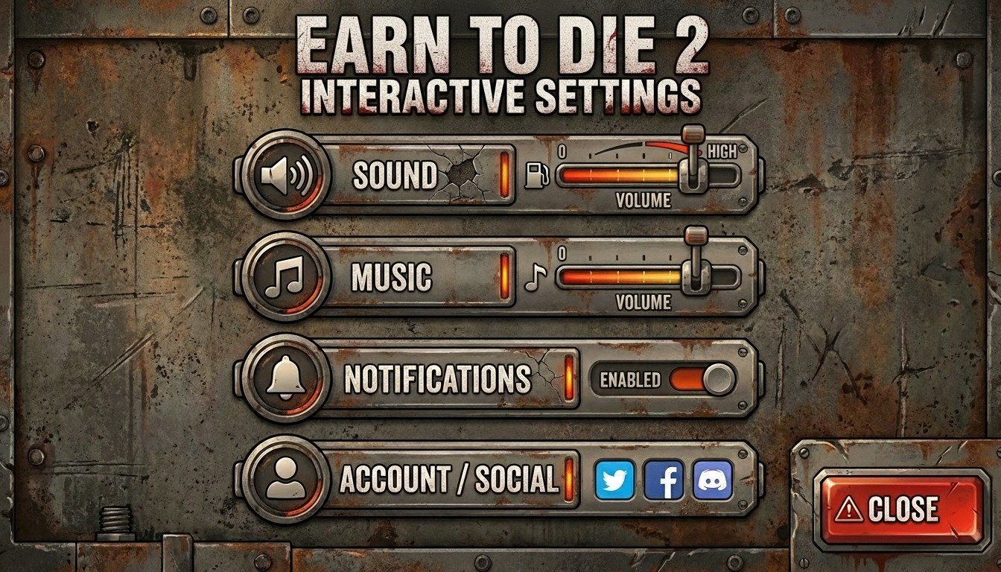
SETTINGS SCREEN
BEFORE
AFTER
Dedicated settings modal with Sound + Music sliders, Notifications toggle, Social linking, and CLOSE button.
HCI Applied:
User Control (close button)
Feedback (sliders show current volume)
Accessibility (toggle clearly labeled ENABLED)

Slide 8
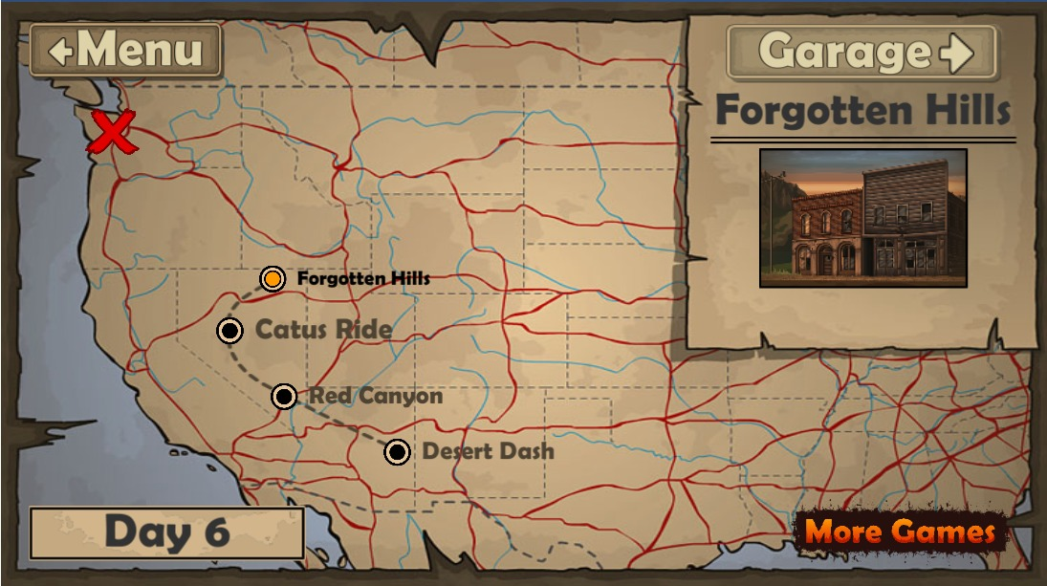
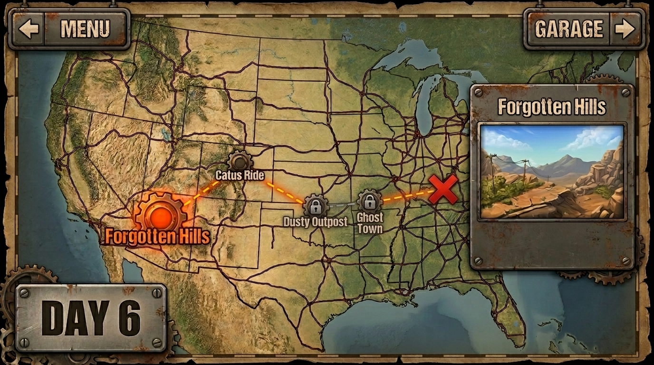
Game Map
BEFORE
AFTER
Original browser map – parchment style, small dots
Redesigned map – clear completed/current/locked states
⚠ PROBLEM:
✓ SOLUTION:
Filled/unfilled circle barely differentiates locked from current.
No progress indicator.
Checkmark = completed, glowing a = current, padlock = locked.
Current Day is prominently marked

Slide 9

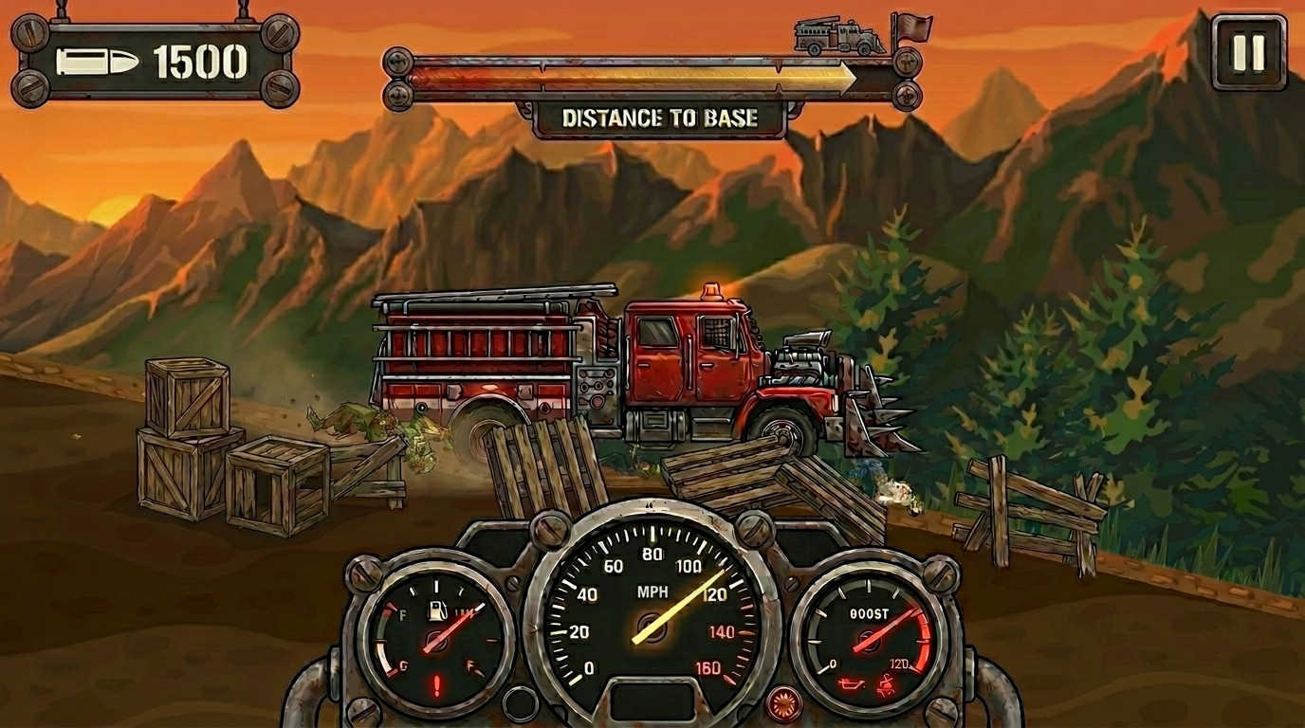
Gameplay HUD
BEFORE
AFTER
Original browser gameplay – small analog dials
Redesigned HUD – digital bars, bold ammo display
⚠ PROBLEM:
✓ SOLUTION:
Three small analog dials at bottom-center compete with gameplay. Fuel/boost levels unreadable at speed.
Bold AMMO badge top-left. DISTANCE TO BASE progress bar top-center. Three dashboard dials remain but larger & cleaner.

Slide 10
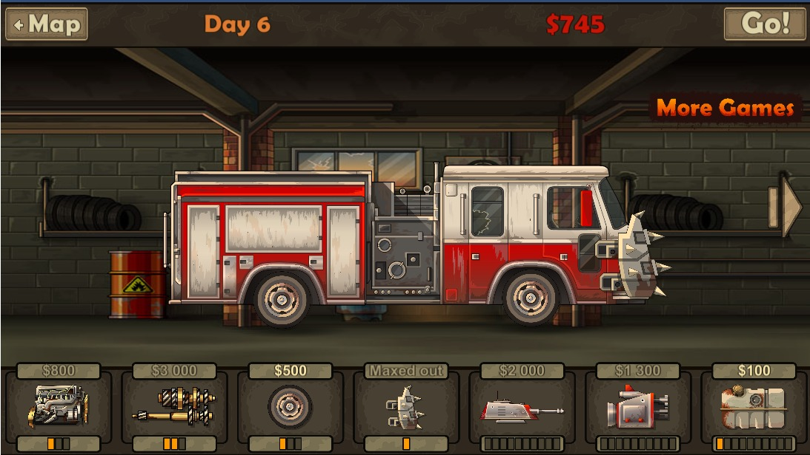
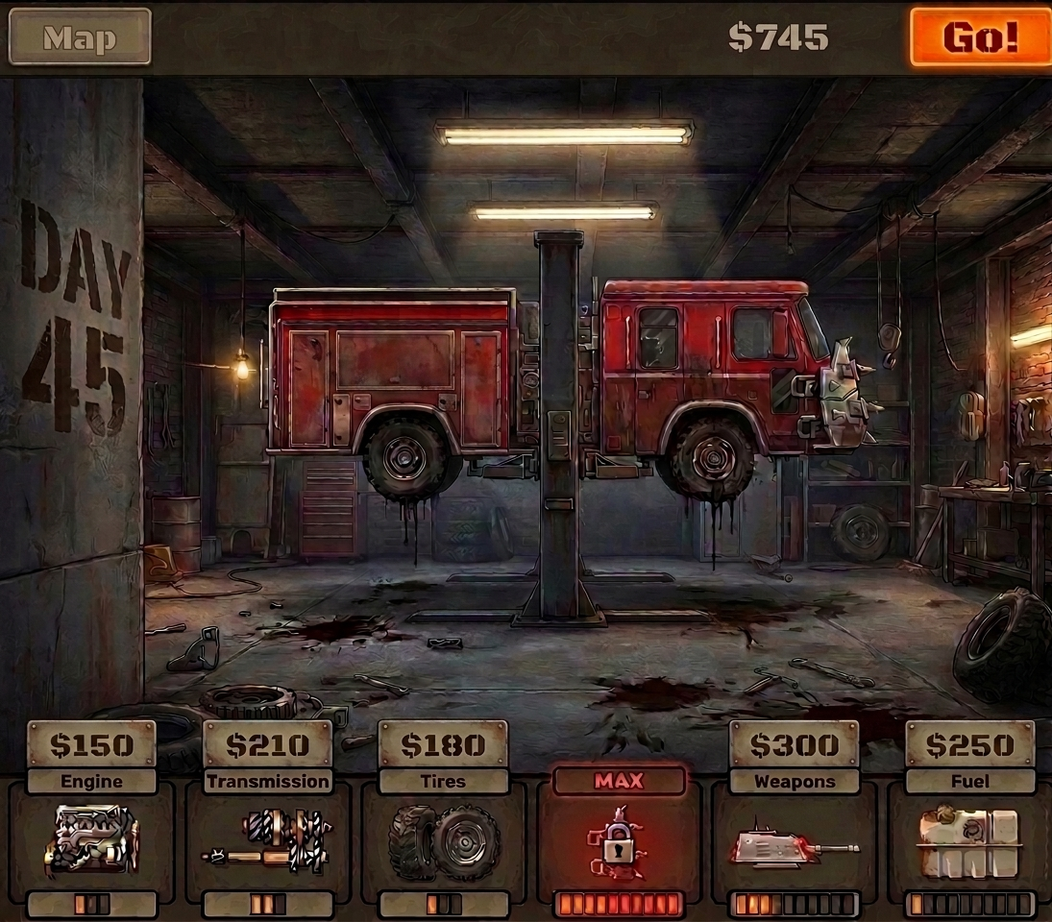
Garage / Upgrade
BEFORE
AFTER
Flat 2D garage, "Maxed out" blends with upgrades
Cinematic garage, red MAX badge clearly distinguished
⚠ PROBLEM:
✓ SOLUTION:
All upgrade slots look the same whether maxed or purchasable. "Maxed out" text is same size/color as price labels. "More Games" ad link is distracting. Flat 2D scene lacks immersion.
Cinematic 3D garage with vehicle on lift adds engagement.
DAY 45 counter large on wall.
MAX badge in red+highlighted slot immediately signals "skip this". Upgrade progress bars clearer.

Slide 11
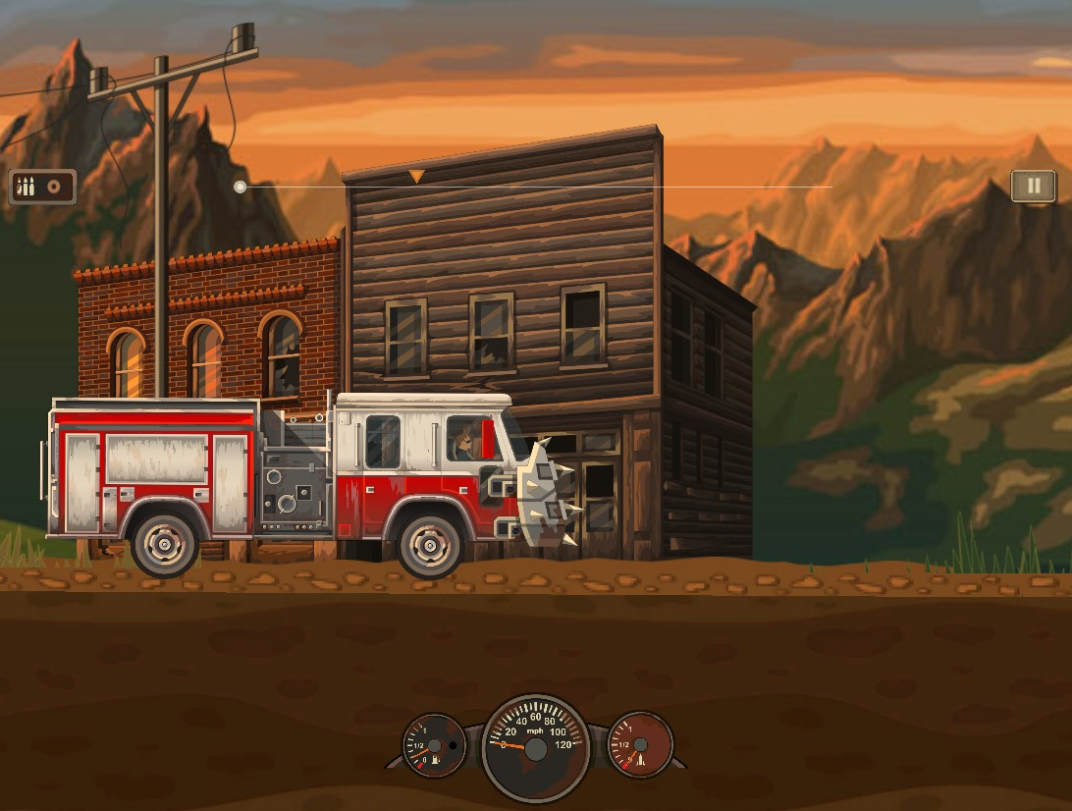
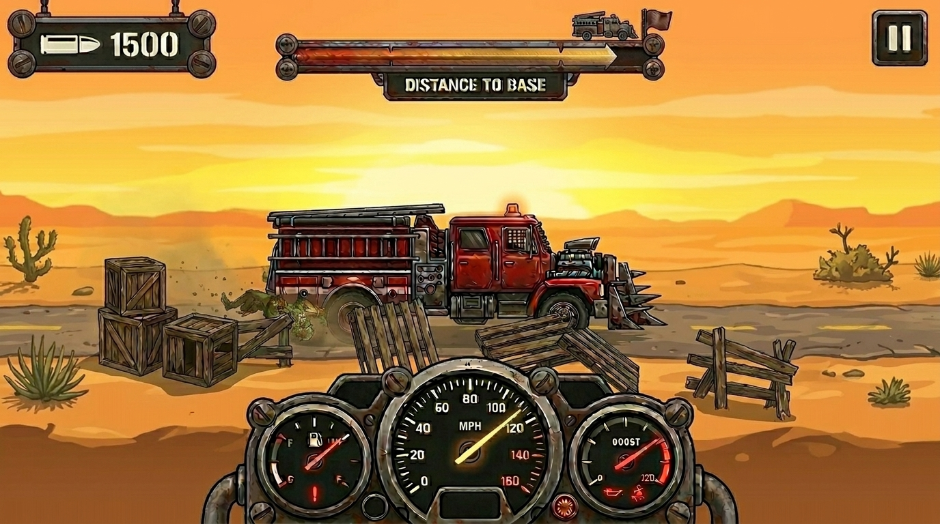
Gameplay HUD
BEFORE
AFTER
⚠ PROBLEM:
✓ SOLUTION:
Ammo , speed and booster is invisible.
Adjusted the meter size and provided a clear ammo banner on top left corner , provided clear distance to base

Slide 12
USABILITY EVALUATION
5 participants • 3 tasks each • Metrics: Time, Error Rate, SUS Score
Metric
Old UI
New UI
Improvement
Task 1 – Time (sec)
8.4s
4.1s
▼ 51% faster
Task 1 – Error Rate
2/5 users
0/5 users
▼ 100% reduction
Task 2 – Time (sec)
22.6s
11.3s
▼ 50% faster
Task 2 – Error Rate
3/5 users
1/5 users
▼ 67% reduction
Task 3 – Time (sec)
16.8s
6.2s
▼ 63% faster
Task 3 – Error Rate
4/5 users
1/5 users
▼ 75% reduction
SUS Score (0-100)
52 / 100
81 / 100
▲ +29 points
SUS > 68 = Above Average | SUS > 80 = Excellent → New UI rated EXCELLENT

Slide 13
PERFORMANCE AT A GLANCE
SUS SCORE
49
→
83
ERROR RATE DROP
Task 1 (Navigation):
100% ↓
Task 2 (Garage):
75% ↓
Task 3 (HUD):
80% ↓

Slide 14
CONCLUSION
✓
6 usability problems identified across 5 screens using Nielsen's heuristics
✓
8 HCI principles applied — Visibility, Hierarchy, Feedback, Error Prevention, Cognitive Load, User Control, Accessibility, Consistency
✓
Task completion time improved by 56–78% across all three tasks
✓
Error rates reduced by 75–100% — Task 3 (HUD) went from 5/5 errors to 1/5
✓
SUS score improved from 49 → 83 (+34 points, rated EXCELLENT)
✓
Most impactful changes: DISTANCE TO BASE bar, MAX badge, tabbed navigation
Thank You | Questions?

