Slide 1
Problem ID:PK416 Team Name: dCodersss
AGRO MART: A decentralized market for agricultural commodities
SIH

Slide 2

Overview
A blockchain based decentralized & paperless web portal for an open and transparent market for agricultural commodities, eliminating middle men.
Machine Learning techniques to provide yield prediction and crop quality prediction.
Company to pay 20% amount at initial stage and 10% in installments periodically to the farmer subsequently. Remaining amount to be paid at the time of harvest.
An android based mobile app for farmer for easy login, selling of produce and periodic image uploading facility.

Slide 3
Objectives
Elimination of middle men, empowering farmers
Pre-selling of crops and installment based payments for better financial support to the farmers
Direct bank tranfer
Leveraging immutability, openness, decentralization and security of blockchain
Yield and crop quality prediction using ML
A one-stop solution with farmer, company and government dashboards
Government’s dashboard to keep a check on hoarding and manage PSF

Slide 4
Technology Stack
Blockchain
- Nodejs
Machine Learning
- Random Forest: Yield Prediction
- CNN: Crop Quality Prediction
Web Portal
- React
Mobile App
- Android Studio
- Firebase

Slide 5
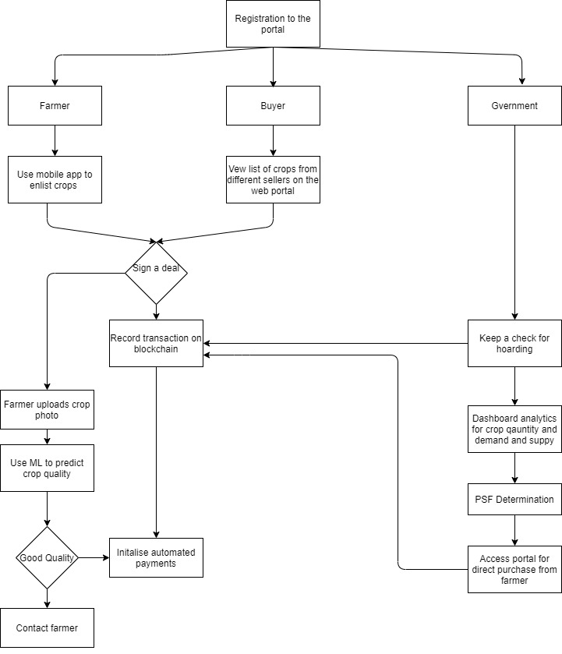
Flow Diagram
YES
NO

Slide 6
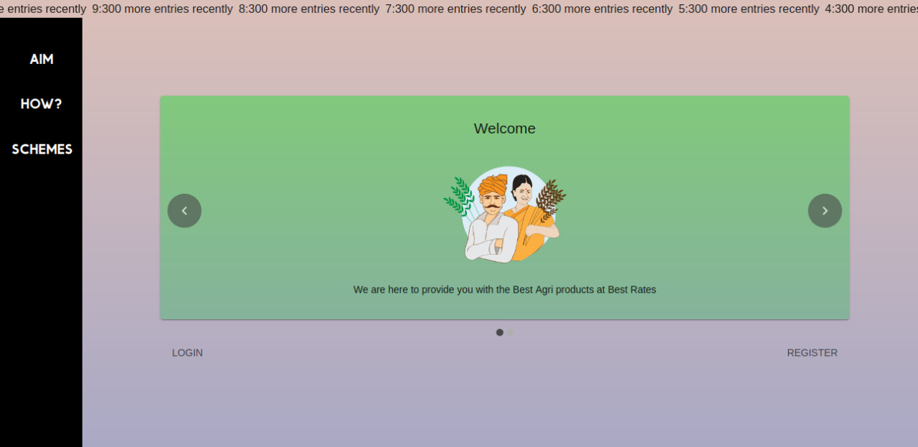
Agro Mart Portal

Slide 7
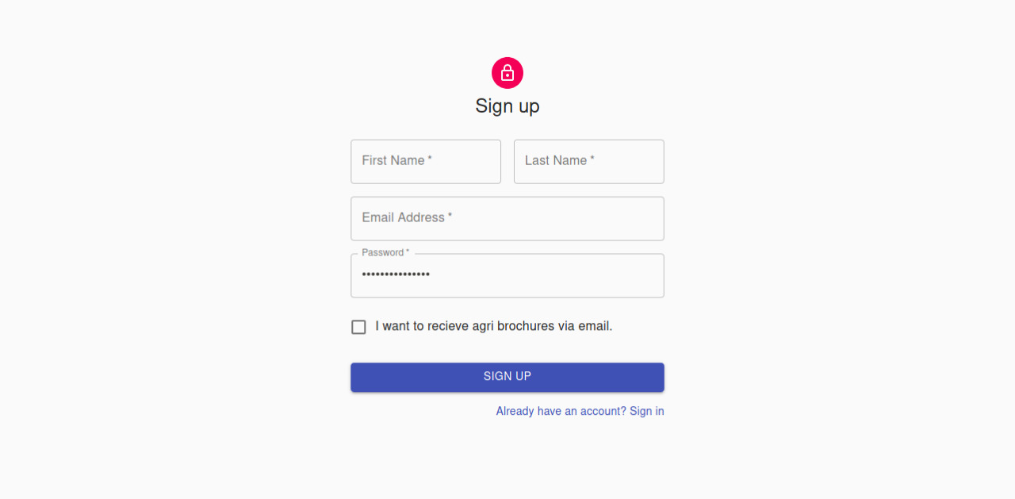
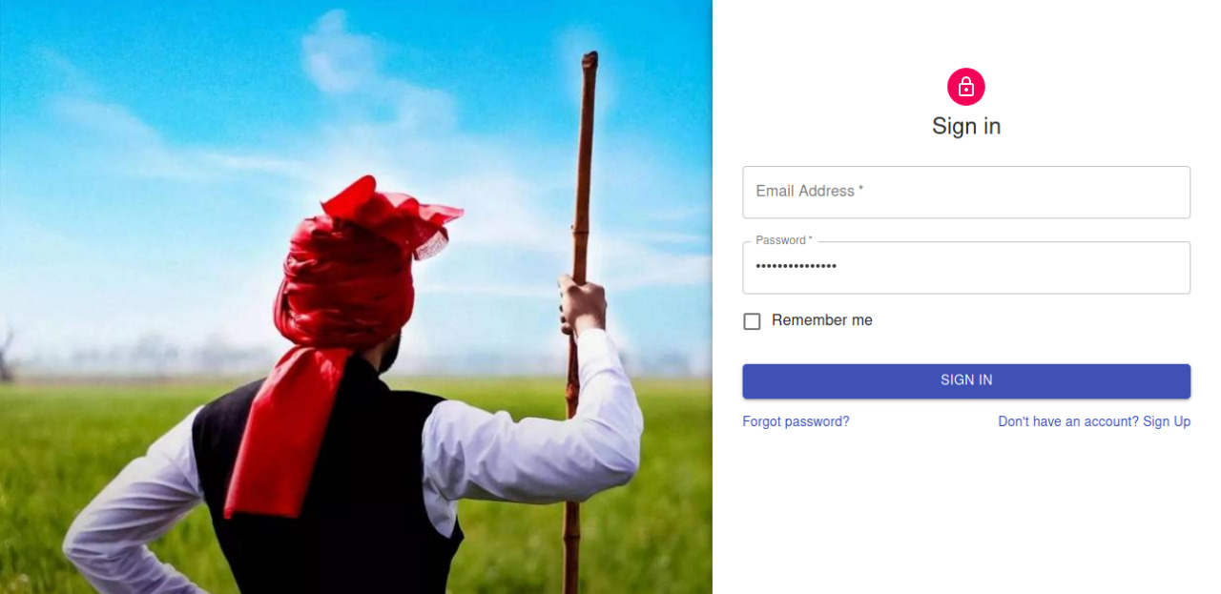
Registration to the Portal

Slide 8
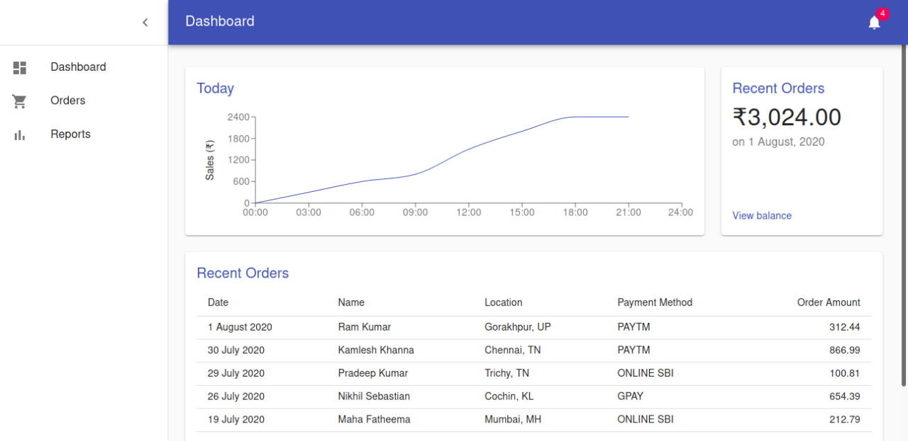
Dashboard – Analytics View

Slide 9
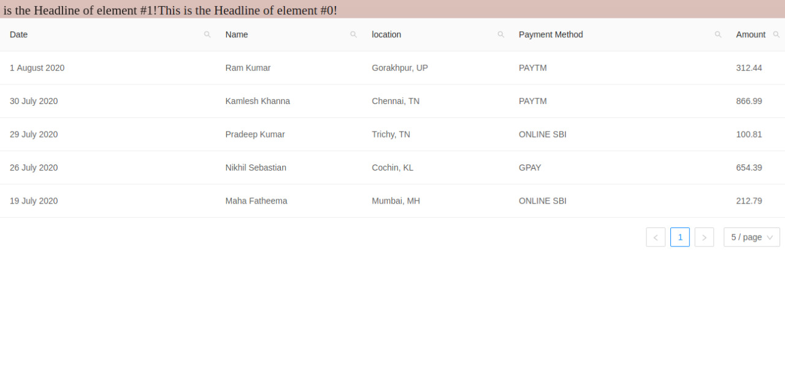
Dashboard

Slide 10
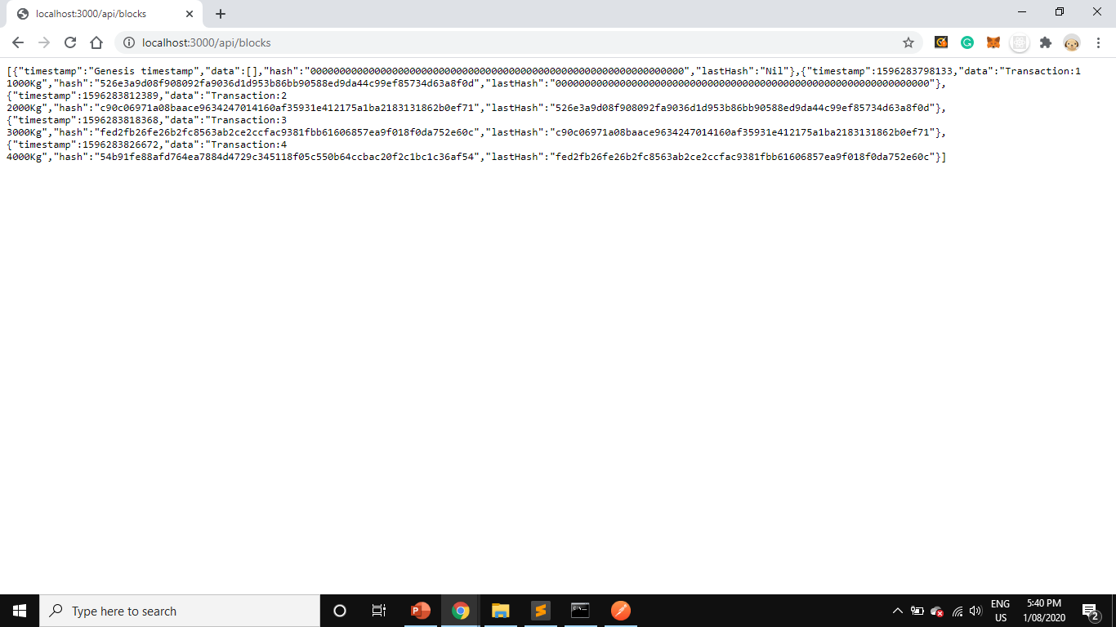
Blocks added for transactions signed

Slide 11
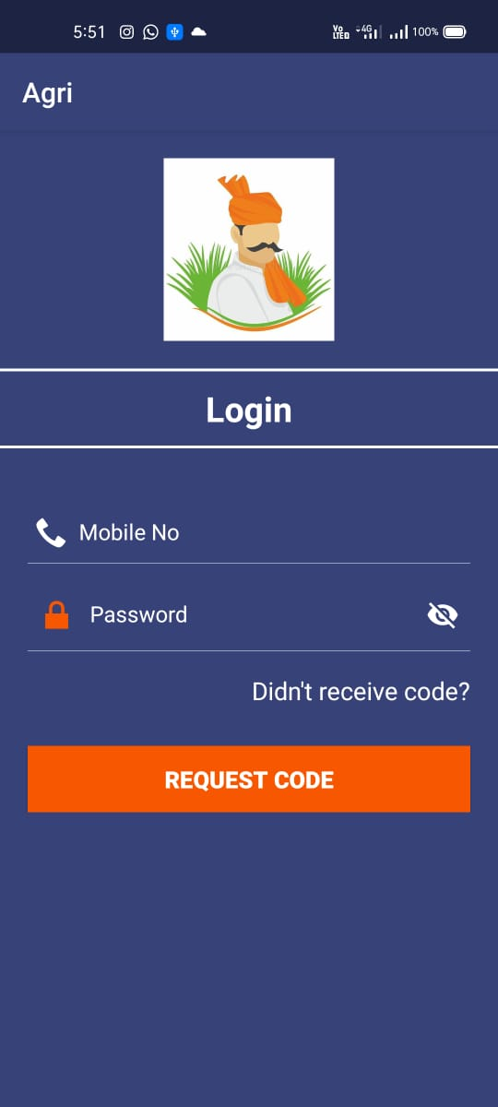
Mobile App for Farmers
A handly mobile app for farmers
User friendly
Convenient to use
Easy access to the Agro Mart

Slide 12
PROGRESS UPDATE

Slide 13
Work completed by Day 1
Blockchain
Developed a blockchain in nodejs using sha256 for immutability
Web Portal
Developed a web portal using React and designed the User Interface
Designed a dashboard for viewing records and analytics along with advanced search on table entries

Slide 14
Work completed by Day 1
Mobile App
Developed an android based mobile app customized for farmers using Android Studio
Developed SMS based login functionality and user interface
Machine Learning
Dataset preprocessing
Crop disease prediction using CNN

Slide 15
New additions aimed for Day2
Blockchain
Creating data models and integrating with the blockchain
Web Portal
Developing dashboard configuration on the portal
Working to develop separate dashboards for government and company/buyers
Configuration of registration functionality

Slide 16
New additions aimed for Day2
Mobile App
Developing database using firebase
Developing functionality in the android studio to allow farmers to enlist crops for selling on the portal
Machine Learning
Price prediction based on data from various Mandis using

Slide 17

Implementations on Day2
SIH
This Photo by Unknown Author is licensed under CC BY-SA-NC

Slide 18
Web Portal
SIH

Slide 19
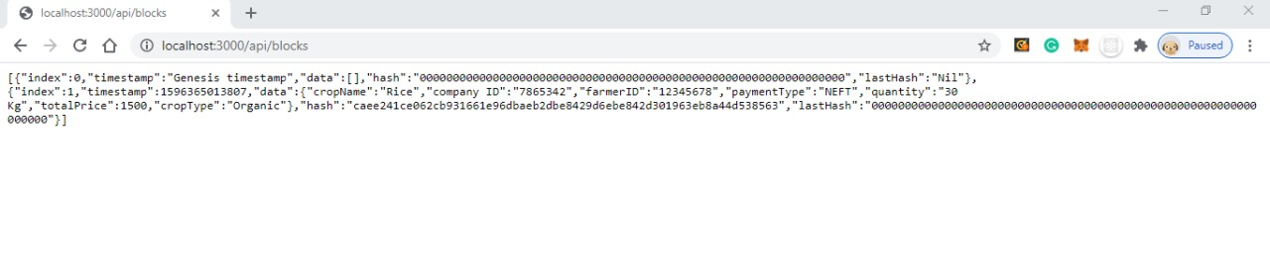
Blockchain
SIH

Slide 20
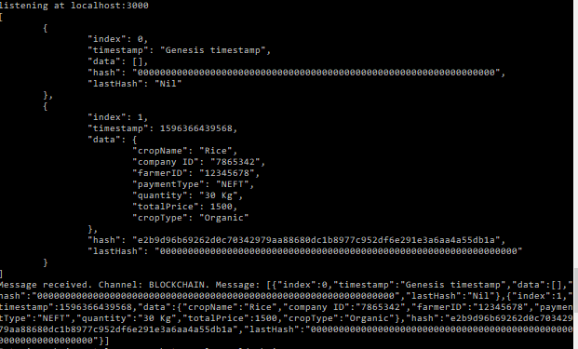
Fetching blocks
SIH

Slide 21
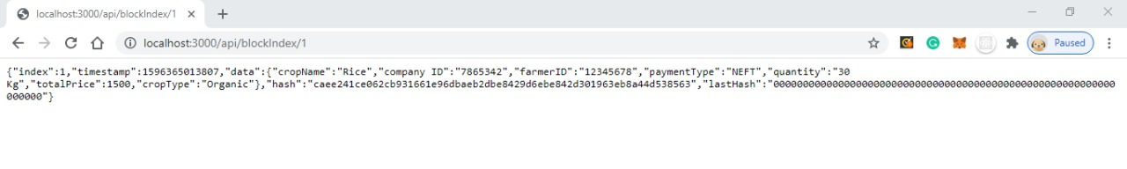
Fetching blocks
SIH

Slide 22
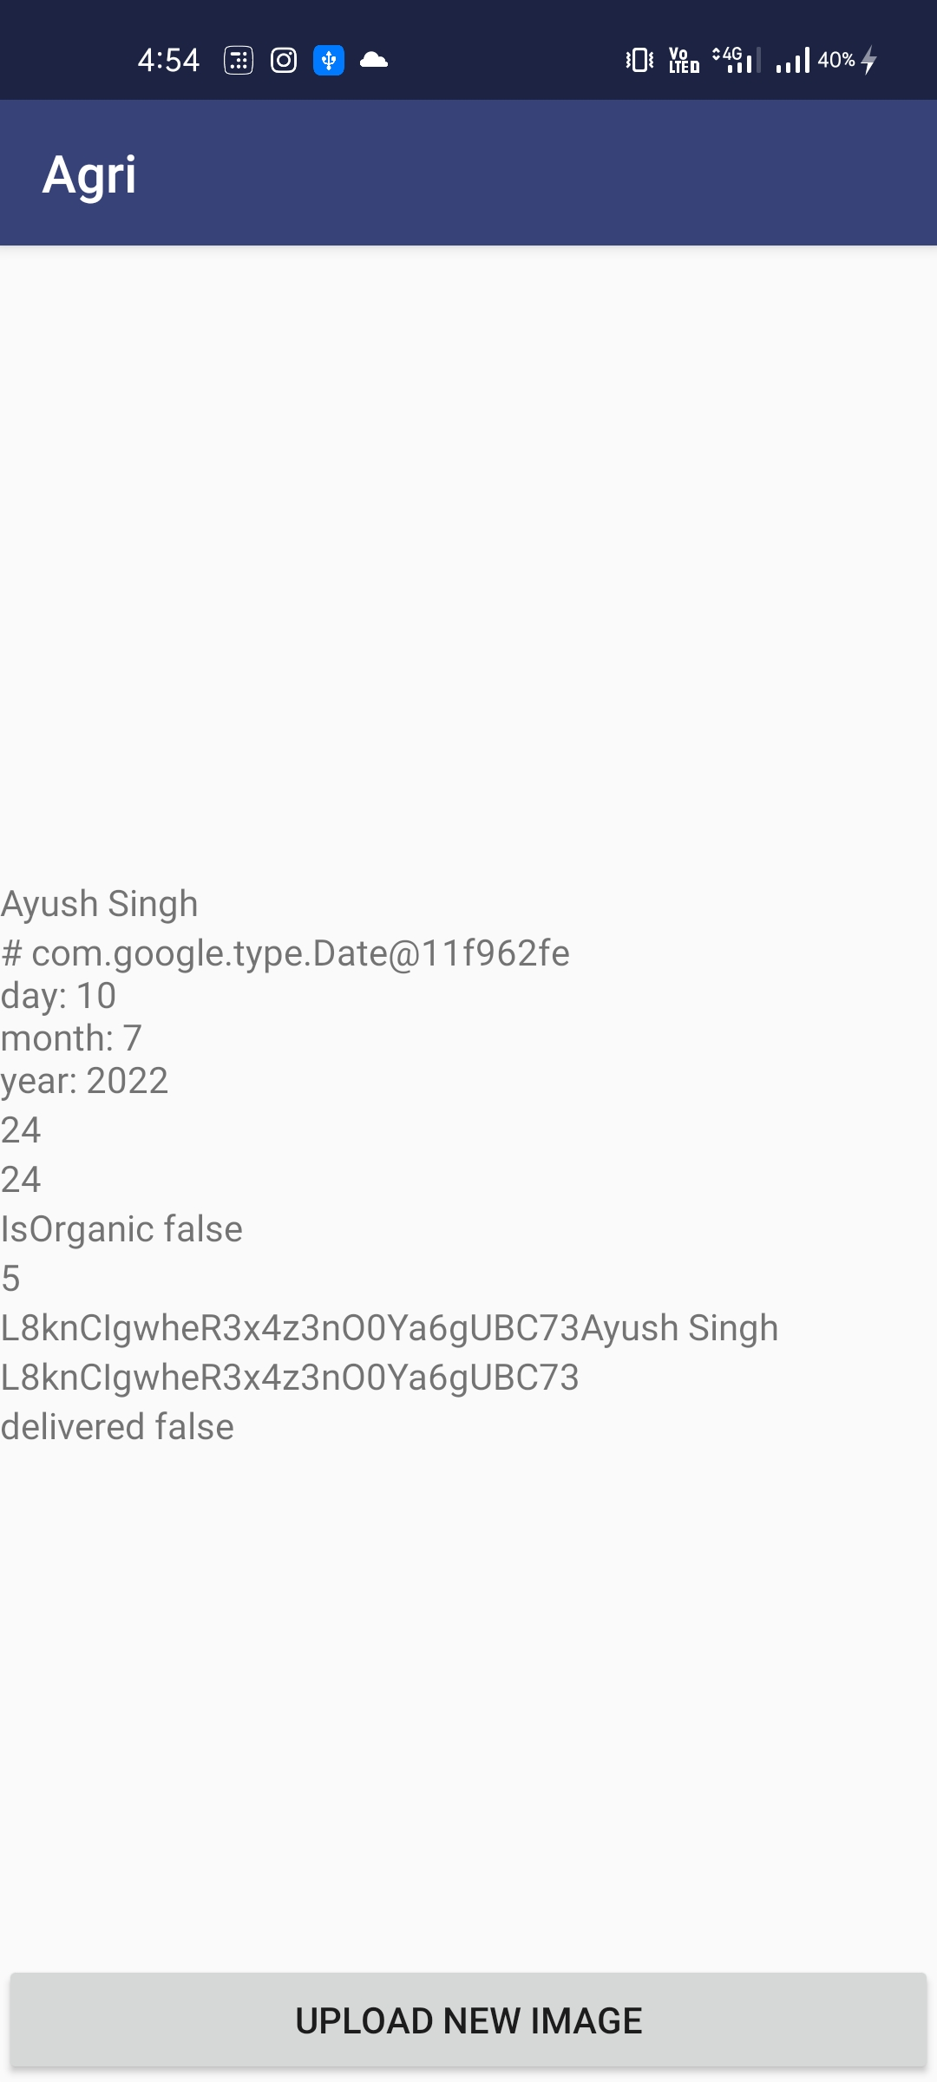
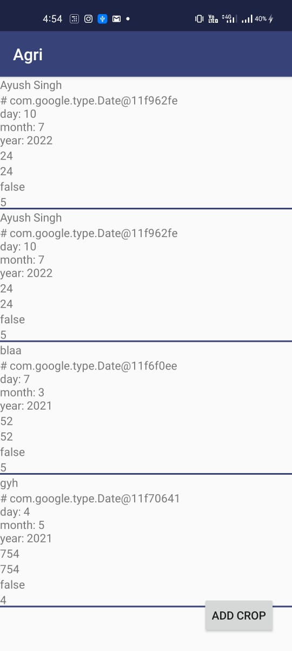
Mobile App
SIH

Slide 23
Work completed by Day 2
SIH
Blockchain
Designed data models as per requirements of Agro Mart portal
Web Portal
Configuration and linking of dashboard
Developed backend for the portal
Sign in and registration functionality implemented
Developed peer-to-peer broadcasting functionality
Added api to fetch by indices

Slide 24
Work completed by Day2
SIH
Mobile App
Developed database using firestore
Developed functionality in the android studio to allow farmers to enlist crops for selling on the portal
Machine Learning
Price prediction based on data from various Mandis using ARIMA

Slide 25
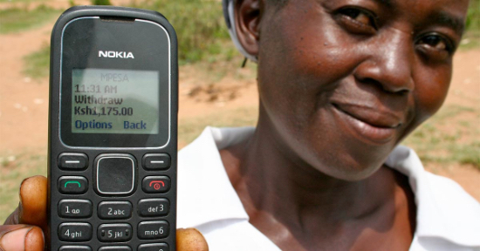
Empowering Farmers through a Digital Solution
This Photo by Unknown Author is licensed under CC BY-SA-NC

