Slide 1
Designing Solutions With Storm

Slide 2



Raghavendar Reddy Maddelavedu
Ganesh Siripuram
Karthik Reddy Muthyala

Slide 3
Topics
Introduction
Types of Data Processing
Storm Vs Hadoop
Storm Components
Maven
Architecture
Hands On
Raghavendar

Slide 4
Introduction to Strom
It is open source software.
Storm is used to process large amount of data.
Strom is easy to set-up, operate.
Many Industries choose it because its distributed, real-time, data processing platform.
In storm, we can execute real-time data in parallel.
Raghavendar

Slide 5
Types of Data Processing
Batch Processing
Real time processing
Online Processing
Distributed Processing
Multiprocessing
Time Sharing
Raghavendar

Slide 6
Batch Processing:
It is used widely for data processing and it is know as serial/sequential, tacked/queued.
Batch processing is used to organized the data into groups for efficient and sequential processing.
Real time processing
It used for real time processing.
Collects, analyzes and produces output in Real time.
Raghavendar
Notes:
Takes large amount of data at a time, analyzes it and produces a large output

Slide 7
Online Processing
It is used for automatic processing method.
It stores the data in one place and used in different place.
Distributed Processing
This method is commonly used in remote workstations.
It is connected to one big central server.
Raghavendar

Slide 8
Multi Processing
It is the widely used type of data processing.
It is used in all computing devices relying on processors.
Time Sharing
One CPU is used for multiple users but time is different for every users.
The process is done in intervals as per the time slot which assigned for each users.
Raghavendar

Slide 9
Storm | Hadoop
It used in Real-time stream processing. | It is used in Batch processing.
Master/Slave architecture with Zookeeper based coordination. The master node is called nimbus and slaves are called supervisors. | Master/slave architecture with Zookeeper based coordination. The master node is called job tracker and slave node is task tracker.
Stateless | Stateful
It runs until stopped by user or an unexpected unrecoverable failure. | MapReduce jobs are executed in a sequential order and completed eventually.
A Storm streaming process can access tens of thousands messages per second on cluster. | HDFS uses MapReduce framework to process vast amount of data that takes minutes or hours.
Raghavendar

Slide 10
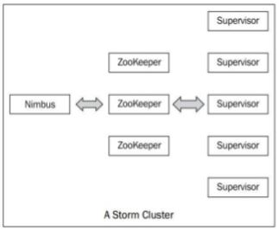
Storm Components
Through zookeeper, storm cluster follows a master-slave model where the master and slave processes are coordinated.
It is used to manage large set of hosts.
Karthik Reddy

Slide 11
Storm Components: Nimbus(Master Node)
Nimbus is a central component of storm cluster.
It is responsible for:
The application code is distributed across various nodes.
Failures of task are monitored.
Each machines are assigned different tasks.
It is restarted when required.
Karthik Reddy

Slide 12
Storm Components: Supervisor(Worker Nodes)
The supervisor nodes means the nodes that follows the instructions given by the nimbus.
These are the worker nodes in the storm cluster.
Every supervisor node runs creating, starting & stopping the worker processes to execute the tasks assigned to that node.
Karthik Reddy

Slide 13
Storm Component: Zoo Keeper
The nimbus and supervisor will interact with each other with help of zookeeper.
The state of nimbus and supervisor will maintained by zookeeper.
The zookeeper cluster is also used by storm to coordinate various processes.
We can kill nimbus and supervisor daemons without affecting cluster because the data is stored in zookeeper.
Karthik Reddy

Slide 14
What is Maven?
It is project Management & Comprehension tool.
In which, it manages a projects build, reporting and documentation from the information.
Maven as so many build tools with that following thing can do:
Build
Document
Dependency Management
Distributions
Test
Report
Karthik Reddy

Slide 15
Architecture
Storm provides two types of components that process the input stream are spouts and bolts.
Spouts are used to process external data to produce streams of tuples.
The spouts will transmits the tuples to the bolts.
Bolts will process those inputs streams and produce the output tuples.
Ganesh

Slide 16
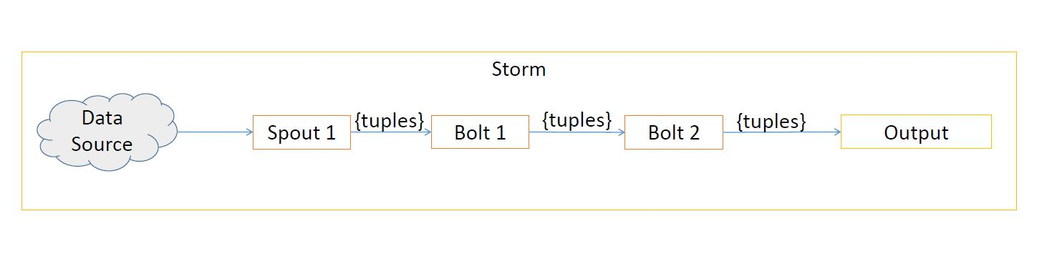
Storm Topology
The data is taken from from data source then it process through the spouts and the output is transmit to the bolts tuples 1 then the output of that tuples will stores in the output stream through bolt 2.
Ganesh

Slide 17

Ganesh

Slide 18
Resources
https://www.tutorialspoint.com/apache_storm/apache_storm_introduction.htm
https://planningtank.com/computer-applications/data-processing-methods-types
https://dzone.com/articles/apache-storm-the-hadoop-of-real-time-1
https://www.simplilearn.com/introduction-to-storm-tutorial-video
https://acadgild.com/blog/apache-maven-beginners-guide

Slide 19


