Slide 1

Pancake Flipping
PayPal
Rahul Muralidharan

Slide 2
Case Background
Arielle and Boris compete in the little-known sport of pancake flipping, and have both been nominated for this season's "best pancake flipper" award.
Half the people in the pancake flipping league office think Arielle is the better pancake flipper, and the other half think Boris is, so they have retained a data scientist to help solve the issue.
The stats from this season are attached. The columns are:
  the contestant's name,
  the match day,
  which hand they used to flip the pancakes,
  their score (how many pancakes they flipped successfully), and
  how many total pancakes they attempted to flip

Slide 3
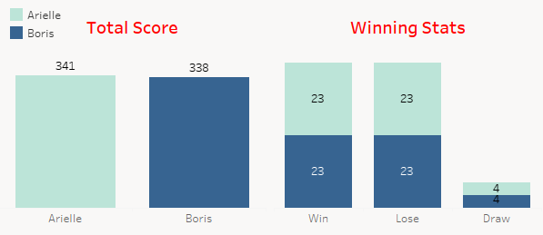
Data Findings
Arielle and Boris have played total of 50 matches each, with 20 attempts per person per match.
If the score of Arielle is higher than Boris, it is considered as win for Arielle and vice versa. If Arielle and Boris has same score, it is considered as draw.
Both have an equal win rate of 46% and draw rate of 8% considering each match score with highest score as winning.
46%
46%
8%

Slide 4
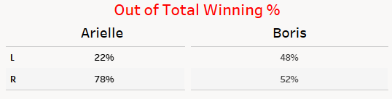
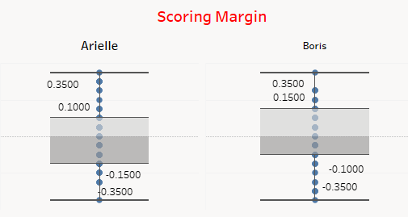
Inference
Out of his wins, Arielle has won 78% of matches when he has played in Right
Boris on the other hand has equals wins on irrespective of playing in Right/Left hand ( 52%-R & 48%-L)
The difference in the score of both the players for a each match is considered as score margin
The number of times Boris has won with higher score margin against Arielle is more than the number of time Arielle has won with higher score margin than Boris

Slide 5
Is Arielle or Boris the better pancake flipper?
Considering the number of times Boris has won with higher margin against Arielle &
Boris has a consistent performance irrespective of Right or Left hand being used
Boris is a better player than Arielle
Do both sides have a case here?
Both have a case depending on the parameter that will be considered for the award.
If the parameter is going to be over all score:
  Arielle has a chance since Arielle score 341 vs 338
  Also has highest number of pancake flip in a match is 13 scored by Arielle
If the parameter is going to be over all consistency and higher score margin:
  Boris has a chance since he is effective with both the hands and the number of times has won with higher margin

Slide 6
Thank you

