Slide 1

IBM SKILLATHON 2026
Health Journey
A privacy-first AI health companion — powered by IBM Bob
Your medical life is scattered across folders, portals and WhatsApp forwards.
Health Journey brings it into one place — and puts an assistant on top of it
that explains your record in plain language, and never guesses.
TEAM NOVATRA
New Horizon College of Engineering
Mantripragada Ramaa Gayatri · Allu Uma Eashanvi · Krupa L P · Madhumitha K
Notes:
Open with the one-line problem, not the product name.
"Every family in this room has a folder, or a drawer, or a WhatsApp thread full of medical reports. Nobody can find anything in it when it matters."
Health Journey is a privacy-first AI health companion. Team NovaTra, New Horizon College of Engineering.

Slide 2

THE PROBLEM
Nobody is holding the whole picture
It is scattered by design
01
Lab reports sit with the diagnostic chain. Prescriptions sit on paper. Scans sit in a hospital portal you log into once. No single place holds the record.
It is remembered by a person
02
Follow-ups, annual screens and vaccine boosters live in somebody's head. When that person is busy, unwell, or caring for a parent as well, things are simply missed.
It is unreadable when it matters
03
A lab report is thirty markers and a reference range. Patients cannot read it, and a seven-minute consultation is not enough time to explain it.
Notes:
Ground this in something the judges recognise. Do not read the numbers off the slide — say the story.
"A follow-up gets missed because nobody remembered it was due. A doctor asks what your last HbA1c was and you're scrolling through a phone gallery in the consulting room. A parent's prescription changes and the family finds out three weeks later."
The point: this is not a data problem, it is a continuity problem.

Slide 3
WHY THIS IS STILL UNSOLVED
The obvious answers each miss something
×
×
×
Hospital portals
Consumer health apps
A general AI chatbot
Accurate, but siloed. One portal per hospital, and none of them talk to each other. You cannot see your journey, only one provider's slice of it.
Good at steps and sleep. They track what a wearable can measure, not what a clinician wrote — and they upload everything to a server.
Fluent and confident, with no access to your record — so it generalises, or invents. A confident wrong number is the failure mode that matters here.
The gap
Nothing owns the whole journey, explains it in plain language, and keeps it on your own device.
Notes:
Pre-empt the 'why doesn't X already solve this' question. Be fair to each option — judges respect that more than dismissal.
Land on the gap: nothing owns the whole journey AND explains it AND keeps it private.

Slide 4

OUR SOLUTION
One record. One assistant. On your device.
1
Everything in one timeline
2
IBM Bob explains it
Upload a report and it is catalogued and placed on your health timeline in a single step — no forms, no filing.
An assistant that reads your actual record and answers in everyday language — medications, appointments, what to ask your doctor.
3
It never leaves your machine
4
It tells you what it cannot do
The record is stored locally. No account, no server, no tracking. Privacy by architecture, not by policy.
Ask for a lab value it has not read and it says so, plainly, instead of guessing a number at you.
Notes:
This is the elevator pitch slide. Four capabilities, thirty seconds.
Emphasise the last one — 'and it tells you what it cannot do' — because that is what separates this from every other AI health demo they will see today.

Slide 5
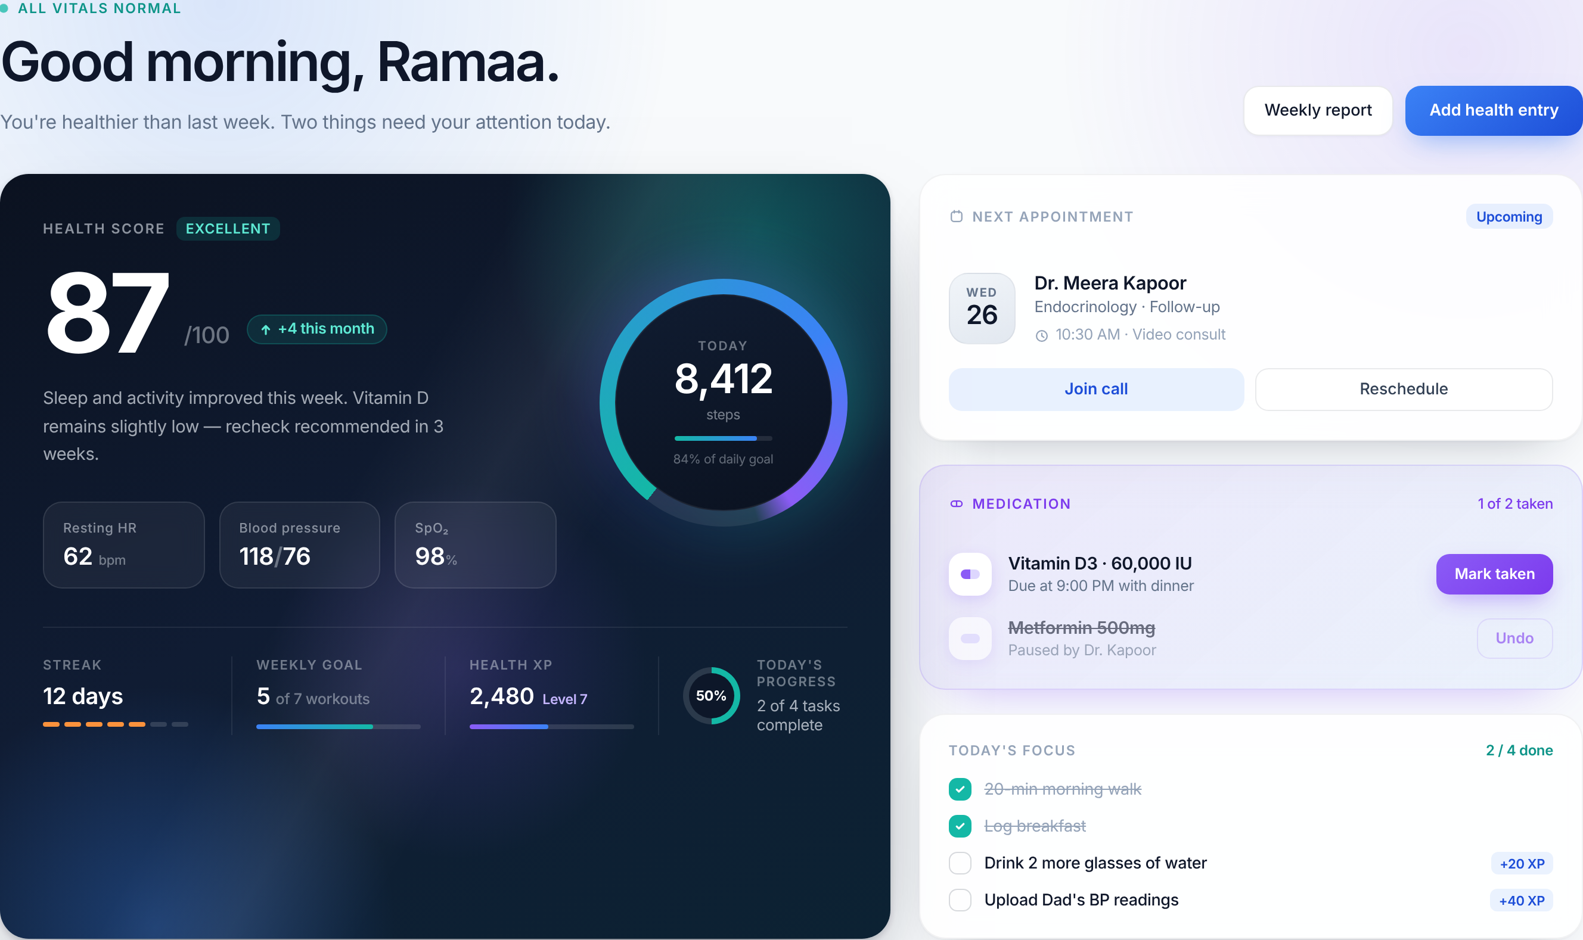
THE PRODUCT
This is running software, not a mockup
Live data, end to end
Every number on that screen is served by the Flask API from a local record store. Nothing is hard-coded.
It writes back
Tick a medication or a focus task and it persists. Restart the server and it is still ticked.
Built to a design system
15 modular React components, plain CSS, one stateful container, wrapped in an error boundary.
React 19 + Vite · Flask backend · 13 REST endpoints · local JSON record store
Notes:
Pause here. Let them look at it for three seconds before you say anything.
"This is not a mockup. It is running on this laptop right now, against a Flask backend and a local record store."
Point out: health score and vitals at a glance, today's medications, today's focus tasks, next appointment. Everything on this screen is live data from the API.

Slide 6
ARCHITECTURE
Built so the AI can fail without the product failing
Frontend
Backend
IBM watsonx.ai
React 19 · Vite · plain CSS
15 components
One stateful container
Error boundary
Python Flask
13 REST endpoints
Upload validation
IBM Bob engine
Granite text generation
IAM token exchange
OPTIONAL — remove this
and nothing breaks
Local disk
database.json · uploads/
Atomic writes, mutex-guarded
Design principle: the application organises health information. Clinical decisions remain with qualified medical professionals.
Notes:
Keep this to twenty seconds. The one thing to say out loud:
"The dashed box on the right can be removed and the application still works completely. External AI is an enhancement, never a dependency."
That single design decision is what makes the demo safe to run on venue wifi.

Slide 7
IBM BOB
A two-tier engine, so the assistant is never dead
1
Tier 1 — IBM watsonx.ai
2
Tier 2 — grounded local engine
Granite instruction model, called with the record serialised into the prompt. Activates automatically when credentials are present. IAM token cached until expiry.
Reads the record and computes the answer. No canned strings — every figure is derived from live state at request time. Runs with zero network.
Used when configured and reachable
Automatic fallback — always available
Proof that Tier 2 is real, not a stub
80
tests across
9 intent branches
Tick a medication. Ask the same question again. The answer changes — because it is computed from the record, not retrieved from a script.
Notes:
This is the strongest engineering idea in the project. Say it plainly:
"Most teams wire up an API key and hope the venue wifi holds. We made offline capability a design constraint and built a second reasoning engine."
Then the proof: tick a medication, ask the same question again, and the answer changes — because Tier 2 computes from the live record on every call. It is not a set of canned replies.

Slide 8
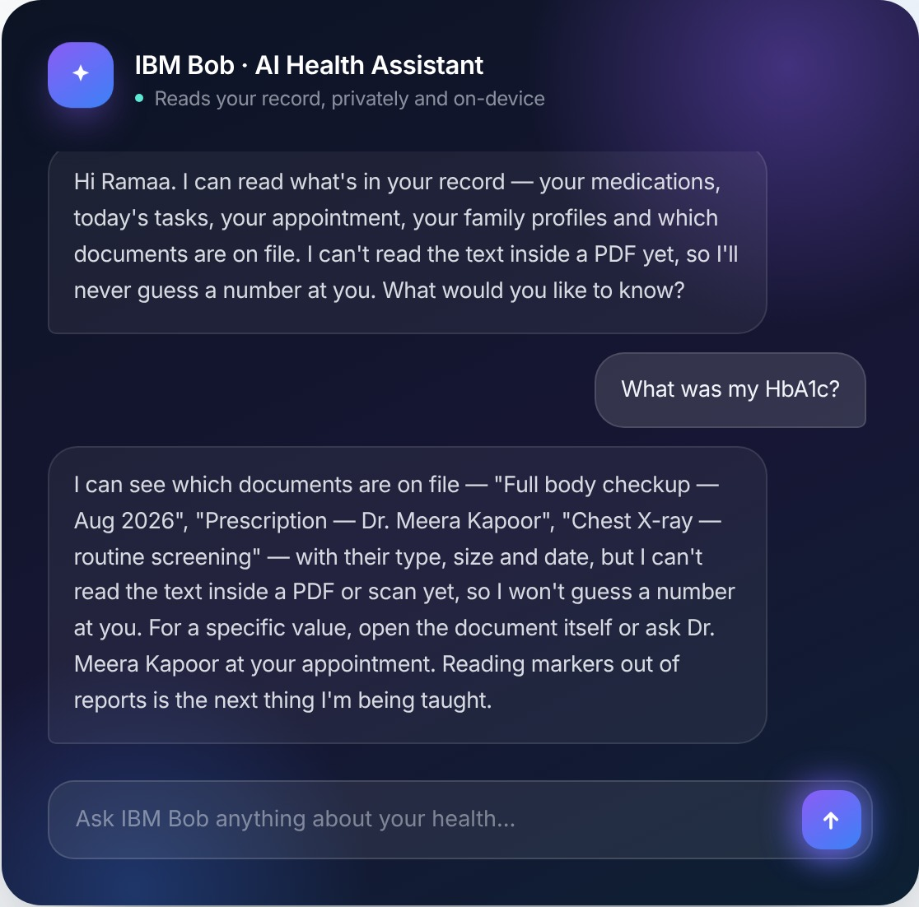
RESPONSIBLE AI
The most important thing it does is refuse
✓
It knows the limit of its own knowledge
Documents are catalogued by name, type, size and date. The text inside a PDF is not read — and IBM Bob says so rather than producing a plausible number.
✓
The rule is enforced twice
Rule 3a constrains the watsonx model, and a dedicated branch enforces the same behaviour in the offline engine. Both tiers answer identically.
✓
Never diagnoses, never prescribes
Both engines defer clinical judgement to the named clinician, and neither will advise starting, stopping or changing a medication.
✓
Every answer declares its source
Each response reports which engine spoke and how many records it was grounded on. The degraded mode is published, not hidden.
Notes:
SLOW DOWN HERE. This is the slide that wins or loses the room.
"A judge will upload a lab report and ask what the HbA1c was. Here is what our assistant does."
Read the reply aloud, especially 'so I won't guess a number at you'.
Then: "We index the document by name, type and date. We have not read inside the PDF. Most AI health demos would produce a plausible number here. Ours refuses — and tells you exactly why."
If asked: this rule is enforced in both engines, in the system prompt AND in the offline branch.

Slide 9
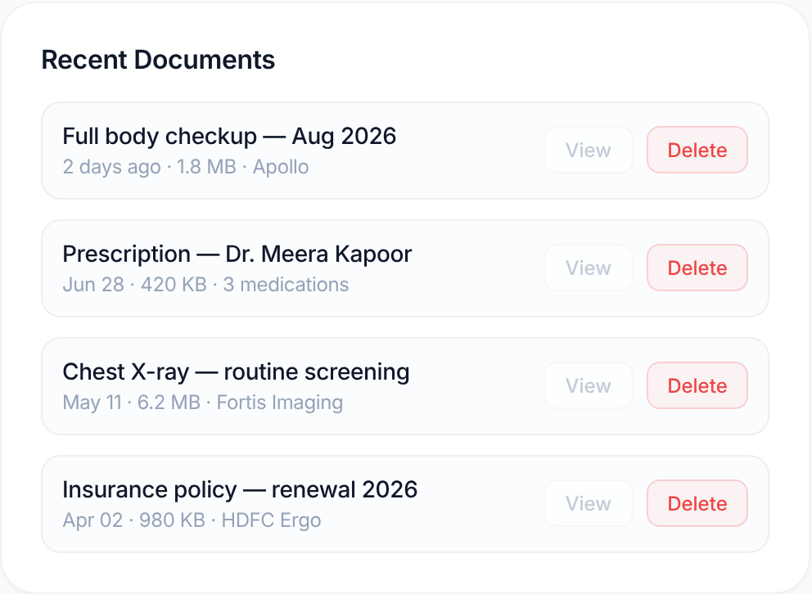
IT ACTUALLY WORKS
Upload once — it lands everywhere it should
1
2
3
4
Upload
It appears twice
Open it
It survives
Pick a PDF or scan. Five validation gates run before a single byte reaches disk.
Catalogued into Recent Documents and inserted at the top of the Journey Timeline.
View serves the file through a controlled route that resolves the document id.
Restart the backend and reload. Everything is still there.
The persistence proof
Upload a report. Stop the server with Ctrl+C. Start it again. Reload the page.
The document, the timeline entry, the medications you ticked and the tasks you completed are all still there — written to disk atomically on every change, not held in memory.
Notes:
This is the demo you will actually run. Narrate it as three beats.
Upload — it appears in Documents AND on the timeline, one step.
View — served through a controlled route, not a guessable path.
Restart the backend — reload — it is still there.
The persistence beat is the one to linger on: 'that survived a full server restart.'

Slide 10
SECURITY
Five gates before a byte touches the disk
1
2
3
4
5
Extension allowlist
Size limit
Magic-byte sniff
Content vs
extension
Dimension check
PDF, PNG, JPEG only
20 MB cap
Renamed .exe rejected
Mismatch refused
Blocks image bombs
Opaque storage
Prompt-injection defence
Loopback only
Files are stored under generated UUIDs, never the name the user supplied.
Document names are fenced as untrusted data before they reach the model.
The server binds to 127.0.0.1 by default — not reachable from the network.
Each gate was verified by building the attack and firing it at a running server — a renamed executable, an HTML file with a script tag, a 50000 × 50000 pixel decompression bomb. All rejected. All three real formats accepted.
Notes:
Twenty seconds. The line that matters:
"Every one of these gates runs before a single byte touches the disk — and we tested each one by building the attack."
If asked how we found these: an IBM Bob security review of the upload endpoint. Five findings, four implemented.

Slide 11
IBM BOB
Nine review sessions, all in the repository
9
32
80
2.86
review sessions,
each one documented
findings raised
across the codebase
tests authored by Bob
in Agent mode
Bobcoins used
of 40 available
Backend code review
11 findings. Race conditions, silent write failures, path traversal, missing validation. Nine implemented.
Test suite — Agent mode
Bob wrote backend/tests/test_bob_engine.py directly into the repo. 80 tests, 10 classes, all passing.
Upload security review
Five findings including magic-byte spoofing and prompt injection through a crafted filename.
Responsible AI review
Assessed against IBM's six principles. Found a seeded score being presented to a patient as an assessment.
Notes:
This is the section the organisers weight most heavily. Be concrete and be honest.
"We used IBM Bob as a reviewer and a test author, not as a code generator. Nine sessions, each one saved as a transcript in the repository with what we accepted, what we changed, and what we declined."
Do not claim Bob wrote the product. Claim what is true and verifiable.

Slide 12
ENGINEERING JUDGEMENT
We did not accept everything it told us
!
Wrong fix — caught by testing
!
Defective remediation — proven by attack
Bob told us to restrict CORS to localhost:3000. That is the Create React App port — we use Vite on 5173. Applied verbatim, it would have blocked every request from our own frontend and broken the demo with no visible error.
Bob found a prompt-injection vector in filenames, then proposed a regex to strip it. We implemented it exactly, then defeated it with a plain-English filename — ordinary letters have nothing to strip. We added a structural defence instead.
Four more findings were correct — and we still declined them
Add authentication
Split app.py into modules
Single-user local app by design. Mitigated by loopback binding instead.
Correct advice, wrong moment. The file was already under 80 passing tests.
Replace the intent router
Move the uploads folder
A better design, but swapping it hours before a deadline risks the demo.
Needs a misconfigured proxy that does not exist in our deployment.
Notes:
This is the slide nobody else will have. Deliver it with confidence, not apology.
"We did not accept everything IBM Bob told us. Twice its advice was wrong in ways that testing caught, and four more times it was right but wrong for our deadline."
The CORS one is the sharpest: applying it verbatim would have broken our own dashboard.
This demonstrates that a human engineer was in the loop making judgements — which is exactly what the organisers are asking us to evidence.

Slide 13
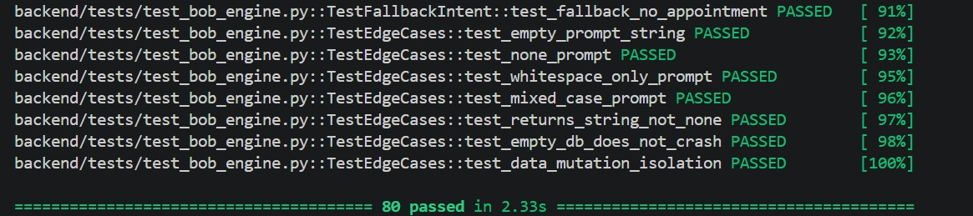
PROOF
You can clone it and run this yourself
80/80
tests passing, re-run after the code they cover was changed
13
REST endpoints, each documented with real captured responses
The suite IBM Bob wrote in Agent mode, re-run after we changed the function it covers.
0
console errors, 4xx or 5xx responses in a full browser pass
Also in the repository
Nine IBM Bob session transcripts with outcomes · full API documentation · architecture document with the trade-offs stated · a README that lists what the system does not do
Notes:
Short and factual. The test suite is the strongest single artifact — a judge can clone the repo and run it.
"Eighty tests, written by IBM Bob in Agent mode, still passing after we changed the code they cover. That is the meaningful test — they were written against one version and re-run against another."

Slide 14
HONESTY
What Health Journey does not claim
—
It is not encrypted at rest
—
It does not read your documents
The record sits in a plain file on your disk. Our privacy property is locality — it never leaves the device — not cryptography. A key stored beside the data it protects would be theatre.
Uploads are catalogued by metadata. IBM Bob can tell you a report exists; it cannot tell you what is written in it, and it says so rather than guessing.
—
It is not multi-user
—
It does not give medical advice
No authentication, one person, one device, one record. Multi-user needs real auth first, and that is named as future work.
Both engines are constrained to describing the record and deferring judgement to a clinician.
Every one of these is written in our README. We would rather a judge read it from us than discover it themselves.
Notes:
Say this before a judge finds it. It converts every weakness into evidence of engineering maturity.
"We think the fastest way to lose credibility is to overstate. So here is what Health Journey does not do."
If a judge asks 'where is the encryption?' — you have already answered it on this slide. That is the whole point.

Slide 15
IMPACT AND WHAT COMES NEXT
Who this is for, and where it goes
●
The family coordinator
Roadmap
One person in most families tracks everyone's appointments, prescriptions and screenings. Health Journey is built for them — family profiles are a first-class feature, not an afterthought.
OCR and marker extraction
so Bob can compare panels value by value
Encryption at rest
for the record store and uploads
●
Anyone managing a long-term condition
An auditable conversation log
so a patient can retrieve what Bob said
Pre-diabetes, hypertension, thyroid — conditions measured in years of panels and slow trends. That is exactly the history a scattered record loses.
Multi-user with real auth
a household, not a single device
The next feature is the one we were honest about not having.
Notes:
Bring it back to people. India has a very large population managing chronic conditions across multiple family members, usually with one person doing all the coordinating.
Then the roadmap — say the first item is OCR, because that is the honest next step and it closes the gap the judges will already have noticed.

Slide 16
An AI health assistant whose most
important feature is knowing
when to say no.
Health Journey organises your health information.
Clinical decisions remain with qualified medical professionals.
Team NovaTra
New Horizon College of Engineering · IBM SkillsBuild SkillUp Hackathon 2026
Mantripragada Ramaa Gayatri · Allu Uma Eashanvi · Krupa L P · Madhumitha K
Notes:
Close on the sentence, then stop talking. Do not trail off into a summary.
"Health Journey organises your health information. Clinical decisions stay with your doctor. We built an AI health assistant whose most important feature is knowing when to say no."
Then: "Happy to take questions, or to run the demo live."
Prepared answers: encryption (we don't claim it), document contents (Bob refuses), multi-user (single user by design).

