Slide 1


NEWS ARTICLE TEXT SUMMARIZATION
SIDDHARTHA INSTITUTE OF TECHNOLOGY & SCIENCES
(UGC – AUTONOMOUS)
(Approved by AICTE, New Delhi & Affiliated to JNTUH, Hyderabad)
Accredited by NBA and NAAC with ‘A+’ Grade.
Narapally, Korremula Road, Ghatkesar, Medchal- Malkajgiri (Dist.)-501 301
Computer Science Engineering (Data Science)
MAJOR PROJECT
BATCH -1
M.RAMYA SRI (20TQ1A6709)
J.GAYATHRI (20TQ1A6717)
CH.ROOPA (20TQ1A6725)
E.NISHANTH REDDY (20TQ1A6704)
GUIDE NAME
DR.A.SATYANARAYANA
Professor-DEPT OF CSE

Slide 2
CONTENT
ABSTRACT
INTRODUCTION
LITERATURE SURVEY
EXISTING SYSTEM
PROPOSED SYSTEM
ARCHITECTURE
SYSTEM DESIGN
USE CASE & SEQUENCE DIAGRAMS
FLOWCHART
SOFTWARE & HARDWARE REQUIREMENTS
UML DIAGRAM
SAMPLE CODE & RESULTS
CONCLUSION
FUTURESCOPE
REFERENCES

Slide 3
ABSTRACT
News article summarization is a process designed to condense full-length articles into concise, informative summaries. This technique is essential in today's fast-paced world, where the volume of news content can be overwhelming. Summarization methods fall into two main categories: extractive and abstractive. Extractive summarization focuses on identifying and selecting key sentences from the original text, while abstractive summarization involves generating new phrases and sentences that encapsulate the core ideas.
Key steps in this process include preprocessing text data, scoring sentences for relevance, and using metrics like ROUGE scores for evaluation. The ultimate aim is to create fluent summaries that effectively capture the main points, events, and facts from news articles, enabling readers to quickly digest large amounts of information.
News Article Text Summarization

Slide 4
INTRODUCTION
System Input :
The system begins by taking a full-length news article as input, setting the stage for the summarization process.
Extractive & Abstractive Summarization :
It employs both extractive and abstractive summarization techniques to distill the essence of the article.
Output Generation :
A concise summary is generated, highlighting key information while maintaining the integrity of the original content.
Efficiency & Scalability :
The system is designed for efficiency, capable of handling large volumes of text, making it suitable for real-time applications.

Slide 5
LITERATURE SURVEY
Neural Networks :
ROUGE Metrics :
Machine Learning :
Centroid Bas ed- Systems :
Since the late 2010s, neural network models have revolutionized abstractive summarization, allowing for more sophisticated generation of summaries.
Machine learning classifiers have been instrumental in extractive summarization, dating back to research by Kupiec et al. in 1995.
Introduced by Lin in 2004, ROUGE metrics have become the standard for evaluating the quality of summarization systems.
Radev et al.'s MEAD system in 2004 marked a significant advancement with its centroid-based approach to scoring sentences.

Slide 6
Existing System
Manual Summarization
Traditional Approach
Drawbacks
Consistency Challenges
Editors and journalists manually summarize articles, a practice rooted in the history of media organizations.
Manual summarization is time-consuming, subjective, and prone to human error, with scalability issues for large volumes of articles.
Inconsistencies in quality and style of summaries are common due to the manual nature of the summarization process.

Slide 7
PROPOSED SYSTEM
News article text summarization where it does overcome all the drawbacks that mentioned in existing system includes :
Automatic Summarization: The system automates the process of summarizing news articles, reducing the need for manual effort and saving time for users. This automation enables the rapid processing of large volumes of news articles, making it suitable for applications requiring real-time summarization.
Customizable Summarization Parameters: Users can customize parameters such as the length of the extractive summary and the word limits for the abstractive summary. This flexibility allows users to tailor the summaries to their specific needs or preferences, enhancing the utility of the system.
Combination of Extractive and Abstractive Techniques: The system leverages both extractive and abstractive summarization techniques to provide a comprehensive summary of news articles. Extractive summarization preserves important sentences from the original article, while abstractive summarization generates summaries that capture the essence of the article in new language. This combination improves the coverage and quality of the summaries, catering to different user preferences and use cases.
Utilization of Pre-trained Models: The system utilizes pre-trained transformer-based models fine-tuned for summarization tasks, such as the T5 model. These models, trained on large-scale datasets, capture complex language patterns and semantic relationships, leading to more accurate and contextually relevant summaries.
Interactive User Interface: The system provides an interactive user interface through Streamlit, allowing users to input news articles and visualize the summaries easily. The interface includes sliders and widgets for parameter selection, enhancing user experience and usability.

Slide 8
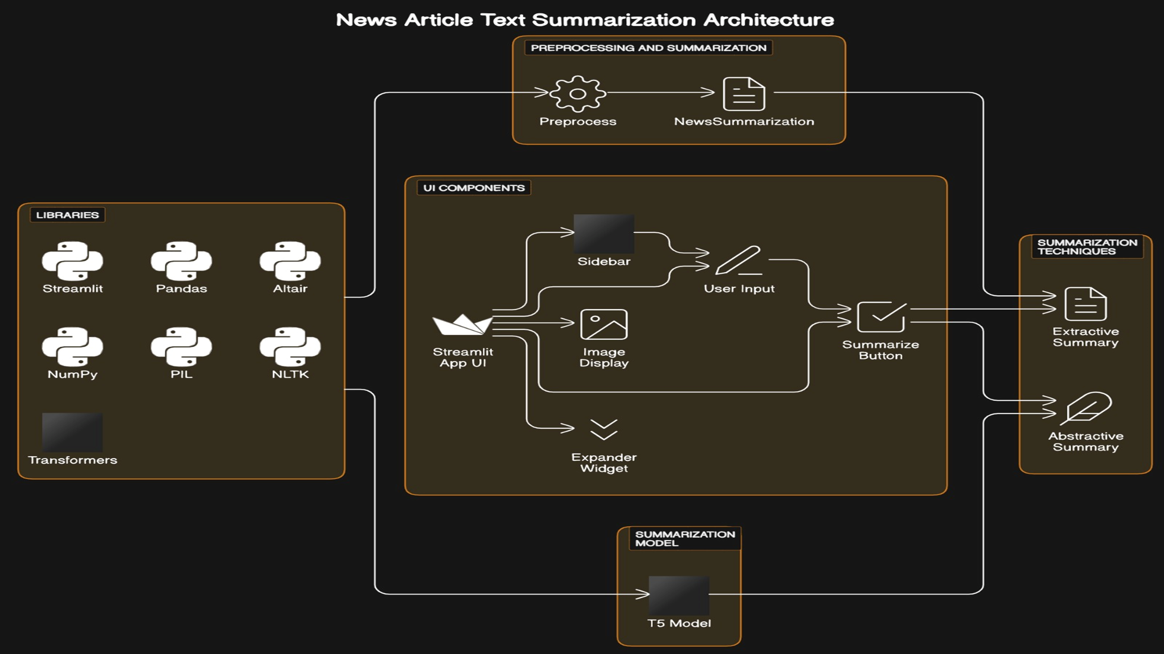
ARCHITECTURE

Slide 9
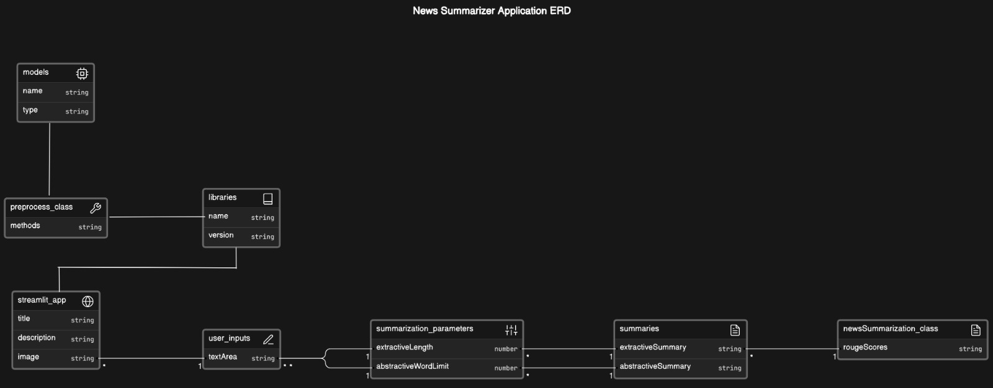
SYSTEM DESIGN ER diagram

Slide 10
USE CASE DIAGRAM
A Use Case diagram is a graphical depiction of a user's possible interactions with a system. A use case diagram shows various use cases and different types of users the system has and will often be accompanied by other types of diagrams as well. A use case diagram doesn’t describe the order in which the use cases are carried out but the behavior and the interactions between the user and the system.

Slide 11
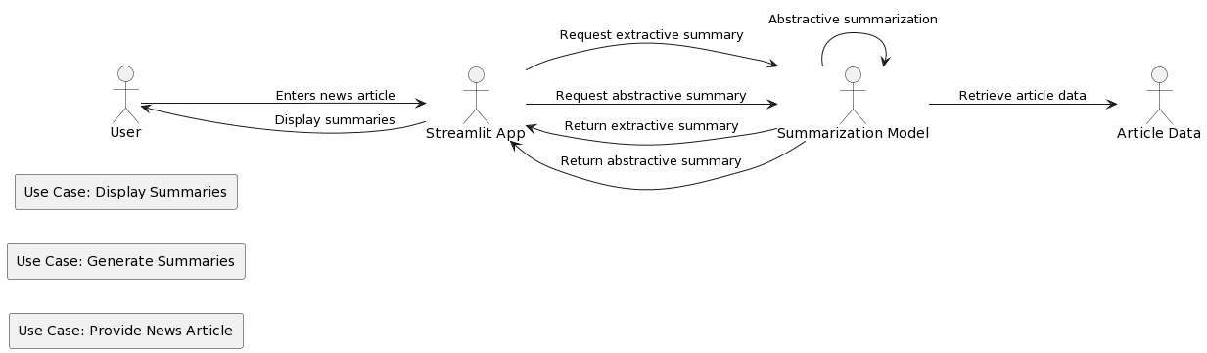
USE CASE DIAGRAM

Slide 12
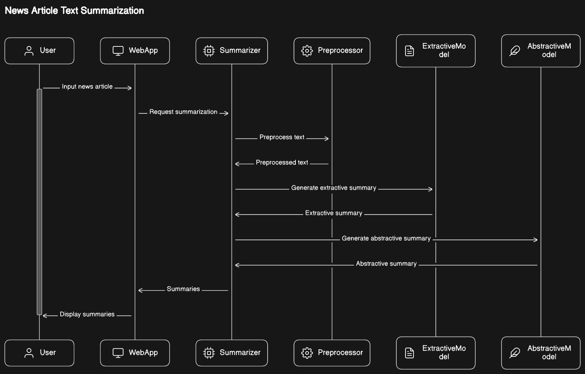
SEQUENCE DIAGRAM
A sequence diagram is a visual representation that illustrates the interactions and order of messages exchanged among objects or components in a system or process. It is commonly used in system design to depict the flow of actions or events over time.

Slide 13
FLOWCHART
It is a type of diagram that represents the flow of process. It can be a pictorial or diagrammatical representation of an algorithm or a system or progression through a procedure. It is represented using multiple conventional symbols and lines that connect the symbols.

Slide 14
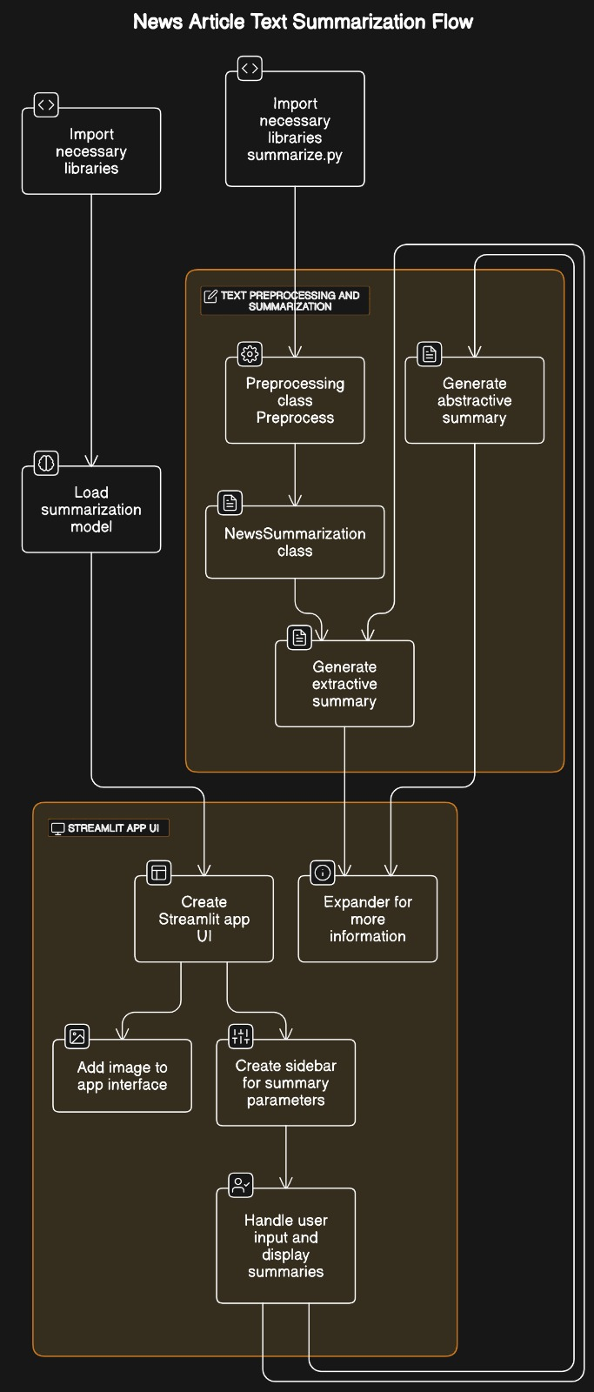
Flowchart:

Slide 15
Software Requirements :
Operating System: The software should be compatible with commonly used operating systems such as Windows, macOS, or Linux.
Python: The code is written in Python programming language, so Python runtime environment needs to be installed on the system. Python version 3.7 or later is recommended.
Python Libraries: Install the required Python libraries using pip or conda package managers. The libraries used in the provided code snippets include:
Streamlit
pandas
altair
numpy
PIL (Python Imaging Library)
nltk (Natural Language Toolkit)
transformers (Hugging Face Transformers library)
gensim
rouge_score
matplotlib
wordcloud
Other Dependencies: Ensure that the NLTK data (such as wordnet) is downloaded to support natural language processing tasks.
Download any pre-trained models required by the transformers library, such as the T5 model used for abstractive summarization.
Internet Connection: The system should have internet connectivity to download any additional libraries or models required by the code, such as NLTK data or pre-trained models from the Hugging Face model hub.
Development Environment: A code editor or integrated development environment (IDE) such as Visual Studio Code, PyCharm, or Jupyter Notebook can be used for writing and running the code.

Slide 16
Hardware Requirements :
Processor (CPU): A multi-core processor with decent processing power is recommended for handling text processing tasks efficiently.
Memory (RAM): At least 4GB of RAM is recommended for smooth execution, especially when working with large datasets or running complex summarization models.
Storage: Sufficient disk space to store the application code, libraries, and any generated data. This requirement can vary depending on the size of the dataset and the models used.

Slide 17
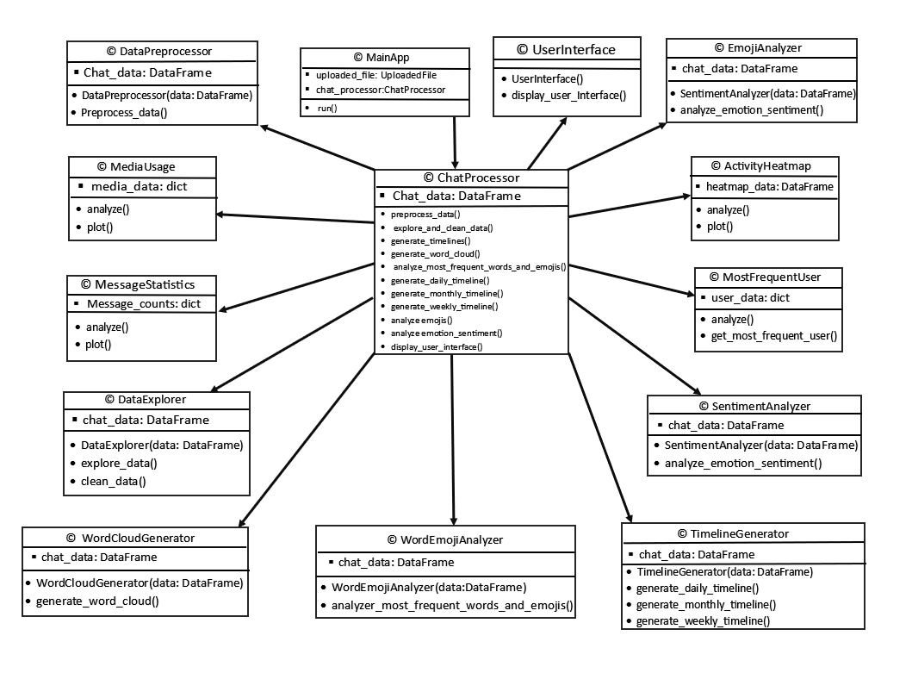
UML DIAGRAM

Slide 18
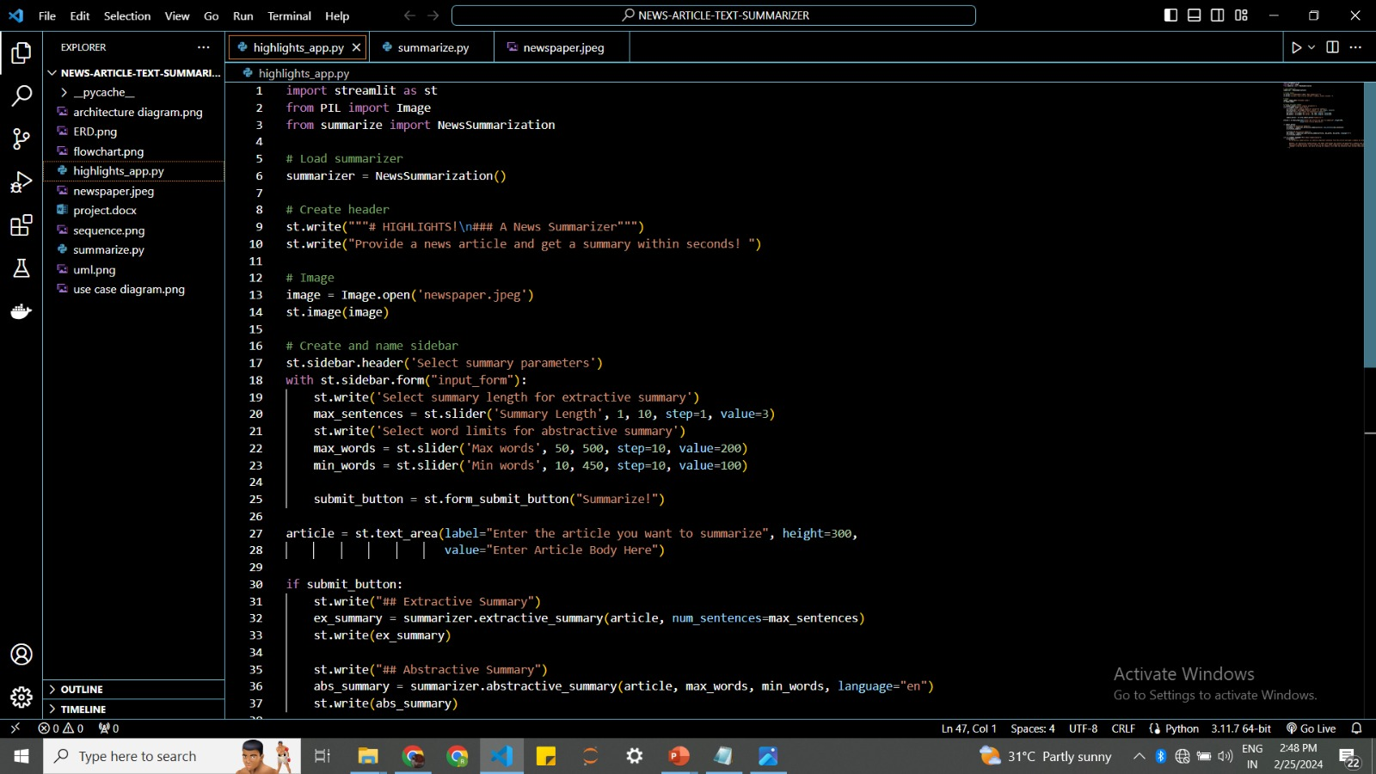
Sample Code :

Slide 19
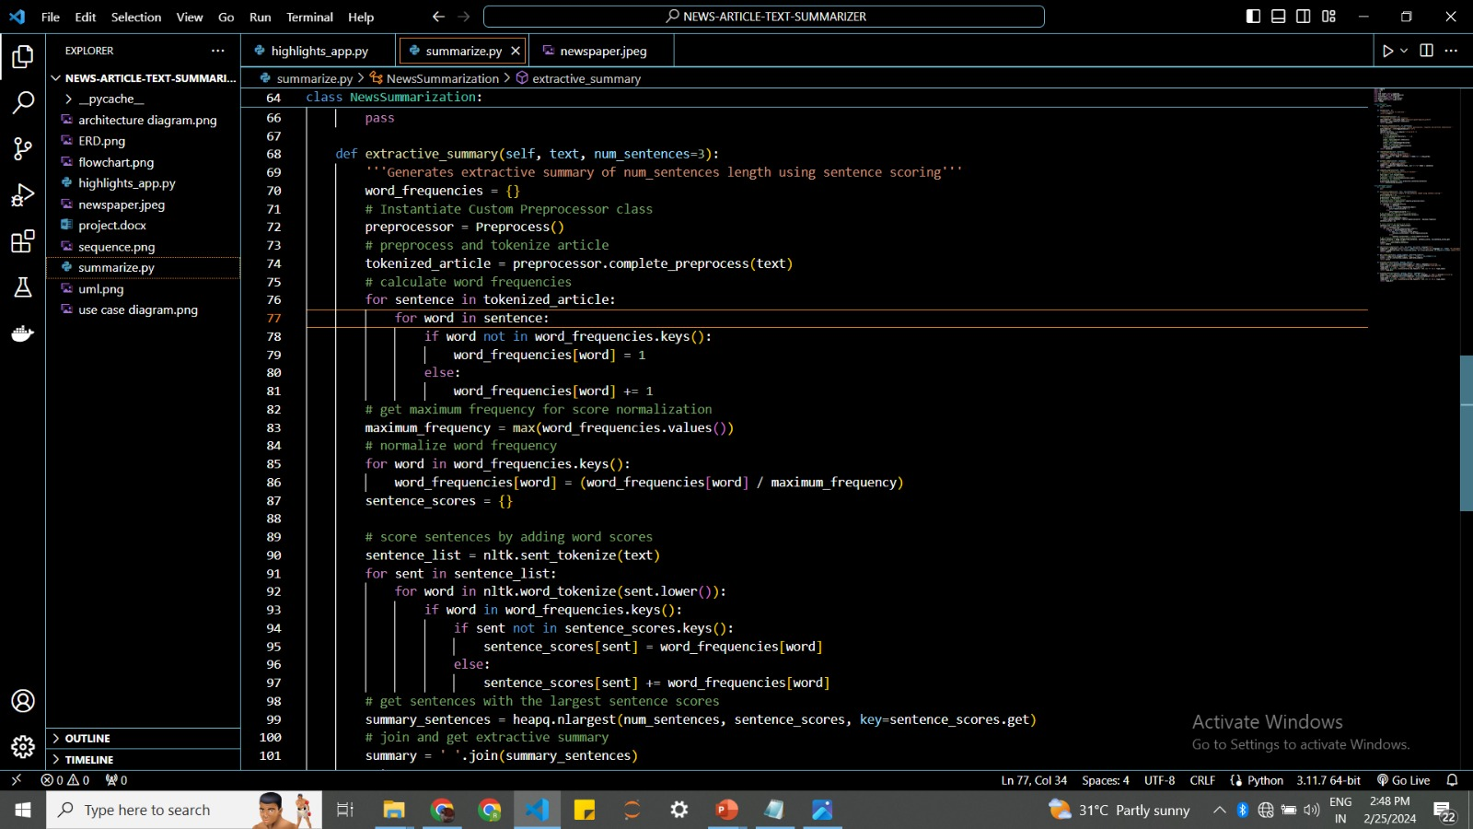

Slide 20
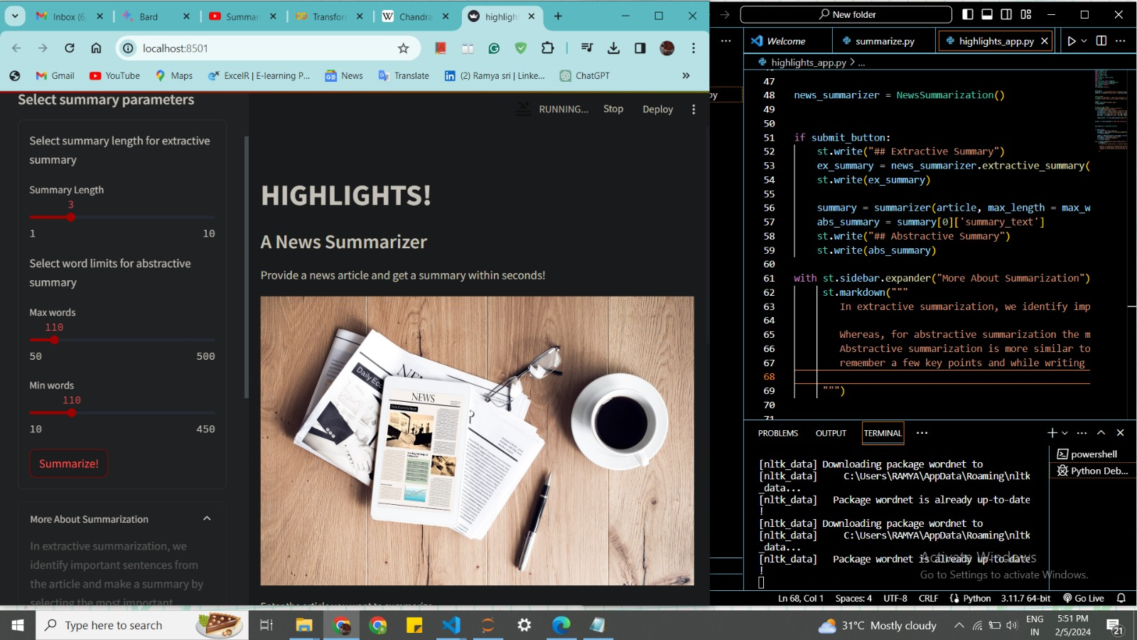
RESULTS:

Slide 21
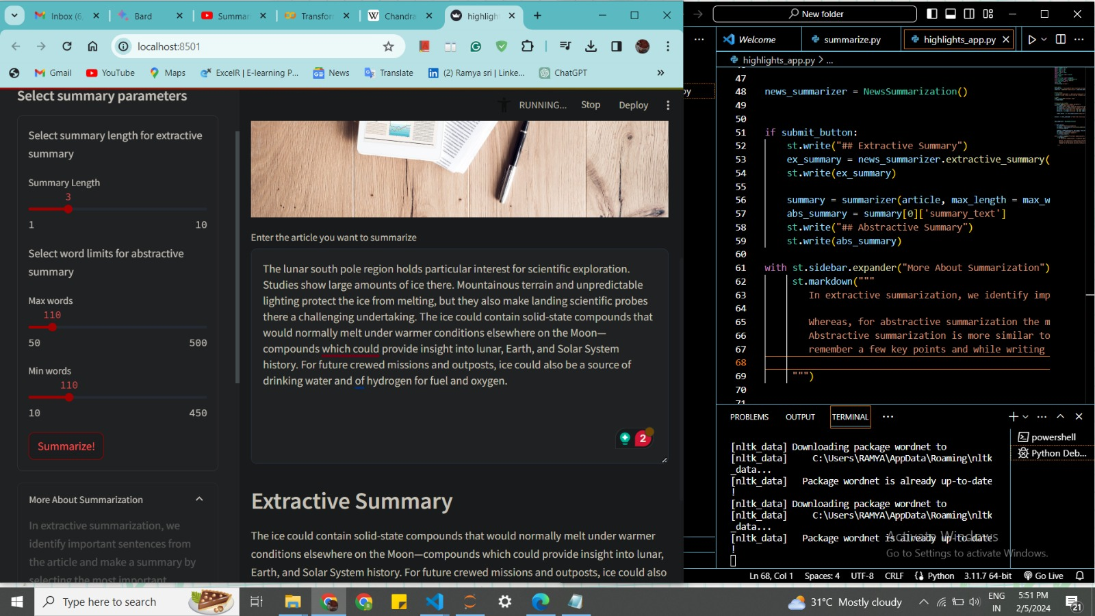

Slide 22
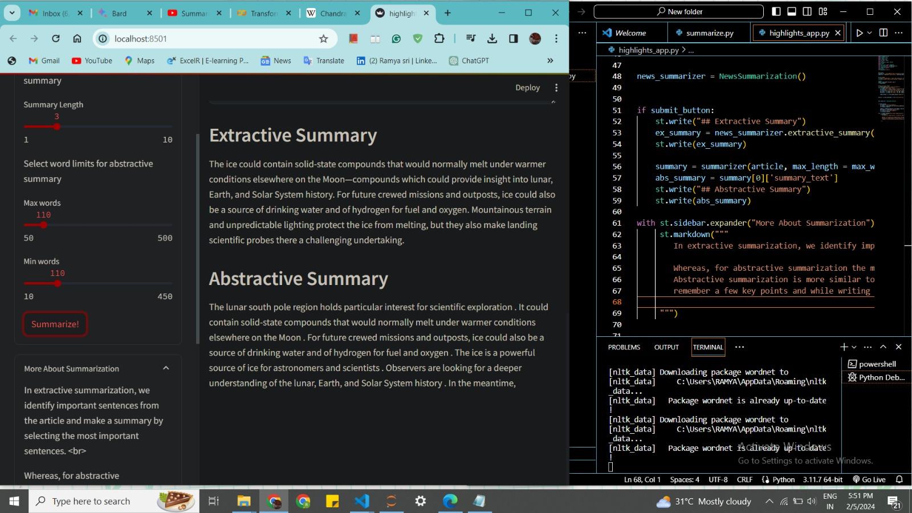

Slide 24
CONCLUSION
In conclusion, the project successfully developed a news summarization system capable of generating both extractive and abstractive summaries, providing users with valuable insights into news articles in an efficient and user-friendly manner. While the system demonstrates significant achievements, ongoing refinement and optimization efforts are essential to further enhance its performance and usability. Overall, the project lays a solid foundation for future advancements in text summarization technology and its applications in various domains.

Slide 25
FUTURE SCOPE
The project on news summarization has a promising future scope, with several avenues for further development and expansion:
1. Domain-specific Summarization: Customizing the summarization models to specific domains, such as finance, healthcare, or technology, would improve the relevance and accuracy of the generated summaries for users with specialized interests. Fine-tuning the models on domain-specific datasets can enhance their understanding of domain-specific terminology and context.
2. Real-time Summarization: Implementing real-time summarization capabilities to process and summarize news articles as they are published would provide users with up-to-date and timely summaries of the latest news events. This could involve integrating the system with news APIs or RSS feeds to automatically fetch and summarize news articles as they become available.
3. User Feedback Integration: Incorporating mechanisms for user feedback and evaluation would enable continuous improvement of the summarization models based on user preferences and quality assessments. Collecting feedback on the generated summaries and adjusting the models accordingly can enhance their performance and relevance over time.

Slide 26
4. Visual Summarization: Exploring techniques for visual summarization, such as generating summary infographics or key phrase extraction, could provide users with alternative formats for consuming summarized content. Visual summarization techniques can enhance comprehension and engagement, particularly for users who prefer visual information presentation.
5. Mobile Application Development: Developing a mobile application version of the news summarization tool would increase its accessibility and usability for users on mobile devices. A mobile app could offer on-the-go access to summarized news content, allowing users to stay informed anytime, anywhere.
6. Integration with News Aggregators: Partnering with news aggregators or media platforms to integrate the summarization tool directly into their platforms could expand its reach and user base. Offering summarization as a built-in feature within existing news applications or websites would streamline the summarization process for users and increase adoption.
7. Research and Innovation: Continued research and innovation in natural language processing (NLP) and machine learning techniques can lead to advancements in summarization algorithms and models. Exploring novel approaches, such as reinforcement learning-based summarization or multi-document summarization, could further push the boundaries of summarization technology.

Slide 27
REFERENCES
1. Original Research Papers:
• Luhn, H. P. (1958). The Automatic Creation of Literature Abstracts.
• Edmundson, H. P. (1969). New Methods in Automatic Extracting.
2. Open-Source Libraries and Frameworks:
• Streamlit Documentation (2023)
• NLTK Documentation (2023)
• Gensim Documentation (2023)
• Hugging Face Transformers Documentation (2023)
3. Official Documentation:
• Streamlit Official Documentation (2023)
• NLTK Official Documentation (2023)
• Gensim Official Documentation (2023)
• Hugging Face Transformers Official Documentation (2023)
4. Research Papers on Evaluation Metrics:
• Lin, C. (2004). ROUGE: A Package for Automatic Evaluation of Summaries.

Slide 28
THANK YOU..

