Slide 1

Predicting Employee Attrition and Layoff Trends Using Machine Learning
Rashi Meda, University of Hertfordshire
11/02/2025

Slide 2
Introduction
Why is employee attrition important?
High turnover costs businesses money and time.
Layoffs impact industries and job markets globally.
Aim: Use machine learning to analyze trends and predict attrition.
Key Benefits: Helps businesses improve retention strategies.

Slide 3

Research Question
Main Question: What factors influence employee attrition and layoffs, and how accurately can ML predict trends?
Key Objectives:
Collect and preprocess attrition-related data.
Apply machine learning models to predict employee exits.
Evaluate models for accuracy and business applications.

Slide 4
Dataset Overview
Data Sources: Kaggle, HR databases, public repositories
Attributes: Age, Salary, Job Satisfaction, Department, Layoff Reason, etc.
Size: ~100,000 employee records
Format: CSV, JSON

Slide 5
Machine Learning Techniques
Classification Models: Predict whether an employee will leave
Logistic Regression, Random Forest, XGBoost
Clustering Models: Identify high-risk groups
K-Means, Hierarchical Clustering
NLP for Exit Interviews: Analyze employee feedback
Sentiment Analysis, BERT
Anomaly Detection: Identify unusual layoff trends
Isolation Forest, One-Class SVM

Slide 6
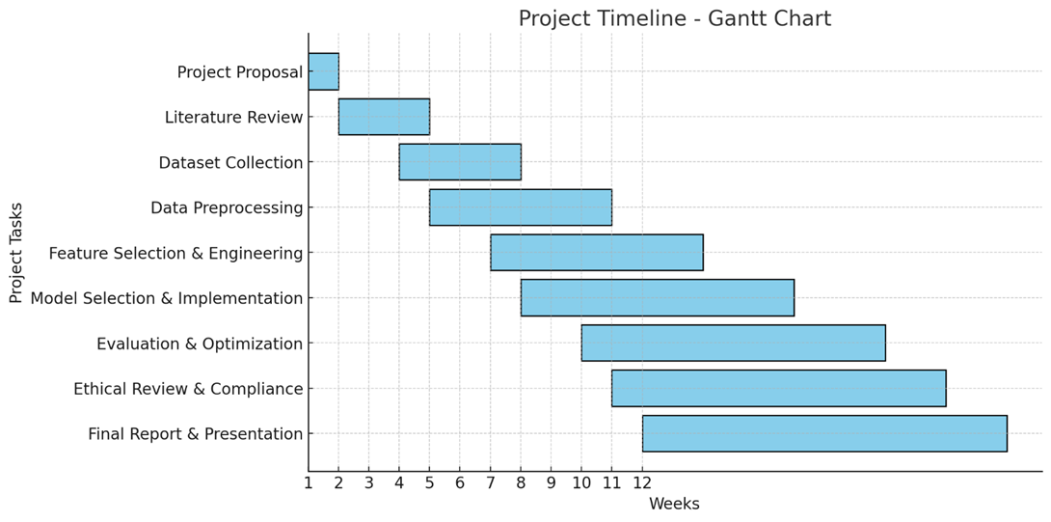
Project Plan & Timeline
Key Tasks:
Literature Review (Weeks 1-2)
Data Collection & Cleaning (Weeks 3-4)
Feature Engineering & Model Training (Weeks 5-8)
Model Evaluation & Optimization (Weeks 9-10)
Final Report & Presentation (Weeks 11-12)

Slide 7
Data Management Plan
Version Control: GitHub repository with weekly commits
Backup & Storage: OneDrive + Local backups
Security: Anonymized data following GDPR guidelines
Ethical Considerations:
Data sourced ethically
Compliance with UH ethical policies

Slide 8
Expected Outcomes
Predicted attrition risk with high accuracy.
Key insights on reasons for employee turnover.
Useful tool for HR decision-making and retention planning.

Slide 9

Conclusion
ML models provide actionable insights into employee attrition.
Businesses can proactively address workforce challenges.
Future Scope: Expand data sources, improve model accuracy.

Slide 10
Q&A
Thank you for your time!
Any questions?

