Slide 1

IILM UNIVERSITY
School of Computer Science and Engineering
DEVOPS ENGINEER INTERNSHIP
Multi-Cloud & AI Platform
Enablement
Three Engineering Projects Across Claude, AWS/Azure and Snowflake
STUDENT NAME
ENROLLMENT NUMBER
Moon Rathi
CS-2341452
PROGRAM & SEMESTER
ORGANIZATION
B.Tech CSE, Semester 7 (Section 4CSE8)
Mactores Cognition Private Limited

Slide 2






OVERVIEW
What This Presentation Covers
About the Organization
Internship Objectives
Mactores Cognition Private Limited — a data & AI engineering consultancy
Building real, multi-platform DevOps engineering competency
Three Engineering Projects
Outcomes Delivered
Claude, Multi-Cloud (AWS/Azure) and Snowflake
Claude Certified Architect, Snowflake SPN badges & more
Work in Progress
Key Takeaways
AWS Cloud Practitioner & Azure Administrator readiness
Skills gained and the road ahead
Moon Rathi | CS-2341452 | Mactores Cognition Pvt. Ltd.
2

Slide 3

THE ORGANIZATION
Mactores Cognition Private Limited
Mactores is a technology consulting and data engineering company specializing in enterprise data platforms — data lakes, scalable databases and modern data warehouses — along with automated DataOps, MLOps and Generative AI solutions.
AWS Generative AI Competency
Strategic AWS partner status
AWS Healthcare Competency
Founded 2008
Bellevue, Washington, USA
HIPAA-compliant, automation-first solutions
Cross-industry clients
FinTech, Manufacturing, Software, Healthcare
Indian Operations: Mumbai, Maharashtra
Role: DevOps Engineer (Intern) | Duration: June 17 – Sept 17, 2026
Moon Rathi | CS-2341452 | Mactores Cognition Pvt. Ltd.
3

Slide 4
WHY THIS TRACK
Problem Statement & Objectives
Modern DevOps teams rarely operate within a single cloud vendor. Engineers proficient in only one platform are at a disadvantage as organisations adopt multi-cloud and Generative AI tooling.
OBJECTIVES
1
Gain foundational-to-applied knowledge of the Claude/Anthropic ecosystem (API, Claude Code, Agent Skills, MCP)
2
Deliver a working Claude/Anthropic engineering credential (Project 1)
3
Build working knowledge of AWS core services (Cloud Practitioner track)
4
Build working knowledge of Microsoft Azure administration (AZ-104 track)
5
Deliver applied Snowflake ML & Generative AI competency (Project 3)
6
Document methodology & outcomes in a verifiable, portfolio-ready format
Moon Rathi | CS-2341452 | Mactores Cognition Pvt. Ltd.
4

Slide 5


THE ROADMAP
Three Engineering Projects, One DevOps Skillset
PROJECT 1
PROJECT 2
PROJECT 3
Claude / Anthropic
Multi-Cloud (AWS & Azure)
Snowflake
AI / Agentic platform enablement
Public cloud foundations engineering
Cloud data & AI platform engineering
Delivered
In Progress
Delivered
Common approach for each project: Foundational Study → Applied Practice → Validation → Deliverable
Moon Rathi | CS-2341452 | Mactores Cognition Pvt. Ltd.
5

Slide 6

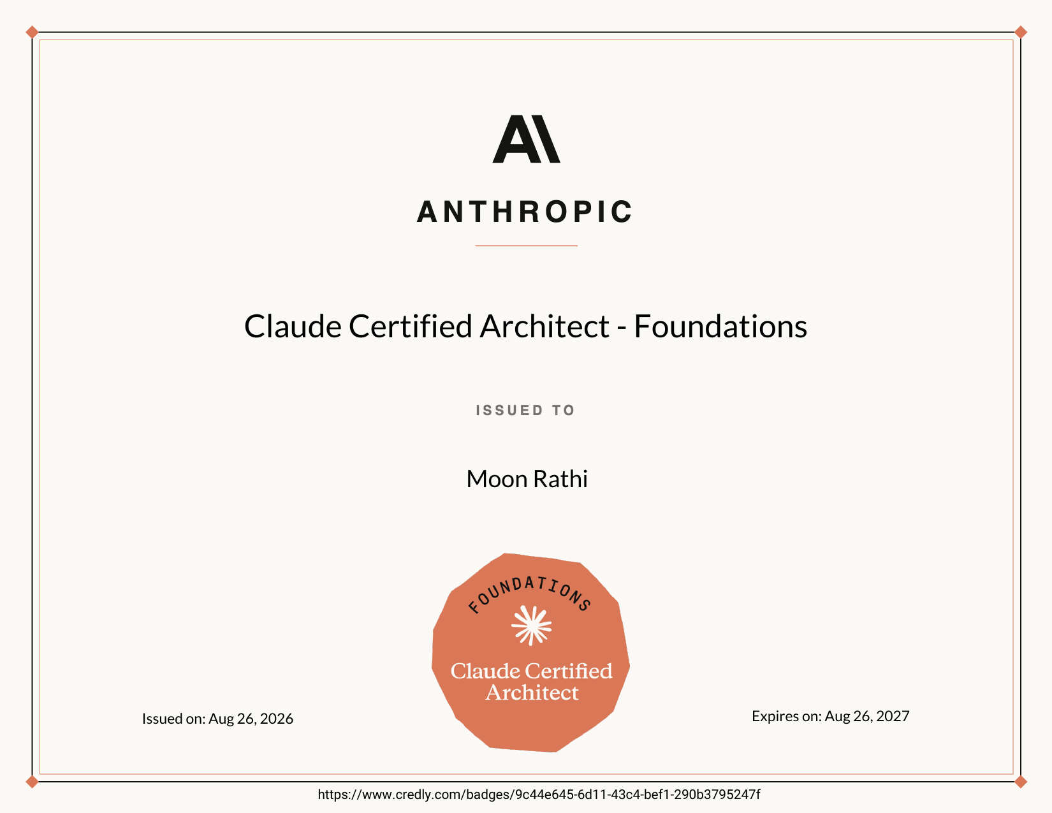
PROJECT 1
Claude / Anthropic AI Platform Enablement
ANTHROPIC ACADEMY COURSES COMPLETED
PROJECT 1 DELIVERABLE — ACTUAL CREDENTIAL
Claude 101
Building with the Claude API
Claude Platform 101
Introduction to Agent Skills
Introduction to MCP
MCP Advanced Topics
Claude Code 101
Claude Code in Action
Introduction to Subagents
PRACTICE & MOCK EXAM PROGRESS
YT – Zero to CCA (Q&A)
75%
YT – CCA Exam Qs Solved
83%
Claude Certified Architect – Foundations
Udemy CCA Foundations (6 exams)
83.5%
GitHub – Solved CCA Qs (33)
87%
ExamHeist (40 Qs)
85%
CertSafari (sample)
86%
Issued by Anthropic (Credly)
Aug 26, 2026 · Valid through Aug 26, 2027
Moon Rathi | CS-2341452 | Mactores Cognition Pvt. Ltd.
6

Slide 7
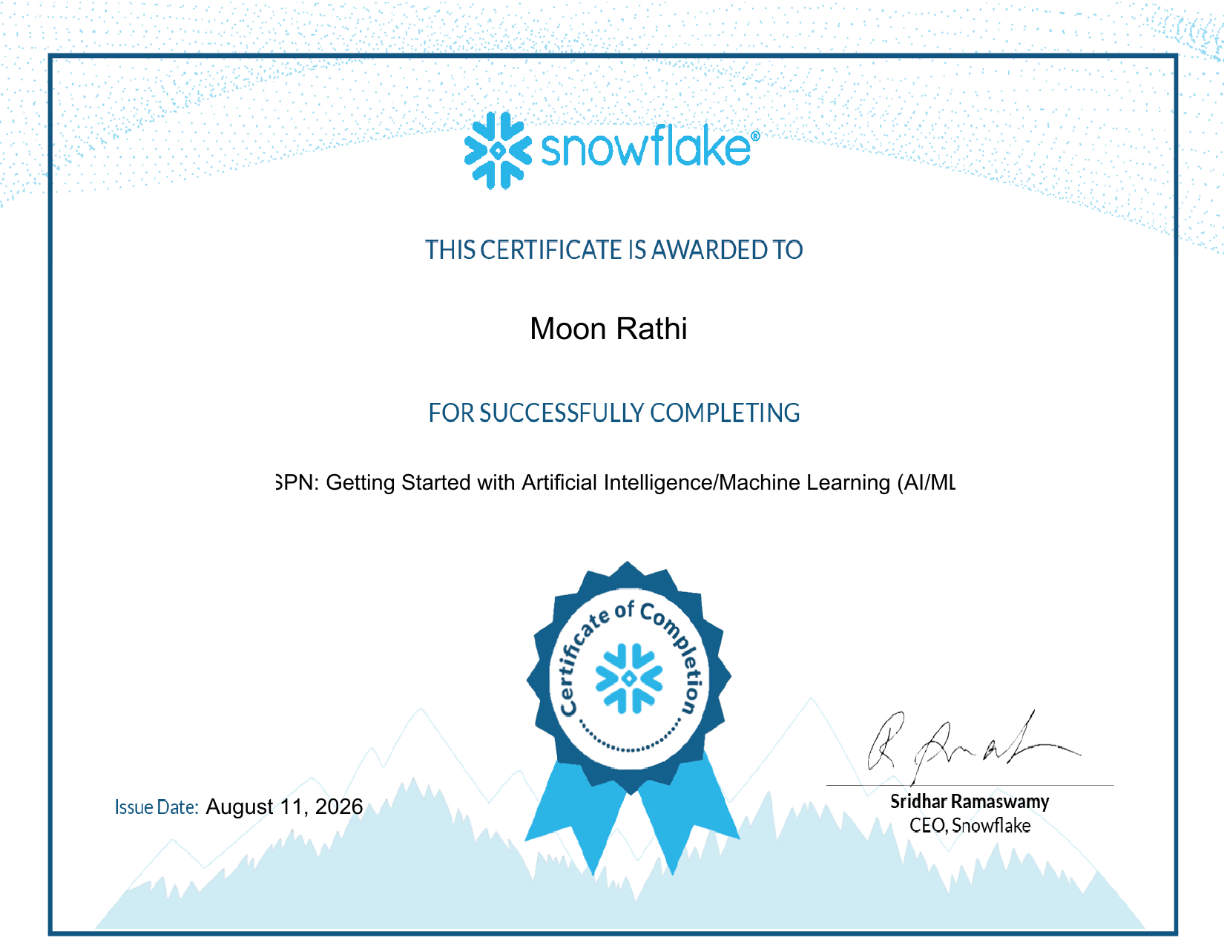
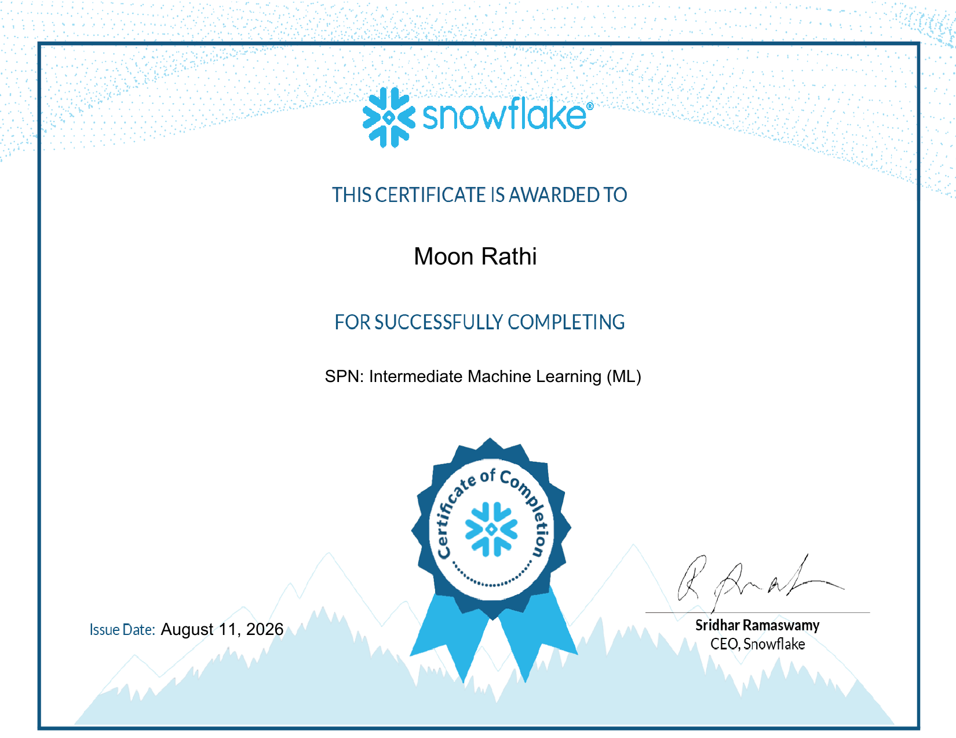
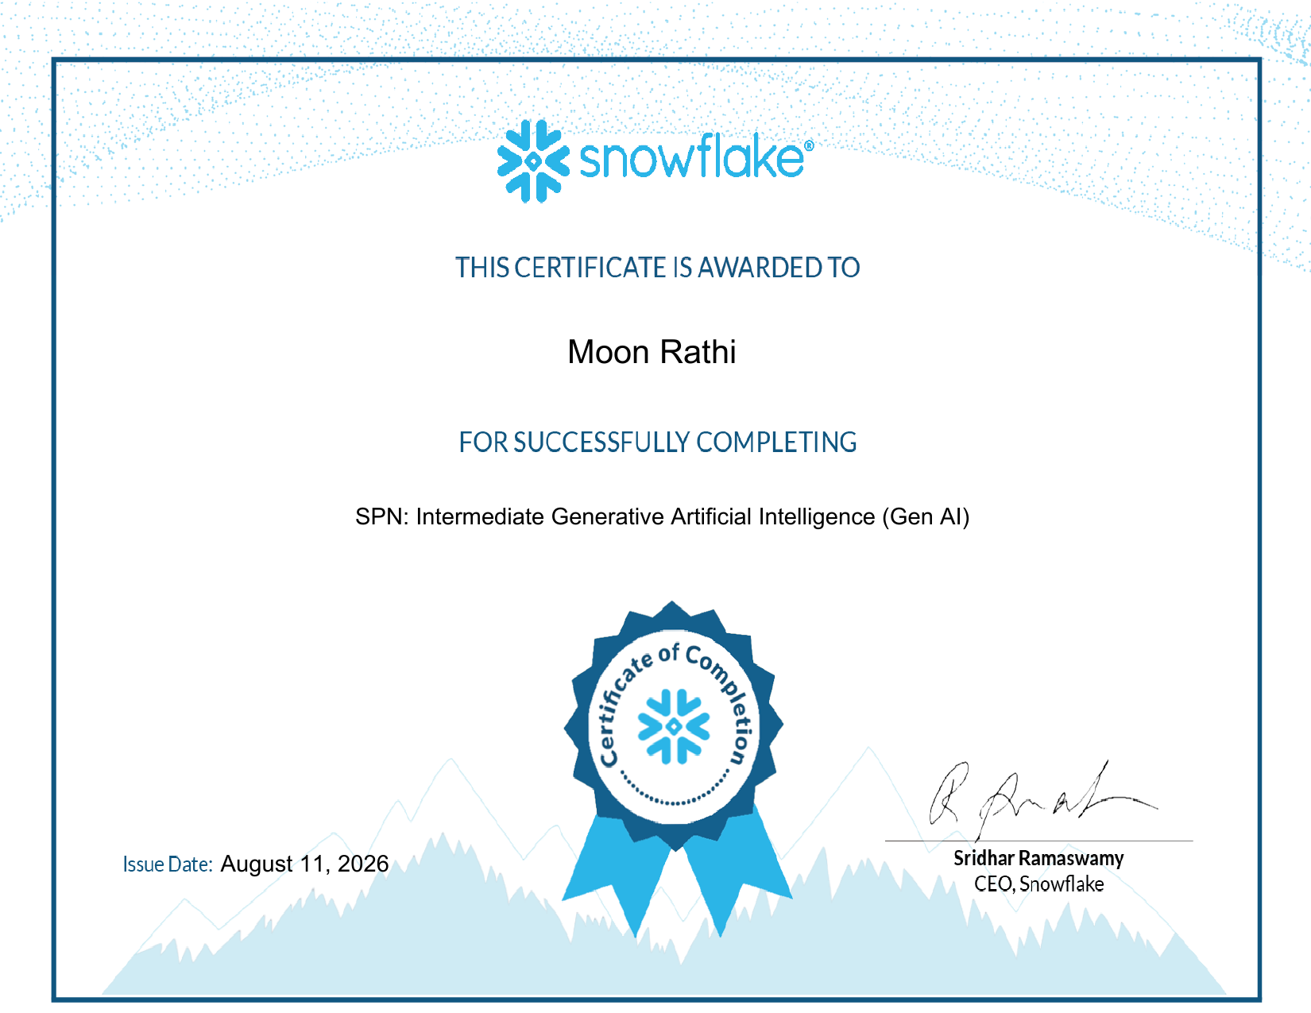
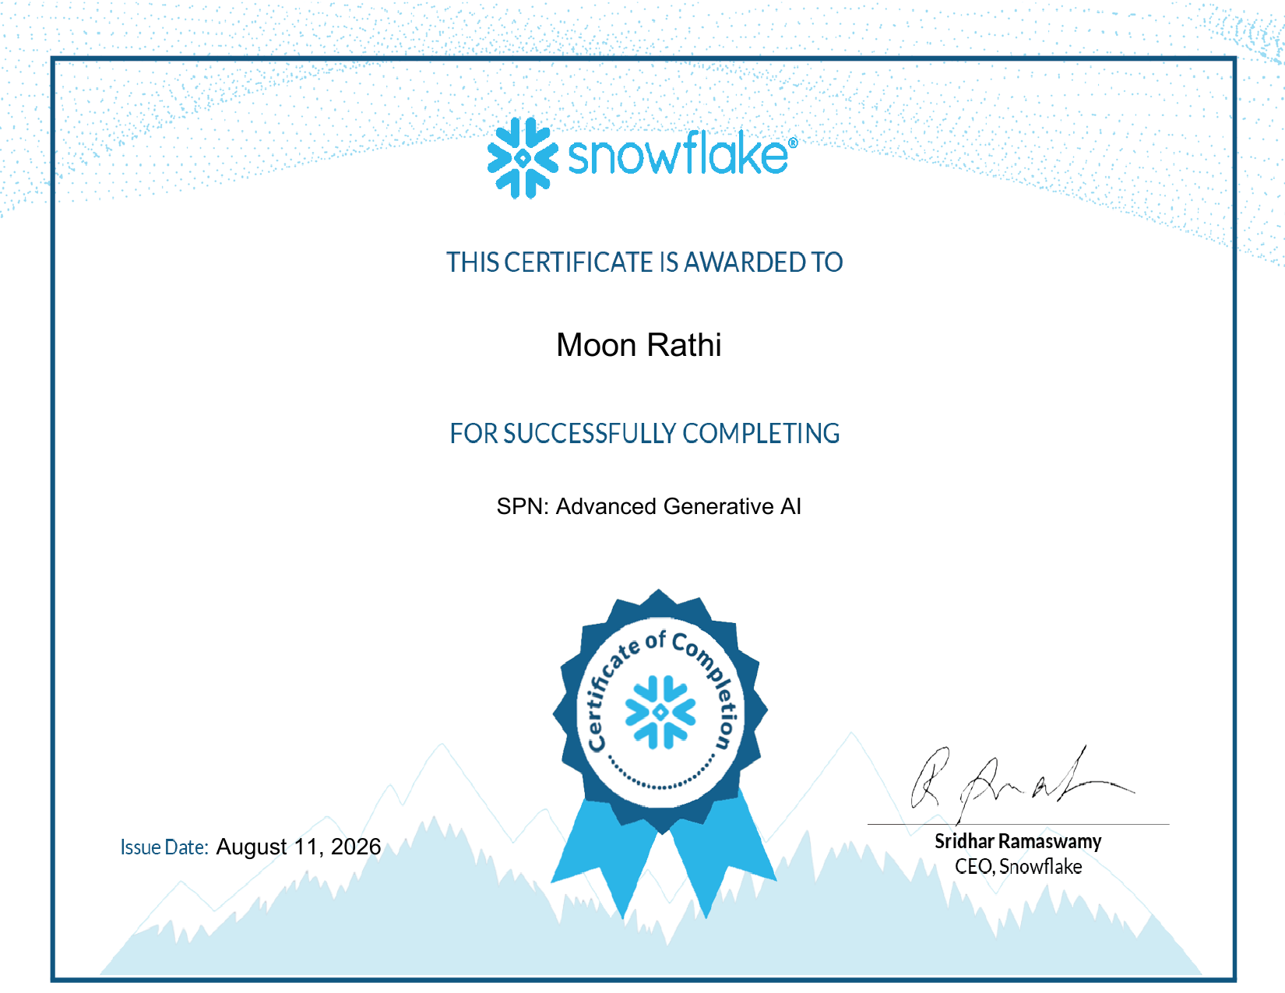
PROJECT 3
Snowflake Data & AI Platform Engineering
Getting Started with AI/ML
Intermediate Machine Learning
Intermediate Generative AI
Advanced Generative AI
SPN Deliverable
SPN Deliverable
SPN Deliverable
SPN Deliverable
Aug 11, 2026
Aug 11, 2026
Aug 11, 2026
Aug 11, 2026
This project delivered all four Snowflake SPN modules, covering the foundations of AI/ML on Snowflake through to advanced Generative AI concepts — reinforcing the AI-engineering skills built in Project 1 with a data-platform-native perspective.
Moon Rathi | CS-2341452 | Mactores Cognition Pvt. Ltd.
7

Slide 8


PROJECT 2
Multi-Cloud Foundations Engineering — In Progress
IN PROGRESS
IN PROGRESS
AWS Certified Cloud Practitioner
Azure Administrator Associate
CLF-C02
AZ-104
Udemy: Ultimate AWS Cloud Practitioner CLF-C02 course
Official Microsoft AZ-104 documentation
Supplementary YouTube course
Practice questions via ExamTopics
Hands-on labs via AWS Skills Builder
Additional mocks via Examsnet & Secexams
Moon Rathi | CS-2341452 | Mactores Cognition Pvt. Ltd.
8

Slide 9


REFLECTION
Key Skills & Learnings Gained
Cross-platform fluency
Applied AI engineering
Comfort navigating AI, cloud and data-platform ecosystems rather than a single vendor stack
Hands-on use of the Claude API, Claude Code and Model Context Protocol for agentic workflows
Structured self-learning
Engineering under deadline
A repeatable pipeline of study → practice → validation → deliverable, applied consistently
Delivering working, verifiable outcomes for each project within a fixed timeline
Moon Rathi | CS-2341452 | Mactores Cognition Pvt. Ltd.
9

Slide 10
LOOKING AHEAD
Conclusion & Road Ahead
By the end of the internship (Sept 17, 2026), the goal is to hold verifiable credentials spanning AI/LLM tooling, public cloud and cloud data platforms — a well-rounded profile aligned with how modern DevOps teams actually work.
1
Complete AWS Cloud Practitioner deliverable (Project 2)
2
Complete Azure AZ-104 deliverable (Project 2)
3
Consolidate all outcomes into the GitHub portfolio repository
4
Apply multi-platform skills to real DevOps/MLOps tasks at Mactores
Moon Rathi | CS-2341452 | Mactores Cognition Pvt. Ltd.
10

Slide 11
Thank You
Questions & Discussion
Moon Rathi | CS-2341452 | B.Tech CSE, Sem 7, Section 4CSE8
Mactores Cognition Private Limited | DevOps Engineer (Intern)

