Slide 1
Chrome: Feature Proposal
CISC/CMPE 322
Mackenzie Furlong
Alex Golinescu
David Haddad
William Melanson-O'Neill
Michael Reinhart
Lianne Zelsman
Notes:
Hello everyone, welcome to our presentation on our proposed feature for the Chrome browser.

Slide 2
Agenda
Proposal Overview
SAAM Analysis
Design Options
NFRs and Stakeholders
Advantages/Disadvantages
Architecture Implementation
Sequence Diagram
Impact & Risks
Concurrency
Testing
Team Issues
Limitations & Lessons Learned
Conclusion
Notes:
Today we're going to go over our feature proposal. We'll walk you through our SAAM analysis, discuss details about our chosen implementation (including a sequence diagram of the main use-case, its overall impact on the system, some risks and our testing plan). We'll also discuss team issues, some limitations we found and our learned lessons.

Slide 3
Proposal

Slide 4
Facial Recognition
Two use cases
Protect autofill data​
Bypass Chrome-prompted login requests​
Value
Improve security​
Increase speed
Notes:
We would like to propose the addition of a facial recognition feature
Such a feature would mainly be used for two things:
As an extra security step to help protect autofill data (such that forms will only be auto-filled once a person’s identity is confirmed)
Or to quickly bypass chrome-prompted login requests (which are needed to login to Chrome or complete actions such as viewing saved passwords)
This feature's main values would be that it would help to improve user data security by preventing people from maliciously accessing a user's accounts and personal information with the autofill functionality, as well as increasing usage speed (since, if implemented correctly, it can be faster than inputting passwords)

Slide 5
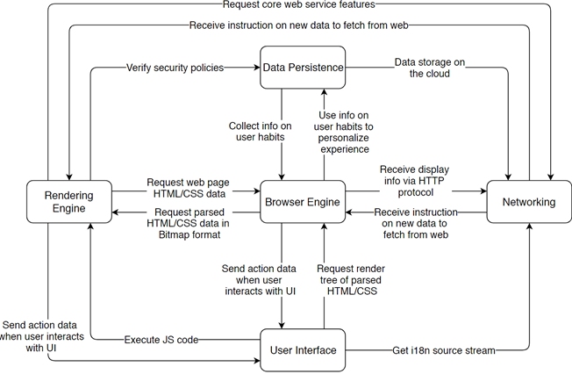
Concrete Architecture
Dependency Subsystem
Notes:
As a reminder, this is what our concrete architecture looks like. It consists of 5 main subsystems: the browser engine, rendering engine, user interface, data persistence object and networking system.

Slide 6
SAAM Analysis
Notes:
In the proposes of designing our facial recognition feature, we came up with two main design options.

Slide 7
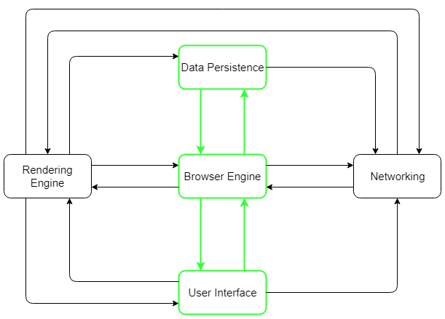
Design One
Dependency Used by Feature Subsystem Used by Feature
Notes:
Our first design option does not involve the addition of any new subsystems or dependencies.
Instead, it adds new functionality to the browser engine, UI and data persistence object, and isolates most features usage to those three subsystems.
The user's preference and facial data will be stored in the data persistence object
The webcam functionality is built into the UI object and controlled by the browser engine, which performs the required image processing algorithms

Slide 8
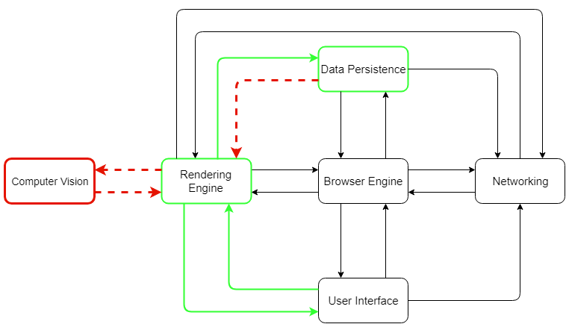
Design Two
Dependency Used by Feature Subsystem Used by Feature
New Dependency New Subsystem
Notes:
Our seconds design builds off of the preexisting autofill and webcam functionality within Chromium
Most of it is controlled by the rendering engine through a Media Stream API, which communicates with both the data persistence object and UI
This design would require adding in a new dependency between the rendering engine and storage, to allow for the API to function correctly
It also adds in a new "Computer Vision" subsystem, which performs the computer vision algorithms for the facial recognition

Slide 9
Stakeholders& NFRs
Users: performance & security
Google: security
Developers: evolvability, maintainability & testability
Notes:
We decided to focus our SAAM analysis on the key non-functional requirements that we felt were the most important for the three main stakeholders:
The users are primarily concerned with system performance (so that it doesn't negatively impact their user experience), as well as the security of their account data
Google is primarily concerned with the legalities of security, ensuring that users' personal data isn't misused or endangered
The developers mainly care about the ease of evolvability, maintainability and testability, as those will directly impact their work

Slide 10
Advantages & Disadvantages
 | Design One | Design Two
Security |  | Preexisting security built into API Concurrency of using rendering engine
Maintainability | Redundancy due to recreation of similar features clutters code
Testability | Decreased cohesion of subcomponents makes individual testing difficult | High cohesion helps with testing Unit tests already exist for autofill and webcam API
Evolvability | Decreased cohesion may reduce evolvability as changes in subsystems will be difficult to make | Increased coupling can make evolution difficult But, spreading out functionality across more subsystems can ease isolated development
Performance | Less subsystems and required connections, so less chance of bottlenecking | API usage increases efficiency However, more subsystems and required connections can increase chance of bottlenecking
Other | More work to develop | Less work to develop
Notes:
We created a table to compare some advantages and disadvantages of the non-functional requirements for each design. We won't go through every single one, but some of the key results are that:
For security, our second design wins as the existing API already implements many security requirements. In addition, by running the feature from the rendering engine, the concurrency provided by having a different rendering thread for each tab means that facial recognition must be rechecked for each webpage
The higher cohesion in the second design that results from having subsystems with more specific functionality helps with both testability and evolvability, although the increase in coupling which occurs from adding new dependencies can negatively impact the ease of evolution
For performance, Design 1 is superior, as the usage of less subsystems reduces the chance of bottlenecking in the chain of communication, although it should be noted that Design two uses an API with WebRTC, which enables fast, real-time communication
In the end we decided to go with Design Two due to the massive security benefits the concurrency provides, as well as the decreased amount of work and testing benefits provided to developers

Slide 11
Implementation

Slide 12
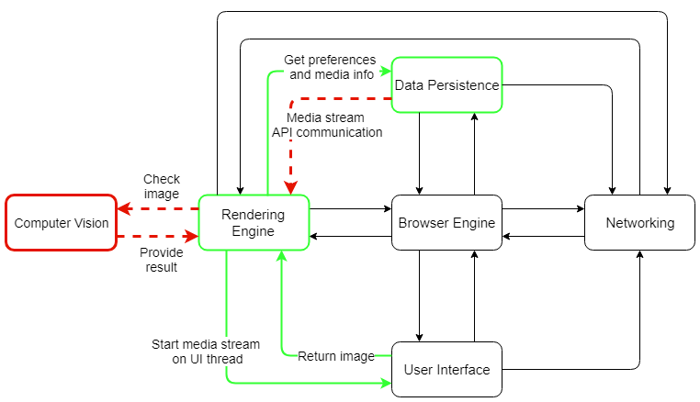
Design
Dependency Used by Feature Subsystem Used by Feature
New Dependency New Subsystem

Slide 13
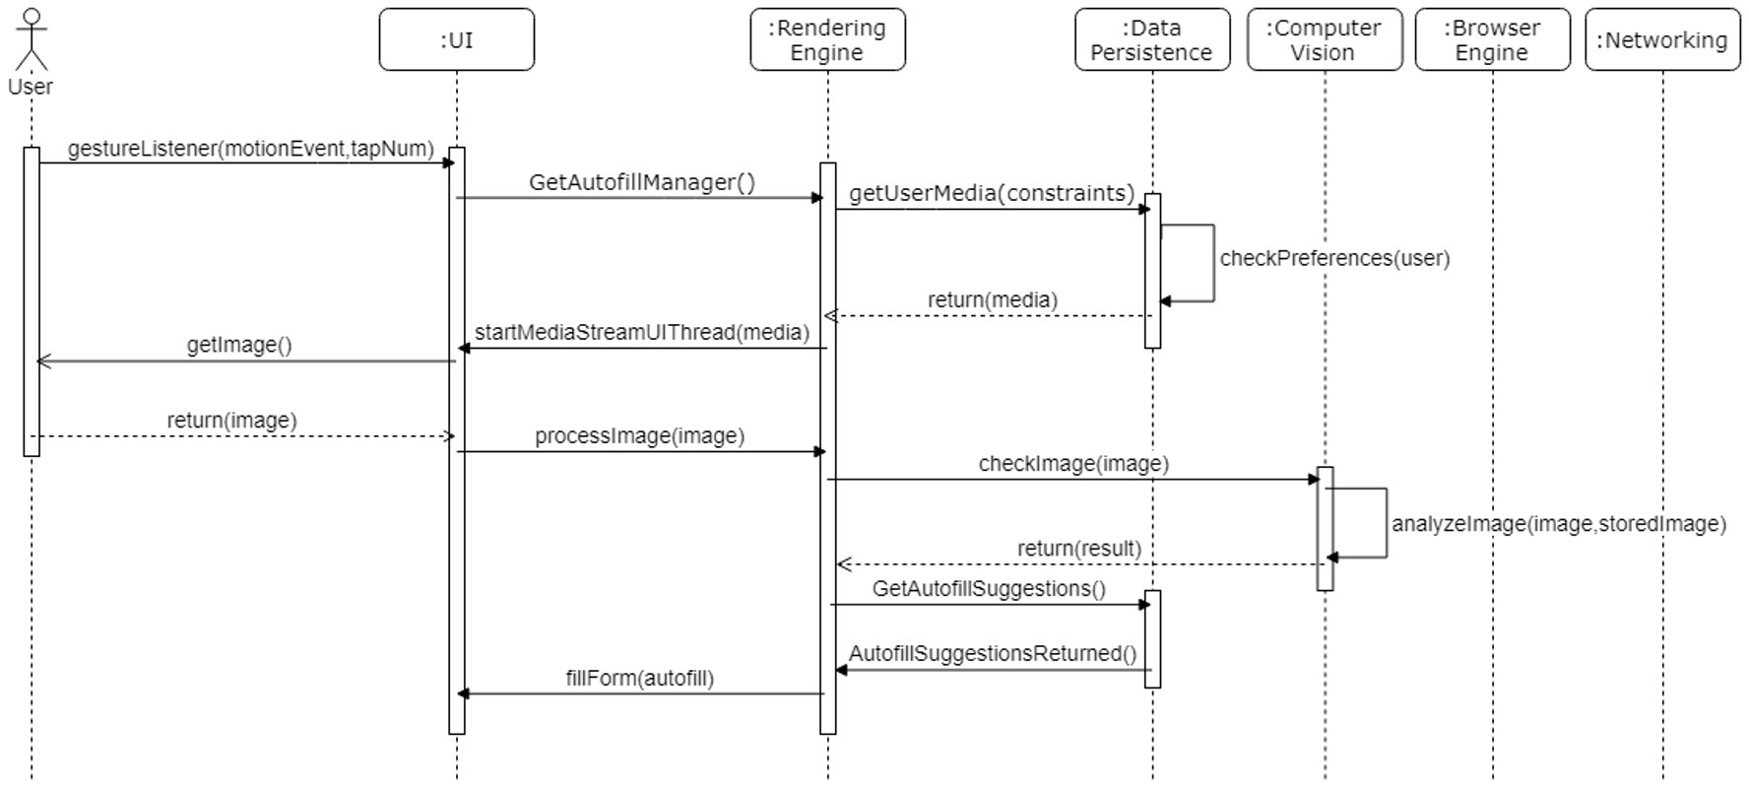

Autofill Use-Case
Message Response Lifeline Object Actor Activation

Slide 14
High-Level Impact
Still object-oriented architecture
No noticeable impact on performance, testability, maintainability
Could decrease evolvability due to increased coupling

Slide 15
Low-Level Impact
No impact on most internal components
Mostly OO internally, with implicit style for UI and layering in rendering/browser system
Data persistence and rendering engine subsystems need minor adjustment to allow new communication channels
Can be done easily using WebRTC, so won’t impact component performance
Following files in rendering engine must be adjusted:
content/browser/renderer_host/media
content/renderer/media/
content/browser/webrtc/
content/public/renderer/

Slide 16
Concurrency
Each Chrome tab runs its own rendering engine instance
Limits performance bottlenecks
Ensures errors in one tab won’t impact login/autofill for another
Increases security (facial recognition must be re-done in each webpage)
Notes:
The concurrency of our architecture provides multiple benefits with this feature's implementation. Since each browser tab runs its own instance of the rendering engine it:
Ensures no performance bottlenecks between different tab processes
Ensures errors in one tab won’t impact the login/autofill success for another
And improves overall security, as each tab/webpage will need to re-check the user's face

Slide 17
Risks
Performance
Inefficient facial recognition algorithm could greatly reduce usage speed
Security
Inaccurate facial recognition (false positives) is a huge security risk
Notes:
The inclusion of the new feature has a few major risks.
Performance --> If the facial recognition algorithm isn’t efficient, it could end up taking much longer than entering a password, which greatly reduces usage speed
Security --> inaccurate facial recognition that results in false positives would allow a stranger to log in to a user’s account and access their personal data

Slide 18
Testing
Facial recognition (performance)
Facial recognition (accuracy)
Correct UI & rendering engine reaction to changes in data persistence object
Correct response to system failures & errors during recognition process
Notes:
There are a few tests the development team would need to do to eliminate those risks.
Both the facial recognition speed and accuracy will need to be tested. This can be done by running the recognition on a large number of different faces, at different angles, in various lighting environments.
For performance, the system should achieve a less than 2 second recognition time (from webcam startup to identification)
For accuracy, the system should have a 95% success rate of identifying individuals, with less than a 1% rate of false positives (false negatives are less detrimental)
The system should also be tested to ensure that the feature is properly disabled if a user's preferences don't allow facial recognition
This wil ensure the UI and rendering engine are correctly reacting to changes in the data persistence object
Finally, the system should also be tested for response to system failures or errors during the recognition process, which is important for security
For example, it should be checked that if there is a loss of internet connectivity, it won't allow the user to bypass the facial recognition

Slide 19
Design Process

Slide 20
Team Issues
Implementation involves multiple subsystems
Require cross-collaboration between multiple teams
Suggestion: main development done by rendering engine team
Consultation with a few UI and data persistence team members to ensure correct feature functionality in those systems
Notes:
Because the feature's implementation involves multiple subsystems, no single subsystem development team can successfully implement it alone
Development would require cross-collaboration between multiple different teams
Our suggestion would be to have the main development done by the rendering engine team, as that subcomponent contains the majority of the functionality already
However, they would need to consult various members of the UI and data persistence teams to ensure that each part of the new feature functions properly within those subsystems

Slide 21
Limitations
Difficult to piece together existing autofill and webcam functionality from Chromium documentation
Multiple assumptions were probably incorrect, skewing accuracy of design
Notes:
It was very difficult to piece together the existing autofill and webcam functionality without spending weeks investigating individual code files
The existing documentation did not provide a "bigger picture" explanation, so many assumptions had to be made about the connections between systems
It is likely multiple of the assumptions resulted in inaccuracies in our design

Slide 22
Lessons Learned
Even seemingly small changes can have a large impact on the entire system in unexpected ways
Really reinforces importance of low coupling and high cohesion
Notes:
The main thing we realized was that even seemingly small changes to a subcomponent can have a large impact on the entire system in unexpected ways
This really reinforced the importance of low coupling and high cohesion within software architectures

Slide 23
Conclusion
Many factors to consider when implementing a new feature
Less intensive approach taken towards feature implementation
Risks to performance and security with improper implementation
But benefits from successful implementation outway risks
Notes:
There were many different factors we had to consider when deciding on an approach for our feature implementation
We eventually decided on a less intensive approach which builds off of preexisting functionality
Though there are risks to the systems performance and security, if the system is implemented properly, it will actually improve both security and usage efficiency for the user

Slide 24
Questions?

