Slide 1
Anatomy of the Brain
Structure, lobes and main functions
Sample lecture deck — content adapted from Johns Hopkins Medicine, 'Brain Anatomy and How the Brain Works'. Diagrams are simplified schematics.

Slide 2
What Is the Brain?
• A complex organ controlling thought, memory, emotion, touch, motor skills, vision, breathing, temperature and hunger
• Together with the spinal cord, forms the central nervous system (CNS)
• Weighs roughly 3 pounds in an average adult and is about 60% fat
• Contains blood vessels and nerves, including neurons and glial cells
• Grey matter is the darker outer portion; white matter is the lighter inner section
• Grey matter processes and interprets information; white matter transmits it

Slide 3
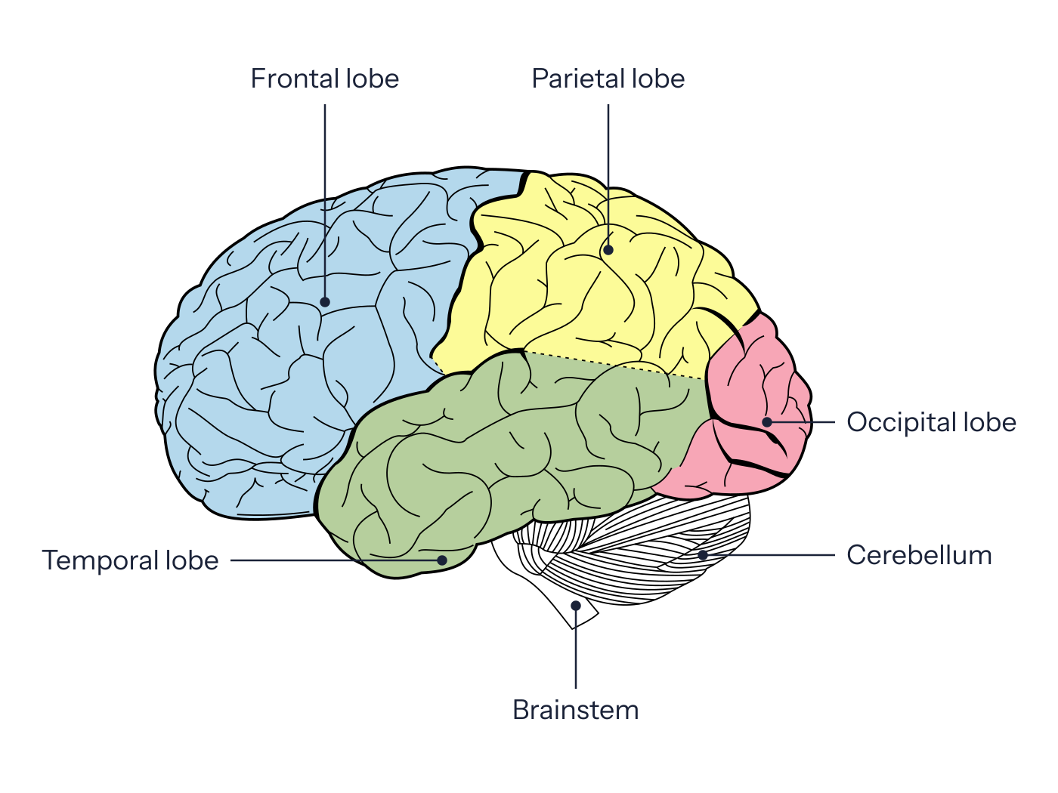
Lobes of the Brain
Each hemisphere of the cerebrum is divided into four lobes.

Slide 4
Lobe Functions
Lobe | Location | Main functions
Frontal | Front of the head | Personality, decision-making, movement, speech (Broca's area)
Parietal | Middle of the brain | Object identification, spatial relationships, pain and touch
Temporal | Sides of the brain | Short-term memory, speech, musical rhythm, smell recognition
Occipital | Back of the brain | Vision
The right hemisphere controls the left side of the body, and the left hemisphere controls the right side.

