Slide 1
Mars Habitat Automation System
A distributed IoT monitoring and control platform for Mars habitat simulation, built for the Advanced Programming Laboratory course.

Slide 2

System Architecture Overview
Data Ingestion
1
Sensor data collected from mars-simulator via REST and SSE endpoints
Message Routing
Normalized messages distributed via RabbitMQ message broker
2
Automation Engine
Rules applied to trigger actuator responses based on sensor conditions
3
Dashboard UI
Real-time monitoring and manual control through web interface
4

Slide 3
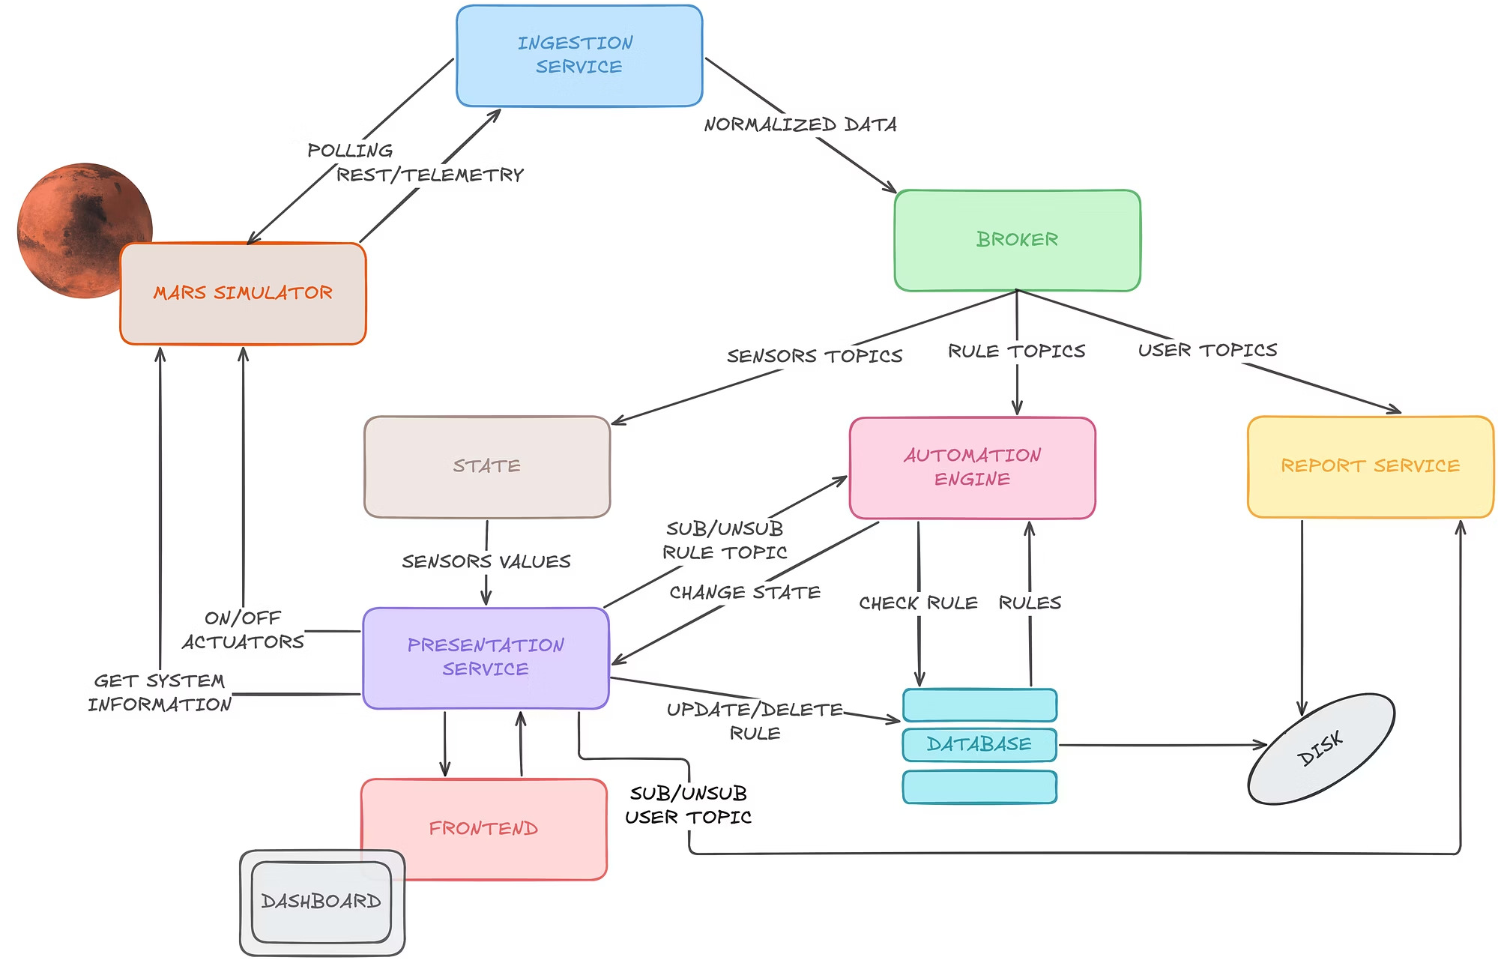
Architecture

Slide 4




Technology Stack
Message Broker
RabbitMQ with topic-based exchanges for real-time data distribution across services
Data Persistence
PostgreSQL database storing automation rules with CRUD operations for rule management
Core Services
Python 3.11 microservices handling ingestion, automation, state management, and reporting
Web Interface
Flask + Flask-SocketIO backend with HTML/JS frontend for real-time dashboard and controls

Slide 5

Event Schema Normalisation
To handle incompatible device dialects, all incoming data is normalised into a unified internal format before being published to the message broker.
{
"id": "string",
"source": "rest | telemetry", "captured_at": "ISO_8601 timestamp",
"status": "ok | warning", "measurements": [
{
"metric": "string",
"value": "number",
"unit": "string"
}
],
"topic": "string"
}

Slide 6

Ruls Modsl s 6utomation
Dynamic Rules
IF-THEN rules evaluated upon arrival of new sensor events
Database Persistence
Rules stored in PostgreSQL to survive service restarts
Actuator Control
Automatic ON/OFF switching based on threshold conditions

Slide 7

Monitoring User Stories
View Sensors
Monitor available sensors with current values and measurement units
Real-Time Telemetry
View live line charts for telemetry data including power and radiation
Sensor Warnings
Visual alerts when sensors exceed critical thresholds or become unreachable

Slide 8

Actuator Control Stories
Manual Control
Operators can manually activate or deactivate actuators through the dashboard interface, providing override capability when automation needs to be bypassed.
Automated Responses
System automatically triggers actuators when rule conditions are met, maintaining optimal environmental conditions without manual intervention.
View actuator list and current states
Track activation history through system logs

Slide 9



Rule Management Stories
Update Rules
Modify existing rules to respond to changing habitat conditions and requirements
Create Rules
Build new automation rules that react to sensor values and control environmental conditions
Enable/Disable
Temporarily deactivate rules without deleting them for testing and troubleshooting
Delete Rules
Remove outdated automation logic that is no longer applicable to current operations

Slide 10




System Features s Capabilities
Rule Persistence
Automation logic preserved and restored automatically after system reboots or failures
PDF Reports
Generate detailed sensor charts and statistics for archiving and analysis
Action Logging
Comprehensive history of actuator state changes for auditing automation behaviour

Slide 11

Key Achievements
7
Microservices
Containerised services working in harmony
16 99.9%
User Stories Real-Time
Complete feature WebSocket updates coverage for for live monitoring
operators
This distributed automation platform demonstrates event-driven architecture principles, microservices communication patterns, and real- time system monitoring capabilities suitable for mission-critical environments.

