Slide 1
SIMULATION & MODELING LAB · SECTION 7C · AUTUMN-2026
Simulation and Optimization of Traffic Signal Timing at a Dhaka Intersection
Team 16
Mahathir Ullah Yafi · Sadiqur Rahman Apon
SM Sabbir Hossin · Nazib Mahmud
University of Information Technology and Sciences (UITS) · Teacher: Afroja Ahmed Smrity
Notes:
Mahathir: Greet the class. Say our project name and that we are Team 16. In one line: we used a computer simulation to see if a better traffic signal plan can cut waiting time at a Dhaka intersection.

Slide 2
The problem and our question
THE PROBLEM
OUR QUESTION
Dhaka traffic wastes hours of commuters' time every day.
Much of the delay builds up in queues at signals.
Changing signal timing costs far less than building roads.
But testing a new plan on a real road is slow and risky.
Can a better signal plan shorten the wait at a Dhaka intersection?
OUR APPROACH
Build a computer model of the intersection, try many signal plans on it, and compare them under the same traffic.
Team 16 · Simulation & Modeling Lab · UITS
2 / 10
Notes:
Mahathir: Explain the everyday problem. Then the question. Then say: instead of changing a real signal, we test plans on a computer first. That is what simulation means.

Slide 3
Who did what
SLIDES 1 TO 3
SLIDES 4 AND 5
Mahathir Ullah Yafi
Sadiqur Rahman Apon
The problem, our question and the project goals.
The data that goes in and how the simulation works.
SLIDES 6 TO 8
SLIDES 9 AND 10
SM Sabbir Hossin
Nazib Mahmud
The results, graphs, animation and sensitivity test.
How far to trust the result, next steps and conclusion.
Team 16 · Simulation & Modeling Lab · UITS
3 / 10
Notes:
Mahathir: Introduce each teammate and what they will present. Edit this slide if your split is different.

Slide 4
What goes into the model
Approach | Vehicles | Per minute | Green (s)
North | 667 | 11.1 | 42
South | 614 | 10.2 | 41
East | 583 | 9.7 | 58
West | none (3-way) | 0 | none
FIVE TYPES OF VEHICLE (ASSUMED)
Type | Share | Headway
Car | 30% | 2.0 s
Bus | 10% | 3.5 s
CNG | 20% | 2.0 s
Rickshaw | 20% | 2.5 s
Bike | 20% | 1.2 s
Source: published counts, Abdul Gani Road Intersection 2, Dhaka (EngrXiv preprint 4440).
We assumed the counts cover one hour.
Headway = time one vehicle needs to leave the stop line. Lost time per signal change: 6 s (assumed).
Team 16 · Simulation & Modeling Lab · UITS
4 / 10
Notes:
Apon: These are our inputs. Arrival counts come from a published Dhaka study, divided by 60 to get vehicles per minute. Vehicle mix, headway and lost time are our assumptions, not measured. Say that clearly.

Slide 5
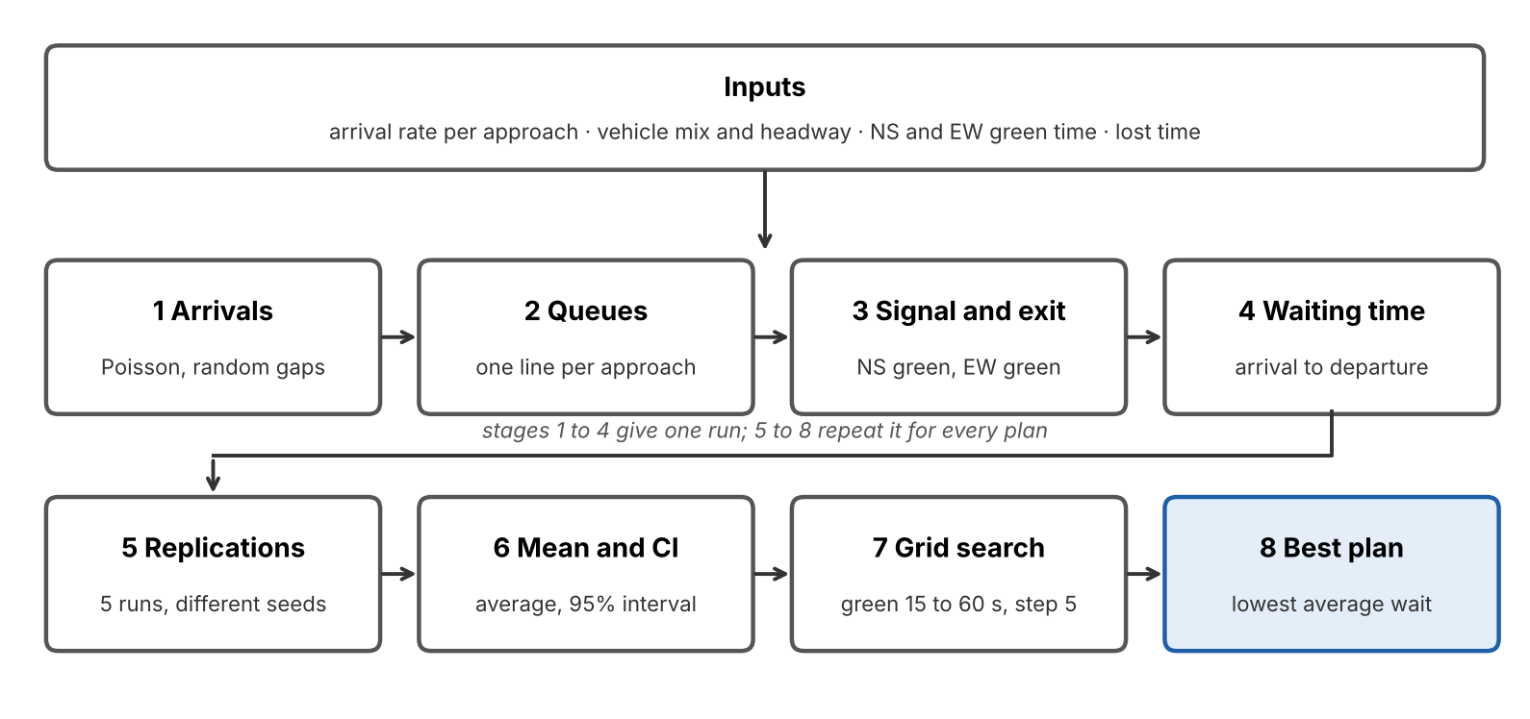
How the model works
IN SHORT
Cars arrive at random times (Poisson).
Each waits in a line until its green.
Signal: NS green, all-red, EW green, all-red.
Waiting time = departure minus arrival.
Run 5 times per plan, average, add a 95% interval.
Try every green-time pair from 15 to 60 s.
Team 16 · Simulation & Modeling Lab · UITS
5 / 10
Notes:
Apon: Walk through the block diagram left to right. Stages 1 to 4 simulate one hour of traffic for one plan. Stages 5 and 6 repeat it 5 times with different random seeds. Stages 7 and 8 repeat for every green-time pair and pick the lowest average wait. Built in Python with SimPy.

Slide 6
Result: the best plan cuts waiting by 59%
−59%
Baseline · NS 42 s, EW 58 s
58.4 s ± 14.1
39 vehicles left in the queue
average waiting time with the best signal plan
Best plan · NS 30 s, EW 25 s
23.8 s ± 1.3
11 vehicles left in the queue
Mean ± 95% confidence interval over 5 runs. Literature-based scenario, not our field data.
Team 16 · Simulation & Modeling Lab · UITS
6 / 10
Notes:
Sabbir: The grid search found NS 30 s and EW 25 s as best. Average wait fell from about 58 s to about 24 s. The two confidence intervals do not overlap, so this is not just random luck. Be clear: it is a model result.

Slide 7
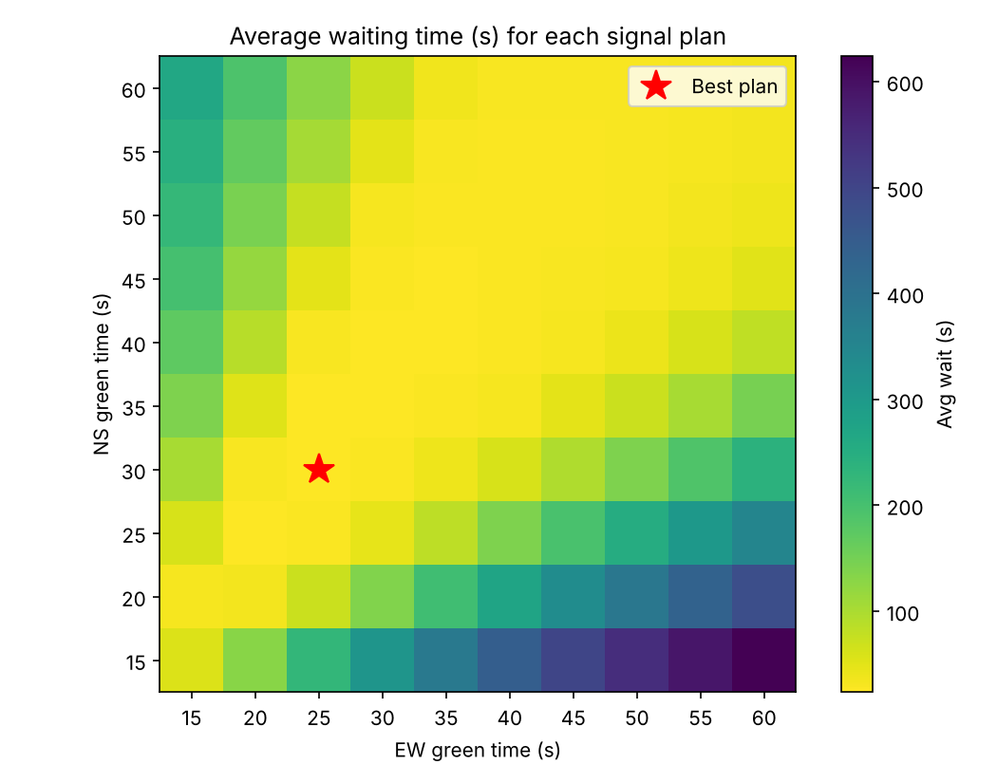
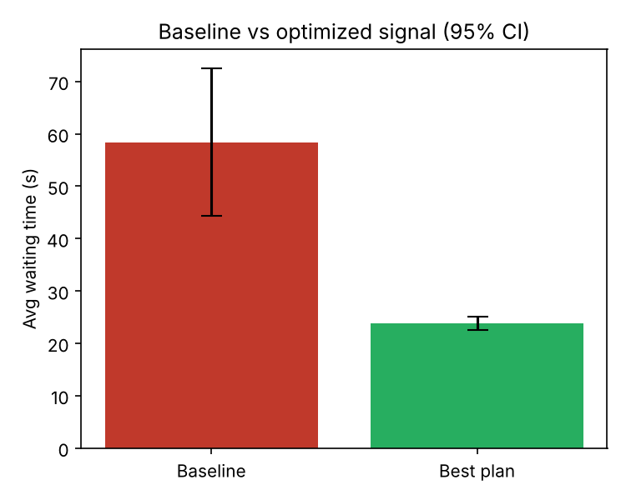
Where the best plan sits
Average wait for every green-time pair. Darker means longer. The star is the best plan.
Baseline versus best plan, with 95% confidence intervals.
Team 16 · Simulation & Modeling Lab · UITS
7 / 10
Notes:
Sabbir: Left graph: every combination of NS and EW green time. Yellow is short wait, dark is long. The star is our best plan. Right graph: baseline against the best plan, the black lines are the 95% intervals.

Slide 8
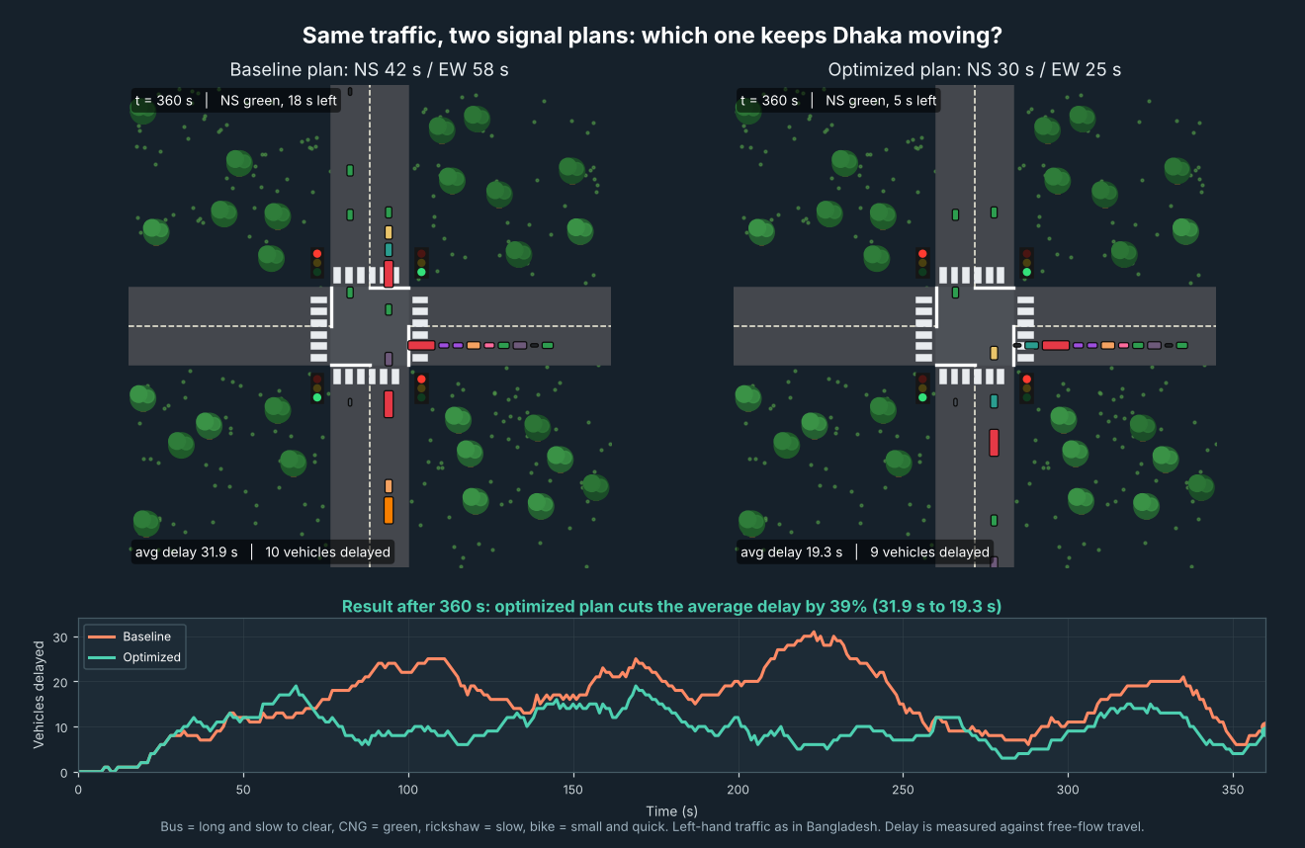
Animation and stress test
WHAT IF TRAFFIC CHANGES?
Traffic | Baseline | Best plan | Cut
80% | 29.5 s | 17.5 s | 41%
100% | 58.4 s | 23.8 s | 59%
120% | 193.3 s | 68.4 s | 65%
The best plan wins at every level. At 120% the old plan breaks down because queues keep growing.
Same traffic, two signal plans side by side: the current one and the optimized one (Python animation in our notebook).
Team 16 · Simulation & Modeling Lab · UITS
8 / 10
Notes:
Sabbir: Left, a frame from our animation where both sides get exactly the same vehicles. Right, the sensitivity test: we raised and lowered traffic by 20%. The best plan stayed better every time.

Slide 9
How far to trust this, and what is next
HONEST LIMITS
NEXT STEPS
Counts come from another Dhaka intersection.
Vehicle mix, headway and lost time are assumed.
Two phases only: no pedestrians or turning.
One simulated hour, 5 runs per plan.
So the 59% is a model result. A real road would likely show a smaller gain.
1 Count vehicles at our own intersection and time the signal cycles.
2 Run the model with those inputs and compare with the field.
3 Add pedestrians, minimum green and turning movements.
4 Compare peak and off-peak, and try an adaptive signal.
Team 16 · Simulation & Modeling Lab · UITS
9 / 10
Notes:
Nazib: This is our honesty slide. The 59% is from a simplified model on published data, not measured on a road. That is why the next step is validation with our own field counts. If asked why 59% is large: demand is light compared with what a green phase can release, so shorter cycles shorten the red wait.

Slide 10

Conclusion: retiming the signal from 42/58 s to 30/25 s cut the wait by about 59% in our model.
Team 16 · Simulation & Modeling Lab · UITS
10 / 10
Notes:
Nazib: State the conclusion in one line, then let the animation on this slide play. Say thank you and ask for questions.

