Slide 1
Q1 Trend Analysis
Presented by: Ruhan Ahmed
Last Updated: 07 July 2025

Slide 2
What are we talking about?

Slide 3
Purpose
Conduct exploratory data analysis on Q1 2025 bookings and sales data to generate insights about customer behaviour and sales performance.

Slide 4
Objectives
Identify top revenue-contributing customers
Understand booking patterns and product preferences
Highlight errors in booking and invoicing data

Slide 5
Tracked KPIs
Total Revenue
Top Customers
Most ordered Product
Average order value

Slide 6
Dataset Overview using Fabric

Slide 7

Dataset Overview
Extracted from pdf forms and Sage database
Stored in a Microsoft Fabric Lakehouse
Over 1’700 booking records
Over 40 columns including: Paper size, Quantity, Cost
Covers Q1 of 2025 (January, February, March)

Slide 8
Project Relevance of the Dataset
Enables exploration of order patterns and sales revenue
Allows for product trend and preference analysis
Essential for building KPIs and identifying high-value clients

Slide 9
Bookings Structure
Column | Type | Description
Booking number | 🟩Numerical | Unique ID per booking
Company name | 🟦Categorical | Customer's company name
Job name | 🟦Categorical | Description of the print job
Order date | 🟨Datetime | When the job was ordered
Date required | 🟨Datetime | When the job is needed
Quantity | 🟩Numerical | Number of items requested
Size, Paper, Description | 🟦Categorical | Product attributes per item
Delivery address | 🟦Categorical | Where the item is to be sent

Slide 10
Sales Structure
Column | Type | Description
Invoice No. | 🟩Numerical | Unique invoice ID
Date | 🟨Datetime | Date of invoice
Name | 🟦Categorical | Company name (payer)
Amount | 🟩Numerical | Total transaction revenue
Sales Order No. | 🟦Categorical | Order booking number

Slide 11
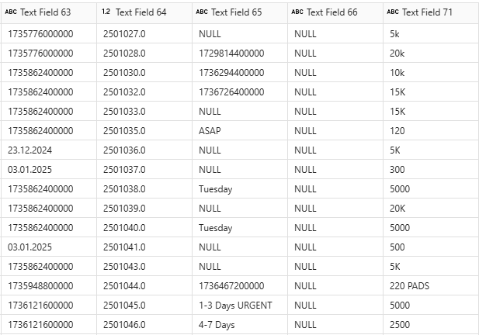
Identifiable Challenges
Data compilation
Missing values
Mixed formats
Duplicate entries
Outlier values

Slide 12
ETL Process using Pandas

Slide 13
Data Cleaning Process
Column Management
Handling Missing Values
Standardising Text Entries
Cleaning Numerical Values
Normalisation (3NF)

Slide 14
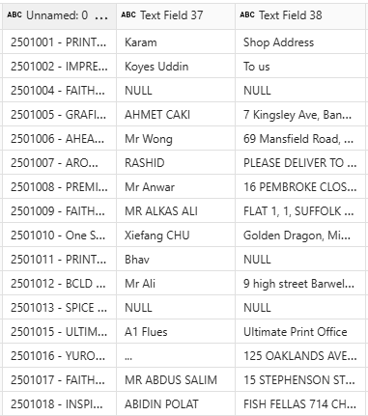
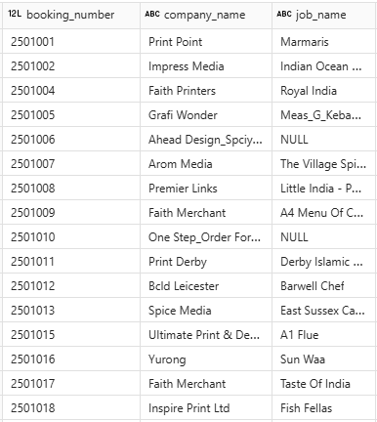
Column Management
Before
After

Slide 15
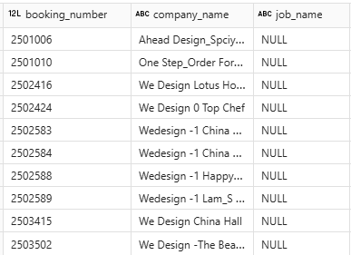
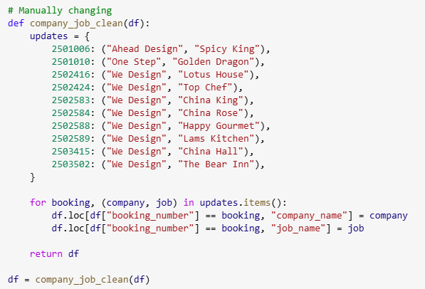
Handling Missing Values
Problem
Solution

Slide 16
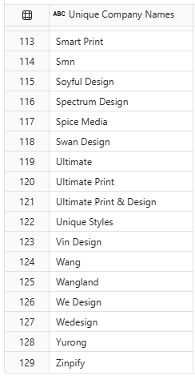
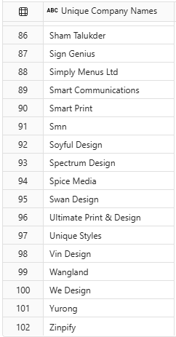
Standardising Text Entries
Before
After

Slide 17
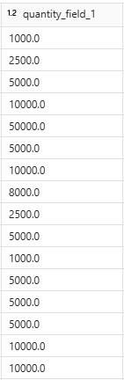
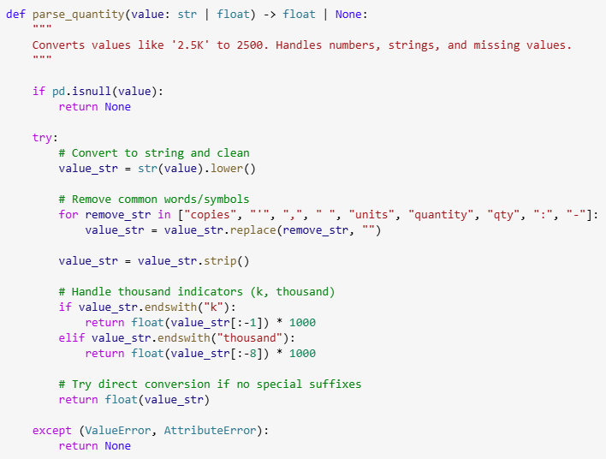
Cleaning Numerical Values
Solution
Result

Slide 18
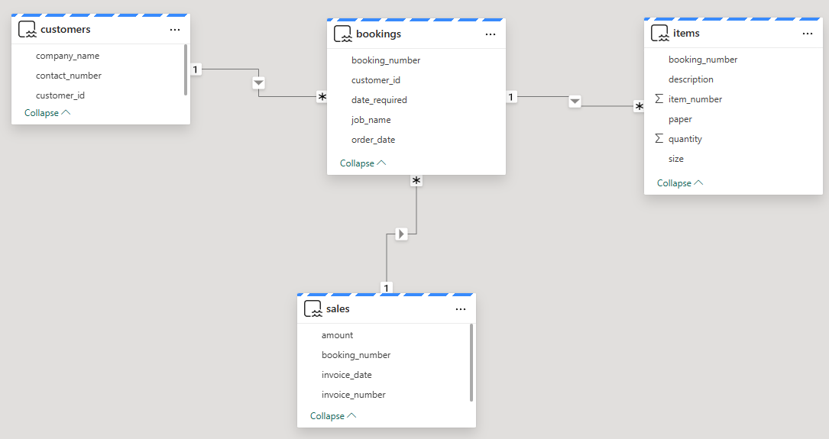
Normalisation (3NF)
Bookings
Items
Customers
Sales

Slide 19
EDA using SQL Queries

Slide 20
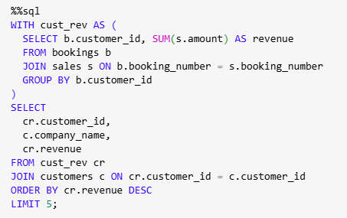
We Design generate 162 percent more revenue than Ultimate Print

Slide 21
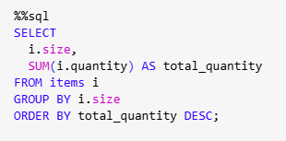
A3 and A4 make 51 percent of all orders

Slide 22
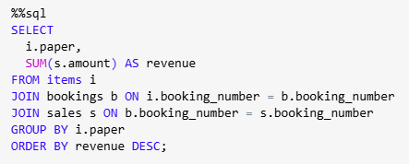
130gsm is the most popular Paper type generating £ 451 thousand in Q1

Slide 23
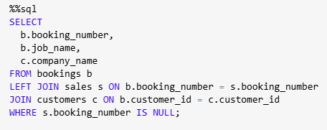
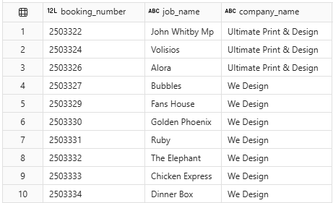
We Design and Ultimate Print have expected unbilled orders
Query
Output

Slide 24
Visual Analysis using Power BI

Slide 25


Slide 27
KPI Insights
Total Revenue £ 724 thousand
Top Customers We Design, Ultimate, One Step
Most ordered Product A4 130gsm
Average order value £ 574 per order

Slide 28
Recommendations
Improve Invoicing accuracy & completion
Focus on High-value customers
Streamline Customer ordering process
Optimise Production planning
Product line Insights

Slide 29
Analysis Limitations
Limited Time Scope
Selective data (pdf forms only)
Incomplete data (some orders not invoiced)
Lack of price dataset

Slide 30
Analysis Potential
Real-time KPI Dashboarding
Targeted Marketing
Predictive Analysis (forecast orders / spot churn risks)

Slide 31
Machine Learning using PyTorch and TensorFlow

Slide 32
Thank you for listening!
I am looking for a Data Analyst Apprenticeship
or a Junior / Entry-level Data Analyst role
Email: mruhan.ahmed@outlook.com
LinkedIn: linkedin.com/in/mruhan-ahmed/

