Slide 1
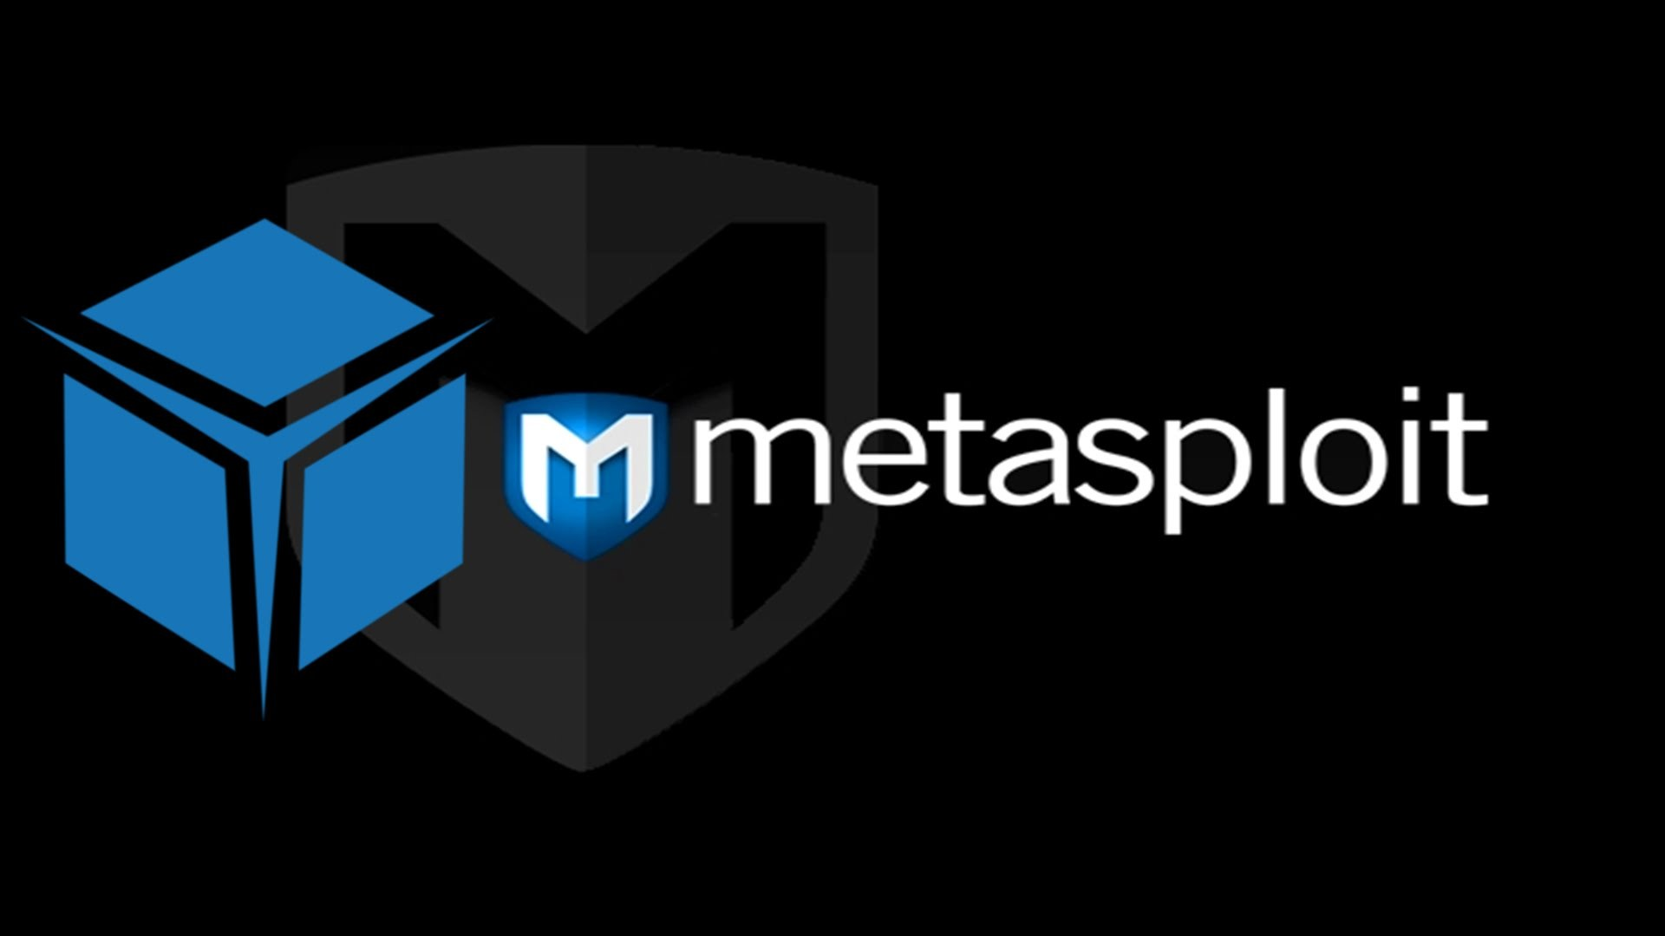

Slide 2

METASPLOIT
CRYPTOGRAPHY
Team:
Ammad(60512)
Rumman(60661)

Slide 3
SOME HISTORY
The world’s most used penetration testing framework
First Release in Oct, 2003 by Offensive Security
Coded in Perl, then in Ruby

Slide 4
Get Started
-A Vulnerability is a weakness of system which allow the attacker to Exploit the system.
-An Exploit is an attack on a system, especially one that takes advantage of a particular Vulnerability of the system.

Slide 5
Get Started
Agenda
• Metasploit Basics
– Some terminology/brief intro to pentesting
– How Metasploit works
– Interacting with Metasploit
• Basic Exploitation
– Exploiting a vulnerability using Metasploit console
• Using Meterpreter
– Using the Meterpreter shell for post exploitation

Slide 6
How Metasploit works
Installation of metasploit framework
Using CMD commands
Exploit
Install Framework
Create
Virus File
Attack!

Slide 7
LETS SEE WHAT CAN WE ACHIEVE

Slide 8

LIVE DEMO

