Slide 1

How Money Functions
Shayan Bakht

Slide 2
SPEECH OVERVIEW
“How Money Functions”
1
2
3
History
Present
Future
How did the world function before the development of our social and economical system?
What is the current economical system? How does the currency of todays world function it? Who controls the economic system?
What will the economical system be like in the future? Would technology upgrade and replace physical currency?

Slide 3

SURVEY
Participants (Age)

Slide 4

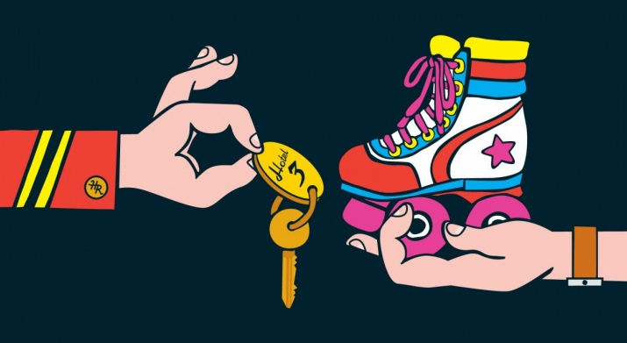
BARTER SYSTEM
An ancient method of exchange.
People exchanged services and goods in return of other services and goods.

Slide 5

SURVEY RESULTS

Slide 6





CURRENCY
Objects that occurred rarely in nature and whose circulation could be efficiently controlled emerged as units of value for interactions and exchange.
Banknotes
Banknotes are a legal-tender. These are regulated and printed by the central bank according to the monetary policy
Material
Coin
Credit Money
Form of currency which is not considered as a legal tender, such as a cheque.
Electronic Money
Money which can be transferred online. Such as debit cards, ATM. It also isn’t considered as a legal tender

Slide 7
SURVEY RESULTS

Slide 8
CRYPTO-CURRENCY
Decentralized
What is Crypto-decentralization?
The decision-making authority, is delegated away from the center.
Cryptocurrency is a type of currency which uses digital files as money.
Usually, the files are created using the same ways as cryptography (the science of hiding information)
Mining
How is Crypto-currency obtained?
These are made through a difficult and time-consuming process. Computers solve a mathematical problem, on the solution, they get a token of the currency.
Secure
Is crypto-currency secure?
Crypto-currency functions on block chain technology, which makes it secure. Mining also adds up to its security.
Threat
Is crypto-currency a threat?
Governments and economy dominators may interpret crypto-currency as a threat because it is decentralized and untraceable.

Slide 9
SURVEY RESULTS
Open-ended question:
Blockchain and related technologies, increase efficiency, effectiveness and security. What reasons can you think of for governments to impose a ban on currencies functioning on these technologies?
Answer:
Cryptocurrencies are more secure and better, but not for the governments. Transactions being extremely secure (due to encryption) are untraceable. This non-transparency would be the real problem for the governments.

Slide 10


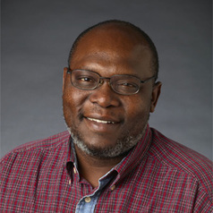
REFERENCES
Andrew Beatti (2021) The history of Money
Chapurukha Kusimba (2017) Then and why did people first start using money?
James Royal, What is Cryptocurrency?
Cryptocurrencyfacts. How is cryptocurrency created?
Moneyadvice. Bitcoin and cryptocurriencies
Dr. James Royal
Andrew Beattie
Chapurukha Kusimba
nerdwallet
investopedia
theconversation
Author of The Zen of Thrift Conversions. Veteran writer and stock analyst with a history of working in the financial-services industry. Skilled in investment management, financial analysis, behavioral finance, and writing. Strong media and communication pro with a Ph.D. in English from the University of Florida.
Part of the original editorial team at Investopedia, Andrew started covering financial topics as a writer for the site in 2003. Andrew filled a number of roles with the site, including overseeing the development of Investopedia Video and operating as a managing editor in charge of educational content. From 2002 to today, Andrew has helped translate financial events and basic concepts for a beginner audience over a time period that included several booms, a few bubbles, and one global financial crisis too many.
Chapurukha (Chap) Kusimba holds his degrees from Bryn Mawr (PhD) and Kenyatta University in Nairobi. His specialties include the archaeology of complex societies and the origins of inequality, ancient African chiefdoms and states, urbanism in Africa, Islam in Africa, and the African Diaspora in Asia and the Americas. He directs multiple anthropological research projects in East Africa and Madagascar. His current project based on the Kenyan Coast is investigating Ancient Trade Networks Between East Africa, South, Southeast and East Asia

Slide 11

THANK YOU!
Shayan Bakht
Section: Roll Number:
AI-K I20-1753
Email:
i201753@nu.edu.pk
Course:
Communication & Presentation Skills Lab

