Slide 1
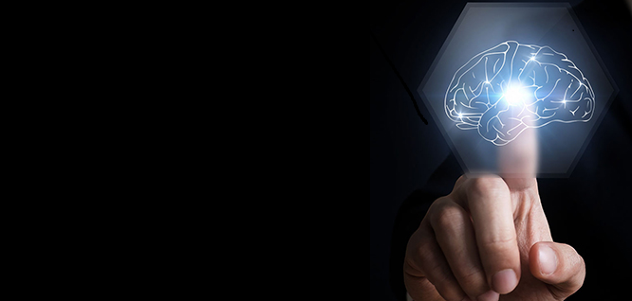
Making of Artificial Intelligence
Presentation by:
Shayan Bakht

Slide 2
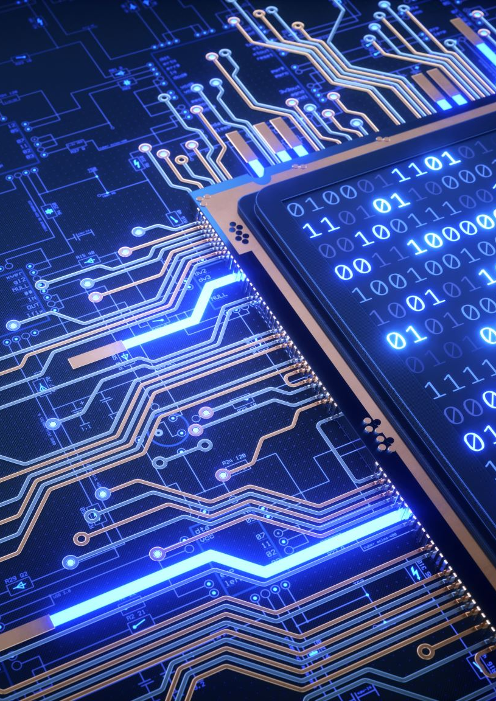
Overview
Introduction
History and AI’s Origin
Turing’s Test
Logic Theorist
Dartmouth Conference

Slide 3
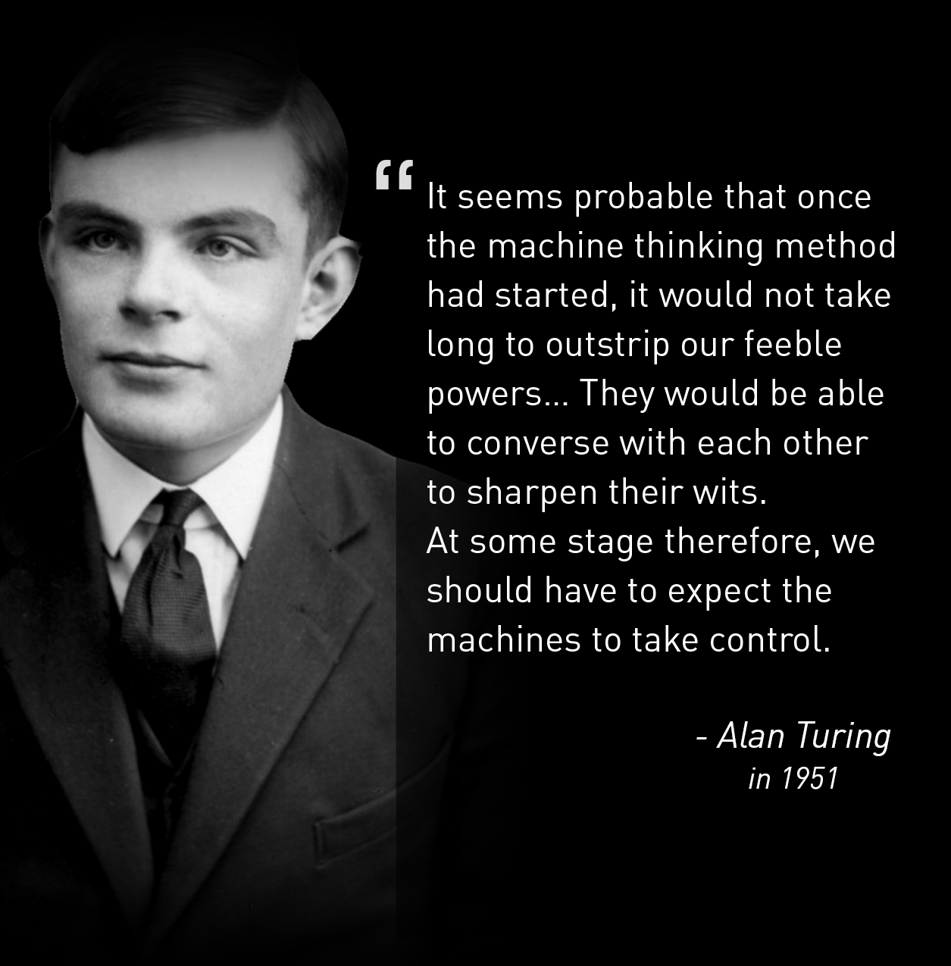

Slide 4
History and AI’s Origin
(early 1800’s and the early 1950s)
Function of human brain (neurons)
Norbert Wieners’ Cybernetics (1948)
Claude Shannon's Information theory (1948)
Alan Turing’s theory of computation
“Possibility to construct an electronic brain”

Slide 5
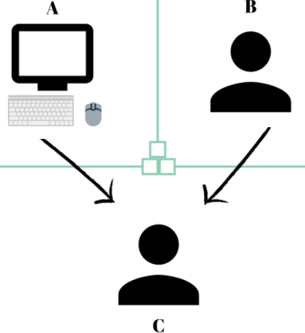
Turing’s Test
A Turing Test is a method of inquiry in artificial intelligence (AI) for determining whether a computer is capable of thinking like a human being.
The ability of a machine to remain indistinguishable for a conversation.
First “Serious” proposal in the philosophy of artificial intelligence

Slide 6
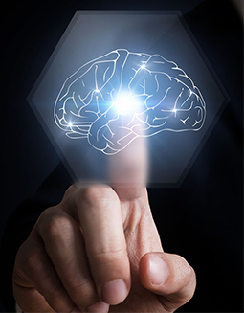
Logic Theorist
Created in 1955 by Allen Newell and Herbert A. Simon
The First AI program
Program engineered to perform automated reasoning
Proved 38 of first 52 theorems in “Principia Mathematica“

Slide 7
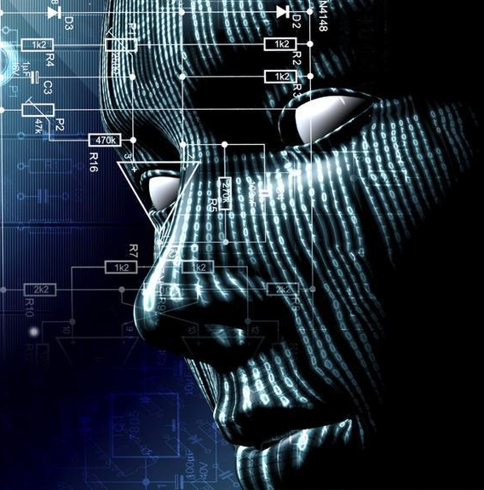
Dartmouth Conference (1956)
“Every aspect of learning or any other feature of intelligence can be so precisely described that a machine can be made to stimulate it”
Birth of AI
Logic theorist was presented to the public
Name “Artificial Intelligence” was adopted

Slide 8
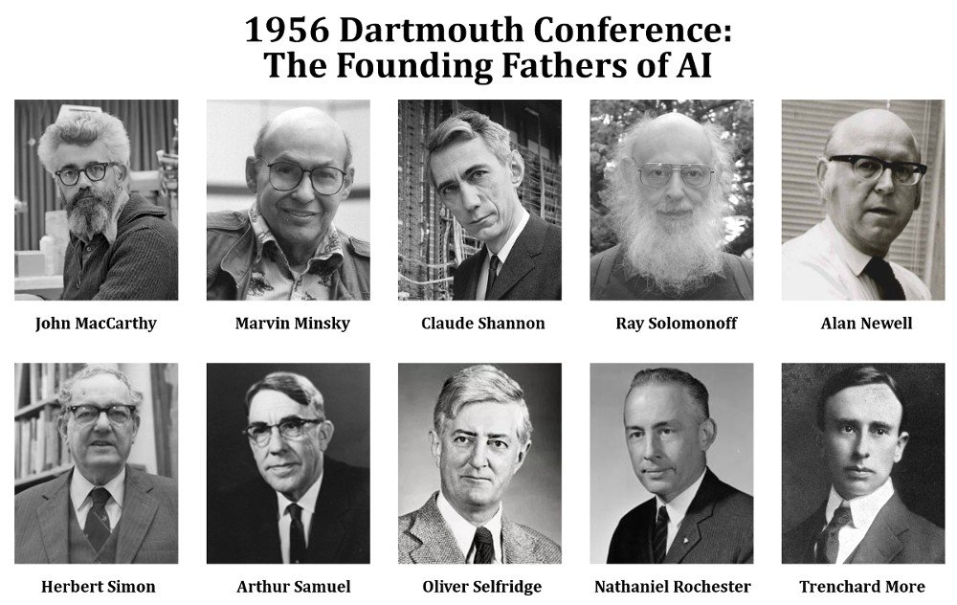

Slide 9
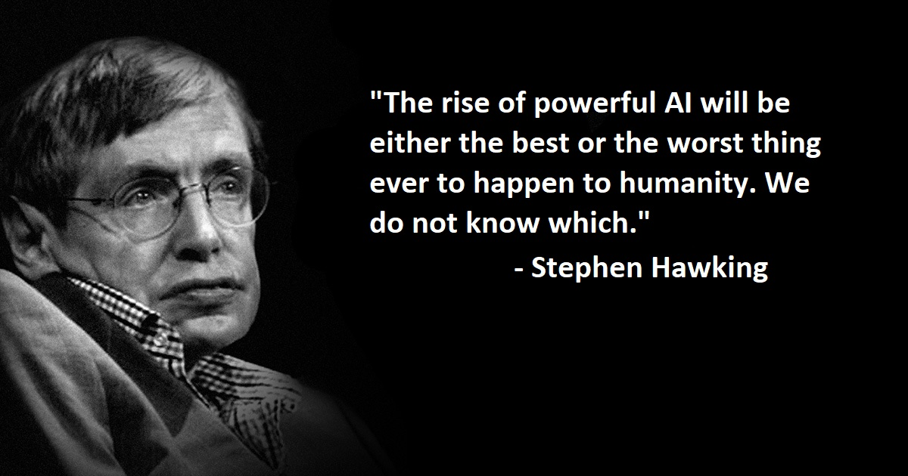
Conclusion

Slide 10
References
Buchanan Bruce G. (2005) A brief history of artificial intelligence
Ferris Jabr (2012) Know Your Neurons: The Discovery and Naming of the Neuron
Seth Lloyd (2019) What Would the Father of Cybernetics Think About A.I. Today?
Graham P. Collins (2002) Claude E. Shannon: Founder of Information Theory
Alexander S. Gillis (2019) Turing Test
History Computer, Logic Theorist – Complete History of the Logic Theorist Program
Dartmouth.edu (https://250.dartmouth.edu/highlights/artificial-intelligence-ai-coined-dartmouth)

Slide 11
