Slide 1
Efficient Agentic Inference via Lightweight KV Cache Indexing

Slide 2
Abstract
Use a lightweight indexer/speculator model to dynamically identify the most relevant KV blocks from the growing conversation history, and only attend to those KV blocks during multi-turn agentic inference

Slide 3
Motivation
Speculative prefill works on single prompts
All agents, chat assistants, etc. are multi-turn
Base speculative prefill cannot work in a multi-turn situation
Problem statement: can token preselection keep serving cheap turn after turn, without losing accuracy and retaining speedup?
Retaining accuracy
Most of the context is dropped, every turn
Selection has to hold up as history grows
And for questions not yet asked when the tokens were chosen
Retaining speedup
The selector itself runs every turn
Its cost has to stay below what it saves
Judged against a dense baseline, not a weaker sparse one

Slide 4
Literature Review
SpecPrefill (arXiv:2502.02789, ICML 2025)
SCBench (arXiv:2412.10319)
KV-cache-centric benchmark design, multi-turn benchmark
Related sparse-KV / long-context methods
H2O, StreamingLLM, Quest, KVzip, HeadKV

Slide 5
Speculative Prefill
LLMs retain most of their quality given only a carefully chosen subset of prompt tokens — and adapt to this zero-shot, no fine-tuning needed
Architecture: a cheap “speculator” model predicts which tokens matter; only those tokens, plus their original position info, go to the expensive base model
Training-free — implemented as a vLLM monkey-patch
Cuts FLOPs roughly proportional to the percentage of tokens dropped — shrinks both attention and the MLP
Can target prefill phase and decode
Full Prompt
(L tokens)
Speculator
(small model)
scores every token
Keep top-k%
restore original
positions
Base Model
(large)
prefill only k·L tokens

Slide 6
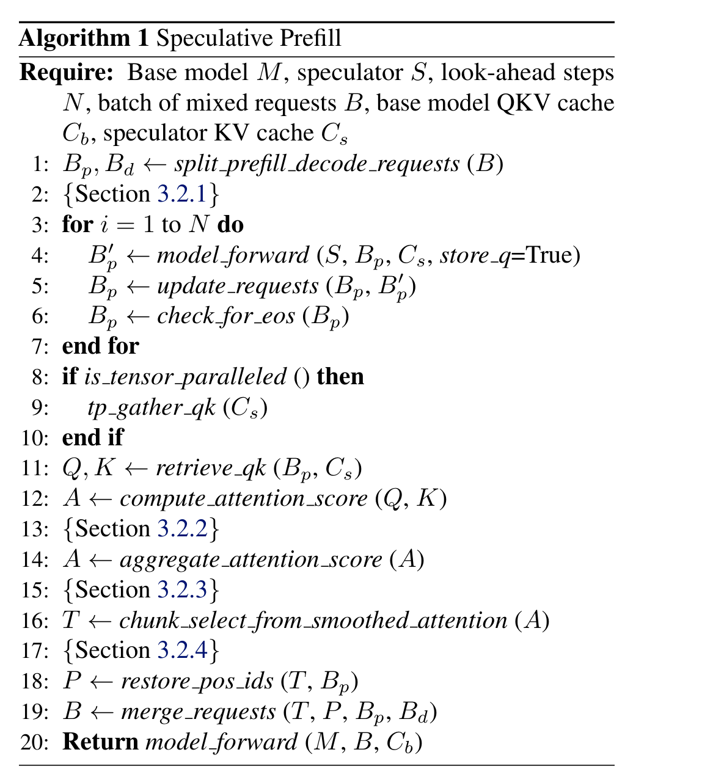
Algorithm
The speculator decodes N look-ahead steps, storing its queries; attention scores against those queries decide which prompt tokens survive
Only the survivors — with their original position ids restored — are handed to the base model's forward pass
Algorithm 1, Liu, Chen & Zhang (2025)

Slide 7
Speculator “Look-Ahead”
Raw last-token attention is biased: the “sink” phenomenon (first tokens overweighted) and proximity bias (tokens near the output overweighted)
Fix: decode the speculator N extra steps and use the new tokens' attention instead of just the prompt's last token
N trades bias reduction against budget — the paper found going beyond 16 look-ahead steps gives minimal extra gain
This project's own pipeline uses look-ahead = 8, matching the paper's evaluation
Task (avg. length) | Keep Rate | w/o Look-Ahead | w/ Look-Ahead (N=8) | Δ
LCC (3.2K tok) | 10% | 62.3 | 70.5 | +8.2
LCC (3.2K tok) | 30% | 69.6 | 70.9 | +1.3
RepoBench-P (10.8K tok) | 10% | 65.8 | 70.5 | +4.7
RepoBench-P (10.8K tok) | 30% | 71.6 | 73.3 | +1.7
QMSum (13.9K tok) | 10% | 23.6 | 24.7 | +1.1
MultiNews (2.6K tok) | 10% | 19.7 | 20.7 | +1.0
VCSUM-zh (11.0K tok) | 10% | 15.3 | 15.3 | ~0.0
Source: Figure 2, Liu, Chen & Zhang (2025) — Llama-3.1-405B-Instruct-FP8, SpecPrefill Full vs. Full LAH; values read from chart (±0.2)

Slide 8
Aggregating Attention into Token Importance
Attention score tensor shape [N, L, S, H] — look-ahead steps × layers × sequence × heads
Max over (layer, head): lets salient tokens stand out instead of being averaged away by uninformative heads
Mean over N (look-ahead steps): fair contribution across the look-ahead window
Identifying a small subset (2-4) “retrieval heads” may provide a small accuracy improvement on some questions, needs to be investigated further – based on Wu, Wang, Xiao, Peng & Fu (2024), “Retrieval Head Mechanistically Explains Long-Context Factuality,” arXiv:2404.15574 (ICLR 2025)
max over (layer, head)
mean over N steps
Attention Scores
[N, L, S, H]
[N, S]
(per look-ahead step,
per token)
Token Importance
[S] (one score/token)

Slide 9
Chunk Selection & Pooling
Tokens positioned near each other share similar importance (locality)
Chunk the context, average the token score within each chunk, select the top-K chunks
Apply 1D average pooling before chunking, to smooth out chunk-boundary artifacts
Token-level importance scores
1D average pool, then chunk
Pooled, chunked scores
select top-K chunks
chunk 1
KEEP
chunk 2
DROP
chunk 3
KEEP
chunk 4
DROP

Slide 10
Design Choice: Restoring Position IDs
Selected tokens are non-contiguous — the base model needs their ORIGINAL positions, not a renumbered sequence
Worked example below (10 prompt tokens, 3 decoding tokens)
Decoding-token positions are explicitly offset to the original context length, even if tokens were dropped before them
Found to be crucially essential for position-sensitive tasks — retrieval, counting
Original prompt positions (kept = solid, dropped = dashed)
0
1
2
3
4
5
6
7
8
9
Sent to the base model (original ids preserved + decode tokens appended)
0
1
3
6
7
10
11
12

Slide 11
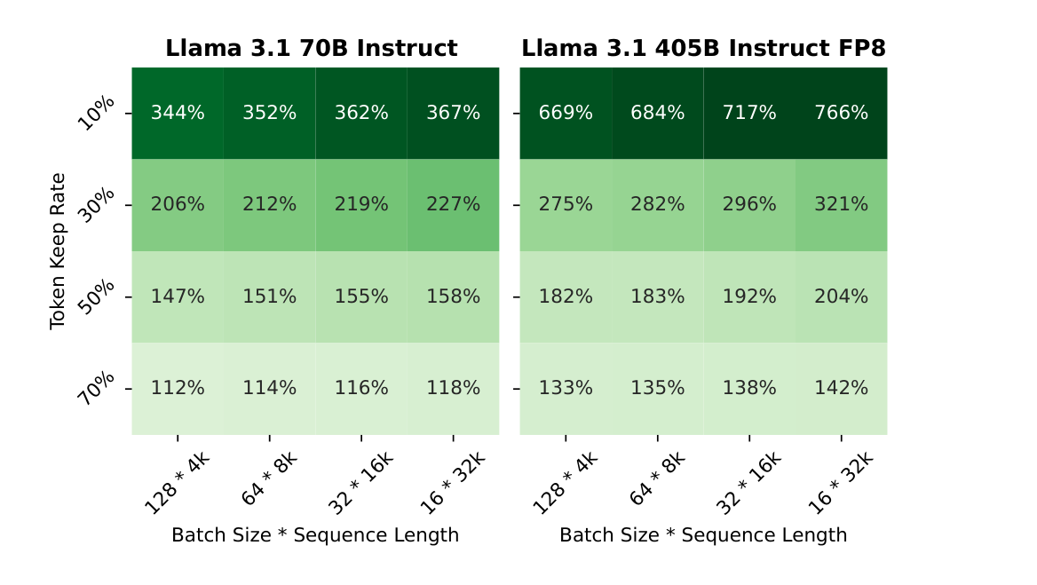
Results: TTFT Speedup
Up to 7.66x TTFT reduction on the 405B model at 10% keep rate
Speedup grows with batch size × sequence length, and grows further as base model size increases — the speculator's relative overhead shrinks
Figure 3, Liu, Chen & Zhang (2025)

Slide 12
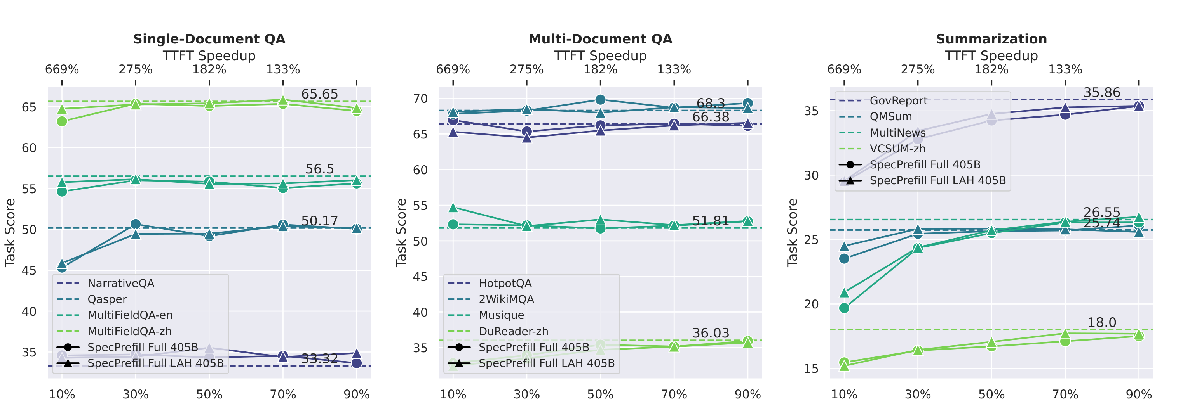
Results: Quality vs. Efficiency Trade-off
Quality preserved down to 10% keep rate for Single/Multi-Doc QA and Few-Shot Learning; graceful degradation for Summarization
Three empirical query categories: information-dense (compresses poorly), compressible (no quality loss), and noisy (quality can IMPROVE after pruning distracting tokens)
Beats RAG-Llama, LLMLingua, and MInference baselines at comparable compression rates on LongBench
Preserves RULER long-context performance up to 64K tokens at 10% keep; degrades specifically on aggregation tasks, where every word matters for word-frequency reasoning
Figure 2 (top row), Liu, Chen & Zhang (2025) — Llama-3.1-405B-Instruct-FP8, keep rate 10%–90%

Slide 13
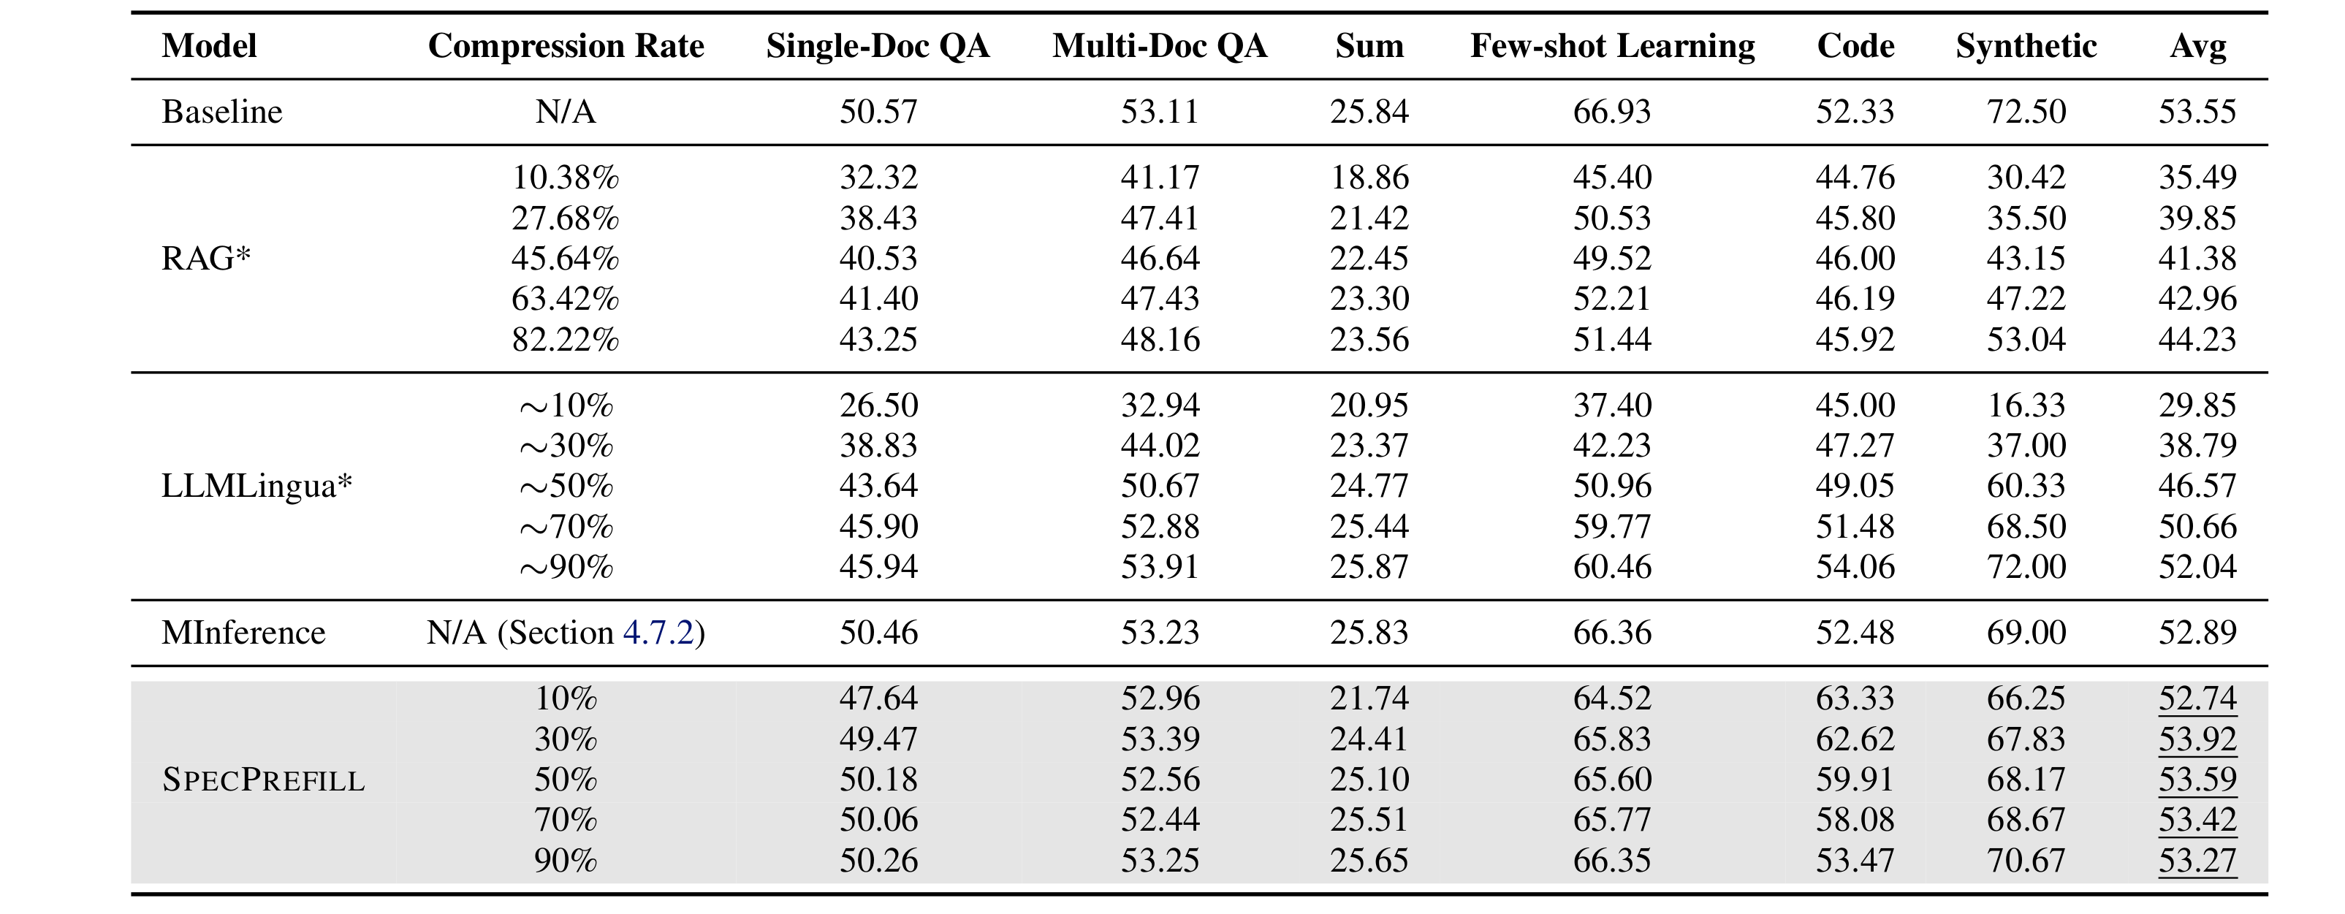
Accuracy vs. Baseline: LongBench Comparison
SpecPrefill's average score (52.7–53.9 across all keep rates) sits within ~1 point of the unpruned baseline (53.55) — and slightly exceeds it at 30–70% keep
RAG-Llama and LLMLingua need much higher compression to approach SpecPrefill's average, and still fall short of it at every comparable rate
Beats MInference (52.89, a sparse-attention baseline) from 30% keep onward, without needing a searched attention pattern
Table 1, Liu, Chen & Zhang (2025) — Llama-3.1-70B-Instruct base model

Slide 14
Agentic
Re-running single-turn pruning each turn doesn't work for a persistent conversation
Problem is information loss
Design: persistent target and speculator KV cache (nothing evicted)
Key parameters: keep rate (k), KV granularity (g)

Slide 15
Two Persistent Caches
Two models both persistent across the whole conversation — neither is reset between turns (unlike normal)
Speculator (Llama-3.2-1B): its own KV cache, grows every turn, used only to score token importance
Target (Llama-3.1-8B): its own KV cache, grows every turn, never evicts a single token
Speculator Engine
Target Engine
Llama-3.2-1B · own GPU
scores →
Llama-3.1-8B · own GPU
Persistent KV Cache
grows every turn,
used only to score
token importance
selects blocks
Persistent KV Cache
grows every turn,
nothing ever evicted

Slide 16
Per-Turn Flow
The same six steps repeat every turn, against a context that only ever grows
Prefill of the new turn's own tokens is sparse too (except turn 0) — selected blocks plus a contiguous tail of this turn's own tokens
①
Turn N
arrives
②
Speculator scores
full context
③
Select top-k%
blocks (size g)
④
Target: sparse
prefill — selected
blocks + own tail
⑤
Target: sparse
decode (gather
selected blocks)
⑥
Append to cache
— nothing evicted
repeats every turn, against a context that only ever grows

Slide 17
KV Cache Syncing
The speculator doesn't generate the target's answer — so before it can score turn N, it has to catch up on what the target actually said in turn N−1
Two things get appended to the speculator's own persistent KV cache every turn: the target's ACTUAL generated output from the previous turn, plus this turn's new query
Everything earlier is a cache hit
Speculator cache
(turns 0…N−1's query)
already resident
+ Target's actual
output, turn N−1
+ This turn's
new query
Speculator synced
→ ready to score
turn N's full context

Slide 18
What's Actually Compressed
Attention compute and KV-bandwidth shrink on both prefill and decode — not the KV cache itself
keep_mode = keep only: a block skipped this turn may be exactly what turn t+4 needs (cross-turn attention drift), so nothing is ever discarded
Turn 0 is always dense — restricting the very first prefill would poison the cache every later turn’s selection reads from
History is self-generated: future turns are built from the model's own actual output, not golden reference text
Prefill (turn ≥ 1)
Decode (generating the answer)
SPARSE — selected blocks +
a contiguous tail of new tokens
SPARSE — attends only to the
top-k% selected blocks
keep_mode = keep → nothing is ever discarded

Slide 19
Proof of Concept: A Basic FLOP Calculation
Formula: FLOPs(L) ≈ linear·L + attention·L²
Model:
target Llama-3.1-8B ≈ 13.96 GFLOP/token linear + attention ∝ 524,288·L²/2;
speculator Llama-3.2-1B ≈ 1.95 GFLOP/token (~7.2x cheaper) linear, attention coefficient ~4x smaller (2x fewer layers, 2x smaller head dimension)
Worked example at L=128,000 (Llama-3.1's context ceiling): M000 dense target prefill ≈6,082 TFLOP (4,295 attention + 1,787 linear); speculator's own dense prefill ≈1,323 TFLOP
Total system cost (speculator + pruned target) vs. M000, by keep rate: k=80% → 90.5% (barely a win); k=60% → 64.8%; k=40% → 44.8%; k=20% → 30.5% (~3.3x reduction)
Note: also a decode time reduction

Slide 20
Experimental Setup: Models & Benchmark
Target: Llama-3.1-8B-Instruct · Speculator: Llama-3.2-1B-Instruct — both BF16
Benchmark: SCBench (arXiv:2412.10319, microsoft/SCBench on Hugging Face)
In general 5-6 turns per prompt
3 of SCBench's 12 configs used: scbench_kv, scbench_qa_eng, scbench_summary
Some prompts skipped due to exceeding max context length of target model
Hardware: 2x A100 80GB
TURN 0
Long shared context (~100K+ tokens)
↓ dense prefill ↓
Target KV Cache + Speculator KV Cache — both built
Turn 1
short Q
Turn 2
short Q
Turn 3
short Q
Turn 4
short Q

Slide 21
Example Prompts
scbench_kv — exact key/value retrieval · metric: in_match
Context (200,011 chars): {"798c2306-...": "5e6b7b90-...", "6ab6ea3e-...": "cb59052b-...", "3ebf05c3-...": "a9ee6345-...", ...}
Q: Key: "6ab6ea3e-f288-4f33-ba46-7f42bb75b03f" → the value associated with the specified key is: ___ A: cb59052b-9128-4979-9c0e-e1de4adcf73b
scbench_qa_eng — semantic retrieval / free-form QA · metric: qa_f1_score
"Yes, of course, if it’s fine to-morrow," said Mrs Bronwyn. "But you’ll have to be up with the lark,"… (381,748 chars — a long literary narrative; character names substituted from the source text)
Q: "Which among Annalisa, Seb, Peyton, and Gannonmarie is not Mrs. Bronwyn’s child?" A: "Peyton"
scbench_summary — global-information summarization · metric: rouge_l_f1
Paper Title: Spontaneous CP violation, sterile neutrino dark matter, and leptogenesis / Text: … (344,064 chars — dozens of concatenated academic paper texts)
Q: "Summarize the key contribution of the paper titled ‘Some Properties of Order-Divisor Graphs of Finite Groups’ in one sentence."
A: "...providing a comprehensive analysis of the structural properties of order-divisor graphs associated with finite groups..."

Slide 22
Metrics & Hyperparameters
Metrics ported from microsoft/MInference/scbench/eval_utils.py, one per config:
scbench_kv → in_match (exact / substring retrieval)
scbench_qa_eng → qa_f1_score (token-overlap F1)
scbench_summary → rouge_l_f1 (LCS-based ROUGE-L reimplementation)
Shared hyperparameters: BF16 · look-ahead count 8 · pool_kernel_size 13 · enforce_eager=True on both engines
Dataset scale (all 3 configs, matched against SCBench's own reference answers):
Config | Conversations | Matched Turns
scbench_kv | ~100 | 500
scbench_qa_eng | ~24 | 117
scbench_summary | ~70 | 350
Total | ~194 | 1,201

Slide 23
Experiment Matrix
Grid sweeps keep rate (k = 80/60/40/20%) x KV granularity (g = 32/64) = 8 SPARSE configs, plus a dense baseline and 4 ORACLE ceiling rows
ORACLE-k{N} = SPARSE-k{N}-g32 with one change: the TARGET checkpoint scores its own attention instead of the 1B speculator estimating it
ID | Label | Keep Rate | KV Granularity
M000 | Baseline (no pruning) | 100% | —
ORACLE-k{80,60,40,20} | Oracle upper bound — target checkpoint scores instead of the speculator | 80/60/40/20% | 32 (pairs with SPARSE-g32)
SPARSE-k{80,60,40,20}-g{16,32,64} | Persistent cache + sparse attention — the actual method (12 configs) | 80/60/40/20% | 32 / 64

Slide 24
Results: Accuracy — scbench_qa_eng
Every configuration lands within 4 points of the dense M000 baseline of 27.26; g64's best (27.12 at keep 80%) is within 0.14.
Not monotonic: keep 20% scores above keep 40% at both granularities — 24.06 against 23.57 at g32, 25.24 against 25.15 at g64.
117 matched turns from 23 conversations — 47 of 69 skipped for exceeding the speculator's context budget — puts the standard error near 2 points.
No individual row is resolvable; read this as no measurable effect, not a dose-response.
Token-overlap F1 leaves little headroom: even the dense baseline only reaches 27.26.
scbench_qa_eng (M000 dense = 27.26) | g32 | g64
Keep 80% | 26.43 | 27.12
Keep 60% | 25.56 | 25.53
Keep 40% | 23.57 | 25.15
Keep 20% | 24.06 | 25.24
qa_f1_score (token-overlap F1). 117 matched turns from 23 conversations.

Slide 25
Results: Accuracy — scbench_summary
Flat across the entire sweep: g32 spans 0.7 points and g64 spans 1.1, against a dense M000 baseline of 36.04.
Not monotonic — keep 60% and keep 40% score above keep 80% at both granularities.
Several configurations edge above the dense baseline (36.26 at g32, keep 60%), which is noise rather than improvement.
350 matched turns from 70 conversations — better powered than qa_eng, and still nothing clears zero.
ROUGE-L on global summaries appears insensitive to which specific tokens survive selection.
scbench_summary (M000 dense = 36.04) | g32 | g64
Keep 80% | 35.89 | 36.01
Keep 60% | 36.26 | 36.24
Keep 40% | 36.08 | 36.20
Keep 20% | 35.56 | 35.17
rouge_l_f1 (LCS-based ROUGE-L). 350 matched turns from 70 conversations.

Slide 26
Results: Accuracy — scbench_kv
g64 reaches 80.80 at keep 80%, within 0.8 points of the dense M000 baseline of 81.60, and falls to 52.00 at keep 20%.
Strictly monotonic on both axes — no exceptions in either direction.
g64 beats g32 at every keep rate, by 1.8 to 5.4 points.
Against a 5% relative drop, only keep 80% clears it (−1.0%); keep 60% just misses (−5.1%) and keep 20% gives up 36% of the baseline.
Excluding turn 0 the scores rise to 84.75 / 81.00 / 72.25 / 53.25 at g64 — turn 0 is the hardest turn, and increasingly so as the keep rate tightens.
scbench_kv (M000 dense = 81.60) | g32 | g64
Keep 80% | 79.00 | 80.80
Keep 60% | 72.00 | 77.40
Keep 40% | 63.60 | 69.00
Keep 20% | 48.80 | 52.00
in_match (exact / substring retrieval). 500 matched turns from 100 conversations.

Slide 27
Oracle: what the 25-point gap is made of
ORACLE-k20 is SPARSE-k20-g32 with one change — the 8B target scores its own attention instead of the 1B estimating it, which separates estimator error from mechanism cost.
The 25-point degradation splits roughly 2:1: 17.0 points are the 1B's estimation error, 8.0 the block-sparse mechanism itself.
The scoring pass is ~0.007% of a turn's FLOPs, so those 17 points are the cheapest available.
Neither gap compounds across turns — one per-turn selection problem repeated five times, not an accumulating one.
Restricting the 1B to four retrieval heads already recovers 8.6 of the 17, at lower cost.
scbench_kv, keep 20%, g32 | score | gap to M000
M000 — dense, no pruning | 81.60 | —
ORACLE-k20 — target scores itself | 73.60 | mechanism 8.0 (32%)
SPARSE-k20-g32 — 1B scores | 56.60 | estimator 17.0 (68%)
in_match on scbench_kv, 500 turns. Decode-only scope — no oracle row has been run under sparse prefill.

Slide 28
Results: FLOPs (steady state, turn 0 excluded)
Turn 0 is excluded throughout — it costs SPARSE ~21% more than dense on every config, so break-even on kv needs ~418 steady-state turns against SCBench's four.
Stacked TFLOP per turn at g64, turns 1+ only, on a shared vertical scale. 400 / 94 / 280 steady-state turns from 100 / 23 / 70 conversations.

Slide 29
Analysis: when speculation pays
The scorer costs the same every turn whatever that turn contains, so speculation pays more when more tokens are generated / processed
Longer questions and longer answers help equally. Short Q&A is the worst case, and SCBench's five short turns over one huge context sit close to it.
The scorer's size relative to the target sets a hard ceiling on the useful keep rate
Moving it takes a structurally cheaper scorer
Turn shape | Pays for itself after
Short Q&A over a long context (SCBench) | hundreds of turns
Code assistant | tens of turns
Document pasted each turn, or long generation | about ten turns
Derivation, coefficients and the full scenario tables: SPECULATION_ECONOMICS.md

Slide 30
Limitations
Struggles more on certain questions styles
Question grading metric is questionable
Unknown when to first use speculation

Slide 31
Next Steps
Evaluate on other model families / sizes
Evaluate with other question styles
Determine when to run speculation for the first time
Since the speculation is external from the target model, it is likely possible that we can adaptively choose when to apply selection based on conditions
Test speculation using first n layers of target model rather than external speculator
Test mid decode rescoring

