Slide 1

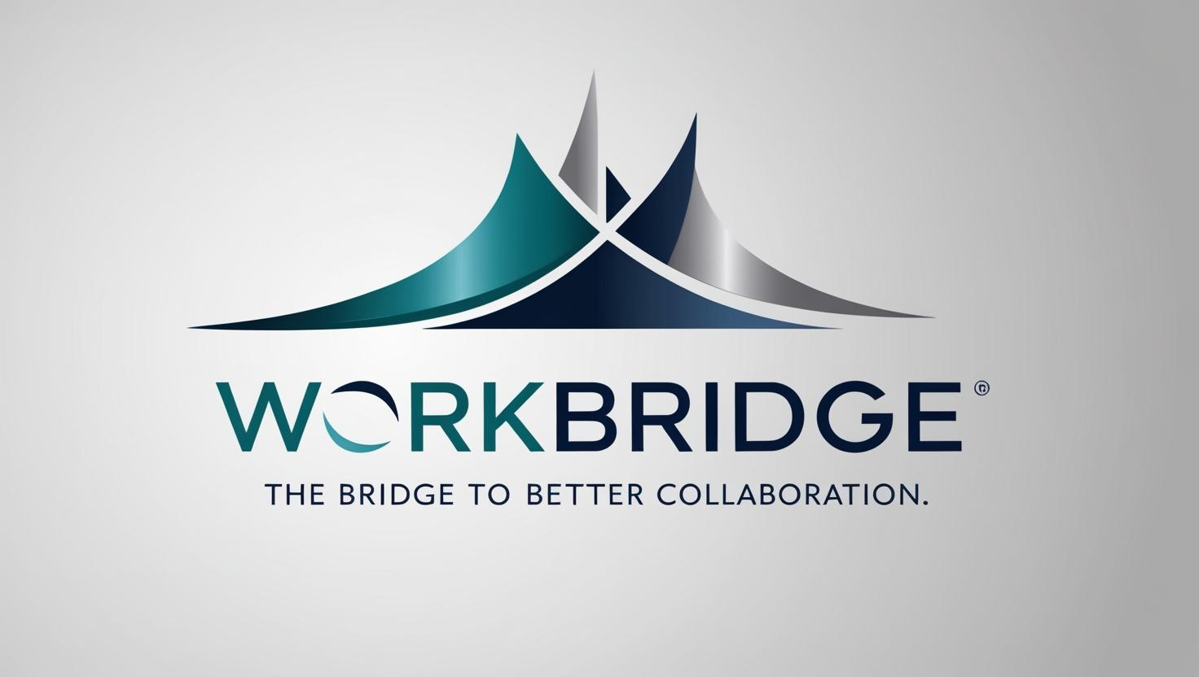
WorkBridge: Organizational Social Network
by Maor Sapo, Roy Har Tziyon, Shai Yona

Slide 2
Problem
Usual applications often focus only on a single function
Teams use multiple disconnected tools (Email, WhatsApp)
Scalability issues as organizations grow

Slide 3
Solution
Single application that combines essential communication tools in one place
Tailored for workplace collaboration
Built to scale with Kubernetes

Slide 4
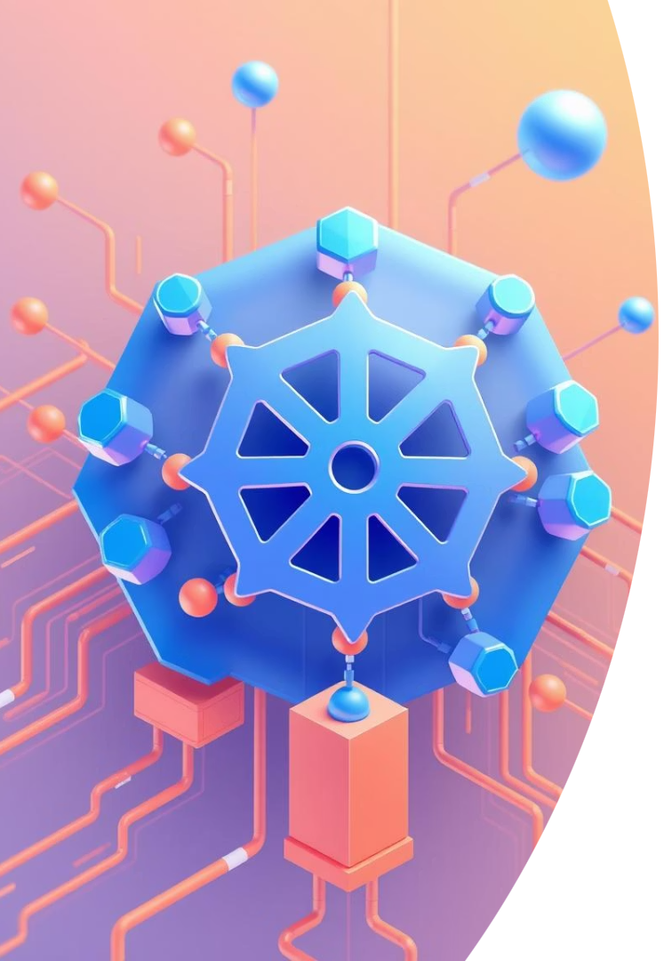




Kubernetes - Benefits
Scalability
Enables autoscaling automatically when needed.
High Availability
Multi-pod deployments, Health checks and load balancing.
Resource Management
Efficient allocation of resources for optimal performance.
Environment Management
ConfigMaps, Secrets, and Namespaces for secure and isolated environments.

Slide 5





Technologies
FastAPI (Python)
PostgreSQL
SQLAlchemy ORM
Picked for speed and type safety, Handles I/O faster than Django or Flask.
Supports ACID transactions, scales smoothly, and integrates well with Kubernetes.
Simplifies code by using Python objects instead of SQL queries and enables easy switching between different databases in the future.
JWT Authentication
JWT is stateless and scalable, No need to store sessions on the server. Signed tokens ensure security and support expiration, making it ideal for microservices and a standard for API authentication.

Slide 6
High‑Level Architecture
• Frontend: React.js
Backend (FastAPI) – Auth, Chat, Media services
Database: PostgreSQL (ACID, scalable)
• Real‑time: WebSockets
Deployment: Docker, Kubernetes

Slide 7
Current Status (Done)
Auth service with JWT
User profiles & registration
Group & private chat endpoints
Initial React frontend pages

Slide 8
Future Work
Must Have (by project end)
• Websocket
• Kubernetes intergration
Nice to Have (time permitting)
• Polls and organizational calendar

Slide 9
THANK YOU
Questions?

