Slide 1

WorkBridge: Organizational Social Network
Unified workplace collaboration platform by Maor Sapo, Roy Har Zion, and Shai Yona

Slide 2




Problem
Single-function applications
Tool fragmentation
Teams juggle email, messaging apps, and more
Most tools focus on one feature only
Growth limitations
Existing solutions break down as companies expand

Slide 3






Solution
All-in-one platform
Essential tools unified
Workplace-focused
Built for team collaboration
Kubernetes-powered
Scales with your organization

Slide 4
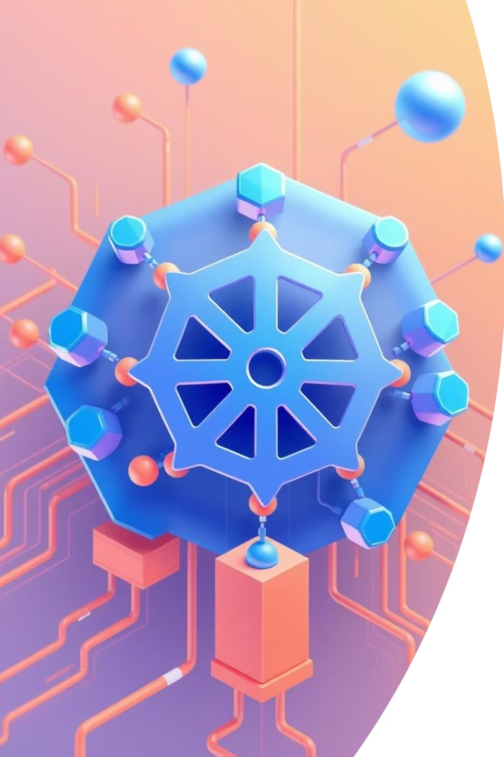




What is Kubernetes?
Scalability
High Availability
Resource Management
Automatic scaling as needed
Multi-pod deployments with health checks
Efficient allocation for optimal performance
Environment Management
Secure, isolated environments

Slide 5





Kubernetes and WorkBridge microservices
Authentication
User identity and access
Chat
Messaging functionality
Media
File sharing and uploads
Frontend
User interface
Database
Data persistence

Slide 6

Technologies
FastAPI (Python)
Speed and type safety
PostgreSQL
ACID transactions
SQLAlchemy ORM
Python objects vs SQL queries
JWT Authentication
Stateless and scalable
Docker
Service containerization
Kubernetes
Container orchestration

Slide 7

Current Status (Done)
Authentication
User Management
JWT-based secure login system completed
Profiles and registration functionality
Messaging
Frontend
Group and private chat endpoints
Initial React UI components

Slide 8



Future Work
Nice to Have
Polls and organizational calendar
Must Have
Kubernetes integration
Must Have
Websocket implementation

Slide 9



THANK YOU
Our Vision
User Experience
Technical Foundation
Unified workplace collaboration
Intuitive and efficient
Built to scale
Questions?

