Slide 1
MSc PROJECT IN COMPUTER SCIENCE
Sales Performance Analysis
and Growth Recommendations
for a Super Store
Research • data analytics • tested software prototype • evaluation
Md Majid Anwer · SRN 419863
The University of Law | Supervisor: Paul Sant

Slide 2
The research problem
Decision support for a fictitious Super Store
Which changes might improve sales and profitability?
WHERE
WHAT
HOW
Regions and customer segments with different sales and profit contributions.
Product categories and subcategories associated with gains or losses.
Discounting, repeat purchasing and monthly demand patterns.
Scope: hypothesis generation and methodological evaluation; not a causal intervention study.
2
MSc Computer Science | Superstore analytics
DEMONSTRATION DATA • NOT VERIFIED RETAIL RESULTS

Slide 3
Aims and success criteria
Research objectives are linked to reproducible software outputs
Load and validate line-item transaction data without removing legitimate negative-profit records.
Reconcile totals across the full dataset and regional, category and segment summaries.
Compare segmentation, sales prediction and monthly forecasting against transparent baselines.
Present actionable recommendations with uncertainty and limitations made explicit.
3
MSc Computer Science | Superstore analytics
DEMONSTRATION DATA • NOT VERIFIED RETAIL RESULTS

Slide 4
Dataset provenance and research boundary
Why the exact source file matters
Published Superstore sample
Executed demonstration
Tableau documents Superstore as a fictitious retail dataset. An external CSV must be sourced and hashed before its results can be claimed.
760 generated line items · 380 orders · 86 customers · dates 2014–2017. These records verify the software only.
Reference: Tableau (sample dataset guidance) | The source file supplied for the MSc project was not available.
4
MSc Computer Science | Superstore analytics
DEMONSTRATION DATA • NOT VERIFIED RETAIL RESULTS

Slide 5
System workflow
The complete Python processing pipeline
01
02
03
04
05
06
→
→
→
→
→
CSV input
Schema checks
Feature engineering
Analytics + ML
Dashboard
Evidence + review
Reproducibility safeguards
SHA-256 source fingerprint • fixed random seed • time-ordered model evaluation
Automated reconciliation and tests • raw source preserved • negative profit retained
5
MSc Computer Science | Superstore analytics
DEMONSTRATION DATA • NOT VERIFIED RETAIL RESULTS

Slide 6
Data quality and cleaning
Observed verification counts on the synthetic demonstration fixture
760
0
338
12/12
Valid line items
Dropped lines
Loss-making lines retained
Unit tests passed
Validation controls
Unique Row ID; parseable dates; non-missing amounts and categories.
Discount between 0 and 1; shipping date not before ordering.
Group totals must reconcile to the line-item source.
6
MSc Computer Science | Superstore analytics
DEMONSTRATION DATA • NOT VERIFIED RETAIL RESULTS

Slide 7
Financial KPI view
All values on this slide are from generated demonstration transactions
$233,909.50
$12,731.06
5.44%
380
Sales
Profit
Profit margin
Distinct orders
Interpretation is restricted to the synthetic fixture. No actual store profitability has been established.
7
MSc Computer Science | Superstore analytics
DEMONSTRATION DATA • NOT VERIFIED RETAIL RESULTS

Slide 8
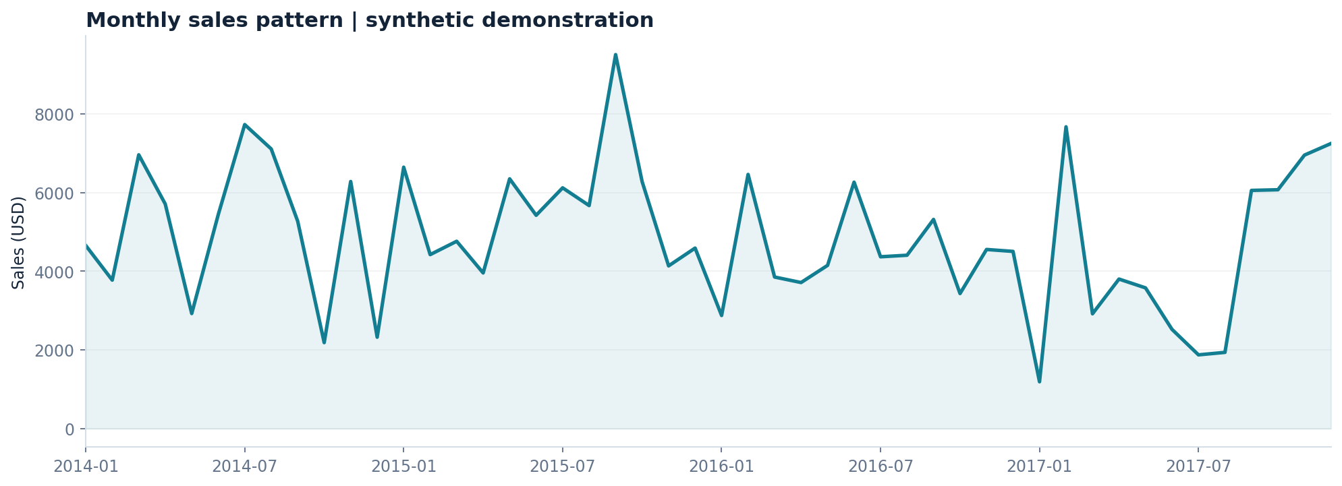
Monthly sales behaviour
Visual diagnostic rather than real-world seasonality evidence
Monthly orders and sales are calculated after explicit date parsing and grouping.
8
MSc Computer Science | Superstore analytics
DEMONSTRATION DATA • NOT VERIFIED RETAIL RESULTS

Slide 9
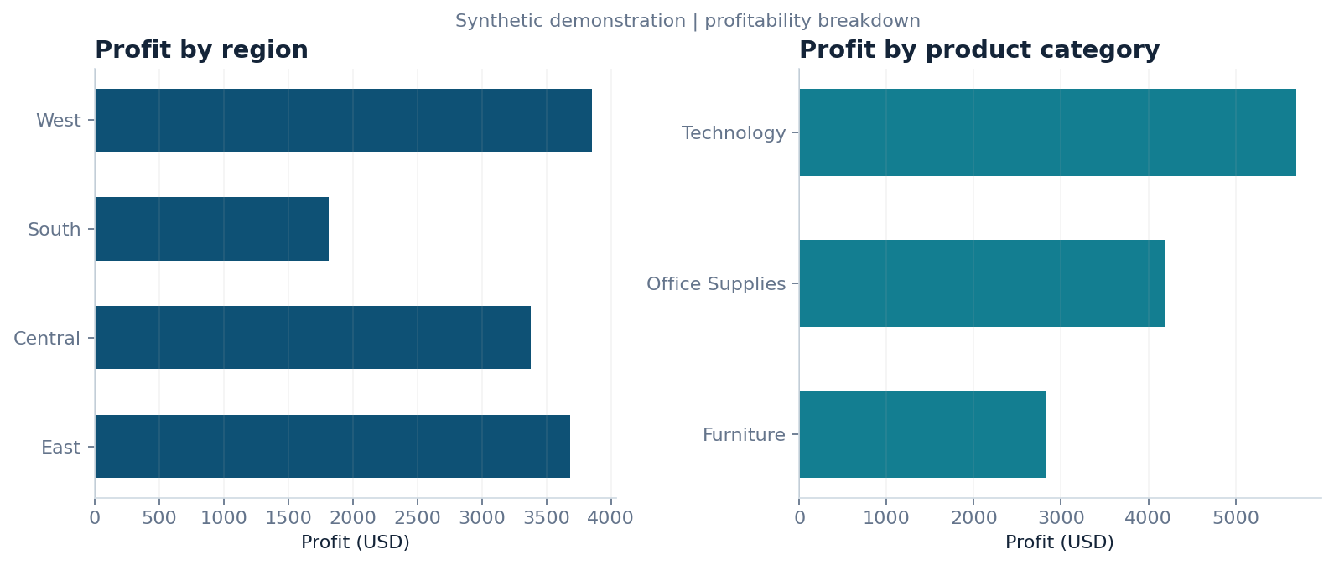
Regional and category profitability
Loss making values are preserved rather than filtered away
Regional and category sums are reconciled against total source sales and profit.
9
MSc Computer Science | Superstore analytics
DEMONSTRATION DATA • NOT VERIFIED RETAIL RESULTS

Slide 10
Customer segmentation
RFM: recency, frequency and monetary value
86 customers
2 clusters
0.437
Customers aggregated by unique customer IDs and order counts.
Selected using silhouette comparison across k = 2–6.
Silhouette score on the synthetic RFM demonstration.
Cautions: scaling and log transformations influence clusters; cluster labels are exploratory and not customer ground truth.
10
MSc Computer Science | Superstore analytics
DEMONSTRATION DATA • NOT VERIFIED RETAIL RESULTS

Slide 11
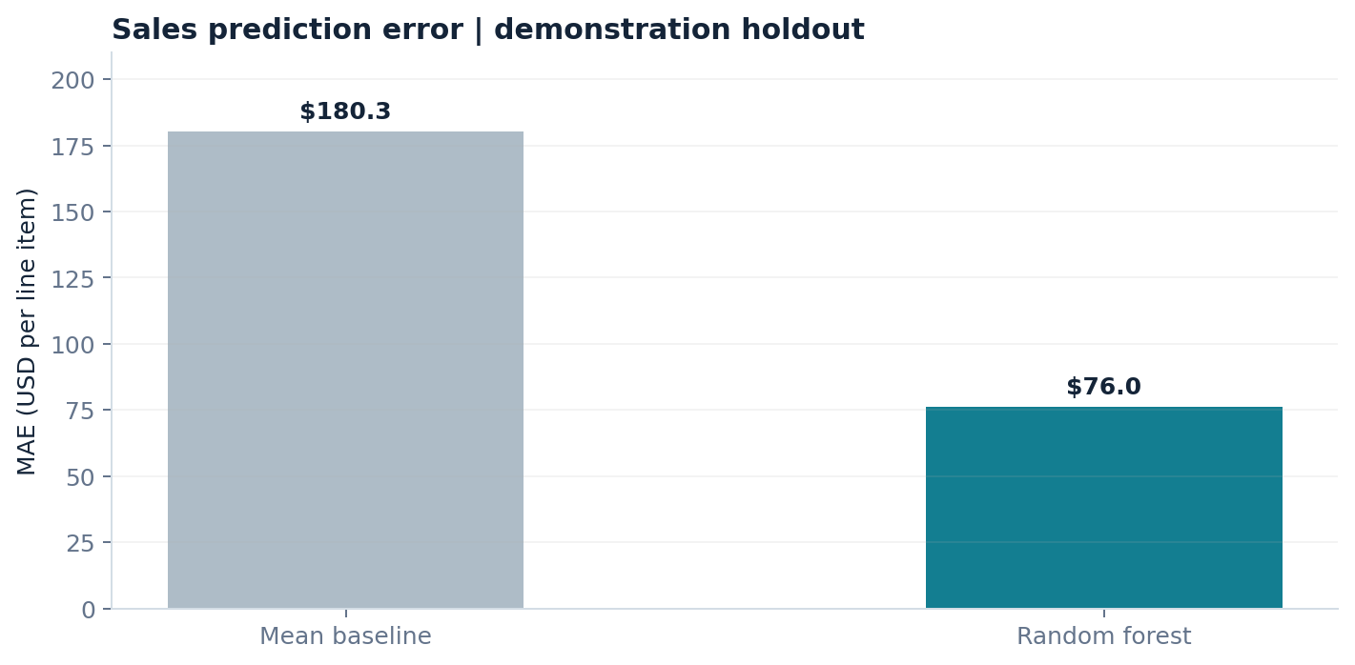
Regression: transaction-level sales
Chronological train/test split avoids random mixing of future orders
0.733 test R²
Random forest on 156 held-out demonstration line items.
Profit is excluded from the predictors. Evaluation remains observational, not live forecast validation.
11
MSc Computer Science | Superstore analytics
DEMONSTRATION DATA • NOT VERIFIED RETAIL RESULTS

Slide 12
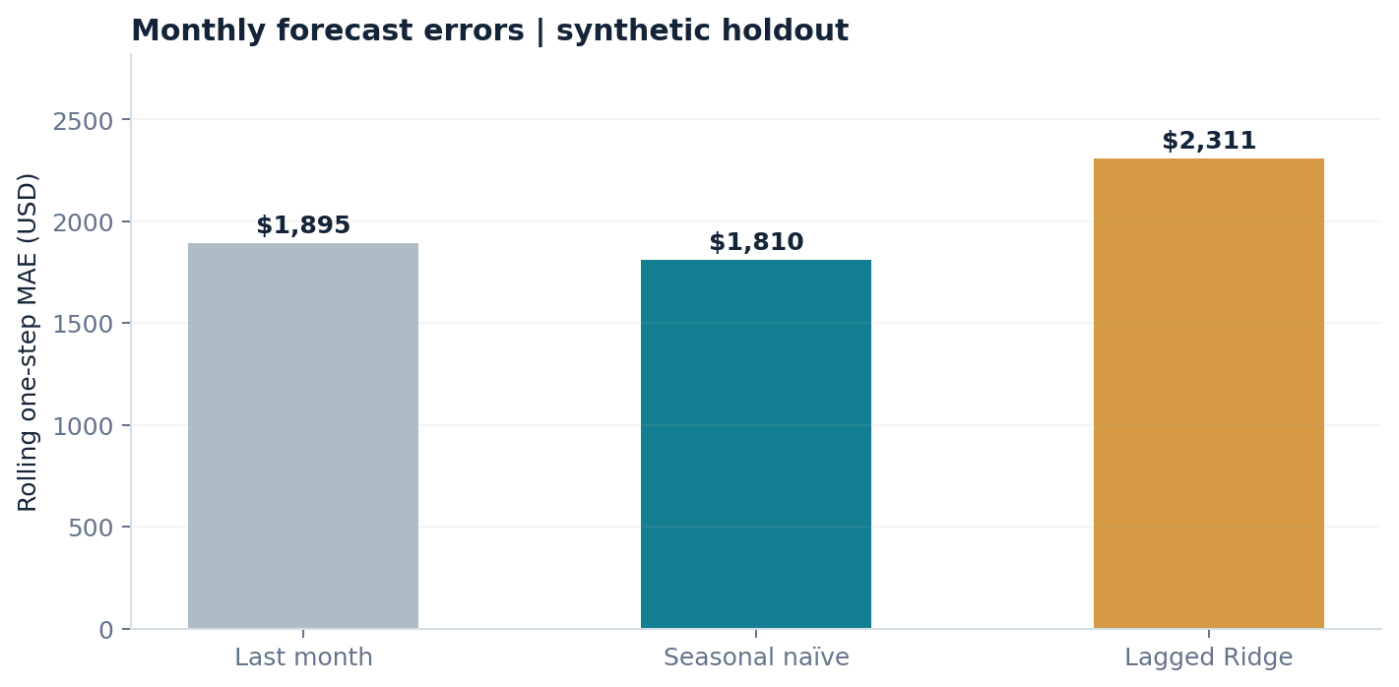
Forecasting: rolling one-step testing
The simplest baseline can outperform a more complex estimator
Seasonal naïve
Lowest MAE among tested methods on the synthetic holdout.
12-month rolling backtest. Avoid selecting the most complex model solely because it is available.
12
MSc Computer Science | Superstore analytics
DEMONSTRATION DATA • NOT VERIFIED RETAIL RESULTS

Slide 13
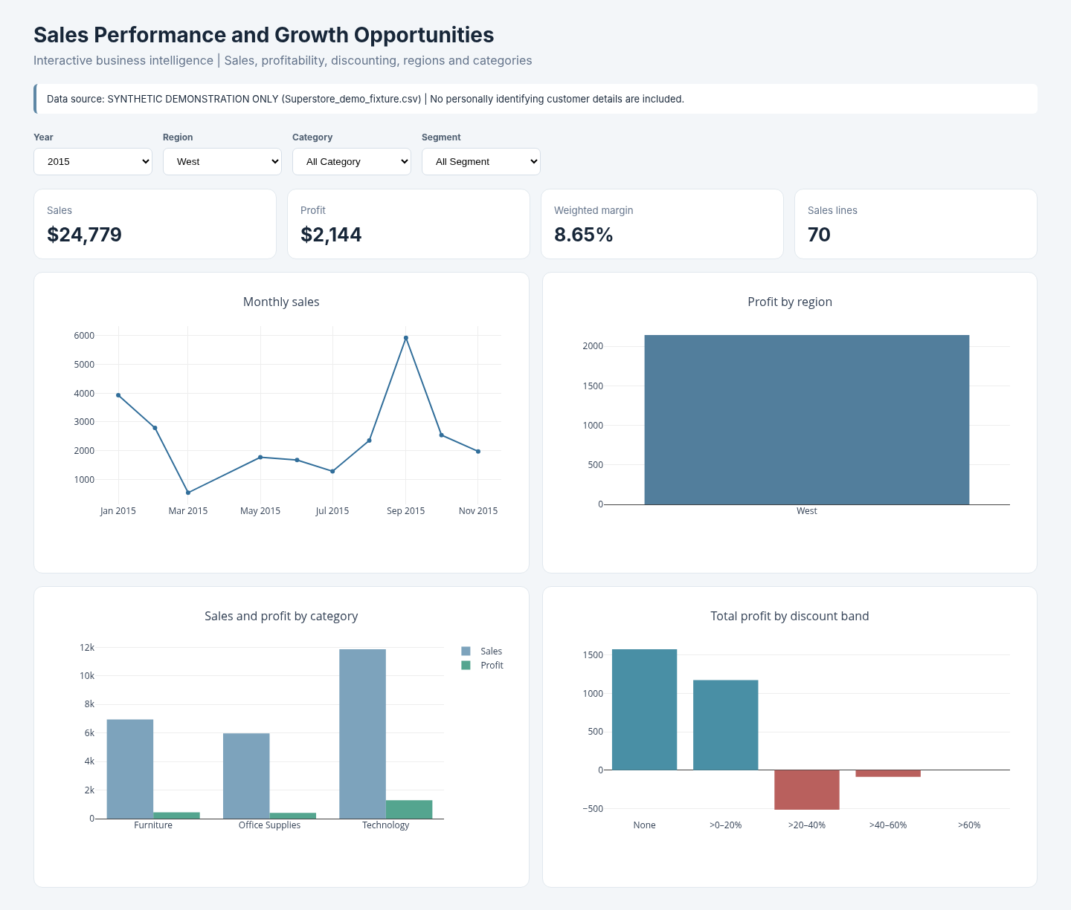
Interactive dashboard prototype
Standalone HTML dashboard (no Tableau/Power BI workbook claimed)
Verified functions
Year filter
Region filter
Category filter
Segment filter
Responsive totals
13
MSc Computer Science | Superstore analytics
DEMONSTRATION DATA • NOT VERIFIED RETAIL RESULTS

Slide 14
Software testing
Test results are reproducible and separate from empirical validity
12 / 12 passed
0 failures
Reproducible
Schema checks, negative-profit retention, aggregation, leakage and time split.
Last local run of the Python unit-test suite.
Commands and requirements included in the project bundle.
Limits of these results
Passing tests do not establish accuracy on an unseen public dataset.
No human participant feedback or formal ethical approval has been evidenced.
14
MSc Computer Science | Superstore analytics
DEMONSTRATION DATA • NOT VERIFIED RETAIL RESULTS

Slide 15
Recommendations for further validation
Hypotheses arising from the analytics design, not proven interventions
Identify negative-profit product groups, then validate causes and costs before changing pricing.
Review discount bands jointly with profit margins; correlation is not evidence that discount caused the loss.
Test segment-specific marketing actions with controlled trials and consent where applicable.
Use out-of-time forecast backtests to judge whether the selected forecasting method is operationally useful.
15
MSc Computer Science | Superstore analytics
DEMONSTRATION DATA • NOT VERIFIED RETAIL RESULTS

Slide 16
Completion boundary and next steps
What is verified, and what still requires independent evidence
Completed and verified
Not yet verified
Executable Python pipeline, notebook, offline HTML dashboard, demonstration charts, regression and clustering tests, and presentation materials.
Public source CSV execution, exact dataset findings, native Tableau/Power BI dashboard, ethically approved user testing, and student-authored final academic submission.
Do not relabel demonstration statistics as observations from a real retailer or an imported public dataset.
16
MSc Computer Science | Superstore analytics
DEMONSTRATION DATA • NOT VERIFIED RETAIL RESULTS

Slide 17
Discussion and references
Questions, reproducibility, and ethical data use
Research question
How can an independently verified dataset convert a technically sound dashboard into defensible, useful managerial evidence?
Key sources
University of Law (2025/26), MSc project assessment brief.
Tableau (n.d.), Sample – Superstore tutorial and sample-data documentation.
Provost and Fawcett (2013), Data Science for Business.
17
MSc Computer Science | Superstore analytics
DEMONSTRATION DATA • NOT VERIFIED RETAIL RESULTS

