Slide 1
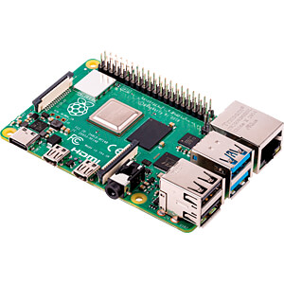
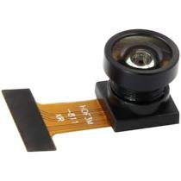
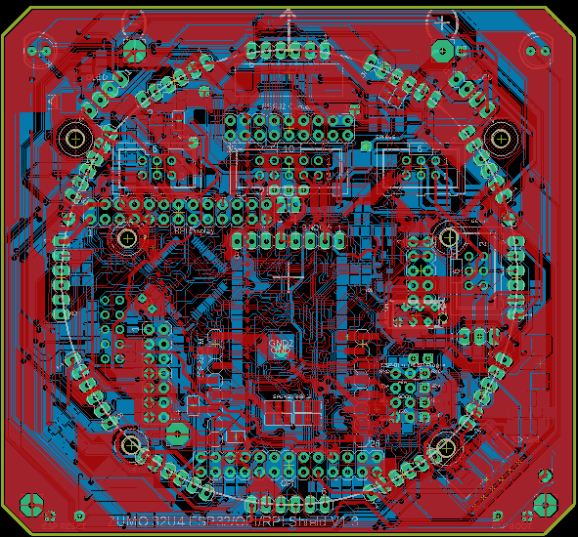
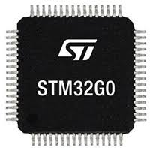
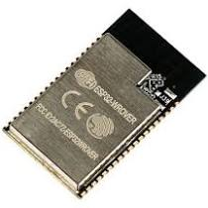
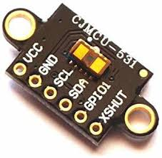
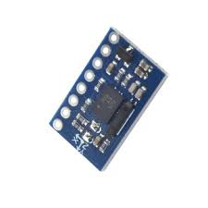
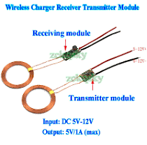
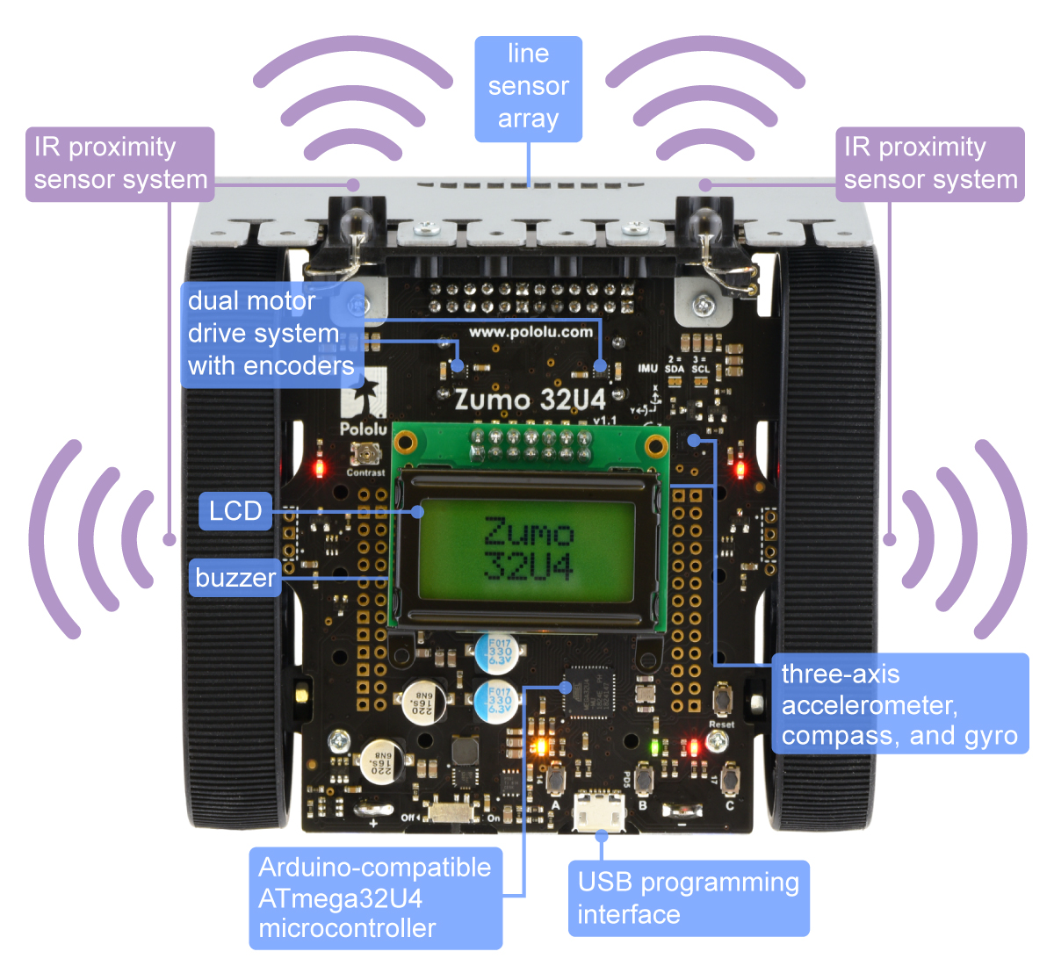
RPI3 or RPI4 or PC
* 64Bit Ubuntu
* ROS2 Head
Wifi
Camera
ESP32 WRover
(16MByte Flash, 8MByte PSRAM)
1-12 * VL53L1X
(Laser TOF Sensor)
1-12 * VL53L1X
(Laser TOF Sensor)
I2C
BNO055
Smart sensor combining accelerometer,
gyroscope, magnetometer and orientation software
Wireless Power Bridge for Charging
ZUMO 32U4
* I2C Slave
* Motor Driver
* Power Switch
* some optical Sensors
* LSM303D and L3GD20H
* 4*AA Battery holder

