Slide 1
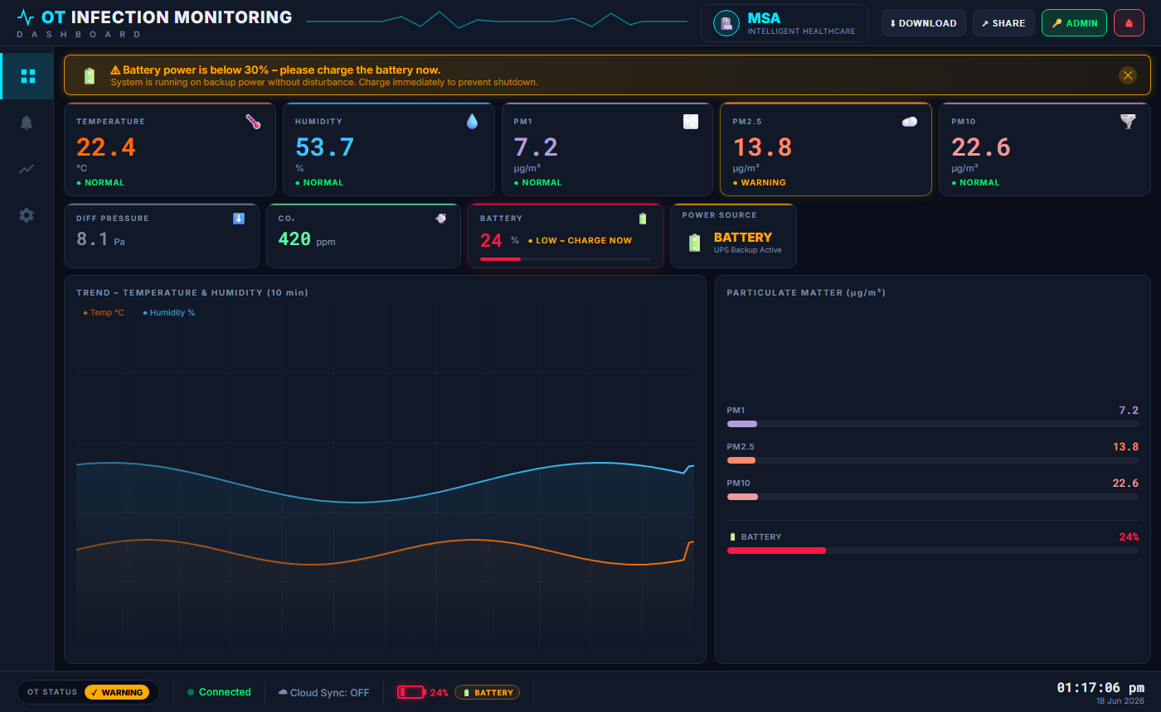
OT INFECTION
MONITORING SYSTEM
Real-time Environmental Monitoring for Operating Theatres
Raspberry Pi 4 · SCD30 · BME280 · PMS5003
CO₂
Temperature
Humidity
PM2.5/PM10
Pressure
Compliant: NABH · ASHRAE 170 · WHO IEQ · ISO 14644-1
Intelligent Healthcare · Operating Theatre Safety

Slide 2
Why Monitor the OT Environment?
Surgical site infections (SSI) are directly linked to uncontrolled environmental parameters
🦠 Surgical Site Infections (SSI)
🌡️ Temperature & Humidity Drift
3–15% of OT procedures result in SSI. Contaminated air is a leading cause. WHO estimates SSIs add 10 extra days to hospital stay.
ASHRAE 170 mandates 20–24°C and 40–60% RH. Violations degrade sterility and affect staff performance and patient thermoregulation.
💨 Particulate Matter (PM2.5 / PM10)
🌿 CO₂ Accumulation
Surgical smoke, skin shedding, and HVAC failure spike PM levels. ISO 14644-1 Class 7 requires <352,000 particles ≥0.5µm per m³.
NIOSH action level: 1000 ppm. Elevated CO₂ indicates insufficient ventilation — raising infection risk and impairing surgeon alertness.

Slide 3
System Architecture Overview
Three-layer design: Physical sensors → FastAPI backend → Web dashboard
HARDWARE LAYER
BACKEND LAYER
DASHBOARD LAYER
▸ SCD30 — CO₂ + Temp + Humidity
▸ FastAPI + Uvicorn (port 8001)
▸ Single-page HTML/CSS/JS app
▸ BME280 — Barometric Pressure
▸ HardwareSource (asyncio + threads)
▸ Served from backend (same-origin)
▸ PMS5003 — PM1 / PM2.5 / PM10
▸ AlarmEngine (hysteresis rules)
▸ Monitor · Alarms · History · Settings
→
→
▸ Raspberry Pi 4 (host)
▸ SQLite storage (90-day retention)
▸ Role-based UI (admin / viewer)
▸ I²C @ 10kHz + UART2 @ 9600
▸ REST API + WebSocket
▸ Live data via REST polling
▸ HMAC-SHA256 session auth
▸ Runs in any modern browser

Slide 4
Hardware Components
Three sensors covering all key OT environmental parameters
SCD30
BME280
PMS5003
Sensirion
Bosch Sensortec
Plantower
CO₂ · Temperature · Humidity
Barometric Pressure
PM1.0 · PM2.5 · PM10
I²C @ 0x61
I²C @ 0x76
UART2 @ 9600
CO₂ Range
400–10,000 ppm
Pressure Range
300–1100 hPa
PM Range
0–500 µg/m³
Temp Range
-40 to +70 °C
Accuracy
±1 hPa
Resolution
1 µg/m³
Humidity
0–95 %RH
Temp Range
-40 to +85 °C
Technology
Laser scattering
Interface
I²C (10 kHz)
Interface
I²C (shared bus)
Interface
UART2 @ 9600
Address
0x61 (fixed)
Address
0x76 (SDO→GND)
Port
/dev/ttyAMA1
Power
3.3V / 19 mA
Power
3.3V / 3.6 µA
Power
5V / 100 mA
Raspberry Pi 4 Model B
Host platform · 64-bit ARM Cortex-A72 · 2–8 GB RAM · Ubuntu/RPi OS Bookworm

Slide 5
GPIO Wiring Diagram
All sensors connect to the 40-pin GPIO header — no soldering required
Raspberry Pi 4
Sensor Connections
Pin 1
3.3V
SCD30
VCC → Pin 1 (3.3V)
5V
SCD30
GND → Pin 6 (GND)
Pin 2
SCD30
SDA → Pin 3 (GPIO2 / SDA1)
Pin 3
GPIO2 / SDA1
SCD30
SCL → Pin 5 (GPIO3 / SCL1)
Pin 5
GPIO3 / SCL1
SCD30
SEL → Pin 6 (GND) ← I²C mode select
Pin 6
GND
BME280
VCC → Pin 1 (3.3V)
BME280
GND → Pin 6 (GND)
Pin 9
GND
BME280
SDA → Pin 3 (shared with SCD30)
Pin 11
GPIO17
BME280
SCL → Pin 5 (shared with SCD30)
Pin 13
GPIO27
BME280
SDO → Pin 6 (GND) ← addr = 0x76
PMS5003
VCC → Pin 2 (5V)
Pin 21
GPIO9 / UART2 RX
GND → Pin 9 (GND)
PMS5003
Pin 24
GPIO8 / UART2 TX
PMS5003
SET → Pin 11 (GPIO17 HIGH)
PMS5003
TX → Pin 21 (UART2 RX)
PMS5003
RX → Pin 24 (UART2 TX)

Slide 6
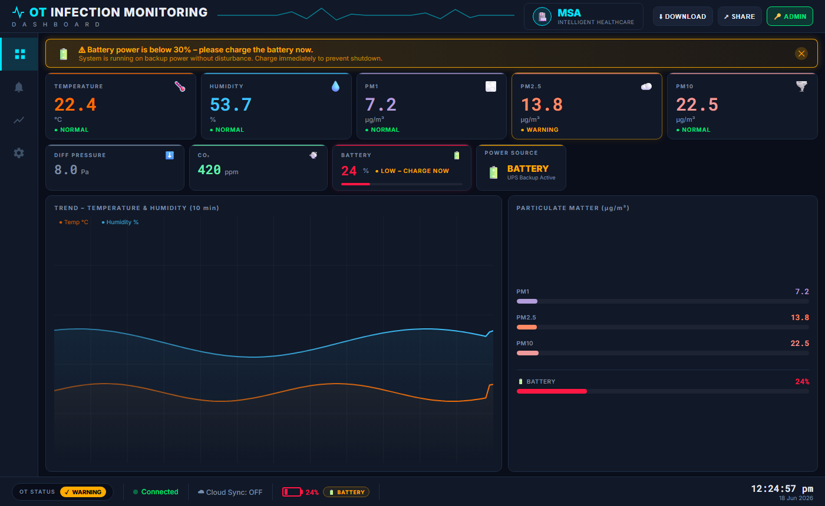
Dashboard — Monitor Panel
Real-time KPI cards, trend charts, and particulate matter bars updated every 2 seconds
Live KPI Cards
Temperature, Humidity, PM1, PM2.5, PM10, CO₂, Battery, Power Source updated every 2 seconds
Battery Warning Banner
Auto-shown when battery < 30%. Covers the full width for immediate staff attention
Trend Chart
10-minute rolling temperature and humidity waveforms
PM Bar Chart
PM1 / PM2.5 / PM10 relative bars with real µg/m³ values

Slide 7
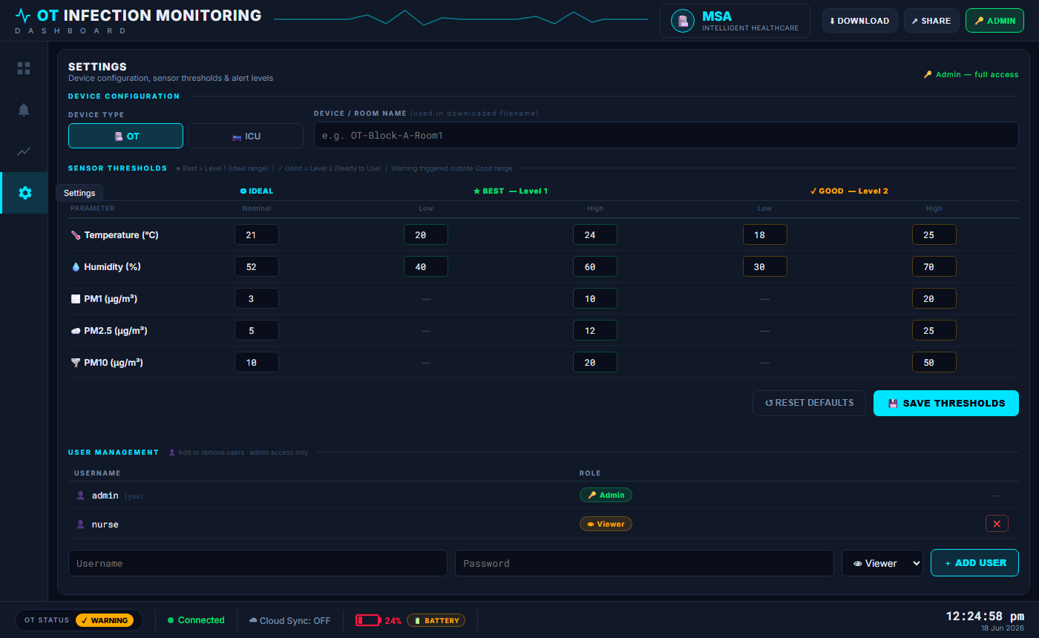
Dashboard — Settings Panel
Admin-only threshold configuration and user management; viewer gets read-only access
Sensor Thresholds Table
Per-parameter Ideal / Best (L1) / Good (L2) thresholds editable by admin — saved to backend
Device Configuration
Set OT type (OT / ICU) and room name — used in CSV export filenames
User Management
Admin-only section: list users, add with role, delete — persisted to users.json between restarts
Role-Based UI
Save button hidden for viewers. User Management section completely hidden for non-admin sessions

Slide 8
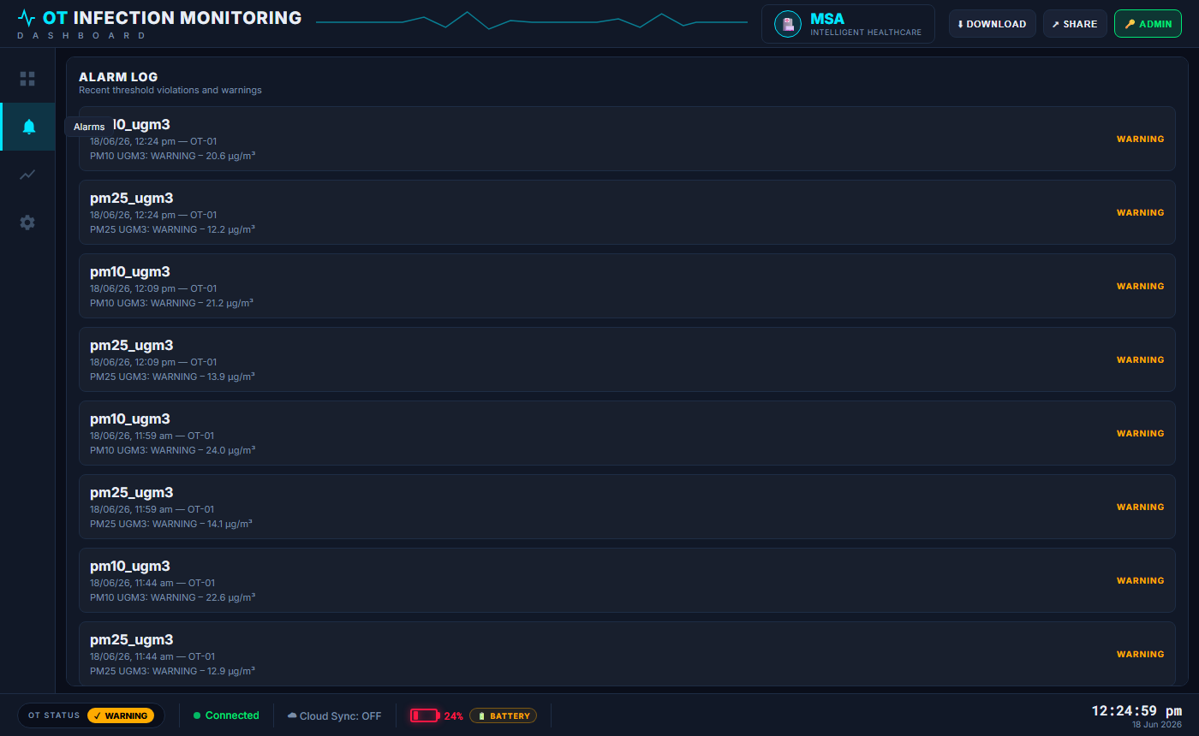
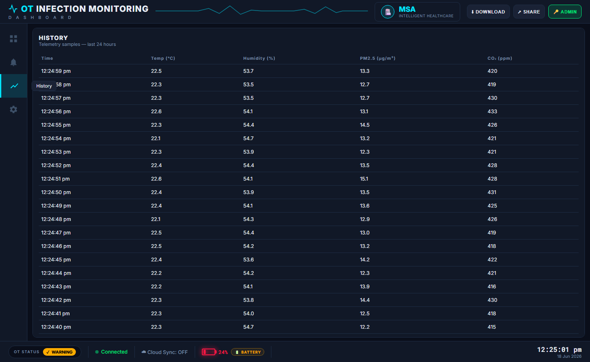
Dashboard — Alarms & History Panels
Alarm log and 24-hour telemetry history pulled live from the SQLite database
ALARM LOG
HISTORY TABLE
▸ Parameter name + timestamp + OT ID
▸ Last 24 hours of telemetry rows
▸ WARNING / ALARM level badge (colour)
▸ Columns: Time / Temp / Humidity / PM2.5 / CO₂
▸ Sorted latest-first from SQLite
▸ Pulls from GET /history?hours=24
▸ Auto-refreshes on nav click
▸ CSV export via DOWNLOAD button (auth required)

Slide 9
Authentication & Role-Based Access
HMAC-SHA256 signed session cookies · Two roles: admin and viewer
1 LOGIN
2 VERIFY
3 SESSION COOKIE
4 ROLE UI
User clicks AUTH button Enters username + password
→
POST /auth/login Backend checks users.json + config.yaml
→
HMAC-SHA256 token set as HttpOnly cookie (60 min expiry)
→
Admin sees full controls Viewer sees read-only User Mgmt hidden
Role Capabilities
Capability
Admin 🔑
Viewer 👁
Monitor panel (live data)
✓
✓
Download CSV
✓
✓
View Alarms / History
✓
✓
Edit thresholds
✓
✗ (hidden)
Manage users
✓
✗ (hidden)
Acknowledge alarms
✓
✗

Slide 10
Alarm Engine — Threshold Rules
NABH / ASHRAE 170 compliant thresholds with hysteresis to prevent alarm fatigue
Parameter Thresholds (ASHRAE 170 / WHO 2021)
Hysteresis Design
Parameter
Nominal
Warning Low
Warning High
Alarm Low
Alarm High
Trigger Delay
Temperature (°C)
21
20
24
18
25
Parameter must exceed threshold continuously for 5 seconds before an alarm fires
Humidity (%RH)
52
40
60
30
70
Clear Delay
Must stay back in safe range for 10 seconds before alarm clears (prevents chattering)
CO₂ (ppm)
—
—
1000
—
1200
PM2.5 (µg/m³)
5
—
12
—
25
Combination Rule
PM2.5 spike + high occupancy together trigger elevated-risk notification
PM10 (µg/m³)
10
—
20
—
50
Alarm Levels
Pressure (hPa)
1013
990
1030
970
1050
NORMAL → WARNING → ALARM → FAULT Each stored in SQLite alarm log

Slide 11
Data Flow — End to End
From physical sensor to dashboard KPI card in under 2 seconds
SENSORS
HARDWARE SOURCE
ALARM ENGINE
STORAGE
REST API
DASHBOARD
SCD30 + BME280 + PMS5003 Read every 2 seconds via asyncio thread pool
HardwareSource assembles TelemetryPacket Timestamped in IST
Evaluate thresholds Apply hysteresis rules Fire callbacks on breach
Insert telemetry row Insert alarm event SQLite WAL mode
GET /history GET /alarms WebSocket broadcast
KPI cards update Alarm banners show History table fills
▶
▶
▶
▶
▶
Total end-to-end latency: < 2 seconds (poll interval = 2 s)
Storage & Retention
Database:
SQLite with WAL mode — concurrent reads without locking the write path
Telemetry:
1 row per 2-second poll · fields: ot_id, timestamp, temp, humidity, PM2.5, CO₂, pressure, status
Alarms:
Every threshold breach logged: parameter, level, value, message, acknowledged, duration
Retention:
90 days default (configurable) · auto-pruned every 6 hours by background task
Export:
GET /export/csv → downloadable audit report for NABH / infection control review

Slide 12
Raspberry Pi Deployment
From fresh SD card to live dashboard in under 30 minutes
1
Flash SD Card
2
Enable Interfaces
3
Install Libraries
Raspberry Pi Imager → RPi OS Lite 64-bit Pre-configure SSH, hostname: ot-monitor
/boot/firmware/config.txt: dtparam=i2c_arm_baudrate=10000 dtoverlay=uart2
pip install adafruit-circuitpython-scd30 adafruit-circuitpython-bme280 pyserial
4
Test Sensors
5
Configure & Run
6
Autostart
python sensors/test_sensors.py All three sensors must show PASS before going to hardware mode
config.yaml: data_source.type: hardware server.host: 0.0.0.0 Change session_secret + passwords
systemd service: ot-monitor.service sudo systemctl enable ot-monitor Dashboard at :8001 on every boot
Access dashboard: http://ot-monitor.local:8001/ or http://<RPi-IP>:8001/

Slide 13
Clinical & Regulatory Compliance
Thresholds derived from NABH, ASHRAE 170-2021, WHO IEQ 2021, ISO 14644-1
NABH
ASHRAE 170-2021
National Accreditation Board for Hospitals & Healthcare Providers (India) OT environment: 20–24°C, 40–60%RH, positive pressure ≥ 8 Pa, ≥ 20 Air Changes per Hour (ACH), HEPA filtration.
Ventilation of Health Care Facilities — North American standard adopted globally. OT: 20–24°C, 30–60%RH, ≥20 ACH total / ≥4 ACH outside air, PM2.5 ≤ 25 µg/m³, PM10 ≤ 50 µg/m³.
WHO IEQ 2021
ISO 14644-1
Indoor Air Quality Guidelines (updated 2021). PM2.5 24-hr average ≤ 15 µg/m³, PM10 ≤ 45 µg/m³, CO₂ < 1000 ppm in occupied clinical spaces.
Cleanrooms and Associated Controlled Environments. OT typically ISO Class 7 (Class 10,000): ≤ 352,000 particles ≥ 0.5µm per m³ — monitored via PMS5003.
All thresholds stored in config/config.yaml — editable via Settings panel (admin only) without restarting the backend

Slide 14
SYSTEM SUMMARY
Complete Hardware Stack
Raspberry Pi 4 + SCD30 + BME280 + PMS5003 — all sensors integrated and tested
Real-Time Monitoring
6 environmental parameters polled every 2 seconds with live dashboard updates
Clinical Alarm Engine
NABH / ASHRAE 170 thresholds with hysteresis — zero false alarm fatigue
Secure Multi-User Access
HMAC-SHA256 sessions, role-based UI — admin vs viewer from any browser
90-Day Data Retention
http://ot-monitor.local:8001/
SQLite time-series + alarm log, CSV export for audit and compliance reporting
admin / OTAdmin2024 · nurse / OTNurse2024
Zero-Dependency Dashboard
Single HTML file served from backend — no build step, works on any device
OT Infection Monitoring System · Raspberry Pi 4 + SCD30 + BME280 + PMS5003 · June 2026

