Slide 1
DevExtreme
By MSA Evan

Slide 2
What is DevExtreme?
DevExtreme is a ready-made enterprise UI component suites for Angular, React, Vue, and jQuery.
It is everything you need to create responsive web application for touch devices, traditional desktops and also compitable for smart phone browser. It includes a comprehensive collection of high-performance and responsive UI widgets for use in web and next-gen mobile applications.
The suite ships with a feature-complete data grid, pivot grid, Tree List, Scheduler, Html Editor, data editors, interactive charts widgets, multi-purpose widgets and much more.

Slide 3
DevExtreme is an open source tool with 1.6K GitHub stars and 528 GitHub forks. Here’s a link to DevExtreme's open source repository on GitHub.
https://github.com/DevExpress

Slide 4
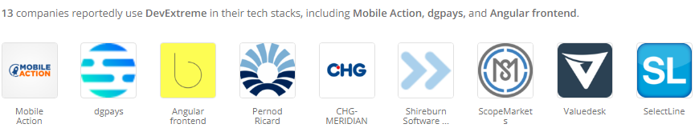
Who uses DevExtreme?

Slide 5
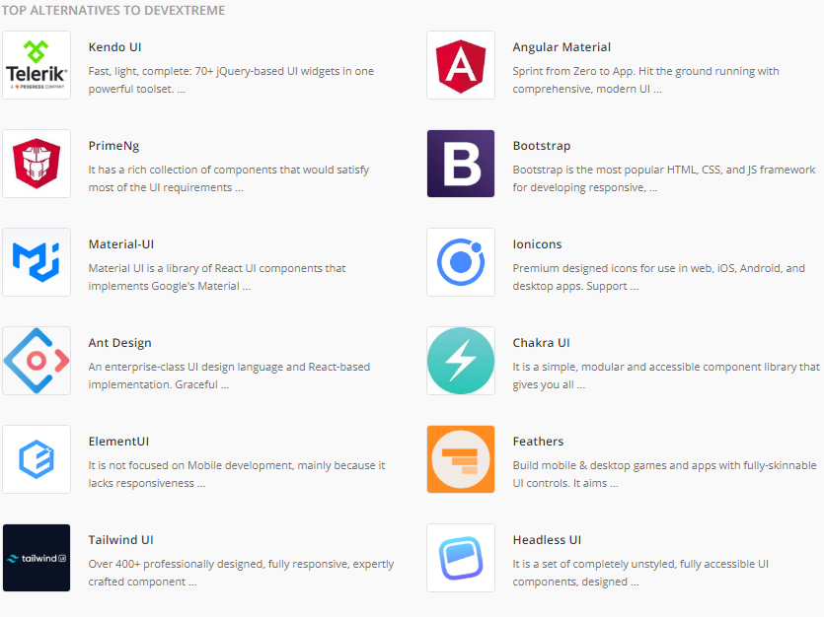
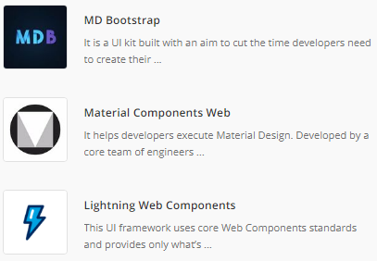
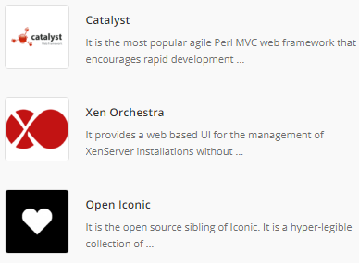
DevExtreme Alternatives & Comparisons

Slide 6
Installation & Initial Configuration
npx -p devextreme-cli devextreme new angular-app app-name | If you want to create a new DevExtreme Angular Application | Install DevExtreme
npm install devextreme@22.1 devextreme-angular@22.1 --save --save-exact | If you want to Add DevExtreme to an Angular Application
"styles": [ "node_modules/devextreme/dist/css/dx.light.css","src/styles.css”] | Configure Stylesheets | Configuration (After configuration we need to run npm update command)
tsconfig.json file "compilerOptions": { ... "paths": {"jszip": ["node_modules/jszip/dist/jszip.min.js"]}} | Register 3rd-Party Dependencies: JSZip Registration

Slide 7
Import DevExtreme Modules Go to the NgModule in which you are going to use DevExtreme UI components and import the required DevExtreme modules.
import { DxButtonModule } from 'devextreme-angular';
@NgModule({ imports: [ DxButtonModule ],
Now you can use the DevExtreme UI component in your application.

Slide 8
Links
CLI Command Links:
https://js.devexpress.com/Documentation/Guide/Angular_Components/Getting_Started/Add_DevExtreme_to_an_Angular_CLI_Application/
Demos Link:
https://js.devexpress.com/Demos/WidgetsGallery/
Components Link:
https://js.devexpress.com/Overview/
Widgets Links:
https://js.devexpress.com/Overview/Widgets/
Sample Project:
https://github.com/MSAEVAN/DevExtreme-Angular

Slide 9


