Slide 1
GRIFFIN
HR Position Classification & Pay Tool
USER GUIDE | v1.0
William & Mary | Mason School of Business
A step-by-step guide for classifying position descriptions
and understanding pay band recommendations
Spring 2026 | BUAD 5722 / BUAD 5742 | Team 7
1 / 20

Slide 2
What is GRIFFIN?
GRIFFIN is a web-based tool that helps HR professionals classify position descriptions into the correct career group and recommends appropriate pay bands.
Think of it as a knowledgeable colleague who reads a position description and says:
"Based on these duties, this position best fits the Financial Services career group, Pay Band 5, with a salary range of $45,000 – $72,000."
GRIFFIN is advisory — it provides recommendations, not final decisions.
You are always the final authority on classification.
No installation required — runs in your web browser.
2 / 20

Slide 3
When to Use GRIFFIN
New Position Classification
Reclassification Review
A new position is being created and you need
to determine the right career group and pay band.
An existing position's duties have changed
significantly and may need a new classification.
Pay Band Verification
Position Comparison
You want to confirm a position is in the right
pay band or check salary range accuracy.
You are comparing similar positions to ensure
consistent classification across the organization.
3 / 20

Slide 4
Getting Started
No installation required
Step 1: Open your web browser (Chrome, Edge, Firefox, or Safari)
Step 2: Go to the GRIFFIN website:
https://griffin-hr-classifier.streamlit.app
Step 3: That's it! You're ready to classify.
Good to Know
No software to install or update
No login or password required
Works on any computer, tablet, or phone with a web browser
Your data is processed in real time and is not stored by the system
4 / 20

Slide 5
Step 1: Paste a Position Description
Copy the full position description text from:
Workday or your HR system
An email or document from a manager
A Word document or PDF
Then paste it into the large text box on the GRIFFIN page.
Tip: Include the FULL description, not just the job title.
The more detail you include (duties, percentages, qualifications, reporting relationships), the better GRIFFIN can match the position.
Tip: When using a current Workday posting as a test, remove existing salary, pay band, and classification codes first — these can bias the results.
Classification takes 15–30 seconds per position description in Full Analysis mode. Fast Mode is instant.
STEP 1 — Paste Position Description
Paste a position description here...
Example: Finance manager responsible for
budget planning, financial reporting, general
ledger management, accounts payable
oversight, and internal audit compliance.
5 / 20

Slide 6
Step 2: Choose Your Classification Mode
Fast Mode
Full Analysis (Recommended)
Instant results (no wait time)
Uses statistical analysis only
Best for: quick checks, bulk screening,
initial triage of multiple positions
Shows: occupational family prediction
with probability scores
Limitation: does not provide specific
role matches or written explanations
Takes 15–30 seconds to process
Uses both statistical analysis + AI reasoning
Best for: final classification decisions,
reclassifications, detailed review
Shows: 3 ranked matches with specific role
names, pay bands, salary ranges, and a
written explanation of why
This is the mode you will use most often
Recommendation: Use Full Analysis for classification decisions. Use Fast Mode for quick checks or when screening many positions.
6 / 20

Slide 7
Step 3: Click "Classify PD"
After pasting your position description and choosing a mode, click the "Classify PD" button.
What happens behind the scenes (in plain terms):
1. GRIFFIN reads your position description
It identifies key duties, qualifications, and responsibilities in the text.
2. Statistical analysis runs
A trained model compares the text against 100+ previously classified positions.
3. AI reviews the duties (Full Analysis only)
An AI reads the description and matches duties to career group definitions.
4. Results appear on screen
You will see ranked matches with career groups, pay bands, and salary ranges.
7 / 20

Slide 8
Understanding Your Results: Best Match
Card 1 of 3 | The top recommendation
Financial Services Manager III
Best Match
Role Name
The specific job title that best matches the duties in your position description
Career Group: 14 – Financial Services
Pay Band: 7
Key Data Fields
Salary Range: $52,187 – $95,505
Career group, pay band, salary range, and W&M grade — the essential data for your classification decision
W&M Grade: S18 ($47,500 – $71,250)
Confidence Bars
ML Probability: 78%
Green bar = statistical score (math)
Gold bar = AI expert judgment (reasoning)
Both high = strong confidence
AI Assessment: 85%
Best Match Badge
Tells you this is GRIFFIN's top recommendation out of all matches
The Best Match card shows GRIFFIN's top recommendation. Always review this card first.
8 / 20

Slide 9
Understanding Your Results: Alternative Role
Card 2 of 3 | Same career group, different level
The Alternative Role card shows the second-best match within the SAME career group. This is useful when a position could fit at a different level.
Example:
Best Match: Financial Services Manager III (Pay Band 7, $52K – $95K)
Alternative Role: Financial Services Manager II (Pay Band 5, $36K – $66K)
This tells you the duties match Financial Services, but the level (Band 7 vs Band 5) is worth reviewing.
When the Alternative Role matters:
If the two cards are close in confidence, the position may be at a transition point between levels
Consider whether the duties are more supervisory (higher band) or more operational (lower band)
The Alternative Role is especially valuable for non-administrative, middle-band positions. With only 103 training positions — most from Administrative Services — the statistical model has limited experience with specialized roles. The Alternative Role provides a second opinion that often reflects the nuanced differences between adjacent band levels in these less-represented career groups.
9 / 20

Slide 10
Understanding Your Results: Alternative Group
Card 3 of 3 | A completely different career group
The Alternative Group card shows the best match in a DIFFERENT career group entirely. This is your "second opinion" — what if the position actually belongs somewhere else?
Low Alternative Confidence (10–20%)
High Alternative Confidence (40%+)
This means the primary classification is
strong. The system looked at other groups
and nothing else came close.
You can feel confident in the Best Match.
This means the duties genuinely span two
career groups. The classification needs
closer review.
Check if duties should be split or if the
PD needs to be rewritten for clarity.
Insight: The Alternative Group card is especially valuable for positions with cross-functional duties (e.g., an IT position that also manages budgets).
10 / 20

Slide 11
Understanding Confidence Metrics
Two different ways GRIFFIN measures certainty
ML Probability
(Green Bar)
Think of this as a test score.
A statistical model trained on 100+ real position descriptions calculates how well your PD matches each career group.
Higher = stronger statistical match.
AI Assessment
(Gold Bar)
Think of this as an expert's opinion.
An AI reads your position description and judges how well the duties match each career group definition.
This is professional judgment, not math.
What it means when they agree or disagree:
Both HIGH (70%+): Strong confidence. The classification is well-supported.
Both LOW (under 40%): The position may not fit neatly into one group. Review the 3 matches carefully.
One HIGH, one LOW: Disagreement. Dig deeper — read the AI explanation and compare all 3 cards.
Note: GRIFFIN's statistical model was trained on 100+ position descriptions. While this provides a solid foundation, it is a relatively small sample — especially for career groups outside Administrative Services. This is why GRIFFIN provides multiple perspectives (ML + AI + three ranked matches) rather than relying on any single metric.
11 / 20

Slide 12
Understanding the AI Rationale
The written explanation below the Best Match card
In Full Analysis mode, GRIFFIN provides a written explanation of its reasoning. Here is what to look for:
AI CLASSIFICATION RATIONALE
"This position focuses primarily on financial reporting, budget planning, and general ledger management, which are core functions of the Financial Services career group. The supervisory responsibilities and scope of financial oversight place this at the Manager III level (Band 7). The alternative match to Administrative Services reflects the general office management duties, but these represent a smaller portion of the role."
What to look for in the rationale:
Which specific duties drove the classification decision
Why the recommended level (pay band) was chosen
Why the alternative matches were ranked lower
Any notes about duties that span multiple career groups
12 / 20

Slide 13
Saving Your Results
Export to Word with one click
After classifying a position, you can save the results as a Word document.
1. Look for the "Download Classification Report" button below the results
2. Click it — a Word document (.docx) will download to your computer
3. Open the file in Word — you can edit it, add your notes, and save to the classification file
The report includes:
The original position description text
All classification results and confidence scores
Career group, pay band, and salary information
The AI rationale (if Full Analysis was used)
Download Classification Report
Pro Tip
Save the Word report to the employee's classification file. It creates a documented record of the tool's recommendation that you can reference during audits or future reclassifications.
13 / 20

Slide 14
Classifying Multiple Positions at Once
You can classify several position descriptions in one session:
1
Paste all PDs into the text box, separated by --- on its own line
2
Each PD will be classified separately with its own results cards
3
Use the "Clear Results" button to start fresh with new PDs
Example:
[First position description text here...]
---
[Second position description text here...]
14 / 20

Slide 15
Using the Data Explorer
Browse career groups and roles in the sidebar
The Data Explorer is in the left sidebar. Use it to:
Browse all available career groups
See which roles belong to each career group
Check pay band ranges for specific groups
Look up occupational family assignments
How to use it:
1. Click the sidebar arrow on the left if the sidebar is closed
2. Under "GRIFFIN Data Explorer," click the dropdown
3. Select a career group to see its details and roles
GRIFFIN Data Explorer
56 career groups | 294 roles | 10 pay bands
Financial Services
Code: 14
Family: Fiscal Services
Pay Bands: 3 – 9
Roles:
• Financial Services Spec I (Band 3)
• Financial Services Spec II (Band 4)
• Financial Services Mgr I (Band 5)
• Financial Services Mgr II (Band 6)
• Financial Services Mgr III (Band 7)
15 / 20

Slide 16
Tips for Best Results
1
Include the full position description
Do not just paste the job title. GRIFFIN needs the detailed duties, qualifications, and responsibilities to make an accurate classification.
2
Include duty percentages if available
If the PD lists duty percentages (e.g., "40% budget management, 30% supervision"), include them. This helps GRIFFIN weigh the duties properly.
3
Include qualifications and reporting relationships
Supervisory scope and required qualifications help distinguish between different levels within the same career group.
4
Review all 3 match cards before deciding
Do not just look at Card 1. The alternative matches can reveal important nuances about where the position truly belongs.
5
Use Full Analysis for important decisions
Fast Mode is great for quick checks, but always use Full Analysis when making a final classification recommendation.
16 / 20

Slide 17
When GRIFFIN Disagrees with Your Judgment
Remember: GRIFFIN is advisory. You are the authority. Your professional judgment comes first.
If GRIFFIN's recommendation does not match your assessment:
Use the 3 matches to triangulate
Look at all three cards. If Card 2 or Card 3 matches your judgment, the answer may be there.
Read the AI rationale carefully
The explanation might highlight duties you interpreted differently. This can refine your own analysis.
Check if duties span multiple career groups
Positions with mixed duties (e.g., IT + finance) can confuse any classification system, including human reviewers.
When ML and AI disagree with each other
If the green bar and gold bar point in different directions, the classification is genuinely ambiguous. Give it extra review.
Document your decision
Download the report and add your notes explaining why you chose a different classification. This creates an audit trail.
17 / 20

Slide 18
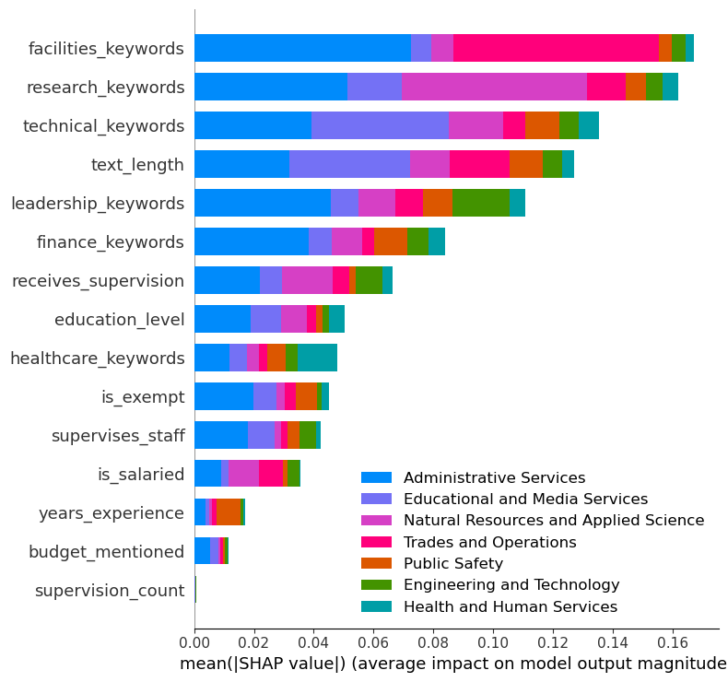
How GRIFFIN’s ML Model Makes Decisions
Feature importance from model training
What This Chart Shows
This chart shows what factors GRIFFIN weighs most heavily when analyzing a position description.
How to Read It
Taller bars = more important factors in the classification decision.
Your Audit Trail
This is your audit trail — it shows HOW the ML model reached its conclusion, not just WHAT it concluded.
Note: This analysis is from the model training phase. A future version may show this per-classification.
18 / 21

Slide 19
Frequently Asked Questions
Is GRIFFIN's classification official?
No. GRIFFIN is an advisory tool only. All classification decisions must be reviewed and approved by qualified HR professionals following your organization's policies.
What if GRIFFIN is wrong?
You are the expert. GRIFFIN is a starting point. Use it to inform your analysis, but rely on your training and judgment for the final decision.
Can I classify multiple positions at once?
Yes. Separate each position description with --- (three dashes) on its own line. Each PD will receive its own set of results.
How do I save my results?
Click the "Download Classification Report" button below the results. This saves a Word document with all the classification details.
Why does it take longer in Full Analysis mode?
Full Analysis uses AI to read and reason about your PD in addition to statistical analysis. The extra 15–30 seconds gives you 3 ranked matches and a written explanation.
Is my data stored anywhere?
No. Your position descriptions are processed in real time and are not saved by the system.
18 / 20

Slide 20
Who to Contact
For Classification Questions
For Technical Support
Questions about career group definitions, pay
band assignments, or classification policy should
be directed to your HR Classification team.
DHRM Classification & Compensation Division
provides the official career group taxonomy
and pay band structure.
If the tool is not loading, showing errors,
or behaving unexpectedly:
Contact: Team 7 (GRIFFIN Development)
William & Mary Mason School of Business
Include: what you were doing, what happened,
and the browser you used.
Looking Ahead | v1.0
This is GRIFFIN v1.0. Future versions will include feature importance analysis (showing which specific words in the PD influenced the classification) and expanded reference data. Your feedback helps us improve!
19 / 20

Slide 21
GRIFFIN
Your Classification Assistant, Not Your Replacement
Paste. Classify. Review. Decide.
Paste the full position description for best results
Use Full Analysis for classification decisions, Fast Mode for quick checks
Review all 3 match cards to triangulate the right classification
Check both confidence bars — agreement means high confidence
Download the report to save your work
YOU are the final authority — GRIFFIN is here to help, not replace you
William & Mary | Mason School of Business | BUAD 5722 / BUAD 5742 | Team 7 | Spring 2026
20 / 20

