Slide 1
GRIFFIN
HR Position Classification & Pay Tool
William & Mary | Mason School of Business
BUAD 5722 — Big Data Analytics | Spring 2026
TEAM 7
Steven Alvarado | Anmol Motwani | JR Jones | Brynn Vetrano
1 / 17

Slide 2
Project Overview
THE PROBLEM
THE SOLUTION
SCOPE & SCALE
William & Mary’s HR is under resourced and struggle to meet classification and compensation setting for current vacancies as well as periodically updating existing positions.
These position descriptions must be classified against 500+ position descriptions into Virginia DHRM career groups and pay bands, translated to W&M’s pay scale, and must be competitive enough to attract high quality applicants.
Manual classification is time-intensive and inconsistent across reviewers.
GRIFFIN — an AI-powered classification & pay setting recommendation system combining:
• Traditional ML (H2O AutoML) for pattern-based matching
• Agentic AI (LangChain + Gemini) for explainable reasoning
Providing HR personnel ranked recommendations with rationale for human review.
Multi-method approach provides both accuracy and transparency.
End-to-end batch analytics pipeline:
• 56 career groups classified
• 294 roles mapped
• 103 position descriptions processed
• 80 ML models trained
Data acquisition → ML training → interactive Streamlit app
56 Career Groups | 294 Roles | 103 Positions | 80 Models
2 / 17

Slide 3
Data Acquisition
1
DHRM WEBSITE
2
W&M WORKDAY
3
CAREERONESTOP API
dhrm.virginia.gov
workday.wm.edu
careeronestop.org
• 56 career group pages scraped
• 50 HTML + 6 PDF documents
• Rate-limited (1.5s delays)
• Cached locally for reprocessing
• 150 job postings extracted
• 103 staff positions retained
• 47 faculty records excluded
• Full position descriptions captured
• Virginia salary benchmarks
• REST API integration
• Classification validation data
• SOC code cross-references
BeautifulSoup, pdfplumber
requests, HTML parsing
REST API, JSON parsing
PIPELINE: Web Scrape → Parse HTML/PDF → Extract Career Group Definitions → SQLAlchemy Database
SQLite local | Cloud SQL deployment-ready
3 / 17

Slide 4
Technology & Architecture
DATA COLLECTION Classification Categories, Codes, Pay Bands, Etc.
DATA STORAGE Put It All In A Central Location
DATA PROCESSING Clean It Up, Separate Test Version Vs. Answer Key
ML TRAINING Let The Machine Take The Test And 'Learn'
LLM CLASSIFICATION Parallel Look Using AI
WEB APPLICATION Human Tailored Results
BeautifulSoup
requests
pdfplumber
CareerOneStop REST API
SQLAlchemy
SQLite
(Cloud SQL ready)
pandas
regex
Custom censoring pipeline
H2O AutoML
80 models
GBM best
SHAP
LangChain agents
Google Gemini 2.5 Flash
3 custom tools
Streamlit
W&M branding
Interactive classification
COURSE TOOLS FEATURED
H2O AutoML | LangChain | Gemini API | CareerOneStop REST API | BeautifulSoup | SQLAlchemy | Streamlit | SHAP
GCP Cloud SQL deployment-ready — local SQLite for development, Cloud SQL for production scale
4 / 17

Slide 5
Data Processing
FEATURE ENGINEERING
CENSORING PIPELINE
KEY INSIGHT
15 engineered features from 103 position descriptions
• Regex-based keyword frequency extraction
• Document length metrics
• Domain-specific term detection
Tools: pandas, regex
30+ skip patterns ensure clean training data
• JP codes (job profile IDs)
• Compensation grades (S/H codes)
• Salary ranges & dollar amounts
• EEO boilerplate text
• Job requisition IDs
Tools: pandas, regex, custom censoring
Censoring prevents data leakage
Without censoring, models memorize classification codes rather than learning from position duties.
[Like a student looking at the answer key before trying the problem]
Models that rely on leaked labels:
• Look perfect in training
• Fail completely in production
Censoring forces genuine learning from job content.
103 PDs → Censoring (30+ patterns) → Feature Engineering (15 features) → Training-Ready Dataset
5 / 17

Slide 6
Machine Learning
H2O AutoML
PERFORMANCE METRICS
80 models trained via automated machine learning
• Best model: GBM with learning rate annealing
• 5-fold stratified cross-validation (due to small ~150 posted jobs)
• 15 engineered features from Notebook 4
• 100 training rows (3 Unknown class dropped)
• Class imbalance: 55 Admin vs 3–4 smallest
ML correctly identifies occupational family;
correct role typically appears in top 2–3
AI recommendations.
Overall Accuracy
69% Top-1 | 90% Top-3 | 0.54 Macro F1
Per-Class Accuracy by Job Family
F1 Score = balance between catching all correct matches and avoiding false matches (1.0 = perfect, 0.0 = never correct)
• Administrative Services: 0.79
• Natural Resources: 0.82
• Public Safety: 0.75
• Trades & Operations: 0.71
Strong performance on well-represented classes;
class imbalance limits underrepresented groups.
6 / 17

Slide 7
LLM / AI Language Processing
Teaching computers to read and classify job descriptions
AGENT ARCHITECTURE
TOOL ECOSYSTEM
AGENTIC ELEMENTS
LangChain multi-agent system
8 components total
3 Specialized Agents:
• Classifier Agent
• Pay Matcher Agent
• Orchestrator Agent
Orchestrator delegates tasks to
specialized sub-agents in sequence.
LLM: Google Gemini 2.5 Flash
5 integrated tools:
3 Custom Tools:
• search_career_groups
• search_roles
• match_pay_band
2 External APIs:
• CareerOneStop API
(salary benchmarks)
• Tavily web search
(supplemental research)
Reasoning
Analyzes duties against DHRM
compensable factors (Complexity,
Results, Accountability)
Tool Use
Queries DHRM database, external
APIs for classification evidence
Reflection
Generates explanation narratives
with caveats and confidence scores
Dual-Method: ML predicts occupational family (instant, local) | Gemini AI provides specific role matching with explainable rationale
Fast Mode (ML only) and Full Analysis (ML + AI) give users control over speed vs. depth
7 / 17

Slide 8
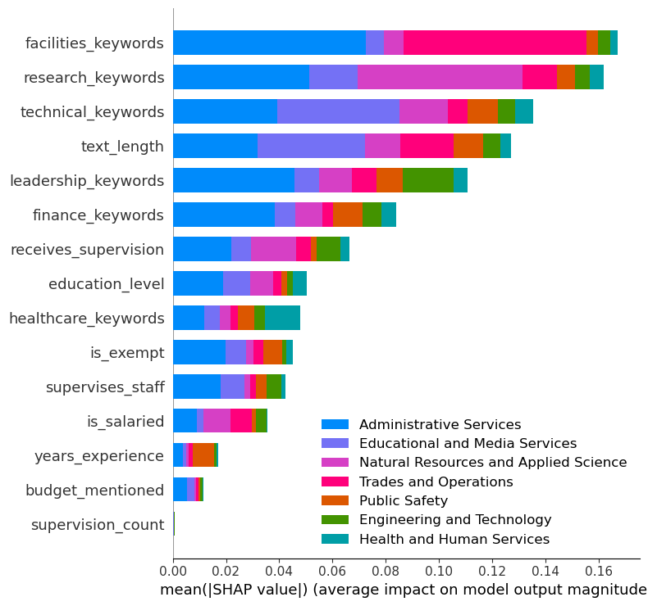
SHAP — What Drives Classification?
Which features of a job description most influence how the model classifies it?
KEY TAKEAWAYS
• facilities_keywords and research_keywords are the strongest signals — PDs mentioning these terms are most clearly distinguished between job families
• text_length matters — longer, more detailed position descriptions give the model more information to work with
• budget_mentioned and supervision_count have minimal impact — these appear across many job families and don’t help differentiate
• Each color represents one of the 7 occupational families. The total bar length shows overall influence — longer bars mean the model relies more heavily on that feature when making its classification decision.
8 / 17

Slide 9
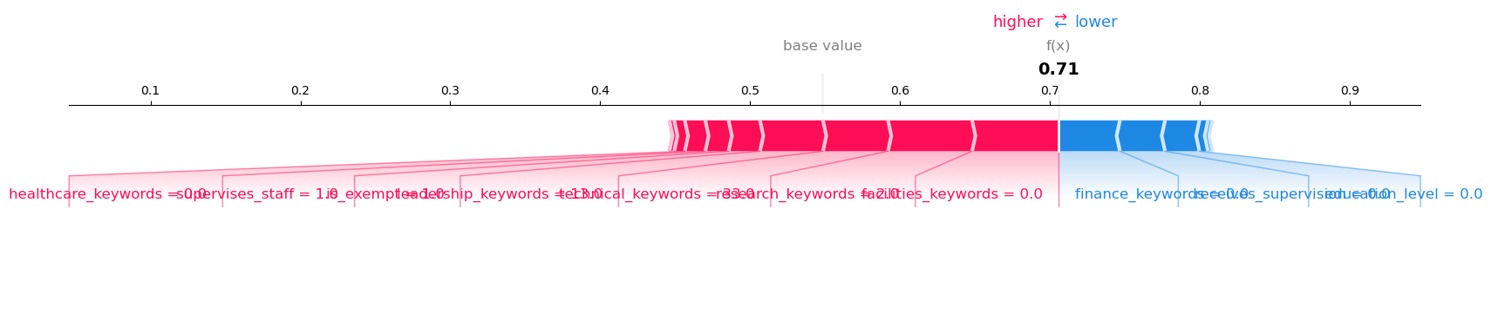
SHAP — How One Classification Was Made
Tracing the model’s reasoning for a single Administrative Services position
Final Confidence: 71%
Starting Confidence: 55%
READING THIS CHART
Think of this as a debate between features arguing FOR and AGAINST classifying this position as ‘Administrative Services.’
Starting Confidence: Initial guess based on class distribution. “In my experience…”
Red Features argue IN FAVOR — healthcare_keywords = 0 (no healthcare terms supports Admin), supervises_staff = 1 (supervision duties are common in Admin roles). These push the confidence UP from 55% toward 71%.
Blue Features argue AGAINST — finance_keywords and receives_supervision suggest this could be Financial Services instead. These push the confidence DOWN.
The Final Verdict: 71% confidence in Administrative Services — the ‘for’ arguments outweigh the ‘against.’ This is explainable AI: every classification traces back to specific, auditable features.
9 / 17

Slide 10
Streamlit Application
LIVE TESTING
CLASSIFICATION OUTPUT
HUMAN-IN-THE-LOOP
Tested with 4–5 live W&M
position descriptions
Fast Mode:
• Instant ML prediction
• Zero API cost
• H2O model runs locally
Full Analysis:
• 3 ranked role matches
• AI confidence scores
• Explainable reasoning narrative
Both modes return:
• Career group recommendation
• W&M pay grade estimate
• Salary range from DHRM bands
Full Analysis adds:
• 3 ranked role matches
• Confidence scores + reasoning
• Alternative career group match
Data explorer sidebar:
Browse 56 groups, 294 roles
AI recommends, HR decides
The tool never auto-submits
classifications or writes to any
HR system.
HR professionals evaluate:
• Confidence percentage
• Classification reasoning
• Alternative matches
AI augments HR expertise —
it does not replace it.
Tested with Live W&M Positions | Fast Mode (ML only, zero cost) | Full Analysis (ML + AI, ranked matches)
10 / 17

Slide 11
Findings & Results
KEY METRICS
KEY INSIGHTS
Model Selection
80 models evaluated → GBM best performer
Accuracy Tiers
69% Top-1 | 86% Top-2 | 90% Top-3
Macro F1: 0.54
Strong: Admin Services (0.79) | Natural Resources (0.82)
Weak: Engineering (0.00 — only 4 training examples)
Real-World Testing Observations
• ML and AI sometimes disagree — by design.
Disagreement flags boundary positions
warranting human review.
• Salary estimates can exceed posted salary —
may indicate positions undersold relative
to DHRM band midpoints.
• Correct classification consistently in top 3.
• H2O runs locally (zero API cost); Gemini
adds role-specific detail when needed.
COURSE TOOLS FEATURED
H2O AutoML | LangChain | Gemini API | CareerOneStop REST API | BeautifulSoup | SQLAlchemy | Streamlit | SHAP
11 / 17

Slide 12
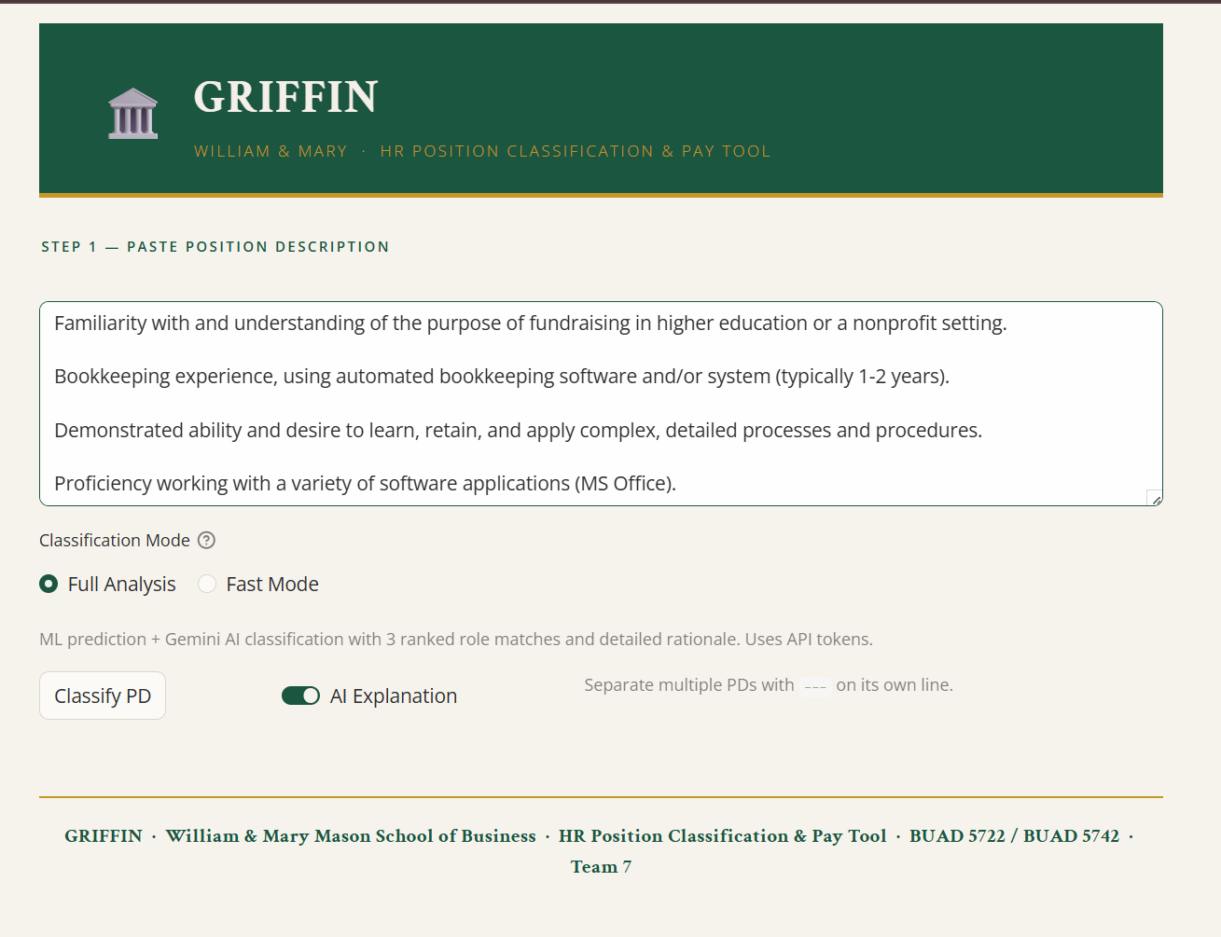
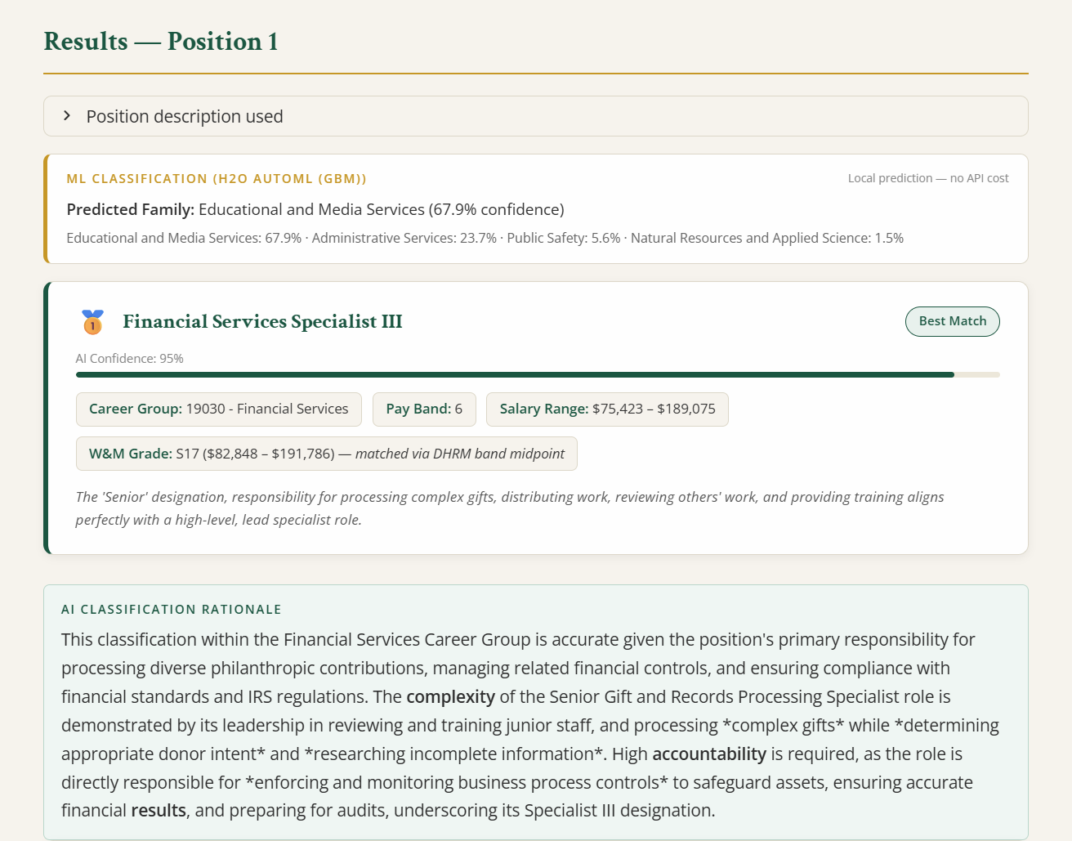
Live Demo — Entering a Position Description
Step 1: Paste position description and select classification mode
Step 2: Top-ranked match with AI confidence and reasoning
12 / 17

Slide 13
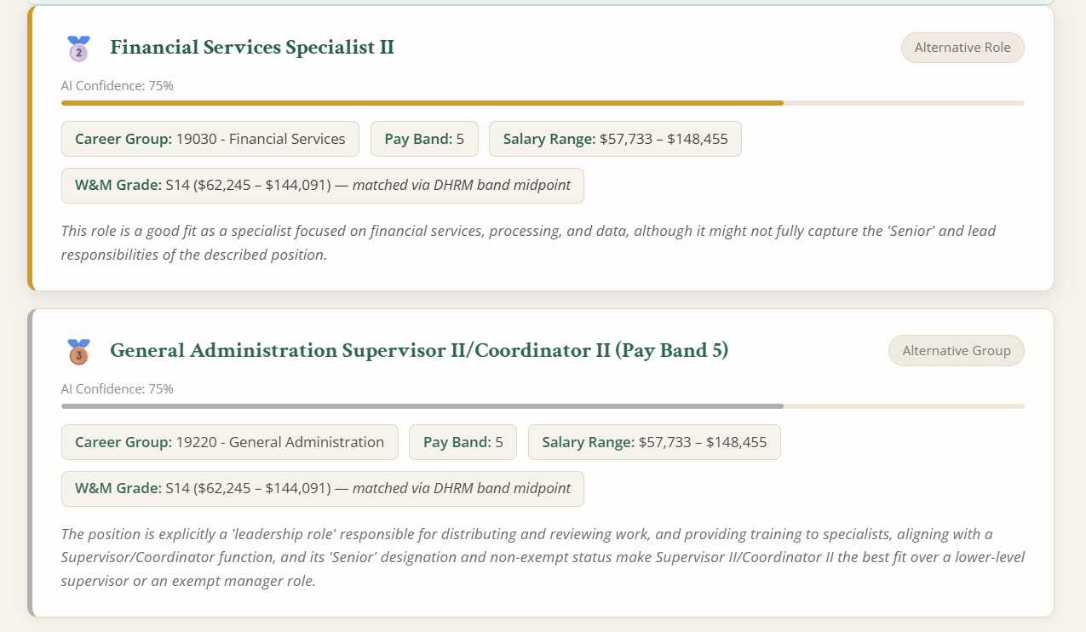
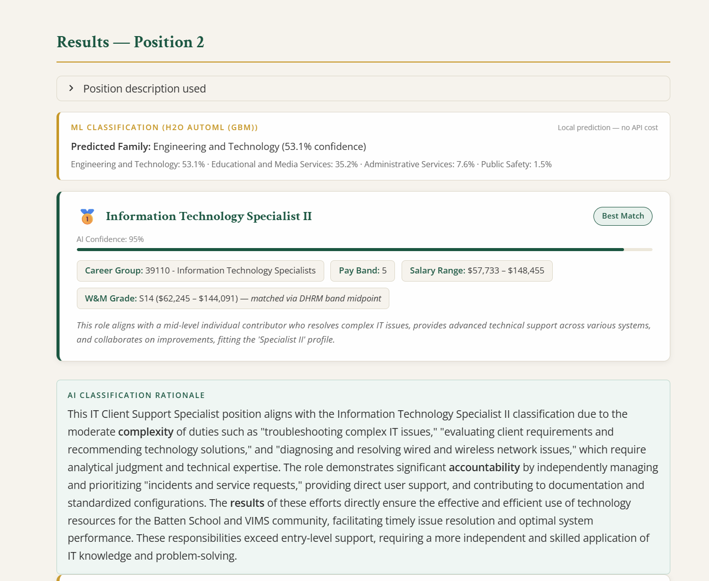
Live Demo — Ranked Alternatives
Alternative roles ranked by confidence for human review
Second position: different career group identified
13 / 17

Slide 14
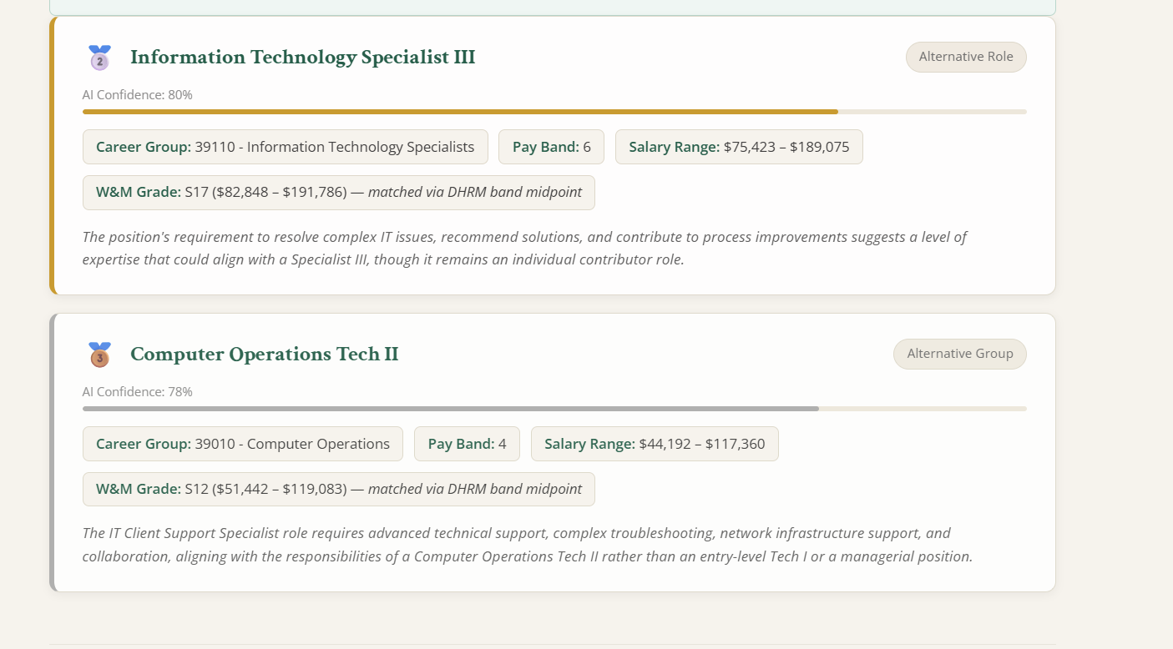
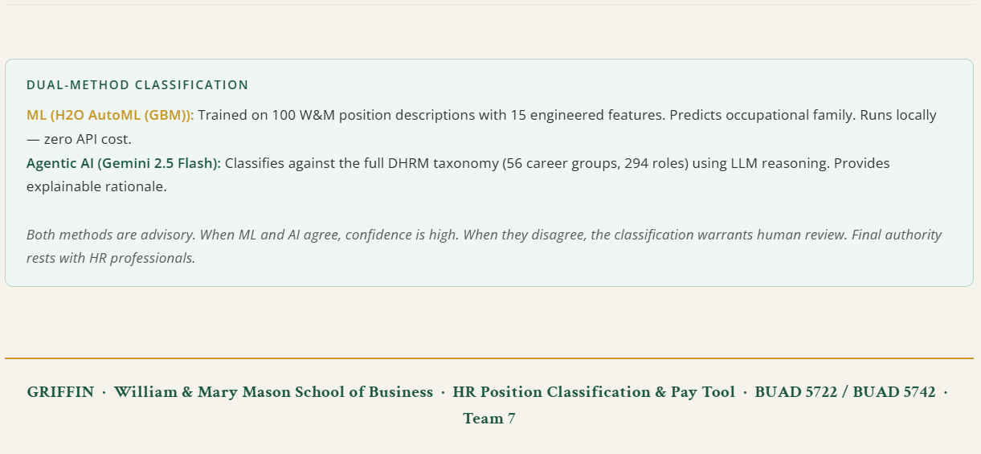
Live Demo — Multi-Position & Methodology
Dual-Method Classification: ML + AI transparency
Ranked alternatives for second position
14 / 17

Slide 15
Ethical Reflection
1. PUBLIC DATA ETHICS
2. CLASSIFICATION BIAS
3. HUMAN-IN-THE-LOOP
Rate-limited scraping (1.5s delays) of public government DHRM data. Cached locally so each URL fetched at most once.
103 PDs with heavy class imbalance acknowledged. Stratified CV preserves proportions. Model framed as advisory, not deterministic.
AI recommends, HR decides. Never auto-submits. Confidence scores + reasoning narratives enable informed professional judgment.
4. LLM TRANSPARENCY
5. DATA PRIVACY
6. API SECURITY
Step-by-step reasoning narratives, not black-box. Auditable 8-component agent pipeline. Every classification is explainable.
Censoring pipeline removes all PII, JP codes, comp grades, salary data before ML training. No personally identifiable information in pipeline. Since we do not have current PDs, future training data MUST be sanitized before being provided.
.env excluded from git via .gitignore. Credentials loaded via python-dotenv. No API keys hardcoded in source files.
Ethics integrated as engineering decisions — not a separate compliance exercise
15 / 17

Slide 16
Next Steps
INFRASTRUCTURE
DATA EXPANSION
AGENT REFINEMENT
GCP Cloud SQL Deployment
• Deployment-ready schema exists
• SQLAlchemy ORM migration path
• Local SQLite → Cloud SQL
Performance
• Cloud deployment eliminates
H2O JVM startup time
• First-run performance gain
Production Readiness
• Containerized deployment
Proprietary Data Integration
• Connect to W&M HR systems
• Additional departments' PDs
• Expand beyond 103 training rows
Class Imbalance Mitigation
• H2O counterbalance weights
• More PDs for underrepresented
career groups
Enhanced Tool Ecosystem
• Additional classification tools
• Conversation memory for multi-
turn classification sessions
Model Improvements
• Fine-tuned embeddings
• Expanded training corpora
• Ensemble ML + LLM scoring
GCP Cloud SQL deployment-ready — schema exists, migration path defined
Thank You | Team 7 | BUAD 5722 Big Data Analytics | Spring 2026
16 / 17

Slide 17
References & Data Sources
DATA SOURCES
Virginia DHRM — dhrm.virginia.gov
56 career group pages, public government data
William & Mary Workday — williammary.wd12.myworkdayjobs.com
150 public job postings, no authentication required
CareerOneStop API — careeronestop.org
U.S. DOL/ETA salary benchmarks
TECHNOLOGIES
H2O AutoML — docs.h2o.ai
Automated machine learning
LangChain — python.langchain.com
Multi-agent orchestration
Google Gemini API — ai.google.dev
LLM classification
SHAP — shap.readthedocs.io
ML explainability
Streamlit — streamlit.io
Web application framework
SQLAlchemy — sqlalchemy.org
Database ORM
REQUIRED ATTRIBUTION
Salary benchmarking data provided by CareerOneStop, sponsored by the U.S. Department of Labor, Employment and Training Administration (USDOL/ETA). This project does not reflect the official position of USDOL/ETA.
17 / 17

