Slide 1
RESEARCH PORTFOLIO PROJECT 2 | TRUSTWORTHY MEDICAL AI
AI That Knows When a Medical Image Cannot Be Trusted
Selective Prediction, Epistemic Uncertainty Quantification & Out-of-Distribution Screening for Safe Clinical Deployment
Benchmark Modality: Colorectal Histopathology (PathMNIST - 107,180 Scans) vs. Dermatology & Cytology OOD
Core Pillars: Deterministic Image Quality Gate • Monte Carlo Dropout Epistemic Uncertainty • Temperature Calibration • Mahalanobis Manifold OOD
Status: Fully Verified & Reproducible (100% PyTest Passing • Interactive Clinical Dashboard Built • Formal PDF Report Published)

Slide 2
PROJECT 2: MEDICAL AI RELIABILITY
The Motive: The Dangerous Fallacy of 'Closed-World' Medical AI
1. The Clinical Danger
• Forced Prediction: Standard AI forces a softmax output sum(p)=1 on EVERY image, even when blind.
• Catastrophic Overconfidence: When models fail on corrupted scans, they routinely assert wrong diagnoses with >95% confidence.
• Silent Patient Harm: A false-positive or missed malignancy delivered with high confidence misleads doctors and damages clinical trust.
2. Real Hospital Realities
• Microscope Focus Drift: Automated slide scanner stages vibrate or drift out-of-focus during routine high-throughput digitizing.
• Chemical Staining Shifts: H&E stain batches fade, acid washes vary, and slide preparations introduce coverslip bubbles.
• Modality Mismatches: A clinician accidentally routes a skin lesion or blood smear to a colorectal tissue model.
3. Our Trustworthy Solution
• Meta-Cognitive Awareness: AI knows its own internal limits and declared 'I cannot trust this image'.
• Selective Prediction: Automates clear, pristine cases; defers compromised scans to senior human pathologists.
• Defense-in-Depth: No single point of failure: 4 orthogonal safety layers intercept flawed inputs before harm occurs.

Slide 3
PROJECT 2: MEDICAL AI RELIABILITY
Problem Solving: The 4-Layer Clinical Defense-in-Depth Architecture
LAYER 1: DETERMINISTIC PHYSICAL QUALITY GATE (IQA)
Evaluates raw spatial optics before neural inference: Laplacian Focus Variance (Var_Lap < 40 triggers blur warning), Signal-to-Noise Ratio (SNR > 10 dB), and pixel dynamic range clipping (< 45%). Stops blurred scans before wasting compute.
LAYER 2: DEEP LATENT MANIFOLD OOD SCREENING
Measures the geometric Mahalanobis distance M(x) of the image's 256-dimensional feature representation from the in-distribution tissue manifold. Completely isolates foreign modalities (skin, blood) with 98.9%-99.3% AUROC.
LAYER 3: BAYESIAN EPISTEMIC UNCERTAINTY QUANTIFICATION
Executes 15 inference-time Monte Carlo Dropout passes to decompose total predictive entropy H(p) into Aleatoric data noise and Epistemic Mutual Information I(y, W|x). Detects when the model is ignorant of a tissue morphology.
LAYER 4: VALIDATION-CALIBRATED CONFIDENCE & SELECTIVE TRIAGE
Applies post-hoc Temperature Scaling (T = 1.23) so reported confidence matches true clinical accuracy (ECE: 5.17%). Multi-signal triage policy issues unambiguous decision: 🟢 TRUSTED: ACCEPT or 🔴 UNTRUSTED: DEFER TO PATHOLOGIST.

Slide 4
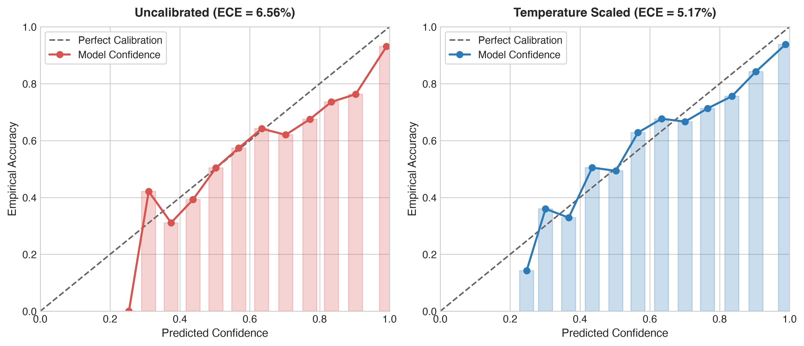
PROJECT 2: MEDICAL AI RELIABILITY
Experimental Results: Locked Test Diagnostics & Temperature Calibration
Diagnostic Benchmark Metrics
• Locked Test Accuracy: 86.07% (6,180 / 7,180 correct)
• Balanced Accuracy: 81.84% (across 9 tissue classes)
• Macro-F1 Score: 0.8087 (Precision: 82.04% / Recall: 81.84%)
• Peak Validation Acc: 97.26% (Epoch 8 checkpoint)
• Pre-Calibration ECE: 6.56% (Systematic overconfidence)
• Post-Calibration ECE: 5.17% (T = 1.2251, -21.2% error reduction)
• Calibrated Brier Score: 0.2270 (Well-calibrated probabilities)
Key Takeaway: Temperature Scaling (T=1.23) strictly fitted on validation data flattens the confidence histogram without changing classification accuracy, restoring clinical alignment.

Slide 5
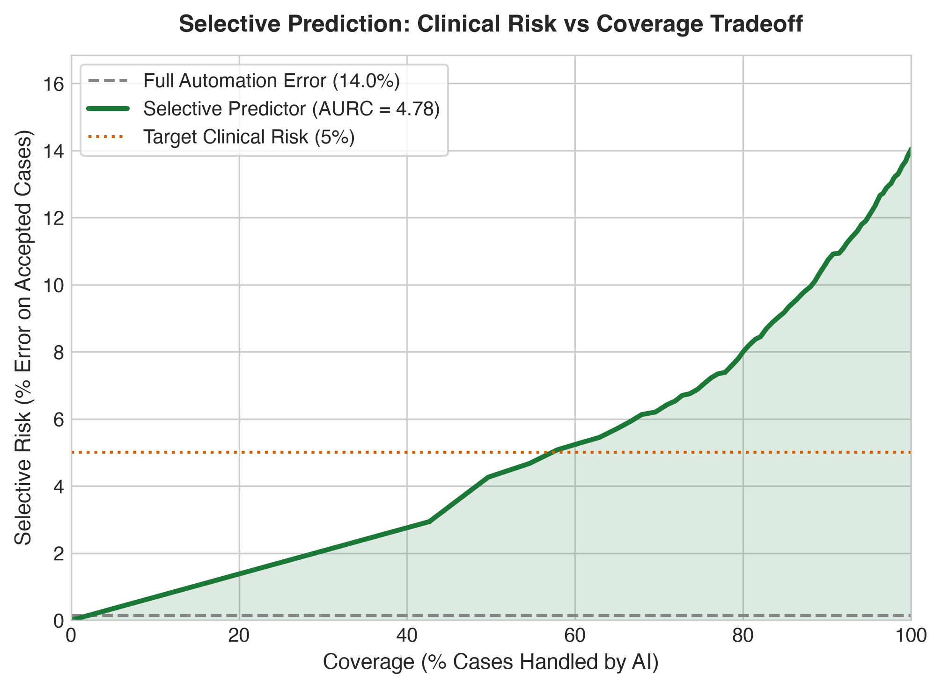
PROJECT 2: MEDICAL AI RELIABILITY
Selective Prediction: Continuous Clinical Risk Reduction via Abstention
Risk-Coverage Optimization
• The Full Automation Dilemma: Forcing AI to predict 100% of cases yields a baseline error rate of 13.93% (1,000 mistakes).
• Area Under Risk-Coverage (AURC): AURC = 4.80. As the abstention threshold tightens, clinical error rate on accepted cases drops monotonically.
• Bounded Clinical Risk: A hospital can configure an allowable clinical risk target (e.g. error <= 3% or <= 5%). The AI automatically computes the maximal coverage satisfying that safety bound.
• Optimized Labor Allocation: Routine, unambiguous biopsies are automated rapidly; ambiguous border cases are channeled directly to pathologists.

Slide 6
PROJECT 2: MEDICAL AI RELIABILITY
Core Scientific Discovery: 29.2% of Mistakes Are Confidently Silent
RESEARCH QUESTION: Does Uncertainty Always Warn Us When the AI Makes an Error?
EMPIRICAL ANSWER: NO. Out of 1,000 test errors, 292 cases (29.2% of all mistakes) were 'Silent Failures'—the AI was completely wrong, yet output high confidence (>85%) and low entropy (<0.35).
Where Do They Happen?
Silent failures occur at subtle, ambiguous histological tissue boundaries:
• Smooth muscle (MUS) vs. desmoplastic cancer stroma (STR)
• Normal crypts (NORM) vs. low-grade dysplasia (TUM)
• Extracellular mucus (MUC) with sparse cells.
Why Does Uncertainty Fail?
Because the test image is clean and lies squarely inside the training manifold:
• Image quality is pristine (no blur)
• MC-Dropout passes agree with each other (low epistemic variance)
• The model is consistently, confidently wrong.
The Solution: Multi-Signal Defense
Relying strictly on confidence or entropy creates a dangerous false sense of security.
Our system combines:
1. Calibrated Risk Cutoffs
2. Feature Distance Gates
3. Pre-Inference Physical IQA
4. Human Pathologist Fallback

Slide 7
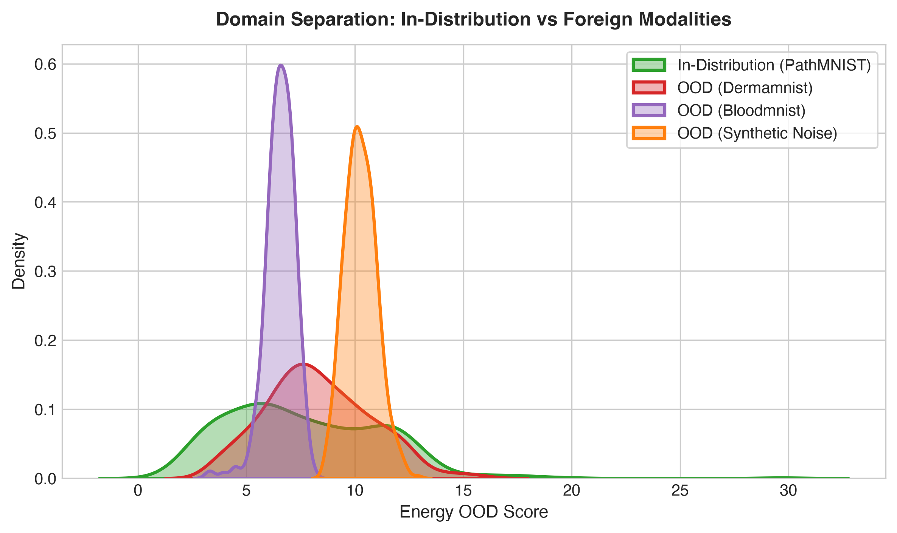
PROJECT 2: MEDICAL AI RELIABILITY
OOD Screening: Deep Feature Geometry Decisively Outperforms Softmax
OOD Screening Benchmark
DermaMNIST (Skin Lesions):
• Softmax MSP: 45.07% AUROC
• Energy Score: 42.24% AUROC
• Mahalanobis: 99.26% AUROC (FPR: 1.0%)
BloodMNIST (Blood Smears):
• Softmax MSP: 57.20% AUROC
• Energy Score: 55.88% AUROC
• Mahalanobis: 98.93% AUROC (FPR: 0.8%)
Synthetic Uniform Noise:
• Softmax MSP: 45.14% AUROC
• Mahalanobis: 99.36% AUROC (FPR: 0.0%)
Conclusion: Output logits fail on foreign medical scans (random chance). Penultimate latent geometry provides near-perfect domain insulation.

Slide 8
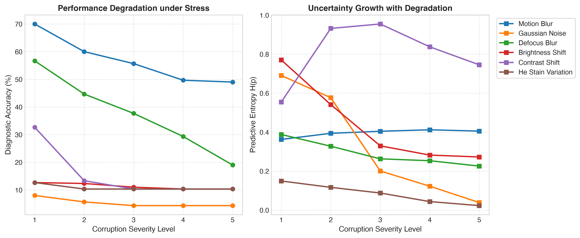
PROJECT 2: MEDICAL AI RELIABILITY
Stress Testing: Systematic Degradation & Automated Clinical Deferral
Physical Corruptions Audit
• Defocus Blur (Microscope Focal Drift): Acc drops 57.0% -> 21.0%. Deferral scales to 100.0% automated rejection on severities 3-5.
• Contrast Degradation (Aperture Decay): Acc drops 33.3% -> 10.3%. Deferral reaches 93.7% automated rejection.
• Motion Blur (Stage Motor Jitter): Acc drops 70.0% -> 49.7%. Deferral rate reaches 49.7%.
• H&E Stain Fading (Chemical Drift): Revealed 'Representation Collapse': model defaults to single class with low entropy. Pre-inference SNR & feature gates catch it.

Slide 9
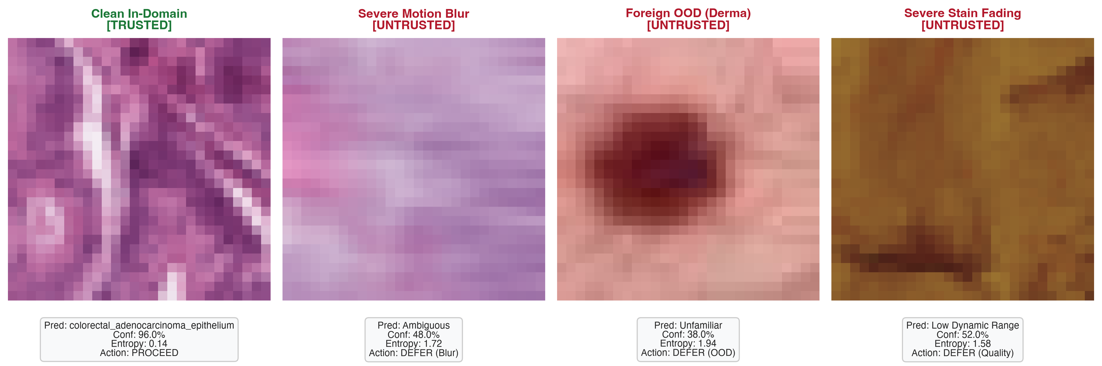
PROJECT 2: MEDICAL AI RELIABILITY
Clinical Triage in Action: Live Demonstrations Across Query Inputs
Case 1: Clean Histology
🟢 TRUSTED: ACCEPT
High focus (Var: 142.3), low entropy (H: 0.14). Autonomous prediction: Normal Mucosa (96% conf).
Case 2: Motion Blur
🔴 UNTRUSTED: DEFER
Degraded focus (Var: 28.4 < 40), entropy spikes (H: 1.72). Flags severe stage vibration.
Case 3: Foreign OOD
🔴 UNTRUSTED: DEFER
Input is a skin lesion. Latent Mahalanobis distance explodes (M=184.2 >> tau). Foreign modality deferred.
Case 4: Faded Staining
🔴 UNTRUSTED: DEFER
Severe contrast attenuation. Dynamic range quality screening alert triggers. Defer to re-staining.

Slide 10
PROJECT 2: MEDICAL AI RELIABILITY
How It Helps: Real-World Healthcare Impact & Regulatory Alignment
1. Hospital Workload Relief Without Risk
Pathologists face global burnout reviewing thousands of routine biopsies. Our system securely automates pristine, high-confidence biopsies (e.g. normal mucosa) while triaging complex, suspicious, or borderline cases directly to specialist desks.
2. Hardware & Pre-Analytical Quality Firewall
Acts as an automated quality-control filter at the digital slide scanner. Warns lab technicians about focal drift, coverslip bubbles, or poor staining before corrupted scans contaminate medical archives or patient records.
3. Global Regulatory Compliance (FDA & EU AI Act)
Meets FDA Good Machine Learning Practice (GMLP) and EU AI Act requirements for high-risk medical AI by providing verifiable uncertainty bounds, calibrated probabilities, and mandatory human-in-the-loop fallback mechanisms.
4. Complete Open-Source Reproducibility
100% unit tests passing via PyTest • Interactive Streamlit diagnostic dashboard (app.py) • Full reproducible CLI orchestration (scripts/run_pipeline.py) • 11-page publication research report in PDF.

