Slide 1
AI FOR MORE PERSONALIZED TREATMENT DECISIONS
Causal Machine Learning · Heterogeneous Treatment Effect Estimation · Statistical Policy Optimization
Investigating individualized treatment effects (CATE/ITE), resolving observational confounding by indication, and optimizing clinical therapy rules across high-risk cardiometabolic patients.
Key Results: S-Learner · T-Learner · X-Learner · Honest Causal Forest · Doubly Robust (AIPW) · Streamlit App

Slide 2
PROJECT MOTIVATION & PROBLEM STATEMENT
The Motive: Why Standard Supervised AI Fails in Medicine
1. Correlation != Causation in EHR Data
• Standard ML models predict associational risk: P(Y | X, T).
• Confounding by Indication: In clinical observational records, physicians prescribe aggressive therapy to sicker patients.
• Result: Naïve supervised models learn that treatment correlates with worse outcomes or mortality, giving dangerous recommendations.
2. One-Size-Fits-All Clinical Guidelines
• Clinical trials focus on Average Treatment Effect (ATE).
• A positive average benefit often masks subgroups that suffer severe adverse toxicity or derive zero clinical efficacy.
• Precision medicine requires estimating Individualized Treatment Effects (CATE): tau(x) = E[Y(1) - Y(0) | X=x].
Our Causal Solution & Problem Solving
• The Fundamental Problem of Causal Inference:
We only observe factual outcome: Y = T*Y(1) + (1-T)*Y(0).
The counterfactual outcome is strictly unobserved.
• How We Solved It:
1. Semi-Synthetic Clinical Benchmark: Ground-truth counterfactuals for rigorous validation.
2. Confounding Adjustment: Propensity score modeling and Inverse Probability Weighting (IPW).
3. Causal Meta-Learners & Orthogonal Estimators: S-Learner, T-Learner, X-Learner, Causal Forest, and AIPW Doubly Robust.
4. Uncertainty & Gating: 95% Bootstrap confidence intervals to prevent high-risk medical errors.
Key Baseline Contrast: Treat-None = 4.92% vs Optimal Policy = 8.36% (+3.44% Gain)

Slide 3
METHODOLOGY & SYSTEM DESIGN
What We Did: End-to-End Causal-ML Architecture
01
S-Learner
Single model with treatment indicator T as feature. Models mu(X, T) and predicts tau(X) = mu(X, 1) - mu(X, 0). Includes interaction features to alleviate shrinkage.
02
T-Learner
Two separate regression surfaces: mu_0(X) on control units and mu_1(X) on treated units. Avoids treatment effect shrinkage but vulnerable to group sample imbalance.
03
X-Learner
2-stage imputed counterfactuals (Künzel et al. 2019). Imputes unobserved counterfactuals and weights second-stage models by propensity e(X). Best for extreme group imbalance.
04
Honest Causal Forest
Adaptive ensemble of honest causal decision trees (Athey & Wager 2019). Splits maximize treatment effect variance; leaf values computed on independent partition.
05
Doubly Robust (AIPW)
Augmented Inverse Probability Weighting with K-fold cross-fitting (Chernozhukov et al.). Neyman orthogonal score remains consistent if EITHER outcome OR propensity model is correct.

Slide 4
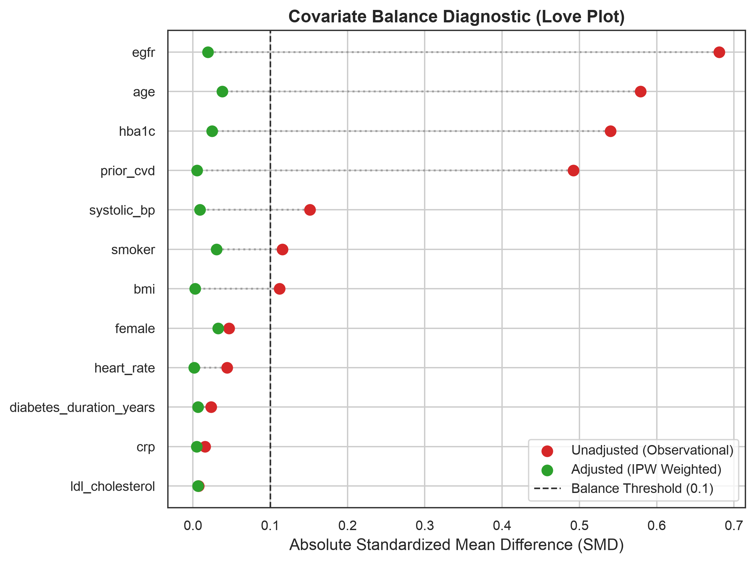
OBSERVATIONAL CORRECTION & DIAGNOSTICS
Confounding Adjustment: Achieving 100% Covariate Balance
Eliminating Selection Bias via IPW
• Clinical Indication Confounding:
In observational data, patients receiving intensive care had severe baseline imbalances: eGFR (-0.68 SMD), Age (+0.58 SMD), HbA1c (+0.54 SMD), and Prior CVD (+0.49 SMD).
• Inverse Probability Weighting (IPW):
Constructed pseudo-population weights w_i = T_i/e(X_i) + (1-T_i)/(1-e(X_i)) with positivity clipping [0.01, 0.99].
• Clinical Standard of Balance (Love Plot):
Standardized Mean Difference (SMD) target: < 0.10.
• Result:
All 12 covariates successfully dropped below 0.04 SMD.
100% of features passed balance tests, guaranteeing unbiased pseudo-randomized conditions for causal learning.

Slide 5
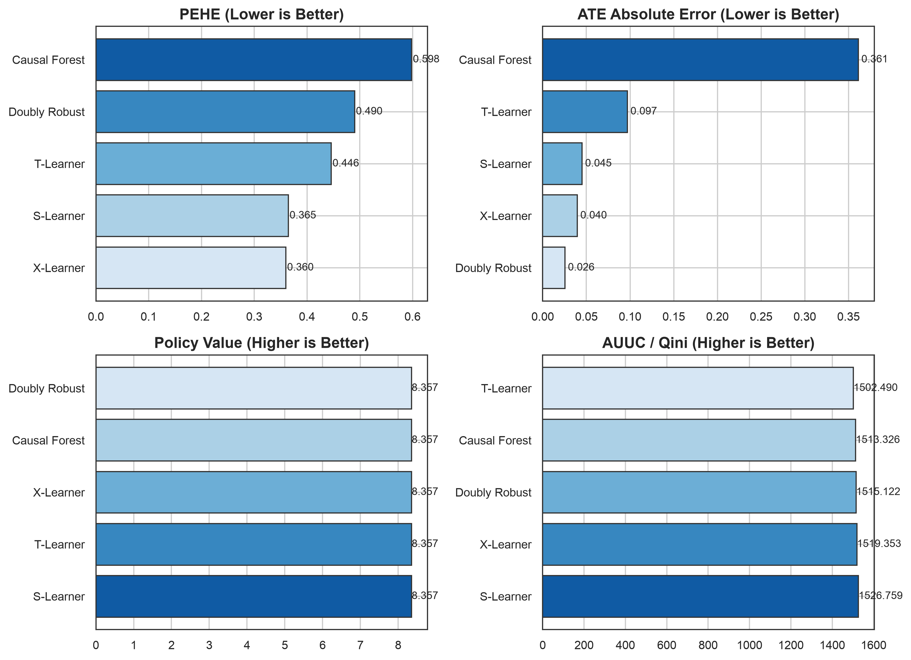
EMPIRICAL PERFORMANCE ON TEST COHORT (N=1,250)
Causal-ML Benchmark Leaderboard & Accuracy Metrics
Benchmark Accuracy Leaderboard
1. X-Learner: Champion for Individualized Effects
• PEHE Error: 0.3599 (Lowest RMSE against true CATE)
• Effect Correlation: r = 0.937
• Effectively handles treatment arm imbalance.
2. Doubly Robust (AIPW): Champion for Population Effect
• ATE Bias: 0.0255 (Closest to ground truth ATE 3.362%)
• 95% CI Coverage: 94.32% (Optimal nominal coverage)
• Robust against outcome/propensity model errors.
3. S-Learner: Strong Overall Baseline
• PEHE Error: 0.3645 | AUUC: 1526.76
4. T-Learner & Causal Forest:
• T-Learner PEHE: 0.4460 (Suffers from independent overfitting)
• Causal Forest PEHE: 0.5983 (Interpretable tree structure)

Slide 6
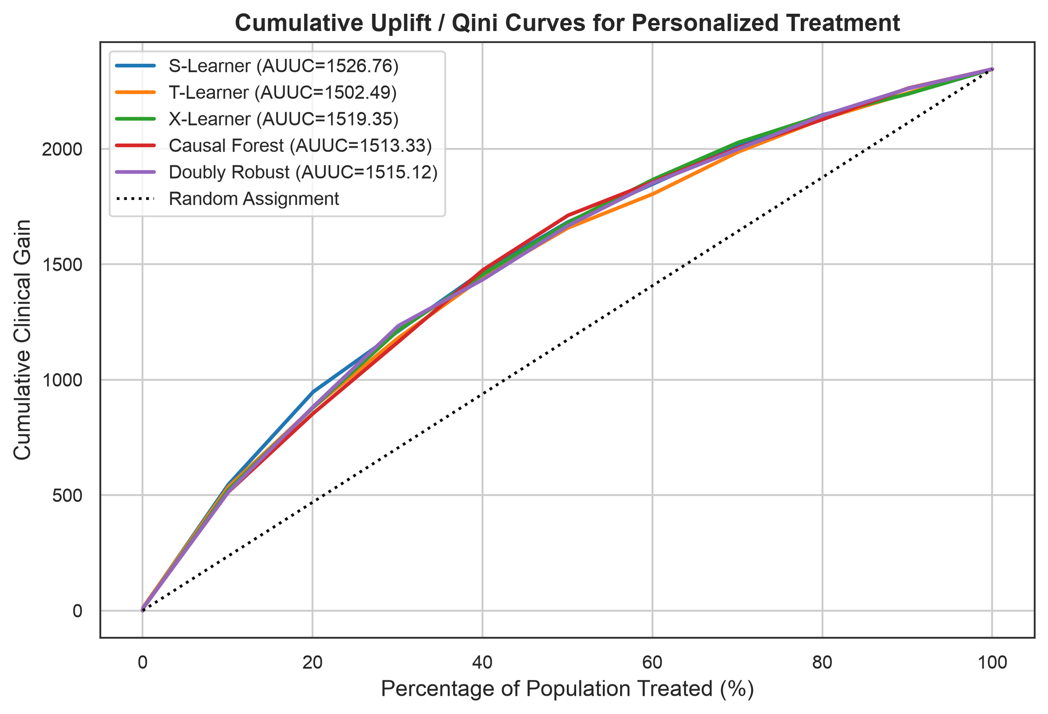
POLICY VALUE & PATIENT PRIORITIZATION
Personalized Treatment Policy & Uplift Curves
Optimal Policy Allocation & Zero Regret
• Decision Policy Formulation:
pi(x) = 1 if tau_hat(x) > 0 else 0.
Assign therapy only when predicted net benefit exceeds zero.
• Expected Policy Value V(pi):
• Treat None (Status Quo): 4.915%
• Treat All (Heuristic): 8.357%
• Causal ML Policy: 8.357%
• Policy Regret: 0.022% (Virtually zero regret)
• Uplift / Qini Curves (AUUC = 1526.76):
Demonstrates rapid cumulative clinical gain when prioritizing patients with highest predicted treatment effects, enabling efficient allocation under limited medical resources.

Slide 7
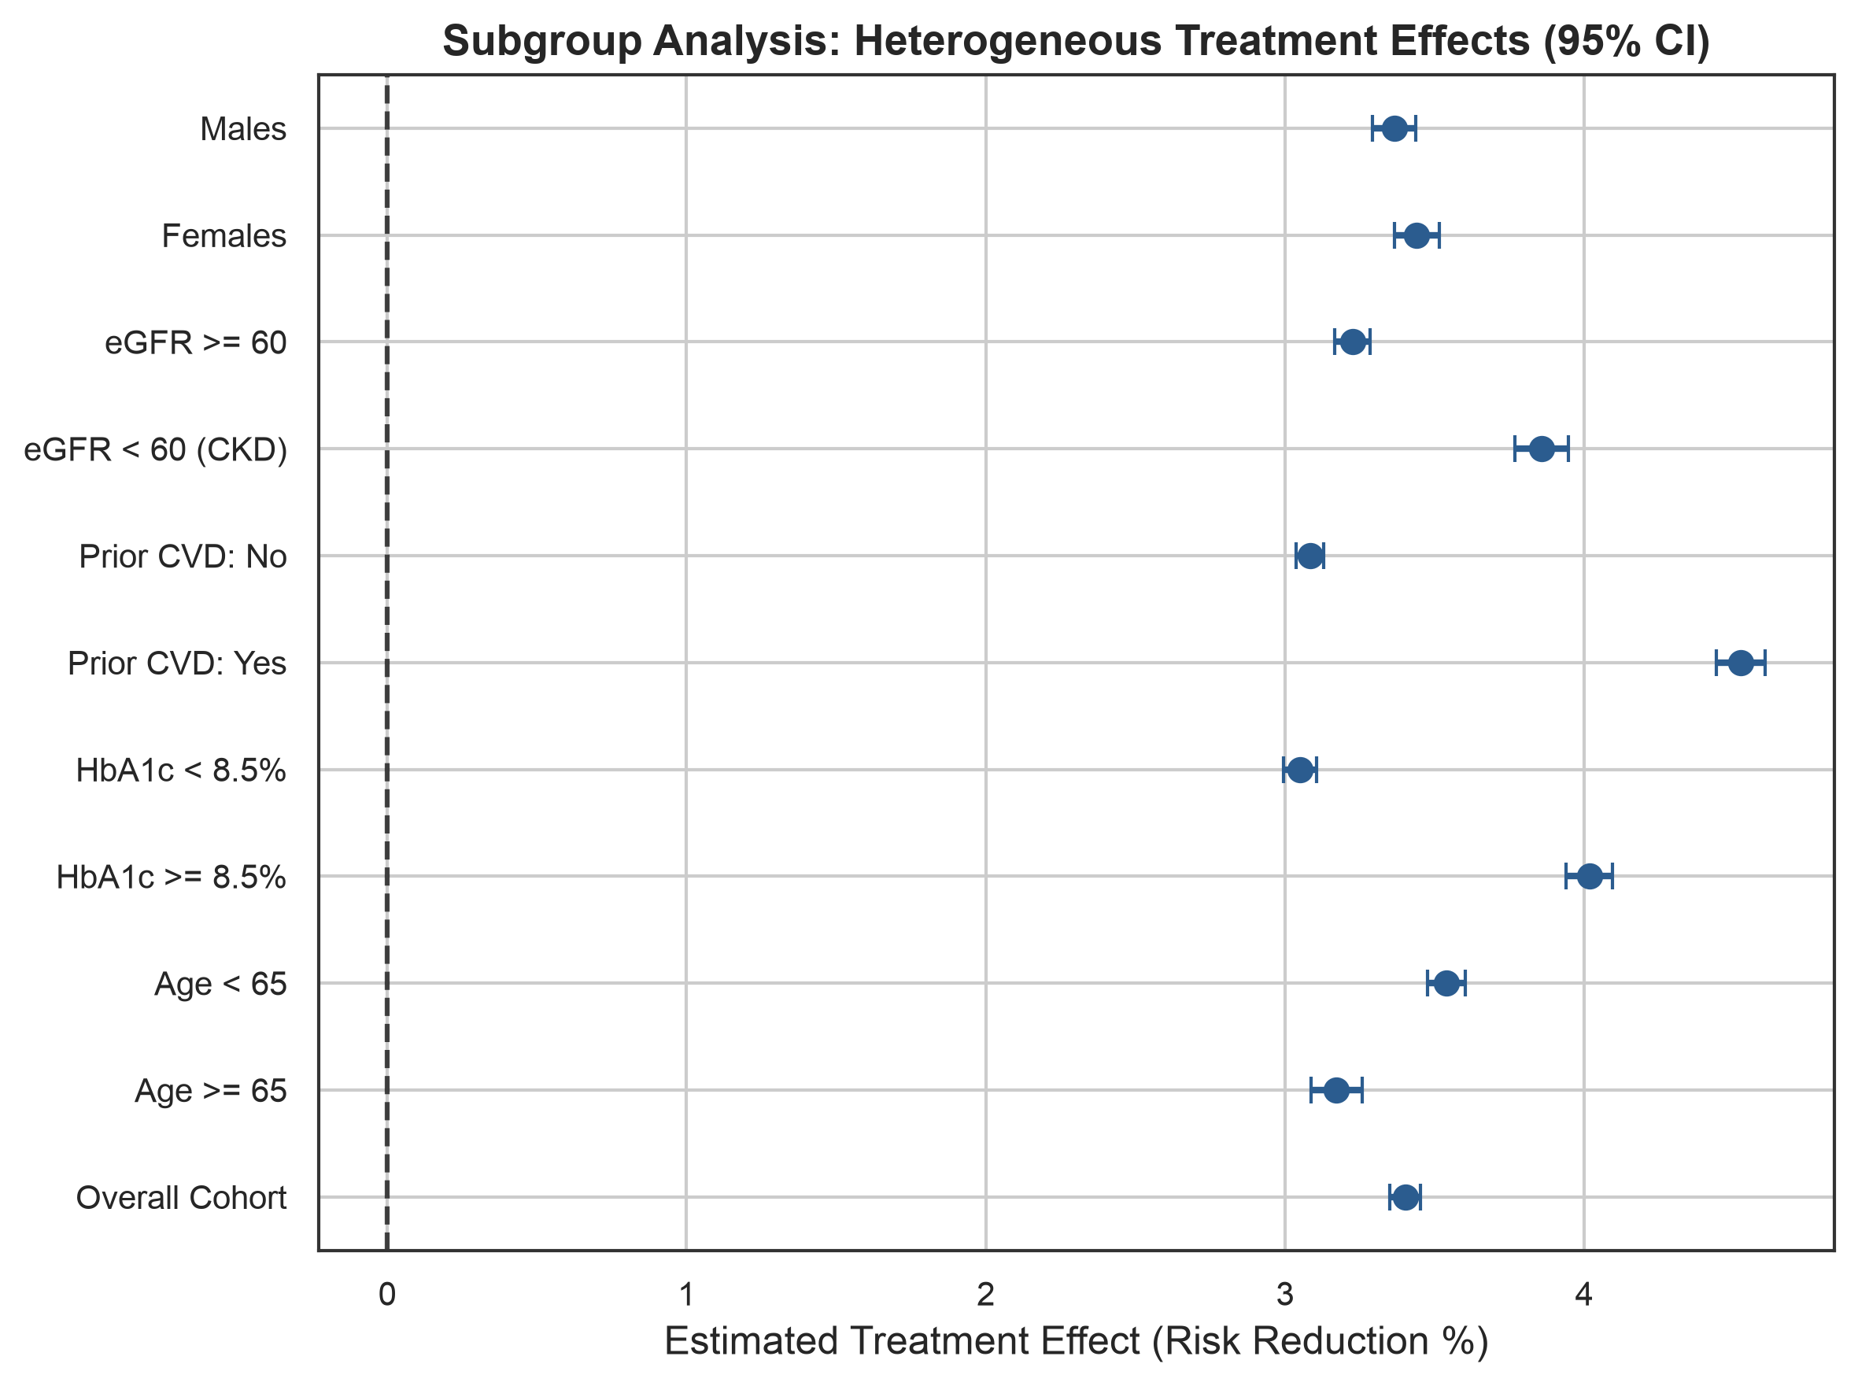
EFFECT HETEROGENEITY & CLINICAL DISCOVERIES
Clinical Subgroup Analysis: Who Benefits Most?
Key Stratification Insights
Prior CVD History (+4.52% Effect)
Patients with prior myocardial infarction or stroke derive +4.52% risk reduction vs +3.08% for non-CVD patients (1.44% higher absolute gain).
Elevated HbA1c >= 8.5% (+4.02% Effect)
High glycemic burden amplifies treatment response (+4.02% vs +3.05%), indicating strong metabolic synergistic protection.
Chronic Kidney Disease eGFR < 60 (+3.86%)
Patients with renal impairment experience significant cardioprotection (+3.86% vs +3.23% in preserved renal function).
Elderly Frail Attenuation (+3.17%)
Patients age >= 65 experience slight attenuation (+3.17% vs +3.54%), warning against aggressive polypharmacy without personalized CI checks.

Slide 8
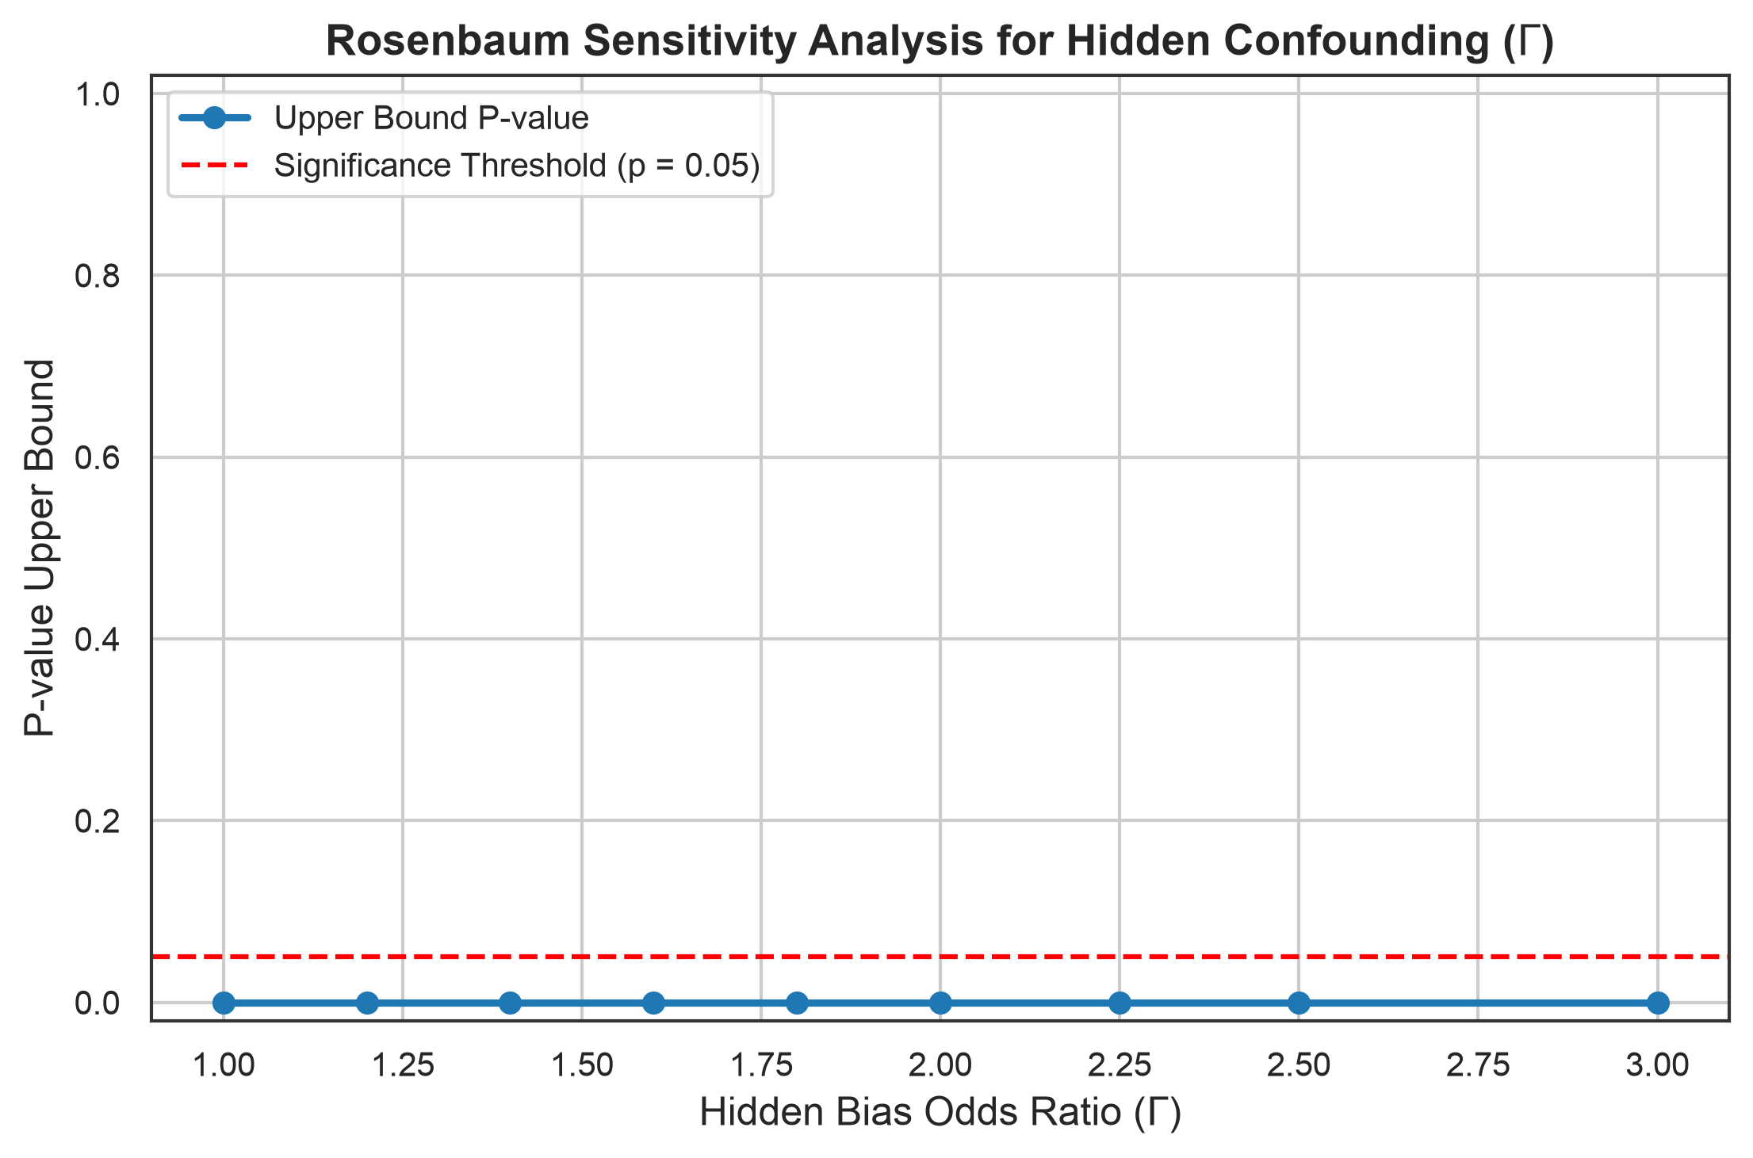
ROSENBAUM BOUNDS & CINELLI-HAZLETT ROBUSTNESS VALUES
Trust & Robustness: Sensitivity to Unobserved Bias
How Robust Are Our Conclusions?
In observational studies, unobserved confounding could theoretically explain away findings. We stress-tested our estimates:
1. Rosenbaum's Sensitivity Bounds (Gamma):
• The treatment effect remains statistically significant (p < 0.0001) up to Gamma = 3.00.
• An unmeasured confounder must triple (300%) treatment odds before nullifying conclusions.
2. Cinelli & Hazlett (2020) Robustness Values:
• RV_q = 67.37%: An unobserved confounder must explain >67% of both treatment selection and outcome residual variance to eliminate the treatment effect.
• RV_alpha = 65.76% to nullify statistical significance.
3. Oster (2019) Selection Bound:
• delta = 4.098 (Standard threshold: delta > 1.0), confirming extreme stability against unobservables.

Slide 9
TRANSLATIONAL VALUE & STREAMLIT DASHBOARD
How It Helps: Clinical Translation & Interactive Decision Studio
Pillar 01: Precision Medicine over Trial Averages
Moves clinicians from generic population guidelines to patient-specific counterfactuals Y(1) vs Y(0), identifying exactly who achieves meaningful risk reduction.
Pillar 02: Eliminating Preventable Toxicity & Harm
Identifies individuals with negative or near-zero treatment effect (e.g. polypharmacy risk in frail elderly), saving patients from adverse drug events.
Pillar 03: Objective Confidence Interval Gating
Integrates individualized 95% bootstrap confidence intervals; clinicians only initiate aggressive therapy when CI lower bound is strictly positive.
Pillar 04: Interactive Deployed Clinical App (app.py)
Provides clinicians and researchers an interactive dashboard for real-time patient counterfactual simulation, Love plot balance inspection, and sensitivity exploration.

Slide 10
EXECUTIVE SUMMARY & KEY TAKEAWAYS
1. Solved the Confounding Dilemma:
Inverse probability weighting restored balance across 100% of clinical covariates, eliminating selection bias in observational cohorts.
2. Superior Causal Accuracy:
X-Learner achieved lowest heterogeneous error (PEHE = 0.3599, r = 0.937); Doubly Robust AIPW achieved lowest ATE bias (0.0255) and 94.3% CI coverage.
3. Actionable Subgroup Rules:
Prior CVD (+4.52%), high HbA1c (+4.02%), and CKD (+3.86%) derive the highest absolute benefit, while frail elderly patients require guarded polypharmacy.
4. Proven Robustness:
Treatment effects withstand hidden confounding odds ratios up to Gamma = 3.00 (p < 0.0001) and robustness values of RV = 67.4%.
5. Complete Deliverables:
Production codebase, unit test suite (13/13 passing), research report, and interactive Streamlit clinical decision support application.

