Slide 1
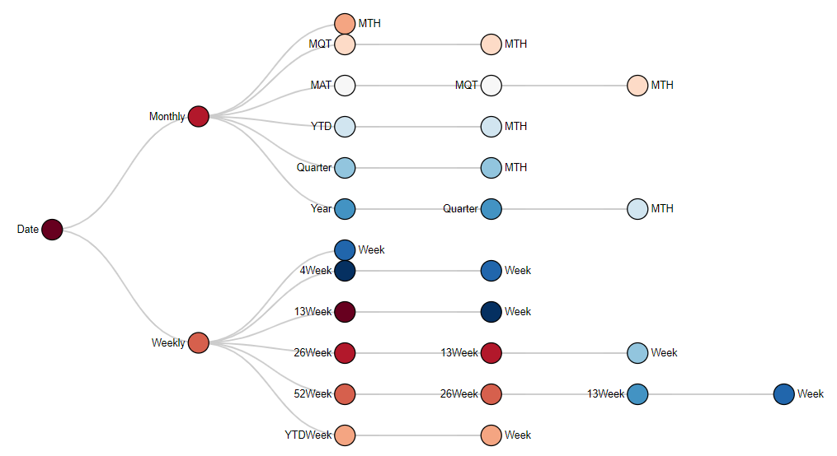
Period Base
Period Type

