Slide 1
COVID-19 News Data Analysis
Yuehua Yang, Tanhya Chitle, Jerry Manning, Bhanuprasad Tudy, Patrick Durkin

Slide 2
Introduction -
The datasets used are CDC data for Covid-19 news articles and Stock Market data containing data from SP500, DowJones, Nasdaq and Bitcoin.
Sentiment Analysis on the text published in the news articles was performed.
The words in the text were sorted according to the frequency of their mentions and a corpus was created.
A visual analysis for the stock datas was also performed.
A Time Series analysis was performed on the stock data to analyse the trend.

Slide 3
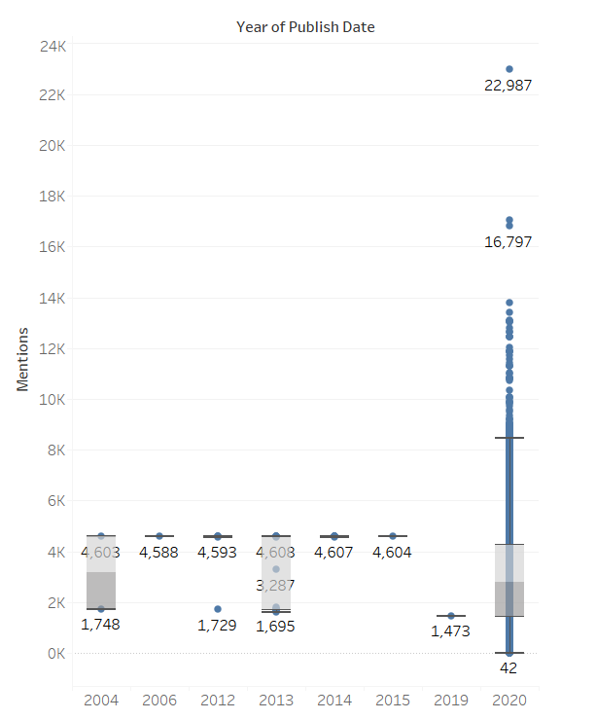
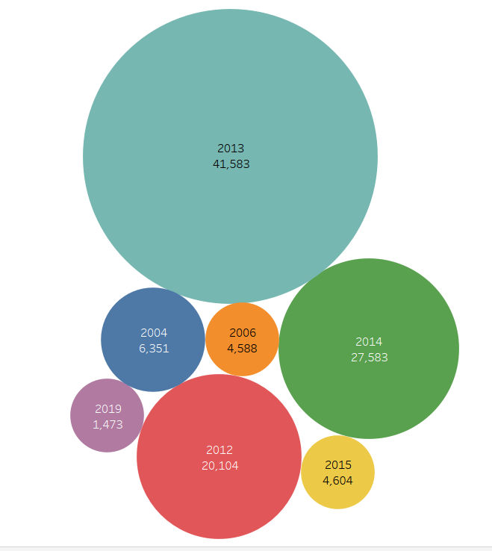
Data Visualization -

Slide 4
Data Cleaning for Text Data
Created functions for :
Removing non-ascii characters
Removing punctuations
Removing Stopwords

Slide 5
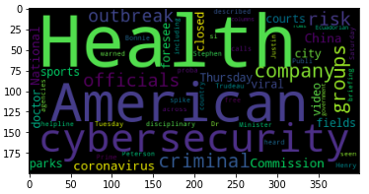
Text and Sentiment Analysis
Using the most frequent words, we got a word cloud for the news description data which highlights the most popular words

Slide 6
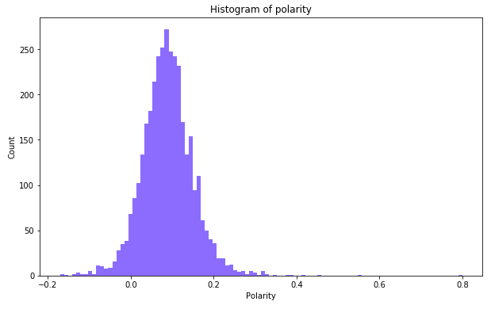
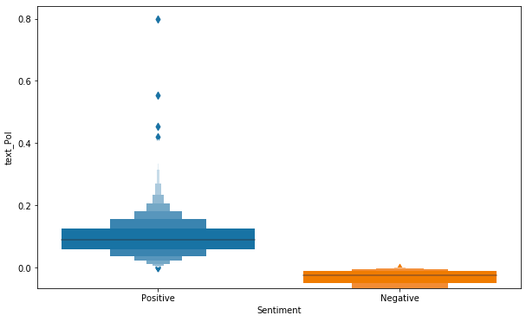
Text and Sentiment Analysis
Sentiment Analysis using TextBlob in Python to give a polarity score for each row of news.

Slide 7
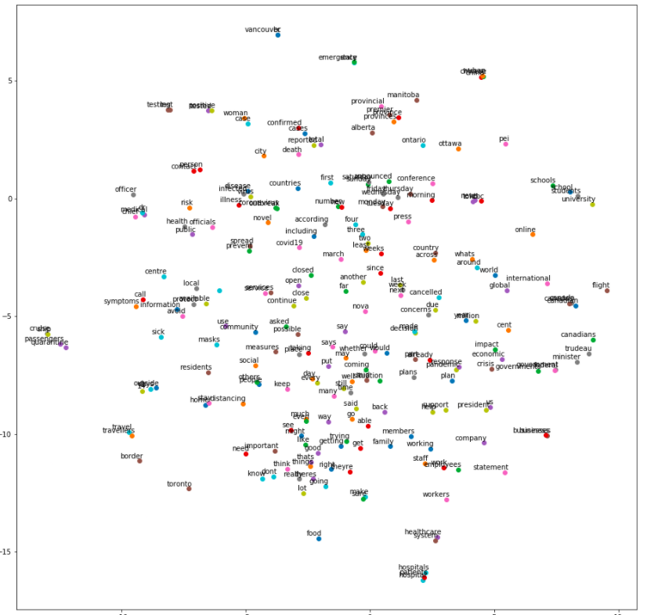
Word Embeddings
Vectorial representation of text corpus using Word2Vec word embeddings and t-SNE

Slide 8
Stock market Data:
Data stored in the S3 bucket, jupyter notebook in aws cluster.
Bitcoin
Nasdaq
SP500
DowJones
Open
High
Low
Close
Adj.Close
Rate: (Close - Open)/Open

Slide 9
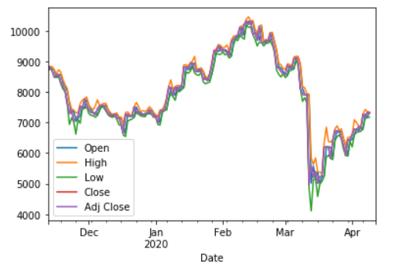
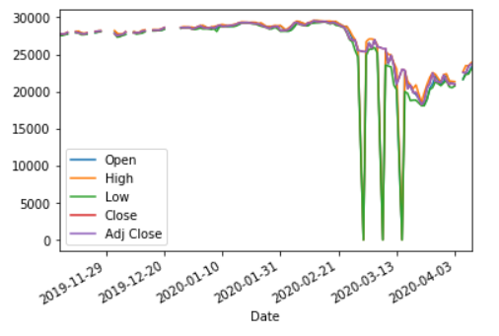
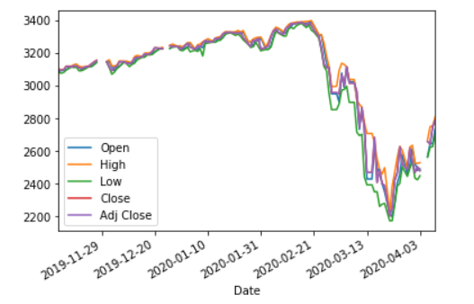
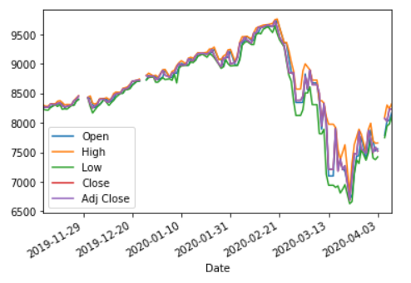
Bitcoin
DowJones
SP500
Nasdaq

Slide 10
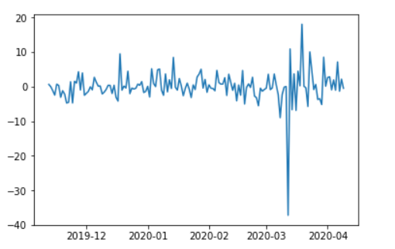
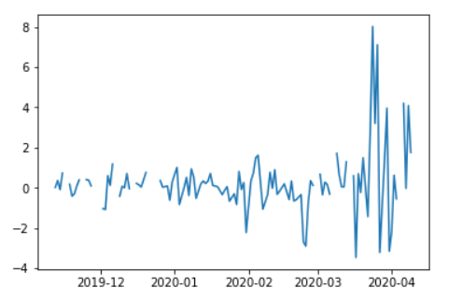
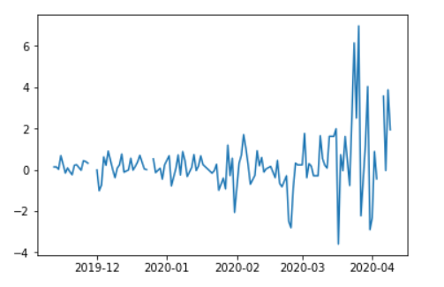
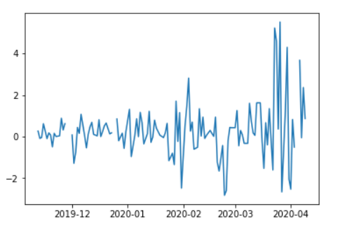
Bitcoin
DowJones
Nasdaq
SP500

Slide 11
Merging
Sentiment measures & market effects
Djia, s&p500, nasdaq, bitcoin
Align dates
Missing data

Slide 12
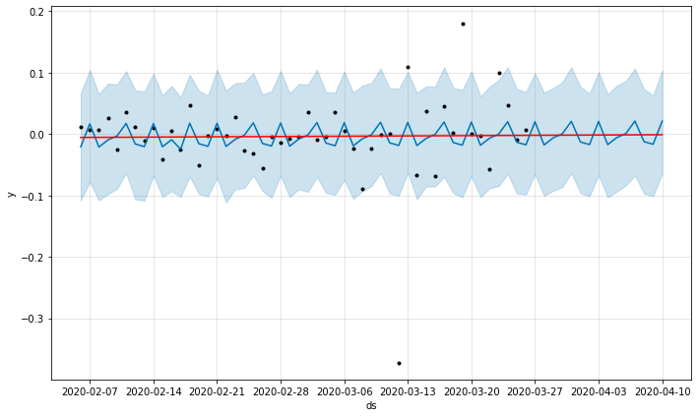
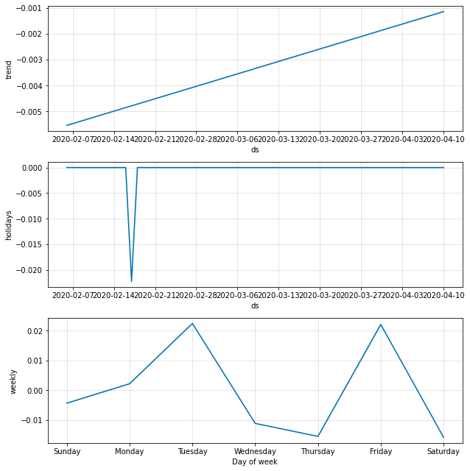
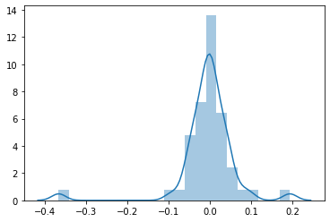
TSA
Prophet
Arima
Residuals

Slide 13
Regression
Small amount of observations
Text_Pol, Desc_Subj
Negative
Measurement error
Can sentiment in a limited # of papers capture stock market?

Slide 14
Thank you!
Questions?

