Slide 1
Introduction
Introduction to Bioinformatics Programming in Python
Ali Sinan Saglam
Anupam Banerjee
Hanxi Xiao
8/30/22

Slide 2

Hybrid Instruction
Introduction to Bioinformatics Programming in Python
In-person (Murdoch 814)
Follow all University guidelines
Building access Masks required
Zoom
Attend synchronously
Lecture recordings are for reference
2

Slide 3

Zoom Etiquette
Introduction to Bioinformatics Programming in Python
•
•
•
Video on is preferred (but not required) Stay on Mute
Use Chat to ask/respond to questions
"Raise Hand" if I don't notice chat or want to share screen/speak on Zoom
Let me know if something isn't working
•
3

Slide 4
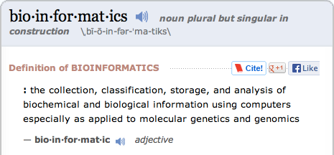
“Bioinformatics”
Introduction to Bioinformatics Programming in Python
Bioinformatics, Computational, and Systems Biology
Proteomics
Bioimaging
Sequence Analysis
Genomics
Molecular Dynamics
Drug Discovery
Biomedical Informatics
Cheminformatics
Systems Modeling
Data Analysis
Protein Dynamics
Protein Structure
4

Slide 5

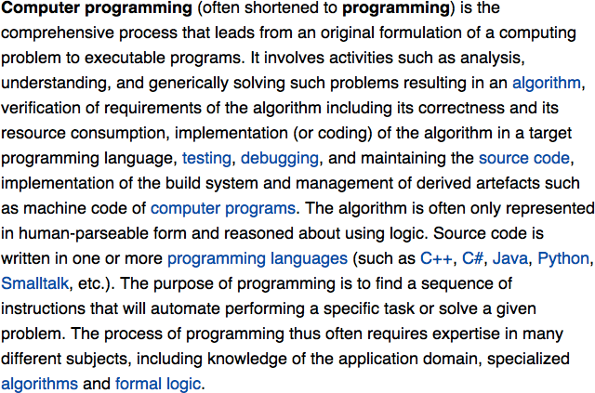
“Programming”
Introduction to Bioinformatics Programming in Python
There is an on-going debate on the extent to which the writing of programs is an art form, a craft, or an engineering discipline.
5

Slide 6

Python
Introduction to Bioinformatics Programming in Python
Designed to be easy to learn
Full featured, powerful language Free - Costs nothing and open-source Ideal for scripting
Popular

Slide 7
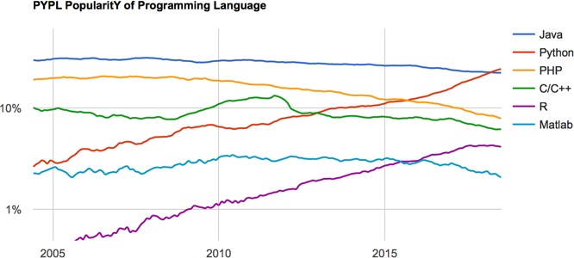
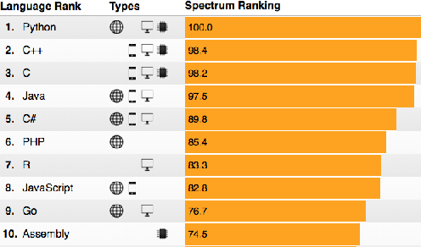
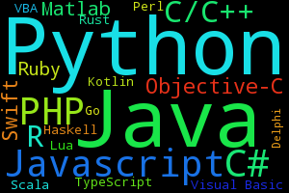
Introduction to Bioinformatics Programming in Python
http://pypl.github.io/PYPL.html
https://spectrum.ieee.org/at-work/innovation/the-2018-top-programming-languages

Slide 8
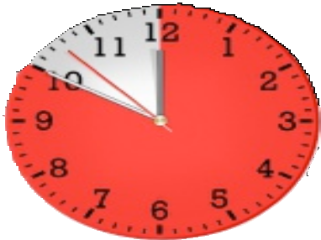


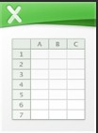


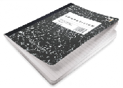





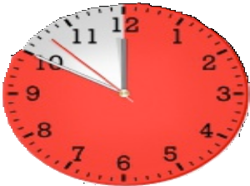

Course Goals
Introduction to Bioinformatics Programming in Python
“Analyze the data”
“Do it again”
“Analyze the data”
“Do it again”

Slide 9

Course Goals
Introduction to Bioinformatics Programming in Python
Gain experience programming Learn Python
Survey computational methods
Improve skills to be a more productive and successful researcher

Slide 10
Logistics
Introduction to Bioinformatics Programming in Python
12 Programming Assignments Due midnight on Tuesday Autograded - submit until it works 1 day late - 90% credit
2 days late - 50% credit
>3 days late - 0% credit
Final Grades
A: >93%
B: >85%
Late penalty only applied to additional points Each assignment worth ~7%
Final Project (create an assignment)

Slide 11
Getting Help
Introduction to Bioinformatics Programming in Python
General questions
Ask in Canvas
Ask after class in classroom
One-on-one help
Get in touch with Hanxi

Slide 12
Academic Honesty
Introduction to Bioinformatics Programming in Python
Do your own work
Do not share or look at other students’ code
Do discuss concepts and problem solving strategies

Slide 13
Website
Introduction to Bioinformatics Programming in Python
https://mscbio2025.github.io/intro2022/
Commandline Basics Laptop setup

