Slide 1

M3B

Slide 2
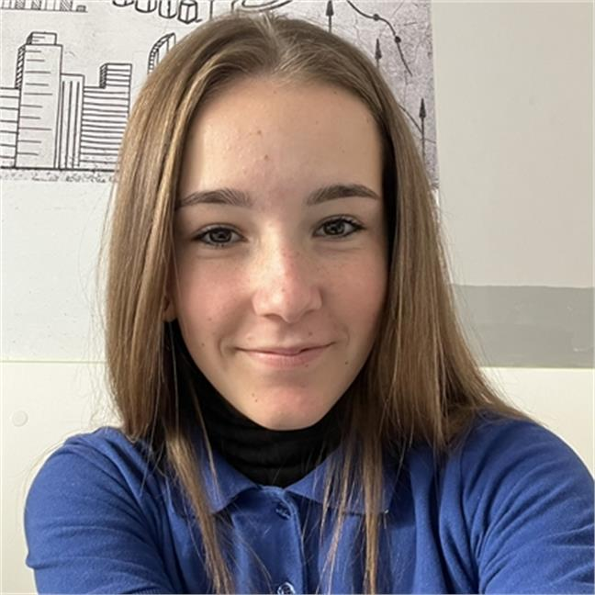
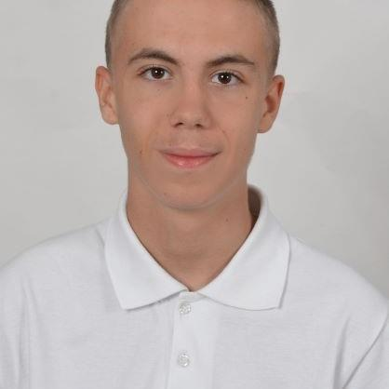
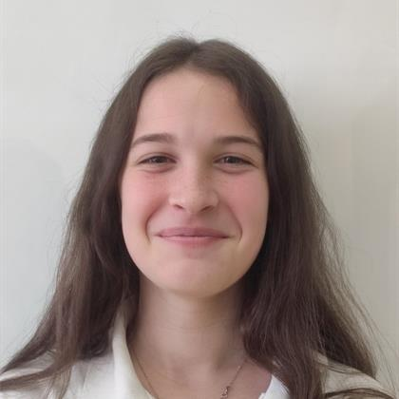
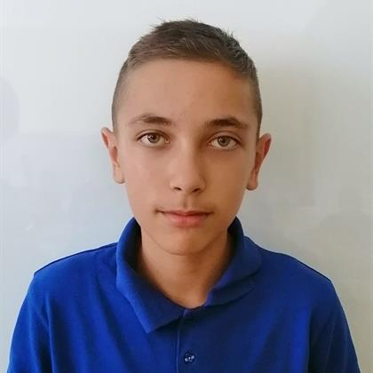
OUR TEAM
Biliyana Badalova Scrum Trainer
Miroslav Ivanov Front-End developer
Mariela Dimova Back-End developer
Miroslav Chobanov Back-End developer

Slide 3
Stages
01
02
04
03
Choose idea
Make the app
Make design
Make documentation

Slide 4










Used programs

Slide 5
Let’s get to the application

